Slide 1
Defining circular functions sine and cosine
14B

Slide 2

Notes:
https://www.transum.org/software/SW/Starter_of_the_day/starter_September15.asp

Slide 3
https://create.kahoot.it/details/e5814978-68fe-4bc6-a5c2-c22582007fdd
https://www.interactive-maths.com/trigonometric-exact-values-qqi-bingo.html
Notes:
https://create.kahoot.it/details/e5814978-68fe-4bc6-a5c2-c22582007fdd
https://www.interactive-maths.com/trigonometric-exact-values-qqi-bingo.html

Slide 4
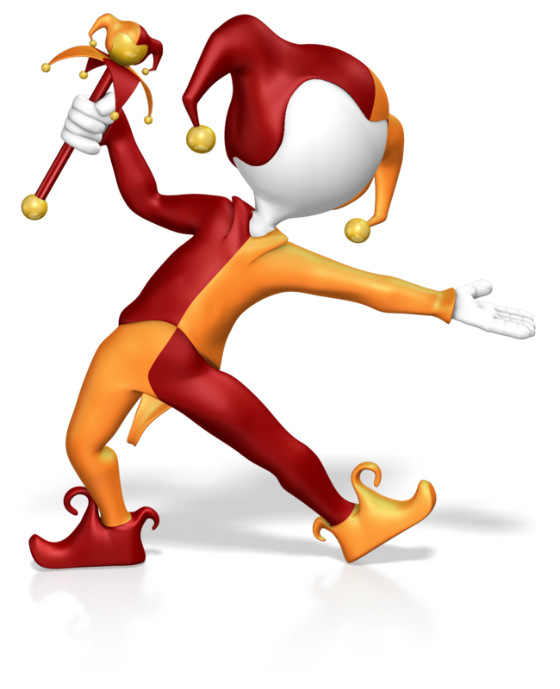
Exact Trig Values

Slide 5
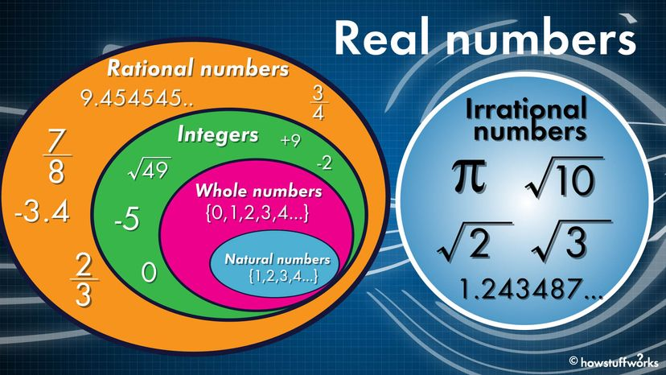

Slide 6
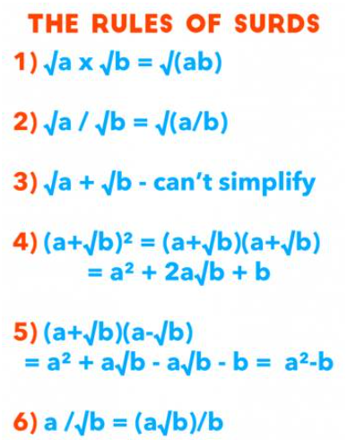


Slide 7
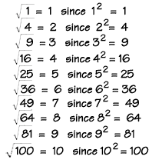

Slide 8
“ Know the exact values of sinϴ and cosϴ for ϴ = 0˚, 30˚, 45˚, 60˚ and 90˚ tanϴ for ϴ = 0˚, 30˚, 45˚ and 60˚"

Slide 9
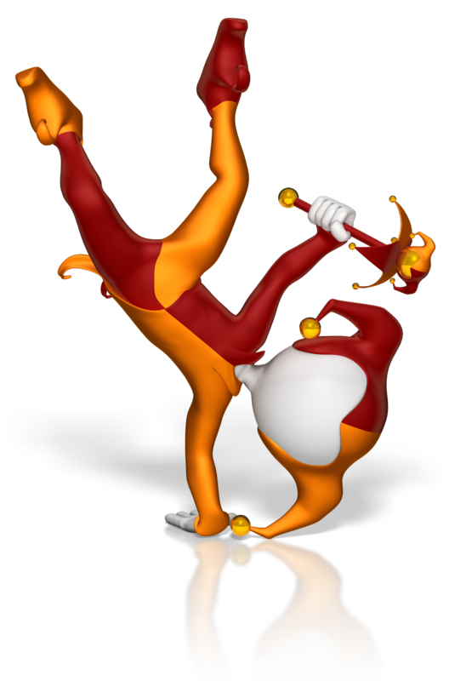
Sine, Cosine and Tangent of 30º, 45º and 60º
Notes:
https://www.interactive-maths.com/trigonometric-exact-values-qqi-bingo.html

Slide 10
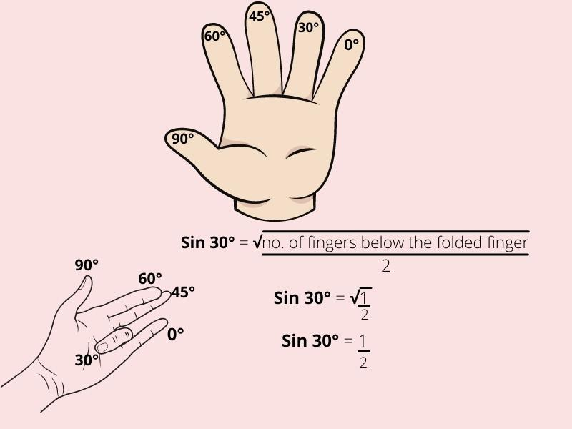
Notes:
https://www.youtube.com/watch?v=PF2nmCVSUEs

Slide 11
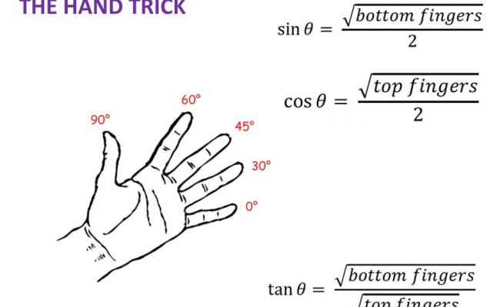

Slide 12
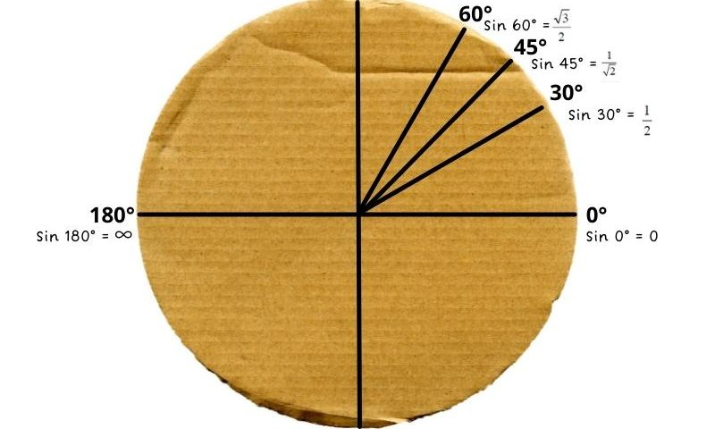
Make a unit circle on a plate

Slide 13
Using an equilateral triangle whose sides are 2 units, write down expressions for the sine, cosine and tangent of 60º and 30º.
30º
2
2
?
√3
60º
?
1
2
?
1

Slide 14
30º
2
2
√3
60º
1
1
√3
1
Cos 60º
√3
=
Tan 60º
Sin 60º
=
=
2
2
1
√3
1
√3
Cos 30º
=
=
Tan 30º
Sin 30º
=
=
2
2
√3
3

Slide 15
Using a right angled isosceles triangle whose equal sides are 1 unit, write down expressions for the sine, cosine and tangent of 45º.
The hypotenuse of the triangle
is √2 units.
45º
√2
1
45º
1

Slide 16
45º
√2
1
45º
1
1
√2
1
√2
Cos 45º
Sin 45º
=
=
=
=
√2
2
√2
2
Tan 45º
1
=

Slide 17
Cos 0º
= 1
Tan 0º
0
Sin 0º
= 0
=
Sin 90º
= 1
Cos 90º
= 0
We will look at why these ratios are true when we look at trig graphs later in the course.

Slide 18
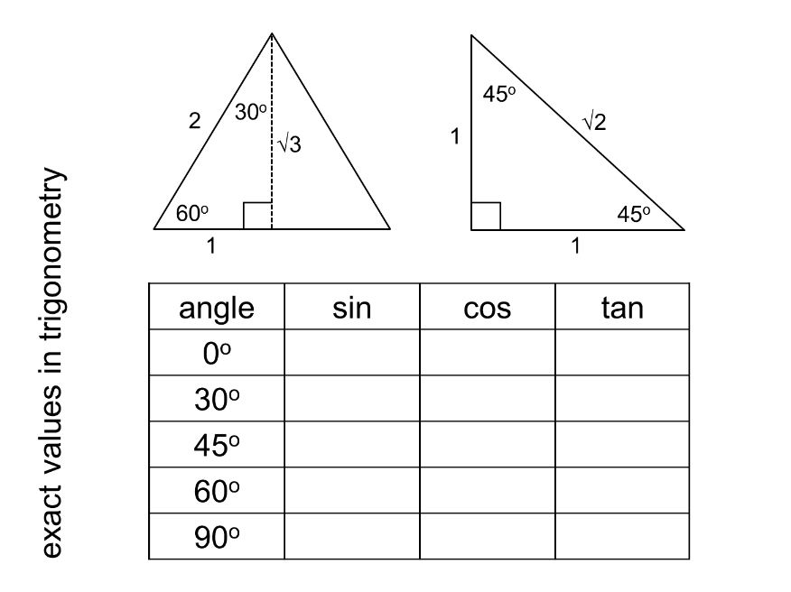

Slide 19
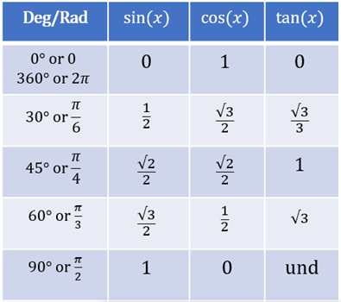

Slide 20
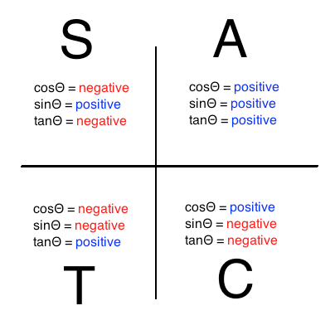
CAST Rule

Slide 21
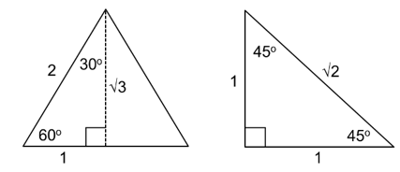
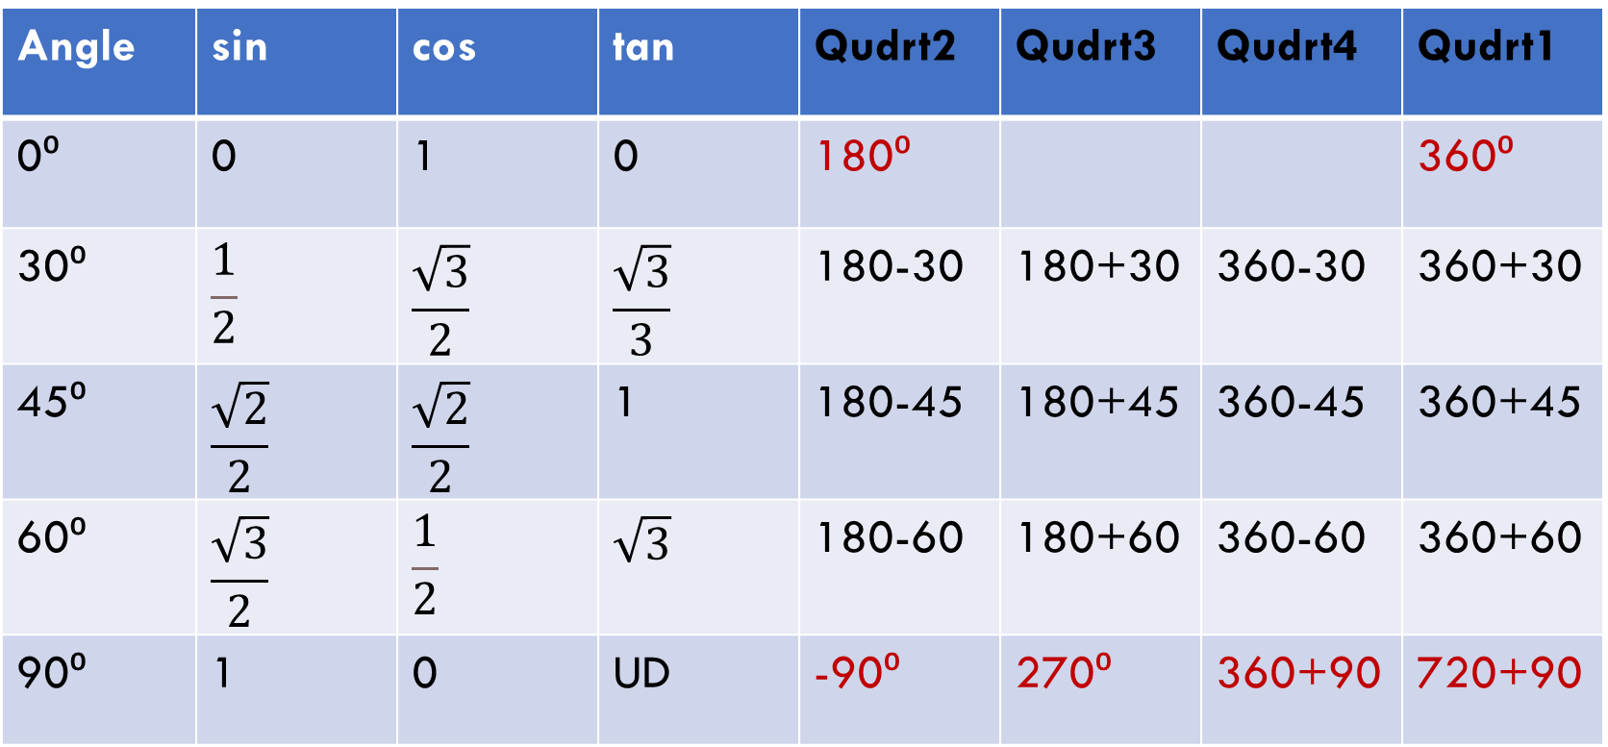
Reference Angles
Angle | sin | cos | tan | Qudrt2 | Qudrt3 | Qudrt4 | Qudrt1
0⁰ | 0 | 1 | 0 | 180⁰ |  |  | 360⁰
30⁰ | $$\frac{1}{2}$$ | $$\frac{\sqrt{3}}{2}$$ | $$\frac{\sqrt{3}}{3}$$ | 180-30 | 180+30 | 360-30 | 360+30
45⁰ | $$\frac{\sqrt{2}}{2}$$ | $$\frac{\sqrt{2}}{2}$$ | 1 | 180-45 | 180+45 | 360-45 | 360+45
60⁰ | $$\frac{\sqrt{3}}{2}$$ | $$\frac{1}{2}$$ | $$\sqrt{3}$$ | 180-60 | 180+60 | 360-60 | 360+60
90⁰ | 1 | 0 | UD | -90⁰ | 270⁰ | 360+90 | 720+90

Slide 22
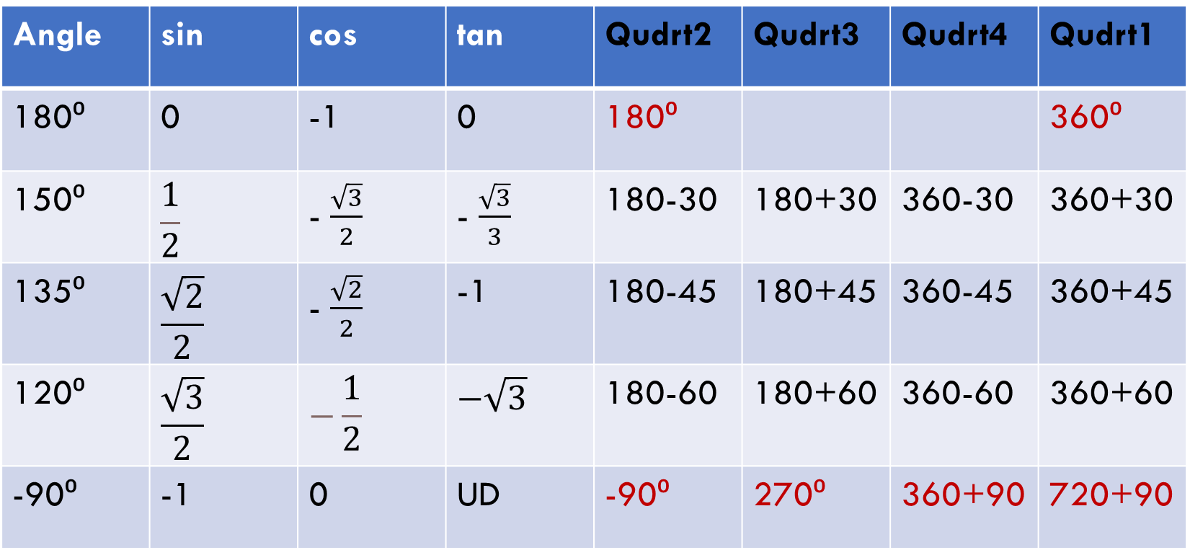
Reference Angles
Angle | sin | cos | tan | Qudrt2 | Qudrt3 | Qudrt4 | Qudrt1
180⁰ | 0 | -1 | 0 | 180⁰ |  |  | 360⁰
150⁰ | $$\frac{1}{2}$$ | - $\frac{\sqrt{3}}{2}$ | - $\frac{\sqrt{3}}{3}$ | 180-30 | 180+30 | 360-30 | 360+30
135⁰ | $$\frac{\sqrt{2}}{2}$$ | - $\frac{\sqrt{2}}{2}$ | -1 | 180-45 | 180+45 | 360-45 | 360+45
120⁰ | $$\frac{\sqrt{3}}{2}$$ | $$−\frac{1}{2}$$ | $$−\sqrt{3}$$ | 180-60 | 180+60 | 360-60 | 360+60
-90⁰ | -1 | 0 | UD | -90⁰ | 270⁰ | 360+90 | 720+90

Slide 23
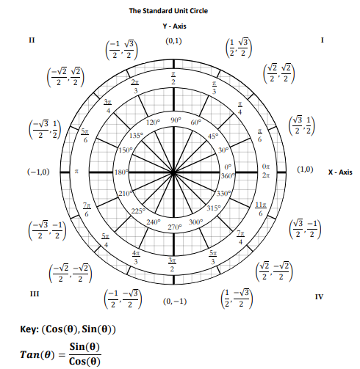
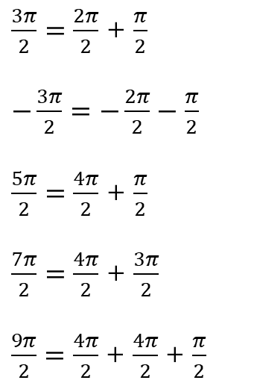
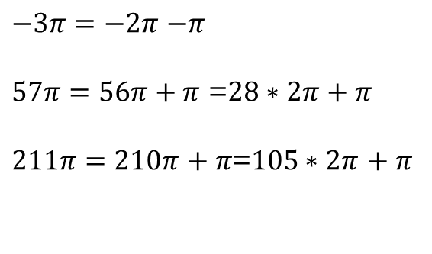
Angle | sin | cos | tan
0⁰ | 0 | 1 | 0
90⁰ | 1 | 0 | UD
180⁰ | 0 | -1 | 0
270⁰ | -1 | 0 | UD
$\frac{3π}{2}=\frac{2π}{2}$ + $\frac{π}{2}$
$−\frac{3π}{2}=−\frac{2π}{2}−$ $\frac{π}{2}$
$\frac{5π}{2}=\frac{4π}{2}$ + $\frac{π}{2}$
$\frac{7π}{2}=\frac{4π}{2}$ + $\frac{3π}{2}$
$\frac{9π}{2}=\frac{4π}{2}$ + $\frac{4π}{2}$ + $\frac{π}{2}$
$−3π=−2π$ $−π$
$57π=56π$ $+ π$ =$28∗2π$ $+ π$
$211π=210π$ $+ π$=$105∗2π$ $+ π$

Slide 24
x
Cos 30º
=
30º
8
8
x
√3
x
=
2
8
8√3
x
=
2
x
4√3
=

Slide 25
5
Tan 45º
=
45º
x
x
5
1
=
x
5
5
x
=

Slide 26
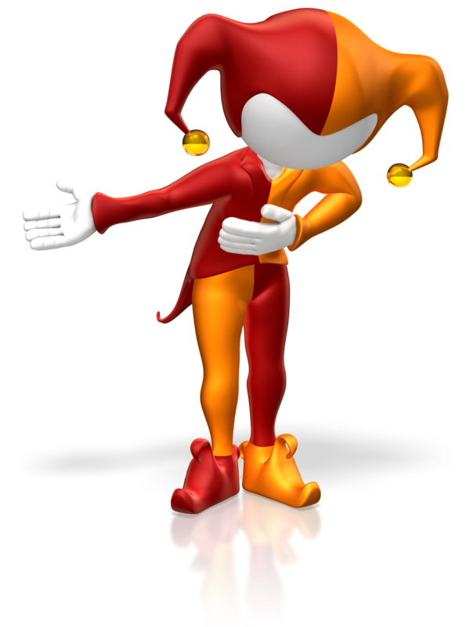
Trig ratio code breaker

Slide 27
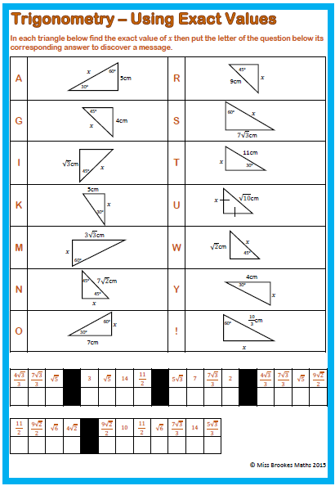
Show all stages of working out in your exercise book

Slide 28
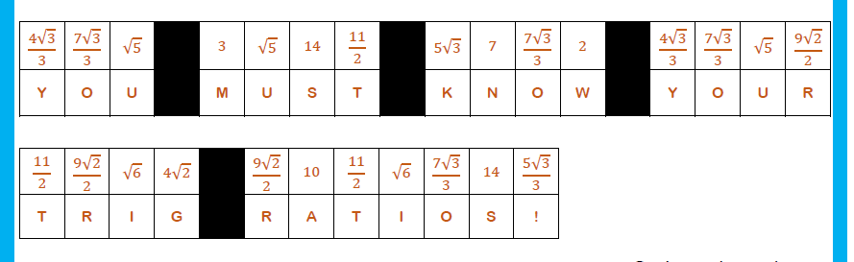

Slide 29
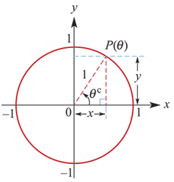
Sine and cosine of a unit circle
Consider the unit circle.
The position of point P on the circle can be described by relating the angle θ to the Cartesian coordinates x and y.
The point P on the circle corresponding to an angle θ is written P(θ).
The x-coordinate of P(θ) is determined by the angle θ. Similarly, the y-coordinate of P(θ) is determined by the angle θ. So we can define two functions, called sine and cosine, as follows:
The x-coordinate of P(θ) is given by x= cosine θ, for θ∈R.
The y-coordinate of P(θ) is given by y= sine θ, for θ∈R.

Slide 30
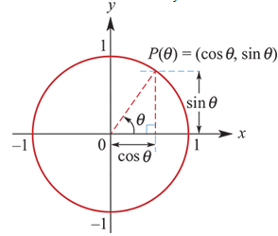
Sine and cosine of a unit circle
These functions are usually written in an abbreviated form as follows:
Image
x=cosθ
y =sinθ
Hence the coordinates of P(θ) are (cosθ,sinθ).
Note:
Adding 2π to the angle results in a return to the same point on the unit circle. Thus cos(2π+θ)=cosθ and sin(2π+θ)=sinθ.

Slide 31
example
Evaluate sinπ and cosπ.
Solution
After moving through an angle of π, the position is P(π)=(−1,0).
∴ cosπ=−1 and sinπ=0

Slide 32

example
Evaluate sin(− $\frac{3π}{2}$) and cos(− $\frac{π}{2}$).
Solution
The point P(− $\frac{3π}{2}$) has coordinates (0,1).
sin(− $\frac{3π}{2}$) =1
The point P(− $\frac{π}{2}$) has coordinates (0,−1).
cos(− $\frac{π}{2}$) =0

Slide 33

example
Evaluate sin( $\frac{5π}{2}$) and sin($\frac{7π}{2}$).
Solution
sin($\frac{5π}{2}$)=sin($2\frac{1}{2}π$)= sin($2π+\frac{π}{2}$)= sin($\frac{π}{2}$)=1
sin($\frac{7π}{2}$) =sin($3\frac{1}{2}π$)= sin($2π+\frac{3π}{2}$)= sin($\frac{3π}{2}$)= − 1

Slide 34

example
Evaluate sin($\frac{9π}{2}$) and cos(27π).
Solution
sin($\frac{9π}{2}$) =sin(4π+ $\frac{π}{2}$)=sin($\frac{π}{2}$)=1
cos(27π)=cos(26π+π)=cosπ=−1

Slide 35
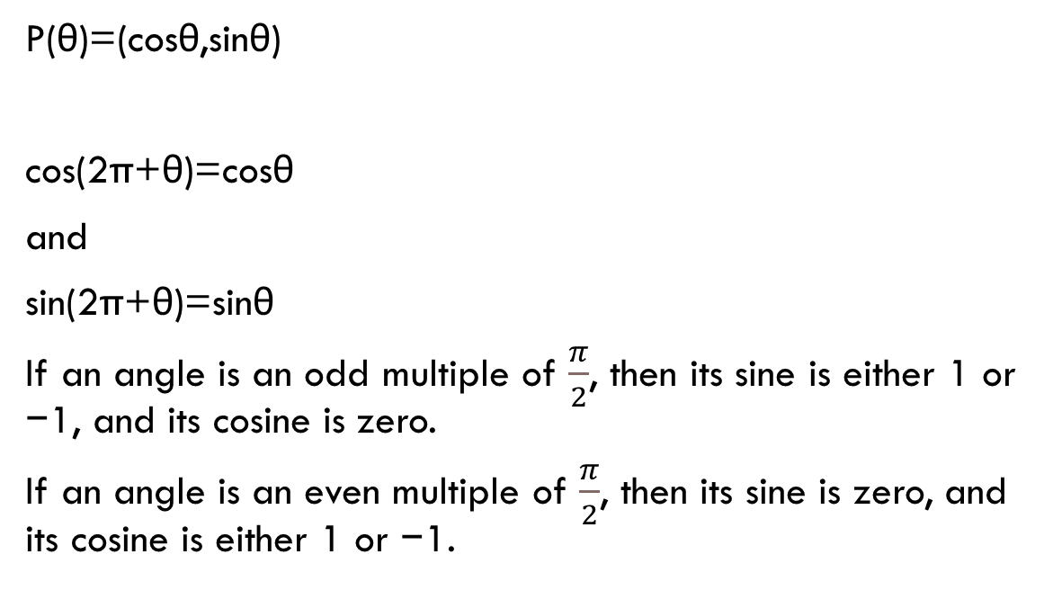
Section summary
P(θ)=(cosθ,sinθ)
cos(2π+θ)=cosθ
and
sin(2π+θ)=sinθ
If an angle is an odd multiple of $\frac{π}{2}$, then its sine is either 1 or −1, and its cosine is zero.
If an angle is an even multiple of $\frac{π}{2}$, then its sine is zero, and its cosine is either 1 or −1.

