Slide 1
Another circular function tangent
14C
Notes:
https://create.kahoot.it/details/8ea9dcaa-aa50-4c49-a834-ecf4d7a291fe
https://create.kahoot.it/details/50e8a4da-9e4d-45ee-b7e6-1bd8ce47d1ab
https://create.kahoot.it/details/5c53f09e-5484-4b4b-acb1-6665939fe229
https://create.kahoot.it/details/7ba90640-837b-48a6-8987-663d0c6038a5

Slide 2
Trigonometry
θ
Notes:
https://www.youtube.com/watch?v=c819bGfH8FA

Slide 3
Definition of an angle
Terminal Ray
+ Counter clockwise
Initial Ray
- clockwise
Terminal Ray
Notes:
Emphasis direction of angle and sign

Slide 4
Coterminal angles – angles with a common terminal ray
Terminal Ray
Initial Ray
Notes:
Find second measure by difference from 2π.

Slide 5
Coterminal angles – angles with a common terminal ray
Terminal Ray
Initial Ray
Notes:
Find negative measure by adding 2π to previous negative angle.

Slide 6
Radian Measure

Slide 7
Definition of Radians
C= 2πr
C= 2π radii
C= 2π radians
360º = 2π radians
r
180º = π radians
1 Radian
≈ 57.3 º
r
Notes:
Use Circumference formula C = 2π r to obtain radian measure of entire circle.

Slide 8
Unit Circle – Radian Measure
Notes:
Bottom half is done in similar manner.

Slide 9
Unit Circle – Radian Measure

Slide 10
Unit Circle – Radian Measure
Degrees
Notes:
Click on degrees to see circle as degrees

Slide 11
Converting Degrees ↔ Radians
Recall
Converts degrees to Radians
Converts Radians to degrees
more examples
Notes:
Examples of converting between angle measures

Slide 12
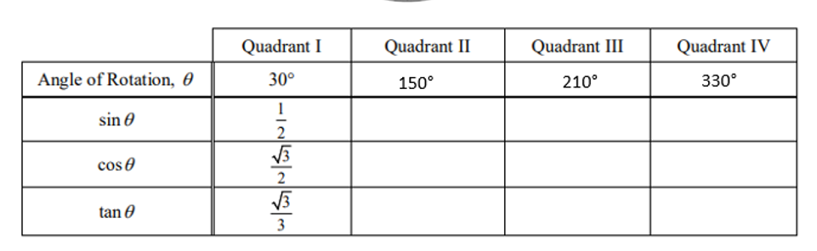
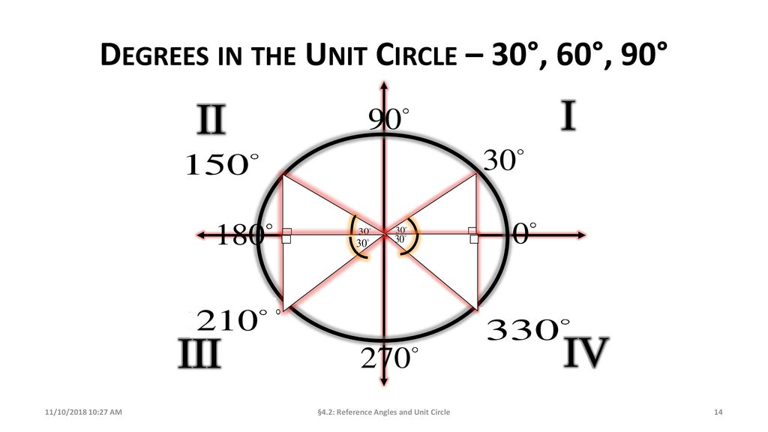

Reference Angles
Reference angles for 30⁰
180-30=120 ⁰ =$\frac{5π}{6}$
180+30=150 ⁰ = $\frac{7π}{6}$
360-30=330 ⁰ = $\frac{11π}{6}$
360+30=390 ⁰ = $\frac{13π}{6}$

Slide 13
Trigonometric Ratios

Slide 14
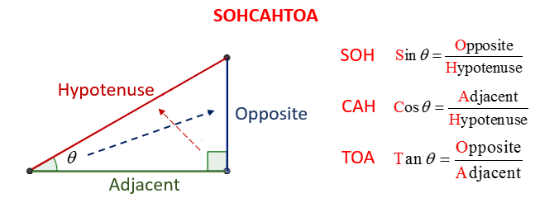
Basic ratio definitions
Hypotenuse
Opposite Leg
Reference Angle
θ
Adjacent Leg
Notes:
Review basic triangle definitions

Slide 15
Circle Trigonometry Definitions
(x, y)
Radius = r
Opposite Leg = y
Adjacent Leg = x
reciprocal functions
Notes:
Wait on clicks until after new definition comes in

Slide 16
Unit - Circle Trigonometry Definitions
(x, y)
Radius = 1
Opposite Leg = y
Adjacent Leg = x
1
Notes:
Unit circle rather than any radius, definitions are just coordinates of endpoint of terminal ray

Slide 17
Unit Circle – Trig Ratios
sin
cos
tan
(-, +)
(+, +)
(-, -)
(+, -)
Skip π/4’s
Reference Angles
Notes:
Develops basic chart – show how triangle is just adjusted by quadrant signs.

Slide 18
Unit Circle – Trig Ratios
sin
cos
tan
(-, +)
(+, +)
(-, -)
(+, -)

Slide 19
Unit Circle – Trig Ratios
sin
cos
tan
(-, +)
(+, +)
(0 , 1)
Quadrant Angles
(-1, 0)
(1, 0)
sin
cos
tan
0
/2π
0
1
0
1
0
Ø
(0, -1)
(-, -)
(+, -)
0
-1
0
View π/4’s
-1
0
Ø

Slide 20
Unit Circle – Radian Measure
sin
cos
tan
(-, +)
(+, +)
Quadrant Angles
sin
cos
tan
1
0
/2π
0
1
0
1
0
Ø
(-, -)
(+, -)
0
0
-1
Degrees
-1
0
Ø

Slide 21
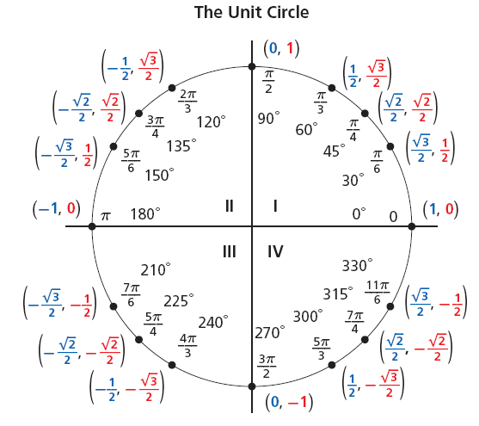



A unit circle is a circle with a radius of 1 unit. For every point P(x, y) on the unit circle, the value of r is 1. Therefore, for an angle θ in the standard position:

Slide 22
Reference Angle Calculation
2nd Quadrant Angles
3rd Quadrant Angles
4th Quadrant Angles
Return

Slide 23
Unit Circle – Degree Measure
90
120
60
135
45
150
30
180
0/360
210
330
225
315
240
300
270
Return

Slide 24
Unit Circle – Degree Measure
sin
cos
tan
(-, +)
90
(+, +)
30
120
60
45
135
45
60
150
30
Quadrant Angles
180
0/360
sin
cos
tan
210
1
330
0/360
0
1
0
225
315
240
300
90
1
0
Ø
(-, -)
(+, -)
0
180
0
-1
270
Return
270
-1
0
Ø

Slide 25
Circle Trigonometry Definitions – Reciprocal Functions
(x, y)
Radius = r
Opposite Leg = y
Adjacent Leg = x
return
Notes:
Wait on clicks until after new definition comes in

Slide 26
Unit Circle – Radian Measure
1

Slide 27
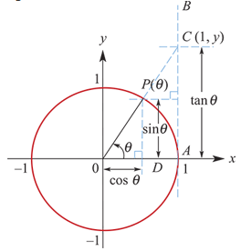

Tangent of a unit circle
Again consider the unit circle.
If we draw a tangent to the unit circle at A, then the y-coordinate of C, the point of intersection of the extension of OP and the tangent, is called tangent θ (abbreviated to tanθ).
By considering the similar triangles OPD and OCA:
$\frac{\tan{θ}}{1}$= $\frac{\sin{θ}}{\cos{θ}}$
∴ tanθ=$\frac{\sin{θ}}{\cos{θ}}$
Note that tanθ is undefined when cosθ=0.
Hence tanθ is undefined when θ=±$\frac{π}{2}$, ± $\frac{3π}{2}$, ± $\frac{5π}{2}$, …
The domain of tan is R∖{θ:cosθ=0}.

Slide 28
Example
Evaluate using a calculator. (Give answers to two decimal places.)
1. tan1.3
2. tan1.9
3. tan(−2.8)
4. tan59°
5. tan138°
Don't forget that your calculator must be in radian mode. cos1.9 is negative.
tan1.3=3.60
tan1.9=−2.93
tan(−2.8)=0.36
Both cos(−2.8) and sin(−2.8) are negative, so tan is positive. Calculate in degree mode.
tan59°=1.66
tan138°=−0.90

