Slide 1

14D
Reviewing trigonometric ratios
Notes:
1

Slide 2
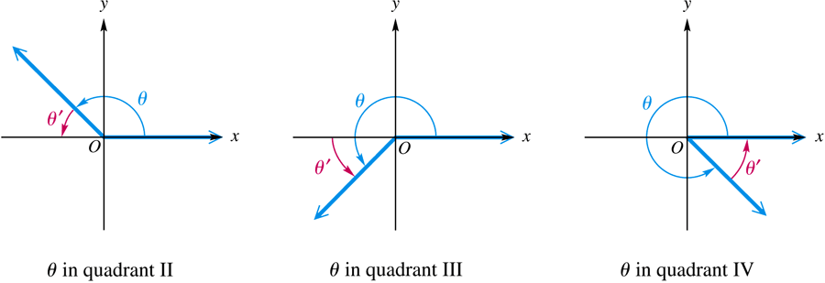
Reference Angles
A reference angle for an angle θ is the positive acute angle made by the terminal side of angle θ and the x-axis.
Notes:
To be able to find exact values of Trig Ratios

Slide 3
Caution
A common error is to find the reference angle by using the terminal side of θ and the y-axis.
The reference angle is always found with reference to the x-axis.

Slide 4
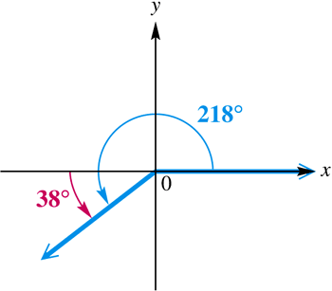
Example 1(a)
FINDING REFERENCE ANGLES
Find the reference angle for an angle of 218°.
The positive acute angle made by the terminal side of this angle and the x-axis is
218° – 180° = 38°.
For θ = 218°, the reference angle θ′ = 38°.

Slide 5
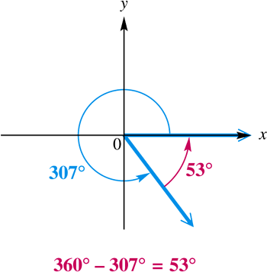
Example 1(b)
FINDING REFERENCE ANGLES
Find the reference angle for an angle of 1387°.
First find a coterminal angle between 0° and 360°.
Divide 1387º by 360 to get a quotient of about 3.9. Begin by subtracting 360° three times.
1387° – 3(360°) = 307°.
The reference angle for 307° (and thus for 1387°) is 360° – 307° = 53°.

Slide 6
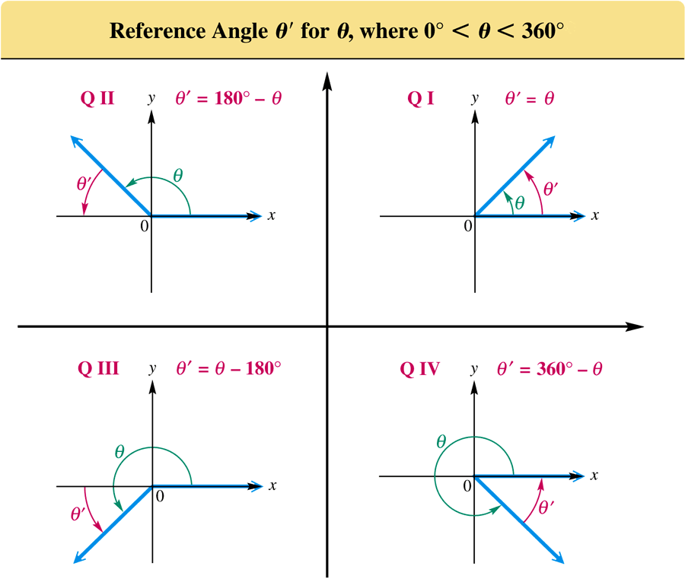

Slide 7
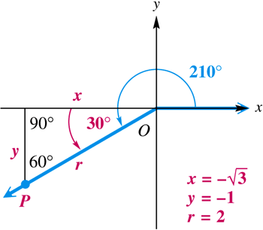
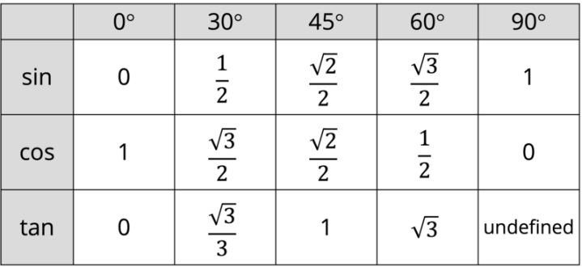
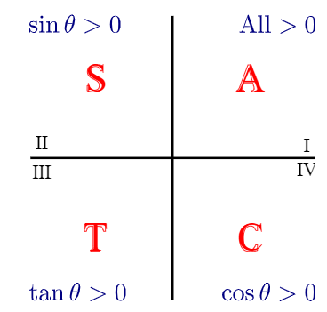
Example 2
FINDING TRIGONOMETRIC FUNCTION VALUES OF A QUADRANT III ANGLE
Find the values of the six trigonometric functions for 210°.
The reference angle for a
210° angle is
210° – 180° = 30°.

Slide 8
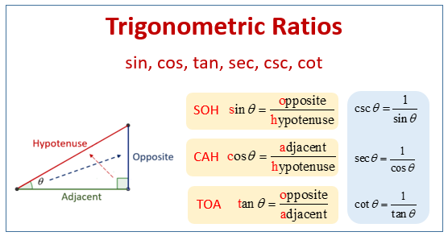
Example 2
FINDING TRIGONOMETRIC FUNCTION VALUES OF A QUADRANT III ANGLE (continued)

Slide 9
Finding Trigonometric Function Values For Any Nonquadrantal Angle θ
Step 1
If θ > 360°, or if θ < 0°, find a coterminal angle by adding or subtracting 360° as many times as needed to get an angle greater than 0° but less than 360°.
Step 2
Find the reference angle θ′.
Step 3
Find the trigonometric function values for reference angle θ′.

Slide 10
Finding Trigonometric Function Values For Any Nonquadrantal Angle θ (continued)
Step 4
Determine the correct signs for the values found in Step 3. This gives the values of the trigonometric functions for angle θ.

Slide 11
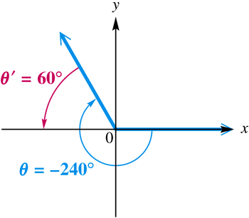
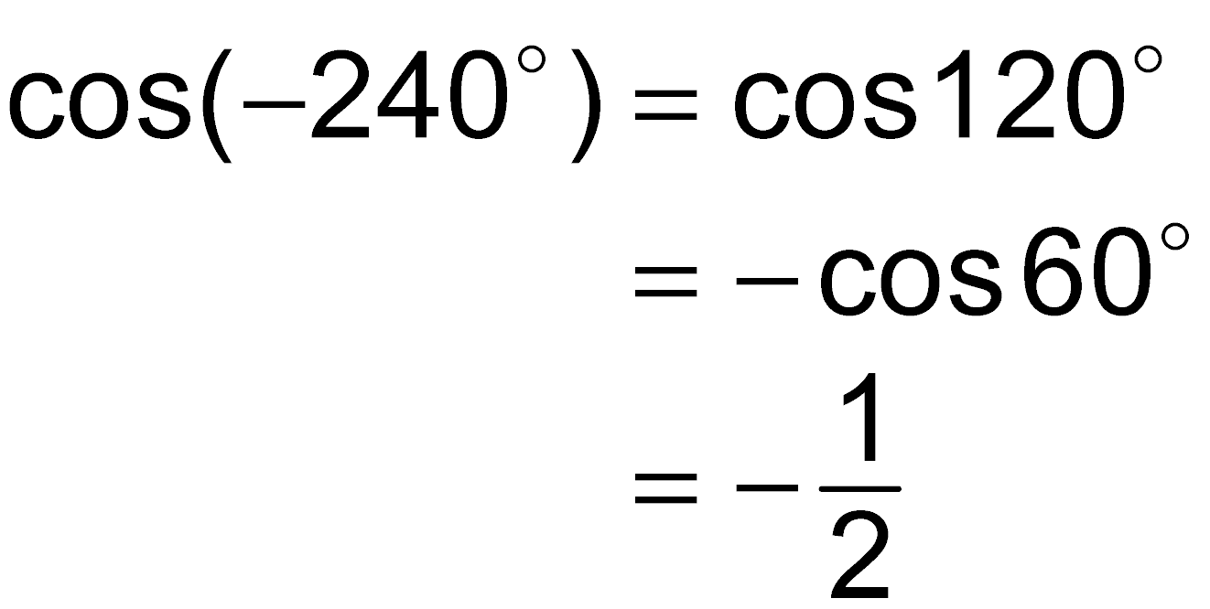
Example 3(a)
FINDING TRIGONOMETRIC FUNCTION VALUES USING REFERENCE ANGLES
Find the exact value of cos(–240°).
Since an angle of –240° is coterminal with an angle of –240° + 360° = 120°, the reference angle is 180° – 120° = 60°.

Slide 12
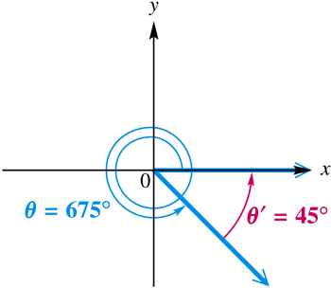
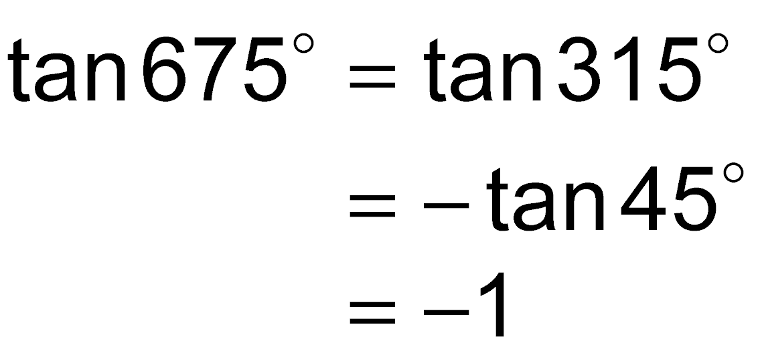
Example 3(b)
FINDING TRIGONOMETRIC FUNCTION VALUES USING REFERENCE ANGLES
Find the exact value of tan 675°.
Subtract 360° to find a coterminal angle between 0° and 360°: 675° – 360° = 315°.
The reference angle is 360° – 315° = 45º. An angle of 315º is in quadrant IV, so the tangent will be negative.

Slide 13
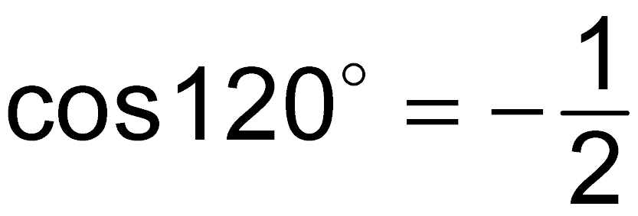
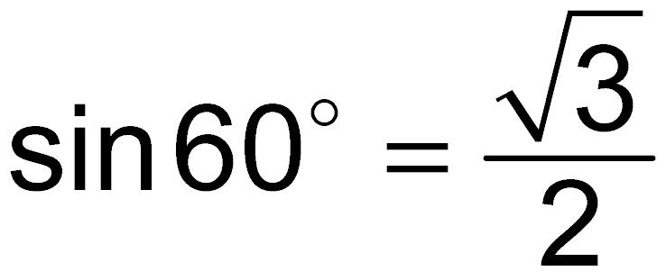
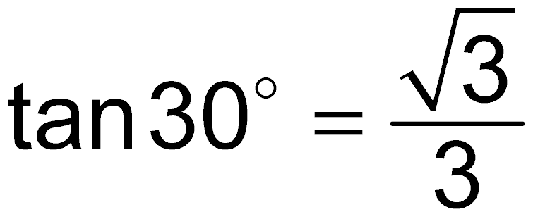
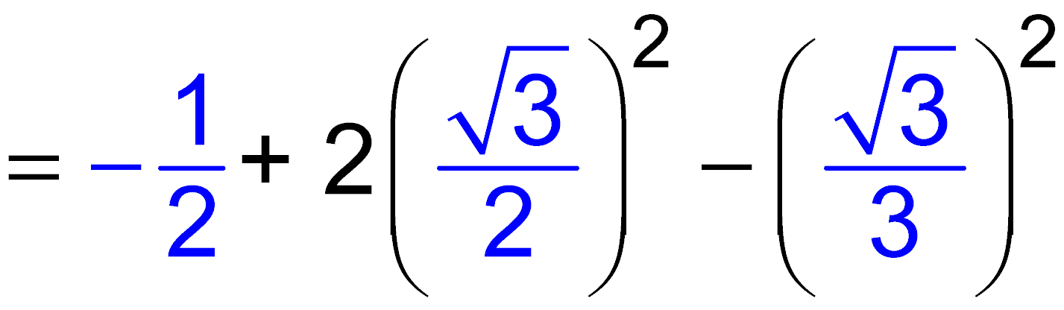
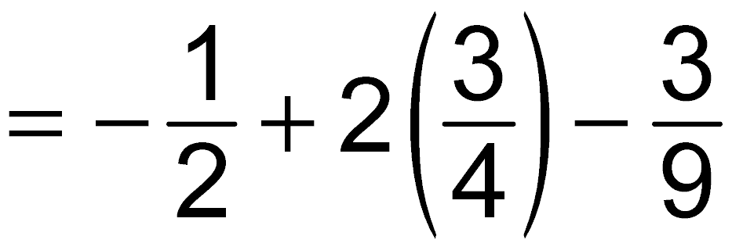
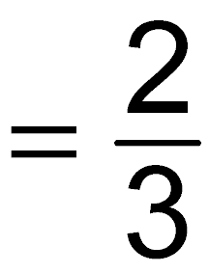
Example 4
USING FUNCTION VALUES OF SPECIAL ANGLES
Evaluate .

Slide 14
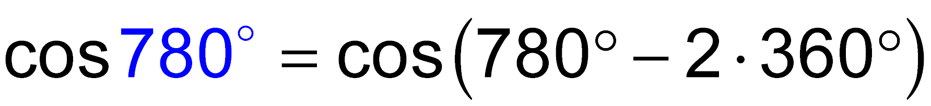
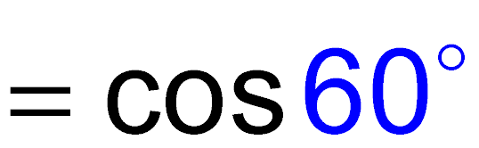
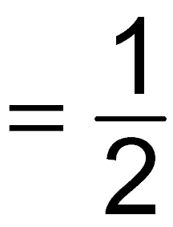
Example 5
USING COTERMINAL ANGLES TO FIND FUNCTION VALUES
Evaluate cos 780° by first expressing the function in terms of an angle between 0° and 360°.

Slide 15
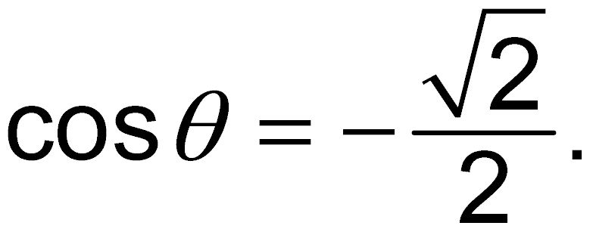
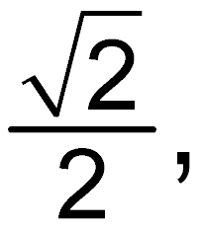
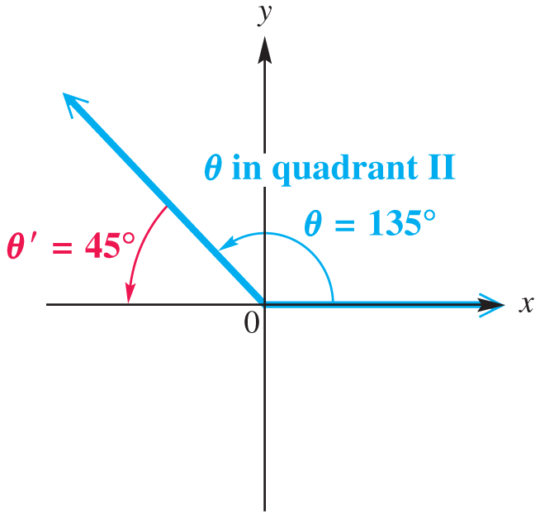
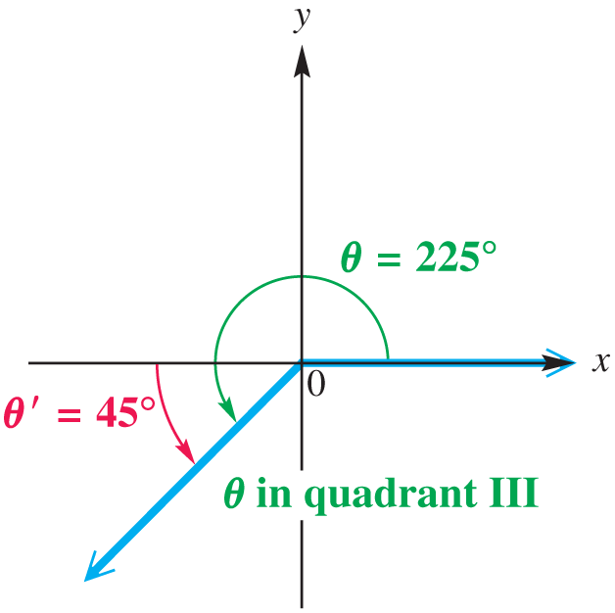
Example 6
FINDING ANGLE MEASURES GIVEN AN INTERVAL AND A FUNCTION VALUE
Find all values of θ, if θ is in the interval [0°, 360°) and
Since cos θ is negative, θ must lie in quadrant II or III.
The absolute value of cos θ is so the reference angle is 45°.
The angle in quadrant II is 180° – 45° = 135°.
The angle in quadrant III is 180° + 45° = 225°.

Slide 16
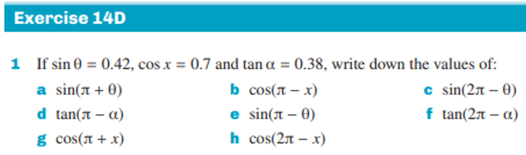
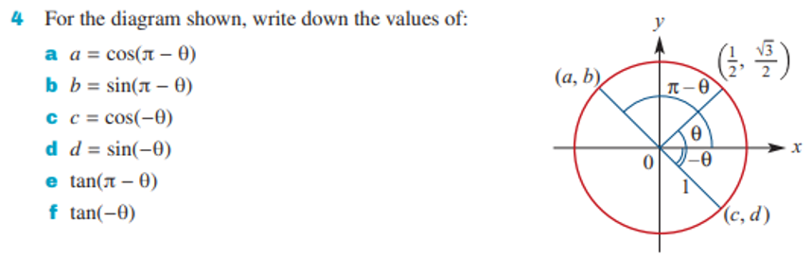
14D

Slide 17
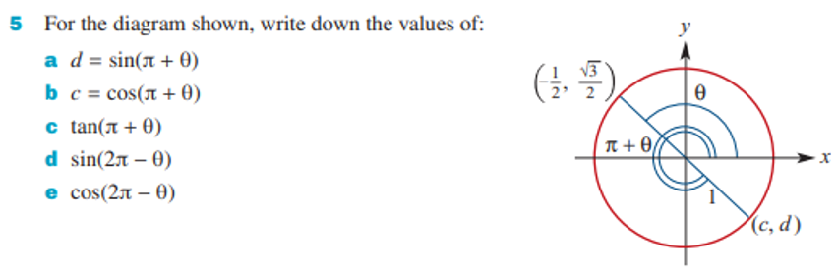
14D

