Slide 1
Symmetry properties of circular functions
14E
https://docs.google.com/forms/d/1bQflCcYFNxKXeBwJEoR9wUpB0DcV-8w5SRB3mby2kUs/copy
https://docs.google.com/presentation/d/1AyIdLF7iCW_zwxyq7xN2eZ8QjCA5Ickt39d1sQvwqfQ/copy

Slide 2
Steps for Finding the Trigonometry exact values
Exact value for reference angle plus = or - sign
Find reference angle
Decide which quadrant this angle is
Find smallest positive co-terminal angle

Slide 3
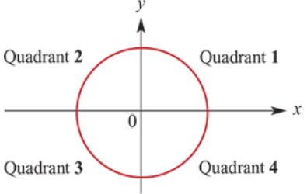
quadrants
The coordinate axes divide the unit circle into four quadrants. The quadrants can be numbered, anticlockwise from the positive direction of the x-axis, as shown.

Slide 4
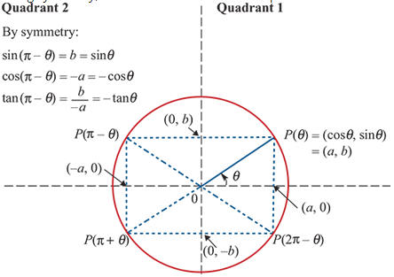
quadrants
Using symmetry, we can determine relationships between the circular functions for angles in different quadrants.
Note:
These relationships are true for all values of θ.

Slide 5
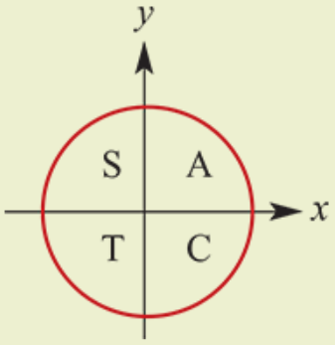
Signs of circular functions
1st quadrant all are positive (A)
2nd quadrant sin is positive (S)
3rd quadrant tan is positive (T)
4th quadrant cos is positive (C)

Slide 6
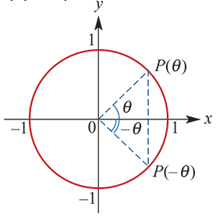
Negative of angles
By symmetry:
cos(−θ) =cosθ
sin(−θ) =−sinθ
tan(−θ) =$\frac{−\text{sin}\text{θ}}{\text{cos}\text{θ}}$= −tanθ

Slide 7
example
If sinx=0.6, find the value of:
sin(π−x)
sin(π+x)
sin(2π−x)
sin(−x)
Solution
sin(π−x)=sinx=0.6
sin(π+x)=−sinx=−0.6
sin(2π−x)=−sinx=−0.6
sin(−x)=−sinx=−0.6

Slide 8
example
If cosx°=0.8, find the value of:
cos(180−x)°
cos(180+x)°
cos(360−x)°
cos(−x)°
cos(180−x)°=−cosx°=−0.8
cos(180+x)°=−cosx°=−0.8
cos(360−x)°=cosx°=0.8
cos(−x)°=cosx°=0.8

