Slide 1
Equations of straight lines
5E

Slide 2
Learning Intentions
A formula for finding the slope of a line
The intercept-slope form of the equation of a
straight line
Sketching straight-line graphs

Slide 3
6
2
2
5
5
6
3
1
1
3
4
4

Slide 4
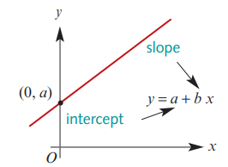
General Equation of a Straight Line…
c +
y = c + mx
y = c + mx
m
The ‘c’ represents the y-intercept of the line:
(where the line crosses the y-axis).
The ‘m’ represents the gradient/slope of the line:
m = $\frac{y_{2}−y_{1}}{x_{2}−x_{1}}$
Keywords: The intercept slope form Equation → y = c+mx

Slide 5
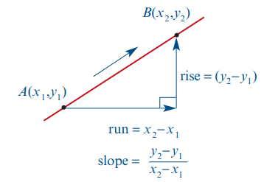
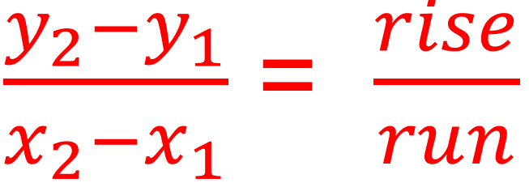

Slide 6
Find the gradient & $y$-intercept for each equation of a line.
Gradient b
$y$-intercept a
$$y=2x+3$$
$$+2$$
$$+3$$
$$y=3x−6$$
$$+3$$
$$−6$$
$$y=5−2x$$
$$−2$$
$$+5$$
$$2y−4=−x$$
$$−0.5$$
$$+2$$

Slide 7
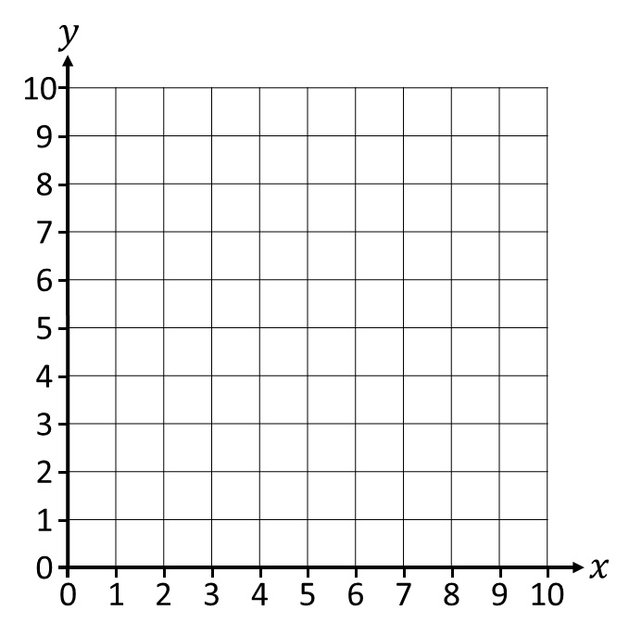
Plotting graphs using the gradient & $y$-intercept.
Plot the graph of
$y=2x+1$
1) Mark the $y$-intercept.
2) Use the gradient to find the
‘next’ coordinate.
“For every 1 across, 2 up.”
3) Plot the line & check!

Slide 8
Plotting graphs using the gradient & $y$-intercept.
①
Plot the graph of
$y=3x+2$
1) Mark the $y$-intercept.
2) Use the gradient to find the
‘next’ coordinate.
“For every 1 across, 3 up.”
3) Plot the line & check!

Slide 9
Plotting graphs using the gradient & $y$-intercept.
Plot the graph of
$y=0.5x+4$
1) Mark the $y$-intercept.
2) Use the gradient to find the
‘next’ integer coordinate.
“For every 1 across, 0.5 up.”
3) Plot the line & check!

Slide 10
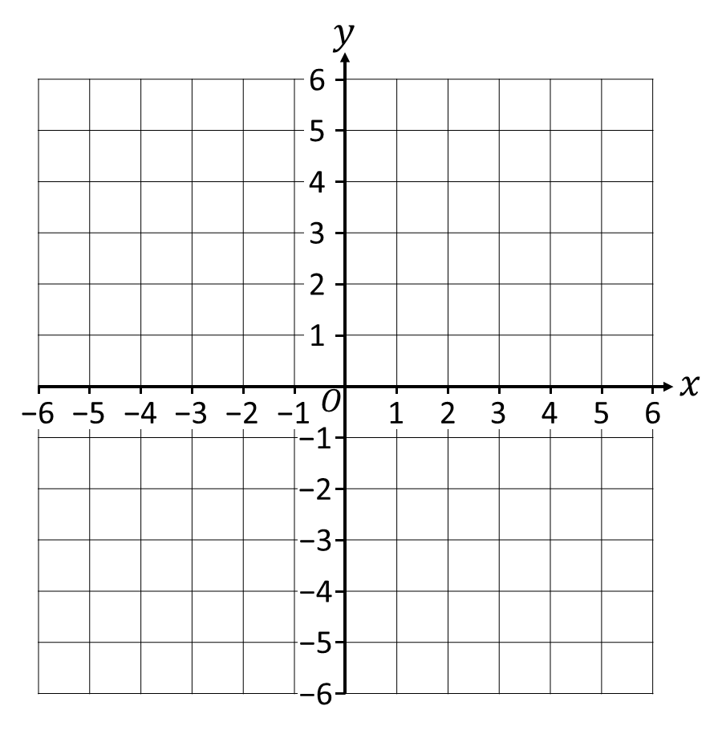
Plotting graphs using the gradient & $y$-intercept.
Plot the graph of
$y=2x−3$
1) Mark the $y$-intercept.
2) Use the gradient to find the
‘next’ integer coordinate.
“For every 1 across, 2 up.”
3) Plot the line & check!

Slide 11
Plotting graphs using the gradient & $y$-intercept.
②
Plot the graph of
$y=3x−1$
1) Mark the $y$-intercept.
2) Use the gradient to find the
‘next’ integer coordinate.
“For every 1 across, 3 up.”
3) Plot the line & check!

Slide 12
Plotting graphs using the gradient & $y$-intercept.
Plot the graph of
$y=5−2x$
1) Mark the $y$-intercept.
2) Use the gradient to find the
‘next’ integer coordinate.
“For every 1 across, 2 down.”
3) Plot the line & check!

Slide 13
Plotting graphs using the gradient & $y$-intercept.
③
Plot the graph of
$y=1−4x$
1) Mark the $y$-intercept.
2) Use the gradient to find the
‘next’ integer coordinate.
“For every 1 across, 4 down.”
3) Plot the line & check!

Slide 14
Plotting graphs using the gradient & $y$-intercept.
Plot the graph of
$y=0.5x−2$
1) Mark the $y$-intercept.
2) Use the gradient to find the
‘next’ integer coordinate.
“For every 1 across, 0.5 up.”
3) Plot the line & check!

Slide 15
Plotting graphs using the gradient & $y$-intercept.
④
Plot the graph of
$y=5−0.5x$
1) Mark the $y$-intercept.
2) Use the gradient to find the
‘next’ integer coordinate.
“For every 1 across, 0.5 down.”
3) Plot the line & check!

Slide 16
exercises & Summary Book
1. Ex
2. Summary notes for Homework.

