Slide 1
The graphs of sinθ cosθ and tanθ
Learning Objectives
To learn the shape of a sin cos tan graph
To understand the amplitude period and asymptotes of a graph
To understand how changing the equation of the graph effects the amplitude period and asymptotes.

Slide 2
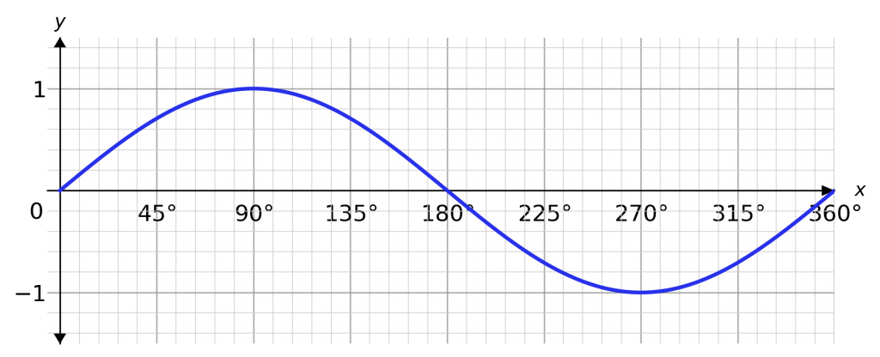
Write down at least 5 things you notice about the graph…
It looks like a wave
The axis are not labelled
y=sinθ
y
θ
It crosses the x-axis at 0, 180 and 360
It crosses the y-axis at 0
It looks like it continues at both ends
Its maximum is at 1
Its minimum is at -1

Slide 3
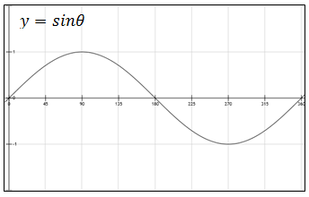
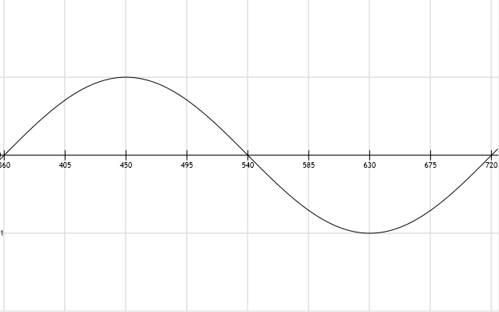
Definitions
The amplitude of a graph is…
The period of a graph is…
the maximum height of the curve
the distance over which the curve repeats itself
amplitude is 1
period is 360˚

Slide 4
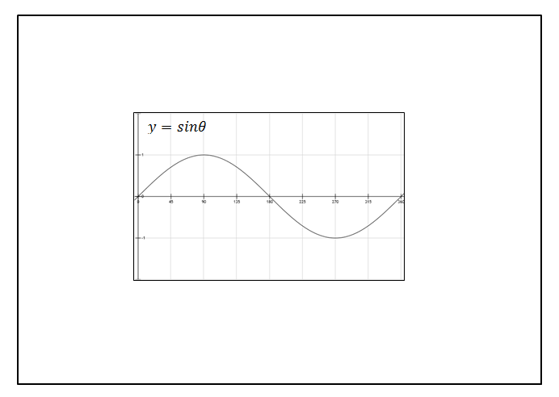
Write down at least 5 things you notice about the graph…
It looks like a wave
The axis are not labelled
y
It crosses the x-axis at 0, 180 and 360
It crosses the y-axis at 0
θ
It looks like it continues at both ends
Its maximum is at 1
Its minimum is at -1
period is 360˚
amplitude is 1

Slide 5
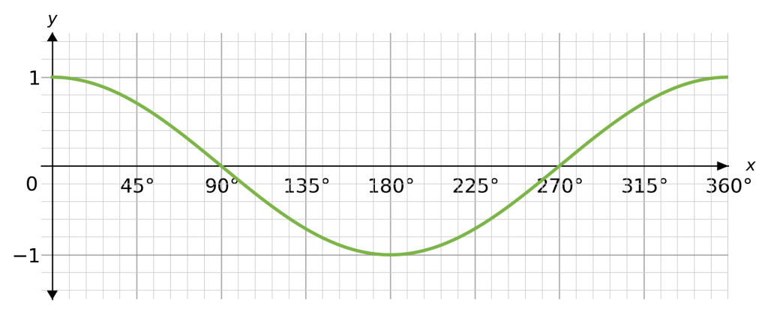
Write down at least 5 things you notice about the graph…
Try to use our new vocabulary
It crosses the x-axis at 90 and 270
It also looks like a wave
y=cosθ
y
It crosses the y-axis at 1
θ
It looks like it continues at both ends
Its maximum is at 1
Its minimum is at -1
period is 360˚
amplitude is 1

Slide 6
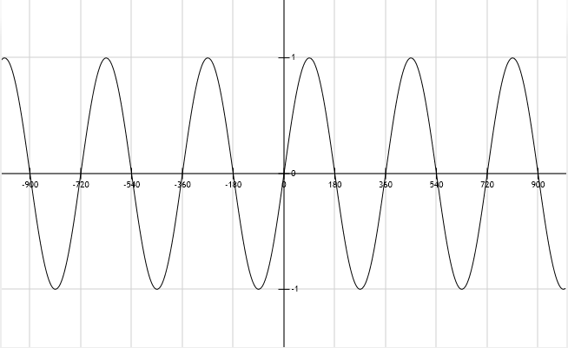
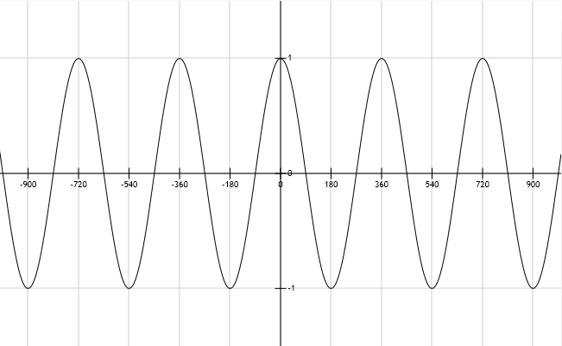
$$y=sinθ$$
$$y=cosθ$$

Slide 7
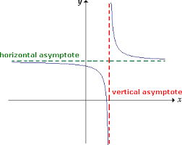
Definitions
The asymptote of a graph is…
a straight line that continually approaches a given curve but does not meet it.

Slide 8
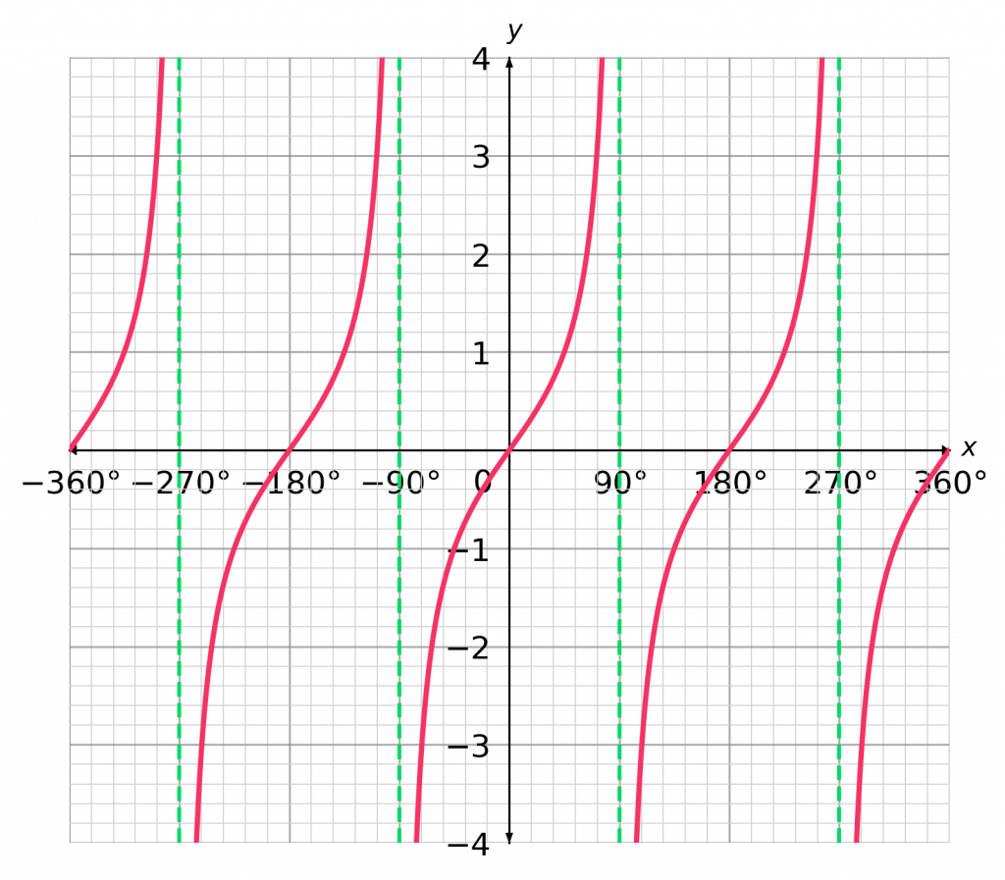
Write down at least 5 things you notice about the graph…
Try to use our new vocabulary
y=tanθ
It crosses the x-axis at 0 and 180
It isn’t a continuous wave.
y
It crosses the y-axis at 0
θ
It looks like it continues at top and bottom ends
It has many lines
of asymptotes
period is 180˚
Asymptotes line are θ=90⁰, θ=90+180=270⁰ ……

Slide 9
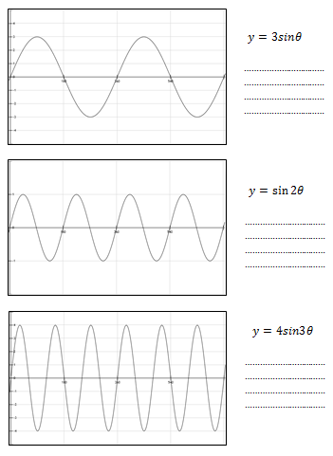
Each graphs you have been given shows y=sinθ between 0˚ and 720˚.
Try to explain what you think the numbers in the equations have done to each graph
The amplitude of a graph is the maximum height of the curve
The period of a graph is the distance over which the curve repeats itself

Slide 10
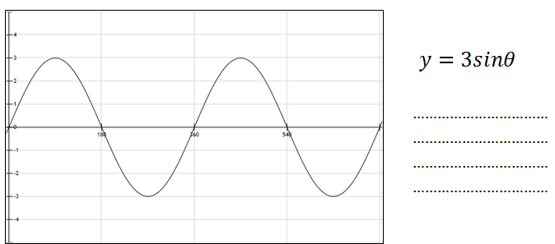
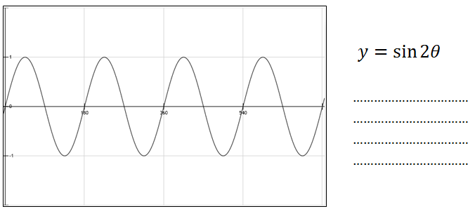
The amplitude has increased to 3
The period has not changed
The period is 180, it has halved

Slide 11
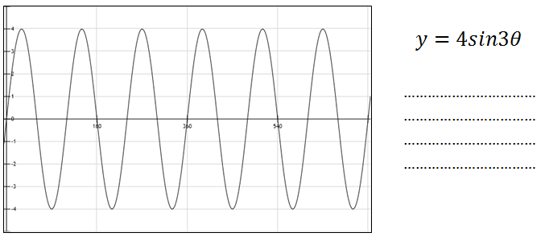
The amplitude has increased to 4
The period is 120, it is a third
In general, for all graphs of type
y = AsinBθ and y = AcosBθ
the amplitude is A
the period is $\frac{360 }{B}$

Slide 12
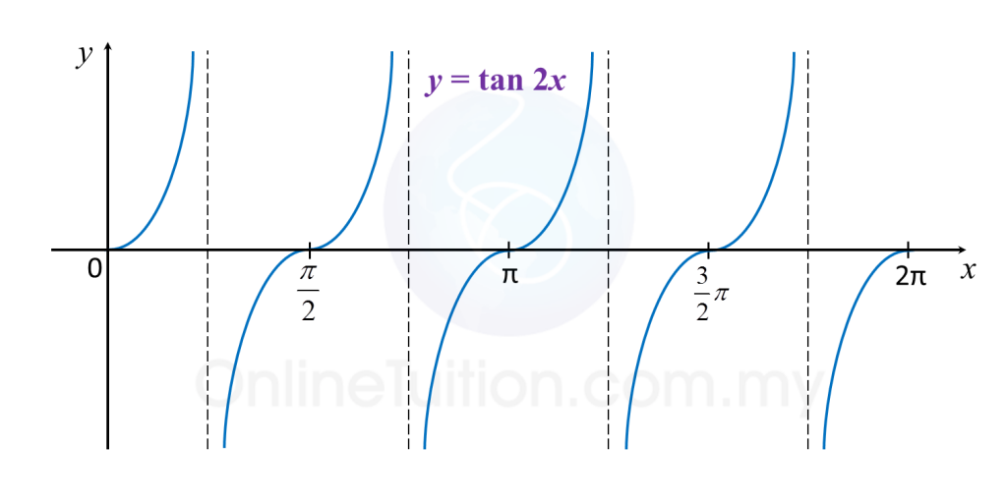
The asymptotes are θ=45 ⁰ , θ=135 ⁰ , θ=225 ⁰ ……
The period is 90°
In general, for all graphs of type
y = AtanBθ
the asymptotes are θ= $\frac{90 }{B}$⁰ , θ= $\frac{90 }{B}$+ $\frac{180 }{B}$⁰, , θ= $\frac{90 }{B}$+ $\frac{180 }{B}$+ $\frac{180 }{B}$⁰
the period is $\frac{180 }{B}$

Slide 13
Radian versus Degree
We will use the following to graph or write equations:
“x” represents radians
“θ” represents degrees
Example: sin x versus sin θ

Slide 14
Key Points in the Sine and Cosine Curves

Slide 15
Sine Function
Graph of the Sine Function
To sketch the graph of y = sin x first locate the key points. These are the maximum points, the minimum points, and the intercepts.
x
0
sin x
0
1
0
-1
0
Then, connect the points on the graph with a smooth curve that extends in both directions beyond the five points. A single cycle is called a period.
y
y = sin x
x

Slide 16
Cosine Function
Graph of the Cosine Function
To sketch the graph of y = cos x first locate the key points. These are the maximum points, the minimum points, and the intercepts.
x
0
cos x
1
0
-1
0
1
Then, connect the points on the graph with a smooth curve that extends in both directions beyond the five points. A single cycle is called a period.
y
y = cos x
x

Slide 17
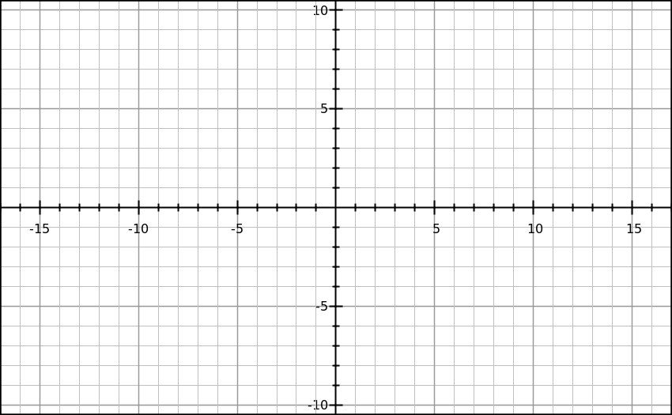
Given : A sin Bx
Amplitude = IAI
period = 2π/B
Sine Graph
Example:
y=5sin2X
Amp=5
Period=2π/2
= π
π/2
π
π/4
3π/4

Slide 18
Example: y = 3 cos x
Example: Sketch the graph of y = 3 cos x on the interval [–π, 4π].
Partition the interval [0, 2π] into four equal parts. Find the five key points; graph one cycle; then repeat the cycle over the interval.
x
0
π
2π
y = 3 cos x
3
0
-3
0
3
max
x-int
min
x-int
max
y
(0, 3)
( , 3)
x
( , 0)
( , 0)
( , –3)

Slide 19
$$A\sin{B}\left(x−h\right)+k$$
Amplitude
Period: 2π/B
Phase Shift: Left ($−$)
Right (+)
Vertical Shift
Up (+)
Down (-)

Slide 20
Example: y = 2 sin(-3x)
What if A is a negative number?
Graph this function:
y = = –2 sin 3x
2
2
amplitude: 2
period:
=
3
Calculate the five key points.
x
0
y = –2 sin 3x
0
–2
0
2
0
y
( , 2)
x
(0, 0)
( , 0)
( , 0)
( , -2)

Slide 21
Summary of Transformations
Vertical Translation
Horizontal Translation
$$y=sin{x}+k$$
$$y=sin{(x}−h)$$
k > 0, translate up
k < 0 translate down
h > 0, translate right
h < 0 translate left
Reflection across x-axis
Reflection across y-axis
$$y=−sin{x}$$
$y=sin(−{x}$)
Dilation factor A from X-axis
Vertical stretches
Dilation factor $\frac{1}{B}$ from Y-axis
Horizontal stretches
$$y=Asin{x}$$
$$y=sin(Bx{)}$$
A > 1, expansion
0 < A < 1 compression
B > 1, compression
0 < B< 1 expansion

Slide 22
Graph y = f(-x)
Use basic trigonometric identities to graph y = f (–x)
Example : Sketch the graph of y = sin (–x).
The graph of y = sin (–x) is the graph of y = sin x reflected in
the x-axis.
y
y = sin (–x)
Use the identity sin (–x) = – sin x
x
y = sin x
Example : Sketch the graph of y = cos (–x).
The graph of y = cos (–x) is identical to the graph of y = cos x.
y
Use the identity cos (–x) = + cos x
x
y = cos (–x)
y = cos (–x)

Slide 23
Example: y = 2 sin(-3x)
Example: Sketch the graph of y = 2 sin (–3x).
Rewrite the function in the form y = a sin bx with b > 0
Use the identity sin (– x) = – sin x:
y = 2 sin (–3x) = –2 sin 3x
2
2
amplitude: |a| = |–2| = 2
period:
=
3
Calculate the five key points.
x
0
y = –2 sin 3x
0
–2
0
2
0
y
( , 2)
x
(0, 0)
( , 0)
( , 0)
( , -2)

