Slide 1
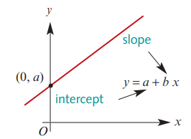
General Equation of a Straight Line…
c +
m
y = c + mx
y = c + mx
The ‘c’ represents the y-intercept of the line:
(where the line crosses the y-axis).
The ‘m’ represents the gradient/slope of the line:
m = $\frac{y_{2}−y_{1}}{x_{2}−x_{1}}$
Keywords: The intercept slope form Equation → y = c+mx

Slide 2
y = c + mx
ALL Using the intercept and slope to find the equation.
MOST Using two points on a graph to find the equation
SOME Finding the equation from two
points using Mathematica
Slope of 2
crosses y-axis
Slope
Increase of 2 up the y-axis
For 1 along the x-axis
Crosses y-axis at 3
y = 3 + 2x

Slide 3
Slope of 3
y = c + mx
ALL Using the intercept and slope to find the equation.
MOST Using two points on a graph to find the equation
SOME Finding the equation from two
points using Mathematica
crosses y-axis
Slope
Increase of 3 up the y-axis
Crosses y-axis at 2
For 1 along the x-axis
y = 2 + 3x

Slide 4
y = c + mx
ALL Using the intercept and slope to find the equation.
MOST Using two points on a graph to find the equation
SOME Finding the equation from two
points using Mathematica
Slope of 1
crosses y-axis
Slope
Increase of 1 up the y-axis
Crosses y-axis at 4
For 1 along the x-axis
y = 4 + x

Slide 5
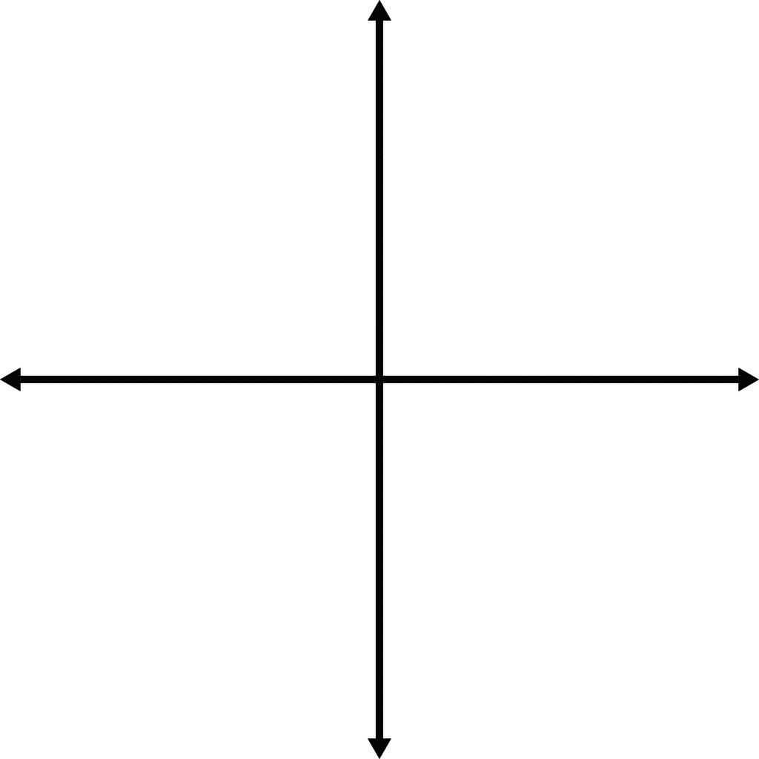
Calculating the equation of a straight line
ALL Using the intercept and slope to find the equation.
MOST Using two points on a graph to find the equation
SOME Finding the equation from two
points using Mathematica
B (5,18)
If you are given two points on a graph, you can calculate the Slope of a straight line that passes through those points.
A (2,6)
y = c + m x
$$Slope$$
$$y−intercept$$
$$Where the line \\ crosses the \\ y axis$$
$\frac{y_{2}−y_{1}}{x_{2}−x_{1}}$ = $\frac{rise}{run}$

Slide 6
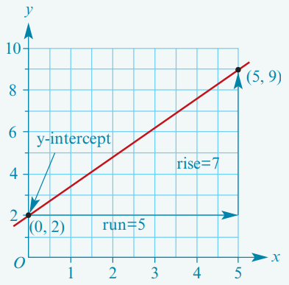
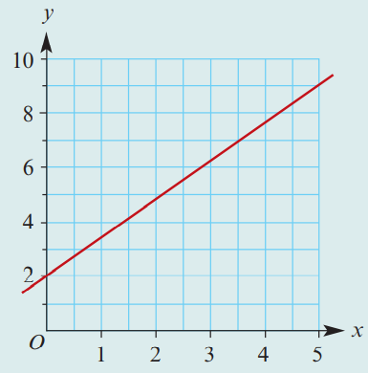
Finding the equation of a line: intercept–slope method
ALL Using the intercept and slope to find the equation.
MOST Using two points on a graph to find the equation
SOME Finding the equation from two
points using Mathematica
y = c + mx
crosses y-axis
Slope

Slide 7
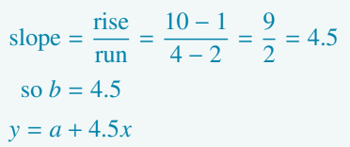
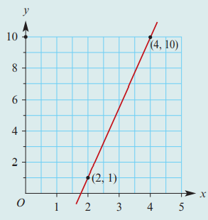
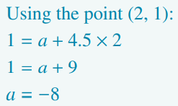
Finding the equation of a straight line using two points on the graph
ALL Using the intercept and slope to find the equation.
MOST Using two points on a graph to find the equation
SOME Finding the equation from two
points using Mathematica
y = c + mx
crosses y-axis
Slope

Slide 8
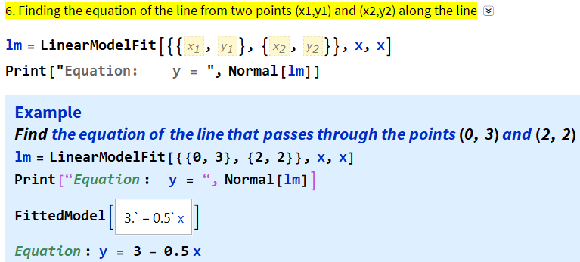
Finding the equation of a straight-line graph from two points using Mathematica
ALL Using the intercept and slope to find the equation.
MOST Using two points on a graph to find the equation
SOME Finding the equation from two
points using Mathematica

