Slide 1
Solving Trigonometric Equations
14G

Slide 2
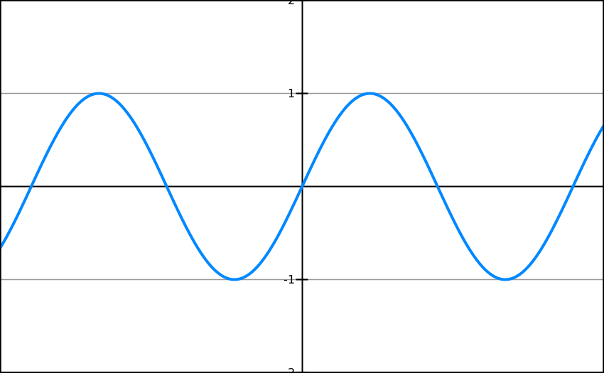
Sin Graph
What does it look like?
?
-360
-270
-180
-90
90
180
270
360

Slide 3
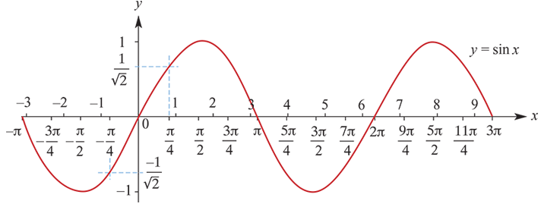
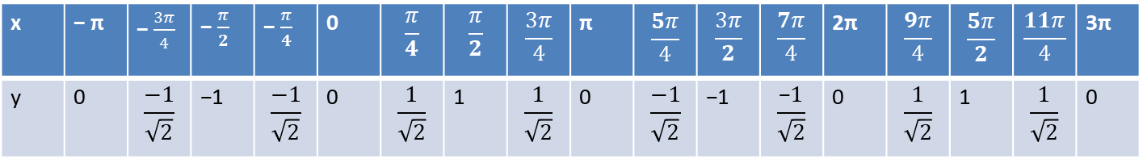
Graph of the sine function
A table of exact values for y=sinx is given below.
A calculator can be used to plot the graph of y=sinx (for −π≤x≤3π). Note this is radian mode.
x | − π | − $\frac{3π}{4}$ | − $\frac{π}{2}$ | − $\frac{π}{4}$ | 0 | $$\frac{π}{4}$$ | $$\frac{π}{2}$$ | $$\frac{3π}{4}$$ | π | $$\frac{5π}{4}$$ | $$\frac{3π}{2}$$ | $$\frac{7π}{4}$$ | 2π | $$\frac{9π}{4}$$ | $$\frac{5π}{2}$$ | $$\frac{11π}{4}$$ | 3π
y | 0 | $$\frac{−1}{\sqrt{2}}$$ | −1 | $$\frac{−1}{\sqrt{2}}$$ | 0 | $$\frac{1}{\sqrt{2}}$$ | 1 | $$\frac{1}{\sqrt{2}}$$ | 0 | $$\frac{−1}{\sqrt{2}}$$ | −1 | $$\frac{\text{−}1}{\sqrt{2}}$$ | 0 | $$\frac{1}{\sqrt{2}}$$ | 1 | $$\frac{1}{\sqrt{2}}$$ | 0

Slide 4
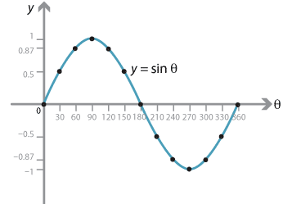
Sin Graph
Suppose we know that sin(30) = 0.5. By thinking about symmetry in the graph, how could we work out:
sin(150) = 0.5
?
sin(-30) = -0.5
?
sin(210) = -0.5
?

Slide 5
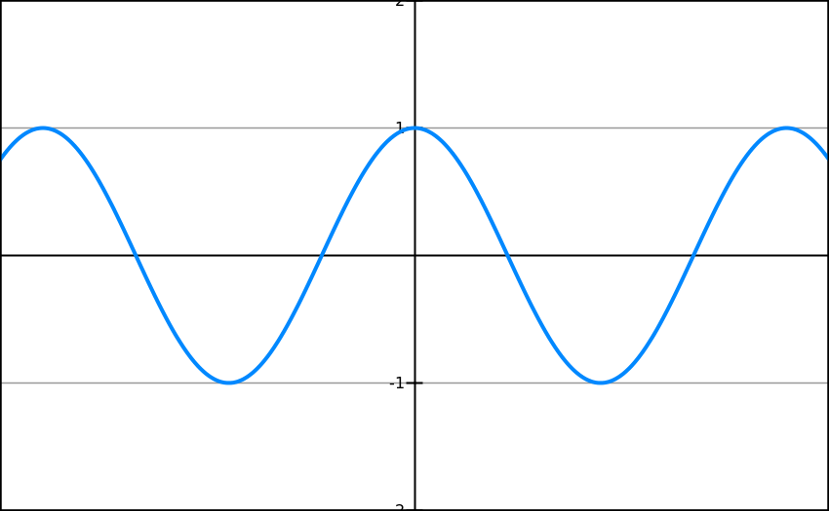
Cos Graph
What do the following graphs look like?
?
-360
-270
-180
-90
90
180
270
360

Slide 6
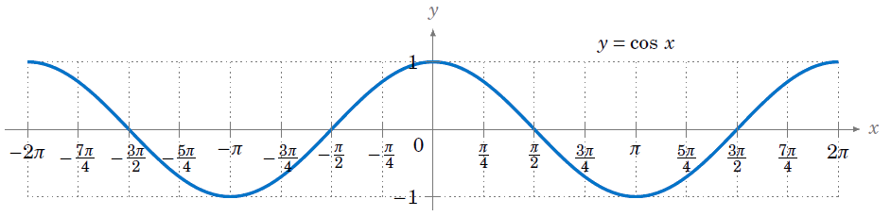
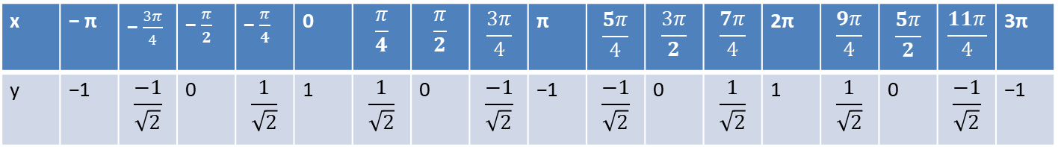
Graph of the cosine function
A table of exact values for y=cosx is given below.
Observations from the graph of y=cosx
The period is 2π and the amplitude is 1.
The graph of y=cosx is the graph of y=sinx translated 𝜋/𝟐 units in the negative direction of the x-axis.
x | − π | − $\frac{3π}{4}$ | − $\frac{π}{2}$ | − $\frac{π}{4}$ | 0 | $$\frac{π}{4}$$ | $$\frac{π}{2}$$ | $$\frac{3π}{4}$$ | π | $$\frac{5π}{4}$$ | $$\frac{3π}{2}$$ | $$\frac{7π}{4}$$ | 2π | $$\frac{9π}{4}$$ | $$\frac{5π}{2}$$ | $$\frac{11π}{4}$$ | 3π
y | −1 | $$\frac{−1}{\sqrt{2}}$$ | 0 | $$\frac{1}{\sqrt{2}}$$ | 1 | $$\frac{1}{\sqrt{2}}$$ | 0 | $$\frac{−1}{\sqrt{2}}$$ | −1 | $$\frac{−1}{\sqrt{2}}$$ | 0 | $$\frac{1}{\sqrt{2}}$$ | 1 | $$\frac{1}{\sqrt{2}}$$ | 0 | $$\frac{−1}{\sqrt{2}}$$ | −1

Slide 7
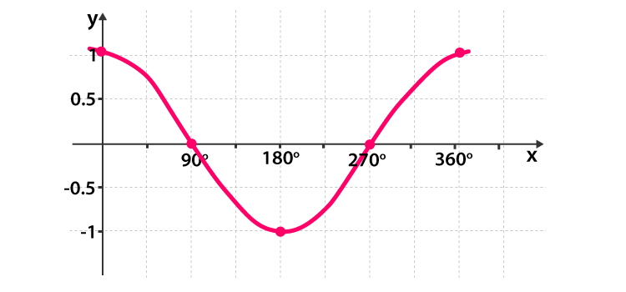
Cos Graph
Suppose we know that cos(60) = 0.5. By thinking about symmetry in the graph, how could we work out:
cos(120) = -0.5
?
cos(-60) = 0.5
cos(240) = -0.5
?
?

Slide 8
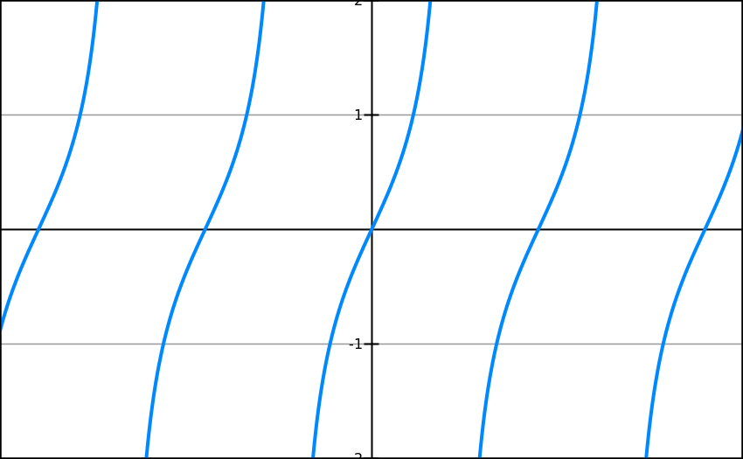
Tan Graph
What does it look like?
?
-360
-270
-180
-90
90
180
270
360

Slide 9
Tan Graph
What does it look like?
-360
-270
-180
-90
90
180
270
360
Suppose we know that tan(30) = 1/√3. By thinking about symmetry in the graph, how could we work out:
tan(-30) = -1/√3
?
tan(150) = -1/√3
?

Slide 10
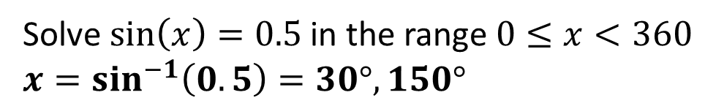
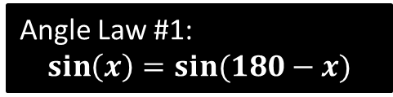


Solving Trig Equations
Solve $\sin\left(x\right)=0.5$ in the range $0≤x<360$
$$x=\sin^{−1}\left(0.5\right)=30°, 150°$$
?
?
Angle Law #1:
$$\sin\left(x\right)=sin⁡(180−x)$$
0.5
-360
-270
-180
-90
$$30°$$
90
$$?$$
180
270
360

Slide 11

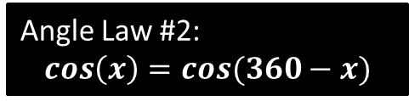



Solving Trig Equations
Solve $2cos\left(x\right)=1$ in the range $0≤x<360$
$$\cos\left(x\right)=\frac{1}{2}$$
$$x=cos^{−1}\left(\frac{1}{2}\right)=60°, 300°$$
?
Angle Law #2:
$$\cos\left(x\right)=cos⁡(360−x)$$
?
?
$$\frac{1}{2}$$
-360
-270
-180
-90
90
180
270
360
$$60°$$
$$?$$

Slide 12
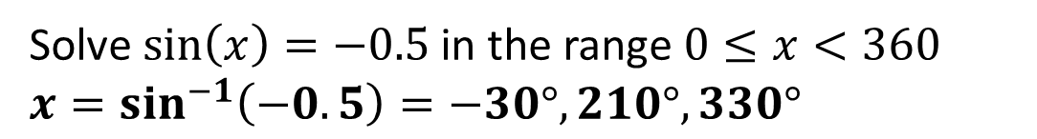

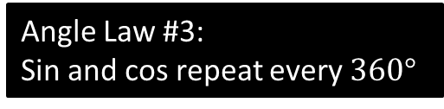


Solving Trig Equations
Solve $\sin\left(x\right)=−0.5$ in the range $0≤x<360$
$$x=\sin^{−1}\left(−0.5\right)=−30°, 210°, 330°$$
?
?
Angle Law #3:
Sin and cos repeat every $360°$
$$−30°$$
$$?$$
$$?$$
-360
-270
-180
-90
90
180
270
360
-0.5

Slide 13




Laws of Trigonometric Functions
!
?
$$\sin\left(x\right)=\sin\left(180−x\right)$$
?
$$\cos\left(x\right)=\cos\left(360−x\right)$$
?
$sin$ and $cos$ repeat every $360°$
?
$tan$ repeats every $180°$

Slide 14
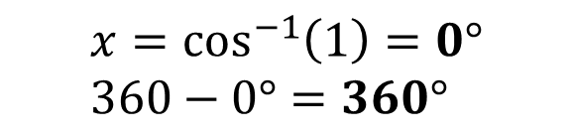
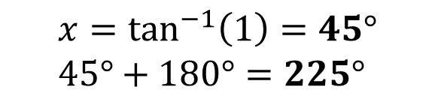
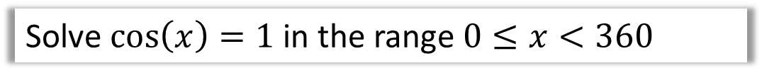
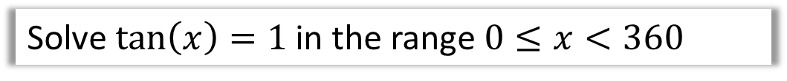
Test Your Understanding
Solve $\cos\left(x\right)=1$ in the range $0≤x<360$
$$x=\cos^{−1}\left(1\right)=0° \\ 360−0°=360°$$
?
Solve $\tan\left(x\right)=1$ in the range $0≤x<360$
$$x=\tan^{−1}\left(1\right)=45° \\ 45°+180°=225°$$
?

Slide 15
Example 1 – Solving a Trigonometric Equation
Solve 2 sin x – 1 = 0. Copy this slide, but not the next.
Solution:
2 sin x – 1 = 0
2 sin x = 1
sin x =
Write original equation.
Add 1 to each side.
Divide each side by 2.

Slide 16
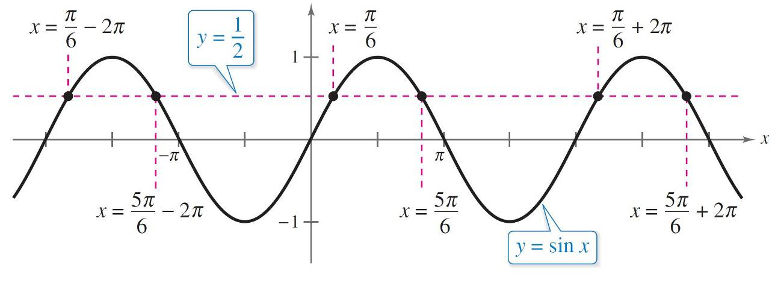
Example 1 – Solution
cont’d
To solve for x, note in this Figure that the equation sin x = has solutions x =π /6 and x = 5π /6 in the interval [0,2π).

Slide 17
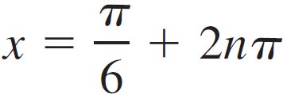
Example 1 – Solution
cont’d
Moreover, because sin x has a period of 2π, there are infinitely many other solutions, which can be written as
and
where n is an integer, as shown in Figure:
General solution

