Slide 1
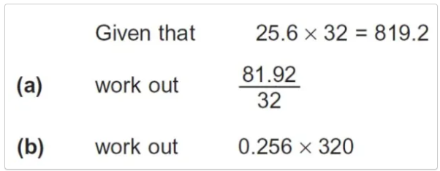

Quick starter
State the value of $x$
$4^{x}=16$
$3^{x}=9$
$2^{x}=8$
$2^{x}=1$
Notes:
https://create.kahoot.it/details/42984ad1-141c-4708-9612-7c19affec58b
https://create.kahoot.it/details/52f36c99-45a5-4a35-b44c-89a88d7090ca
https://create.kahoot.it/details/d33150c9-f9c4-44a7-af0f-06e38dbde871

Slide 2
Exponentials and logarithms
Learning outcomes:
Able to convert from index to logarithmic form and vice versa
Able to apply the laws of logarithms
To be able to prove laws of logarithms
Starter: Notes on logarithms
$$3^{4}=81↔\log_{3}{81=4}$$
$$2^{5}=32↔\log_{2}{32=5}$$
The logarithm of $x$ to base $a$ is the power to which $a$ must be raised to give $x$
$$a^{y}=x↔\log_{a}{x=y}$$
a>0 and a$≠1$

Slide 3

Addition Law of Logarithms
log_{a}(xy) = log_{a}x + log_{a}y
Let p = log_{a}x and
q = log_{a}y
Convert x = a^{p} and
y = a^{q}
xy = a^{p+q}
Convert p + q = log_{a}(xy)
p + q = log_{a}x + log_{a}y
log_{a}(xy) = log_{a}x + log_{a}y

Slide 4

Express as the sum of two logarithms.
Express as the sum of two logarithms.

Slide 5
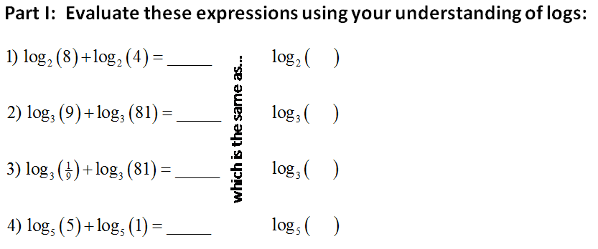
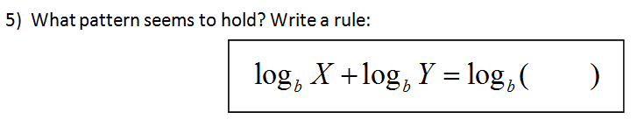

Slide 6

Subtraction Law of Logarithms
log_{a}(^{x}/_{y}) = log_{a}x - log_{a}y
Convert x = a^{p} and
y = a^{q}
x/y = a^{p-q}
Let p = log_{a}x and
q = log_{a}y
Convert p - q = log_{a}(^{x}/_{y})
p - q = log_{a}x - log_{a}y
log_{a}(^{x}/_{y}) = log_{a}x - log_{a}y

Slide 7
Express as the difference of two logarithms.
Express as the difference of two logarithms.

Slide 8
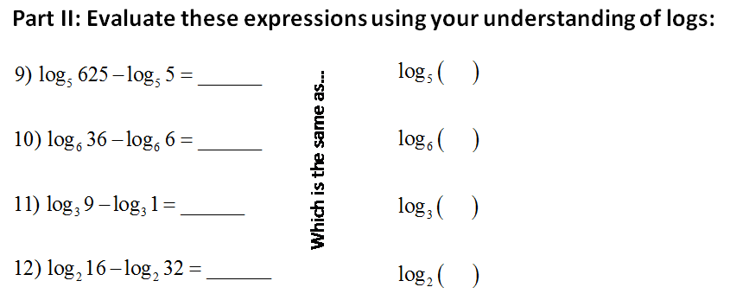
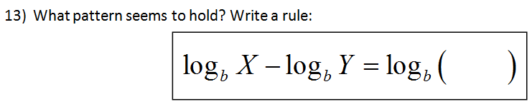

Slide 9
Comparing Exponent Laws to Laws of Logarithms
a^{m}.a^{n} = a^{m+n}
log_{a}(xy) = log_{a}x + log_{a}y
a^{m}/a^{n} = a^{m-n}
log_{a}(^{x}/_{y}) = log_{a}x - log_{a}y
Express
as a sum and difference of logarithms
= log₃27 + log₃3 - log₃9
= 3 + 1 - 2
= 2

Slide 10


Power Law:
log_{b}(x^{n}) = nlog_{b}x
log_{b}m^{n} =
n log_{b}m
log₂4
^{1/3}
log_{b}m
ª
3
log₂5

Slide 11
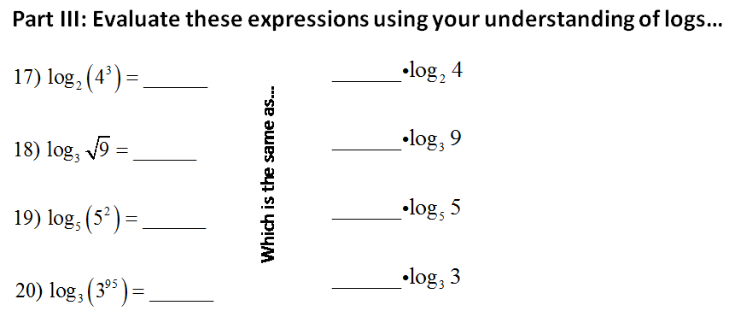
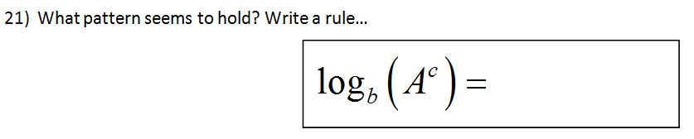

Slide 12
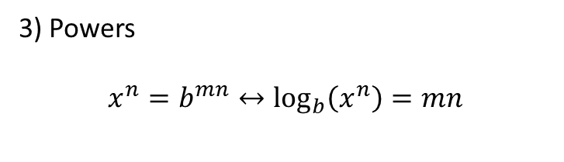
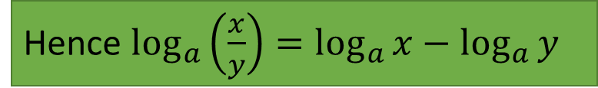

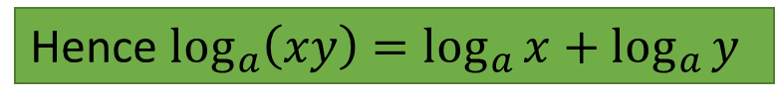
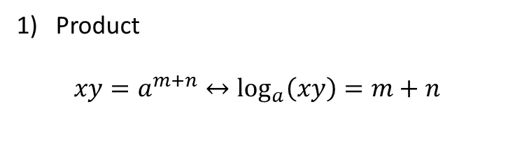
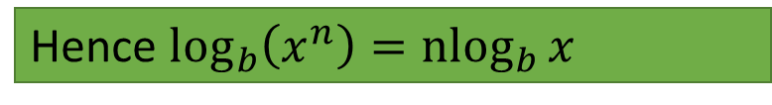
Laws of logs
Laws of indices
$$a^{m}×a^{n}=a^{m+n}$$
$$a^{m}÷a^{n}=a^{m−n}$$
$${(a^{m})}^{n}=a^{mn}$$
If $a^{m}=x and a^{n}=y$ then, $\log_{a}{x=m} and\log_{a}{y=n}$
Product
$$xy=a^{m+n}↔\log_{a}\left(xy\right)=m+n$$
Hence $\log_{a}\left(xy\right)=\log_{a}{x+\log_{a}{y}}$
Examples – Write as a single logarithm
log 2 + log 5
$\log_{10}{3−{4log}_{10}\left(\frac{1}{2}\right)}$
2log5+3log2
2) Division
$$\frac{x}{y}=a^{m−n}↔\log_{a}\left(\frac{x}{y}\right)=m−n$$
Hence $\log_{a}\left(\frac{x}{y}\right)=\log_{a}{x−\log_{a}{y}}$
3) Powers
$$x^{n}=b^{mn}↔\log_{b}\left(x^{n}\right)=mn$$
Example- Express in terms of $\log_{a}{x}$, $\log_{a}{y}$, $\log_{a}{z}$
$$\log_{a}\left(\frac{x\sqrt{y}}{z}\right)$$
Hence $\log_{b}\left(x^{n}\right)={nlog}_{b}{x}$
$$\log_{a}{a=1}$$
$$\log_{a}{1=0}$$

Slide 13

Assignment:
State whether the following are True or False for logarithms to
every base.
a) log 2 + log 3 = log 5
b) log 4 + log 3 = log 12
c) log 10 + log 10 = log 100
d) log 2 x log 3 = log 6
e) log 3² + log 3⁻² = 0
f)
g)

Slide 14
Assignment:
State whether the following are True or False for logarithms to
every base.
a) log 2 + log 3 = log 5
False
b) log 4 + log 3 = log 12
True
c) log 10 + log 10 = log 100
True
d) log 2 x log 3 = log 6
False
e) log 3² + log 3⁻² = 0
True
f)
False
g)
False, think of change of base.

Slide 15
Assignment
State whether the following are True or False for logarithms to
every base.
a) log 5⁻² = -2log 5
b)
c)
d)
e)
f )

Slide 16
Assignment
State whether the following are True or False for logarithms to
every base.
a) log 5⁻² = -2log 5
True
b)
True
c)
False
d)
False
e)
True
f )
False

Slide 17
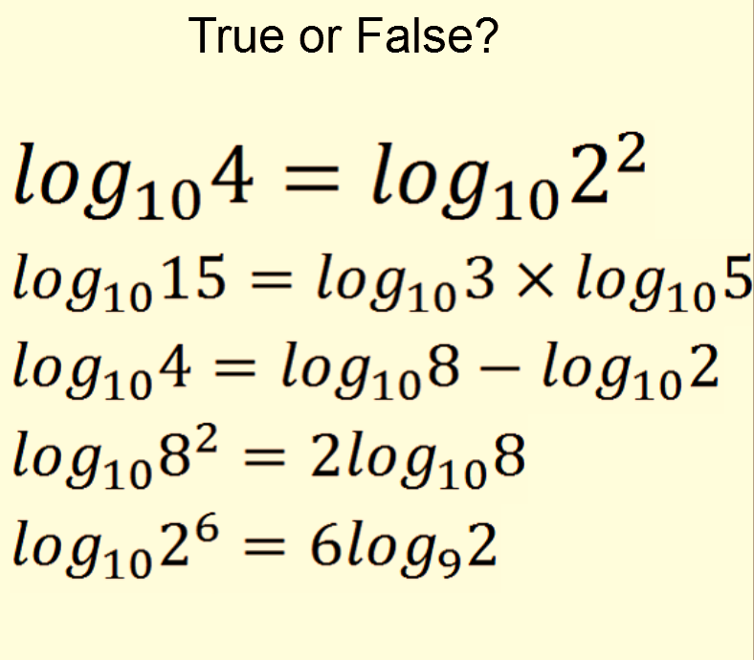

Slide 18
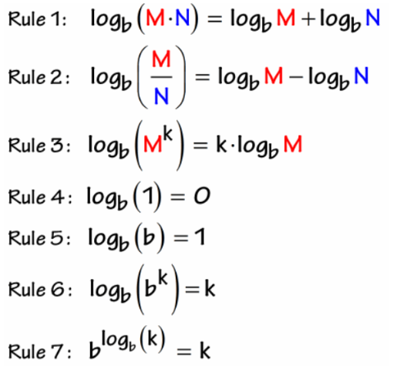
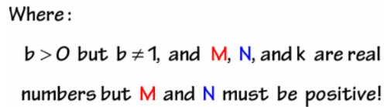
Log Rules

Slide 19
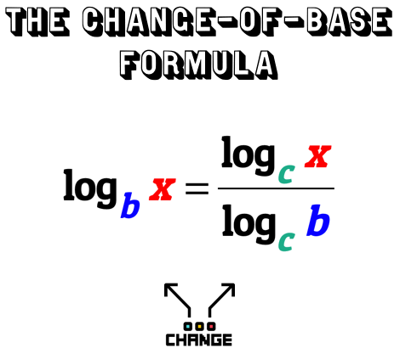
Log Rules

Slide 20
Common Logarithms

Slide 21
Common Logarithm
The logarithm with base 10 is called
the common logarithm.
  It is denoted by omitting the base:
  log x = log₁₀x

Slide 22
Common Logarithms
From the definition of logarithms,
we can easily find that:
log 10 = 1
log 100 = 2

Slide 23
Common Logarithmic Function The logarithmic function with base 10

Slide 24
Common Logarithms
However, how do we find log 50?
  We need to find the exponent y such that
  10^{y} = 50.
  Clearly, 1 is too small and 2 is too large.
  Thus, 1 < log 50 < 2

Slide 25
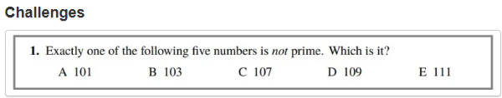
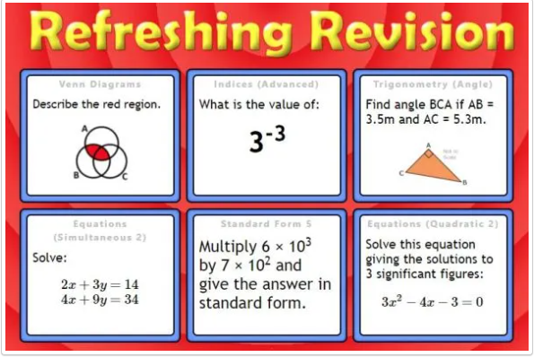

Slide 26
