Slide 1
Solving Logarithmic Equations
16.9
Notes:
https://create.kahoot.it/details/b98185a5-0e81-437a-82f1-a5cce316e4bf
https://create.kahoot.it/details/3d5419df-0a9b-47a0-8798-a7ac5597c13c
https://quizizz.com/admin/quiz/624441d035ac36001d19e109/logarithms?source=MainHeader&page=FeaturedPage&searchLocale=&fromSearch=true
https://quizizz.com/admin/quiz/6302d89e55cbdd001ea976ec/logarithms?source=MainHeader&page=FeaturedPage&searchLocale=&fromSearch=true

Slide 2
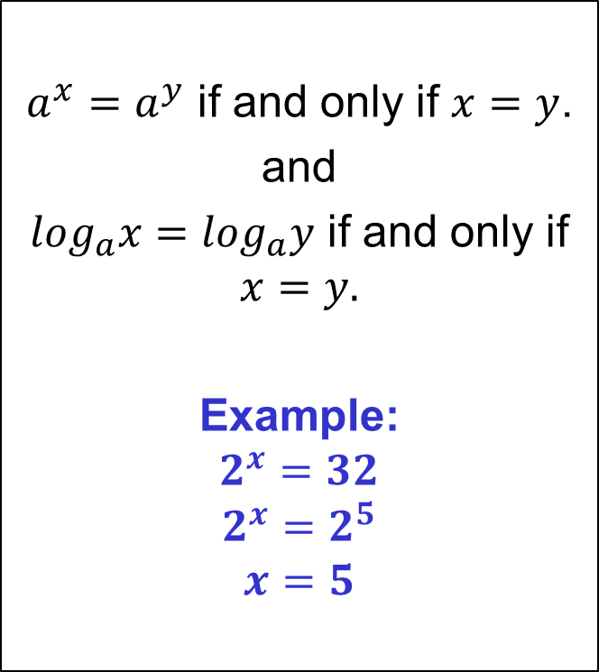
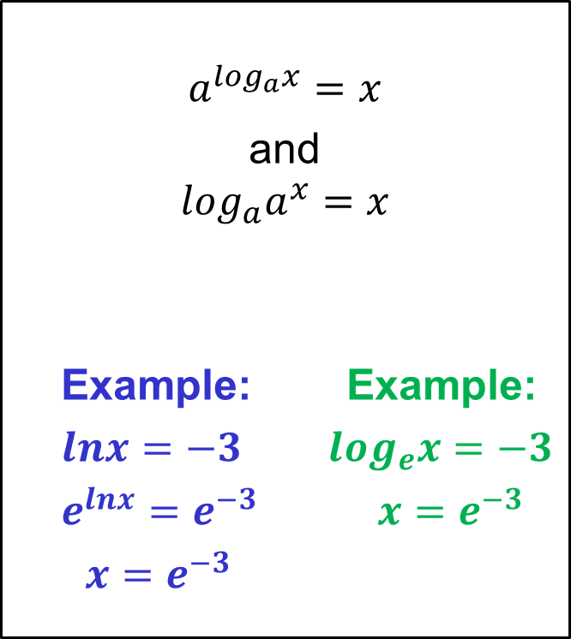

Basic Strategies for Solving Exponential & Log Equations
One-To-One Properties
Inverse Properties
Example:
$$\log_{10}{x}=−3$$
$${10}^{−3}=x$$
$$x=\frac{1}{{10}^{3}}=\frac{1}{1000}=0.001$$

Slide 3
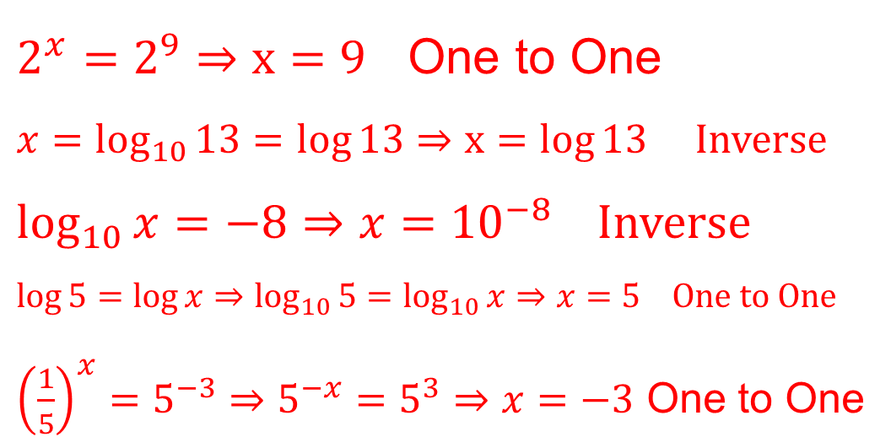

Practice: Solve the equations and determine the property used.
$2^{x}=512$
${10}^{x}=13$
$\log{x}=−8$
$\log{5}−\log{x}=0$
${\left(\frac{1}{5}\right)}^{x}=125$
$2^{x}=2^{9}⇒x=9$ One to One
$x=\log_{10}{13}=\log{13}⇒x=\log{13}$ Inverse
$\log_{10}{x}=−8⇒x={10}^{−8}$ Inverse
$\log{5}=\log{x}⇒\log_{10}{5}=\log_{10}{x}⇒x=5$ One to One
${\left(\frac{1}{5}\right)}^{x}=5^{−3}⇒5^{−x}=5^{3}⇒x=−3$ One to One

Slide 4
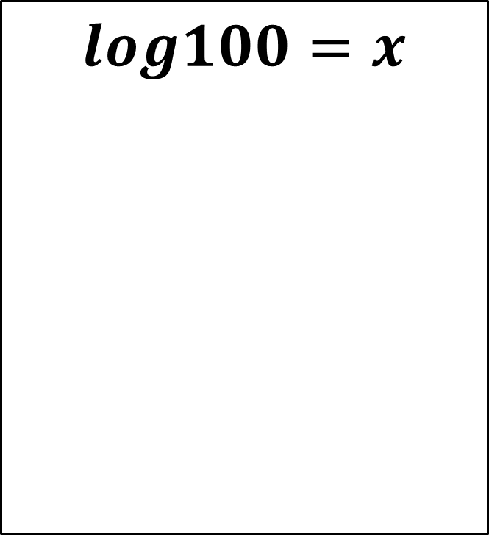
Solve

Slide 5
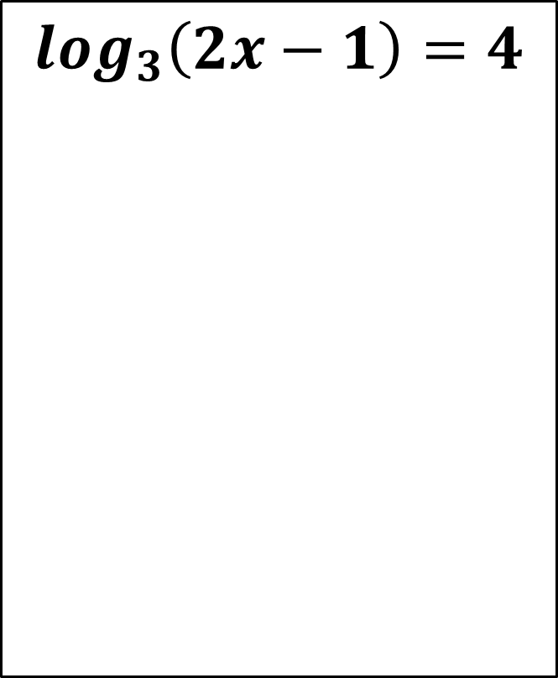
Solve

Slide 6
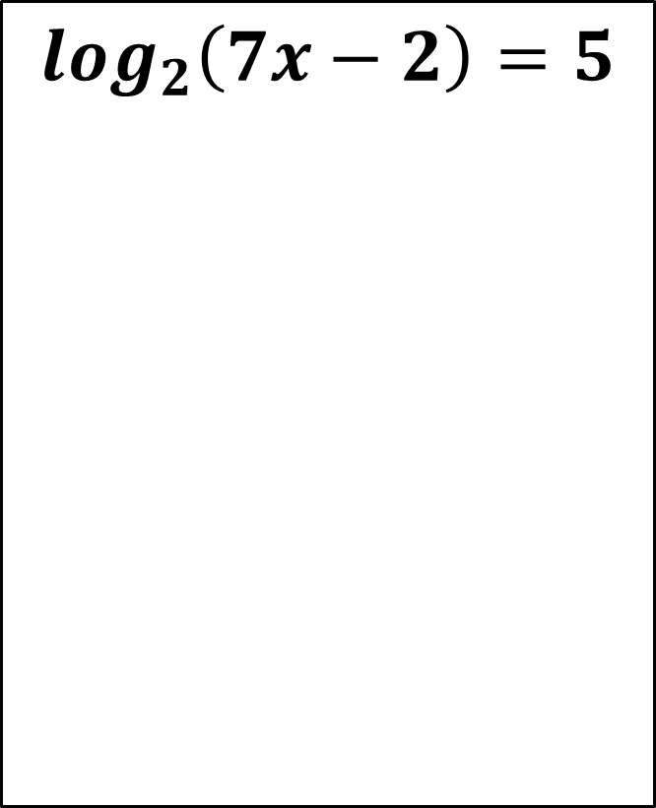
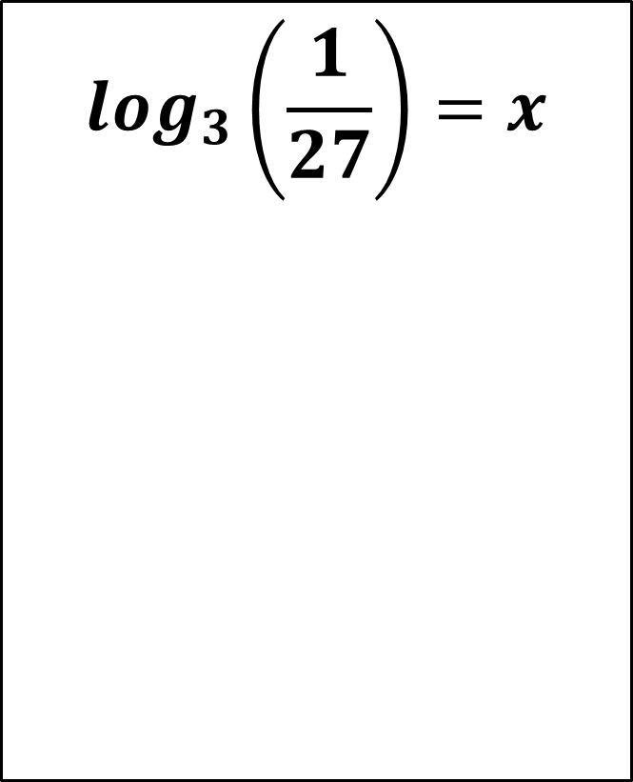
Solve

Slide 7
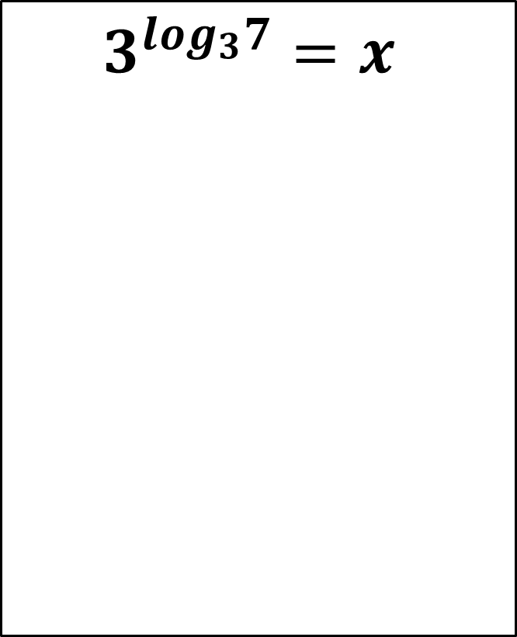
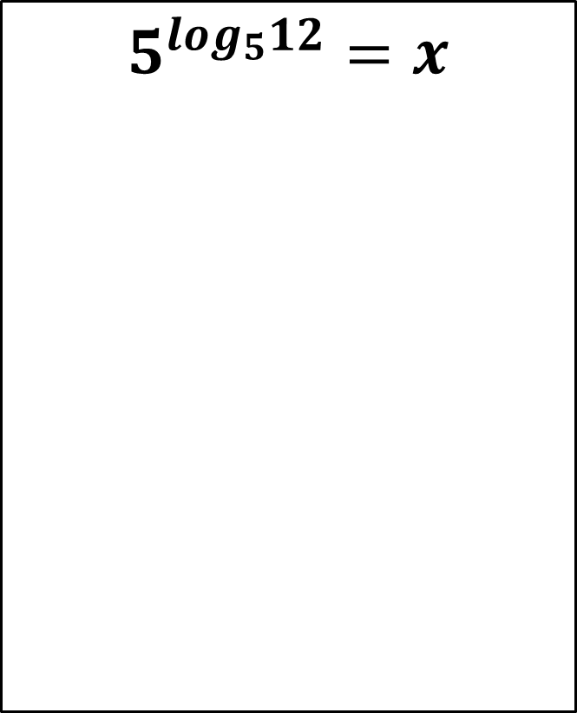
Solve

Slide 8
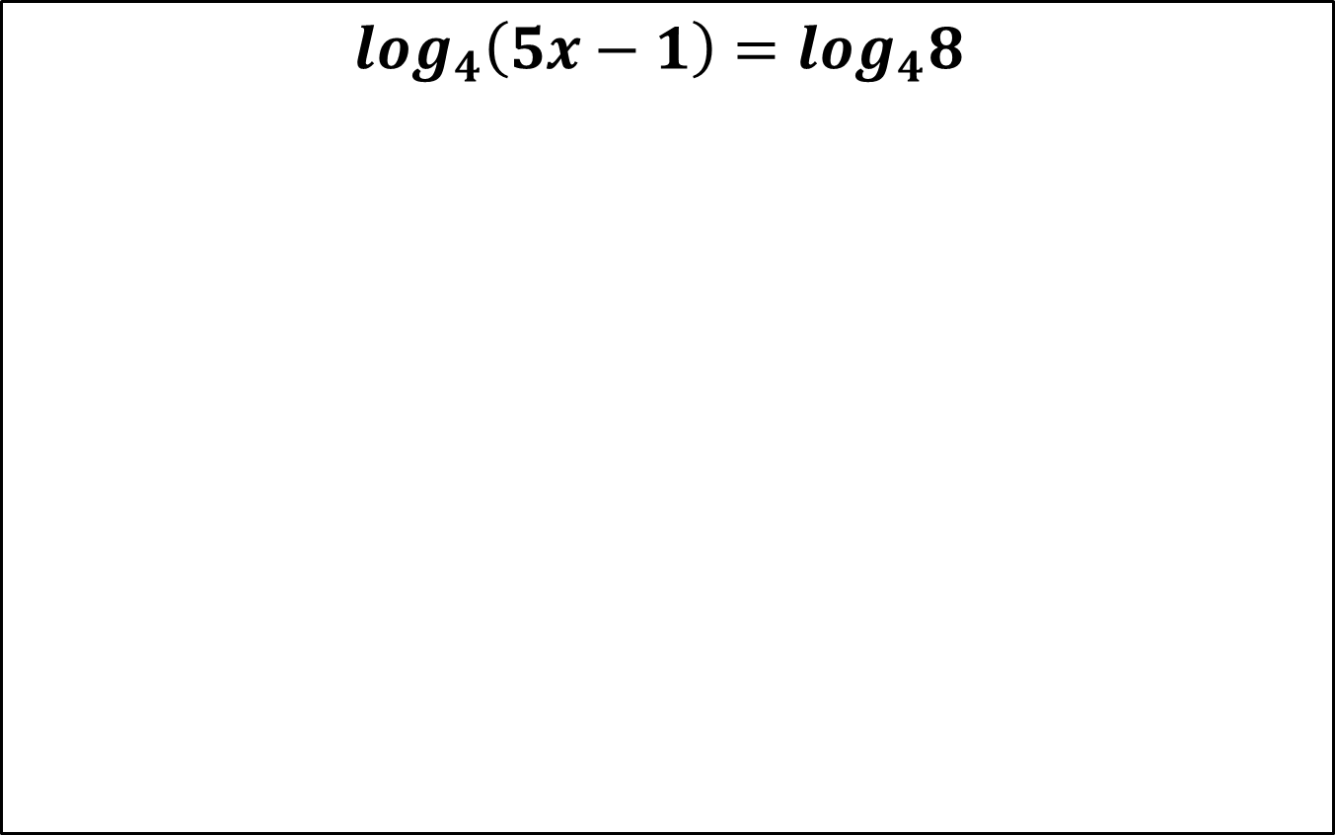
Solve

Slide 9
The Common Logarithm
The base-10 logarithm is called the common logarithm.
The common logarithm is usually written as logx.

Slide 10
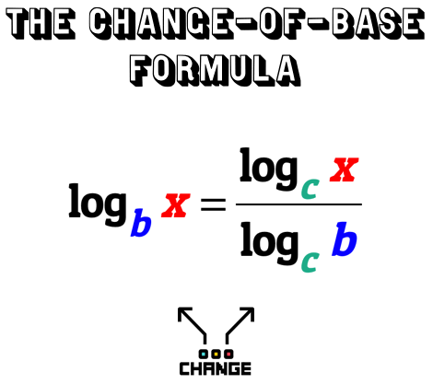
Log Rules

Slide 11
Example: Evaluate to the nearest hundredth.

Slide 12
Practice (Nearest 100th)

