Slide 1
Log Revision
Chapter 16

Slide 2
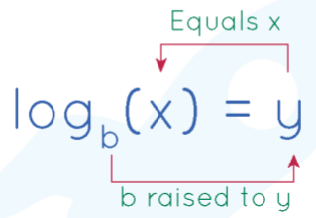
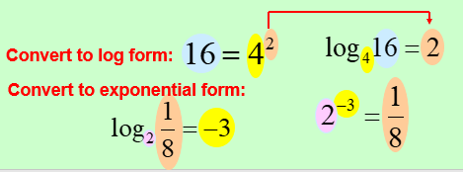
Log Forms

Slide 3
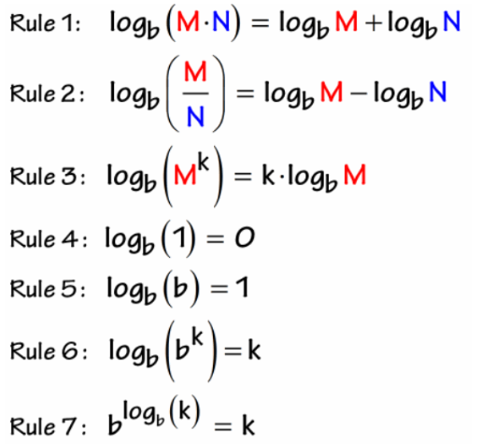
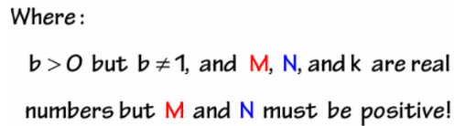
Log Rules

Slide 4
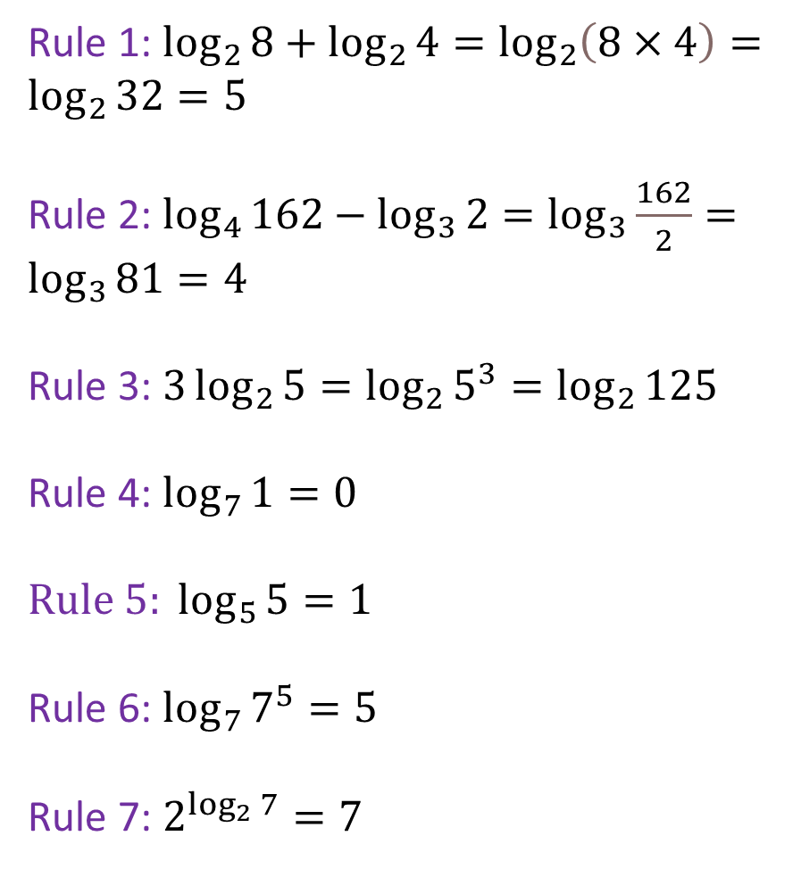
Log Rules
Rule 1: $\log_{2}{8}+\log_{2}{4}=\log_{2}\left(8×4\right)=\log_{2}{32}=5$
Rule 2: $\log_{4}{162}−\log_{3}{2}=\log_{3}{\frac{162}{2}}=\log_{3}{81}=4$
Rule 3: $3\log_{2}{5}=\log_{2}{5^{3}}=\log_{2}{125}$
Rule 4: $\log_{7}{1}=0$
$${Rule 5: log}_{5}{5}=1$$
Rule 6: $\log_{7}{7^{5}}=5$
Rule 7: $2^{\log_{2}{7}}=7$

Slide 5
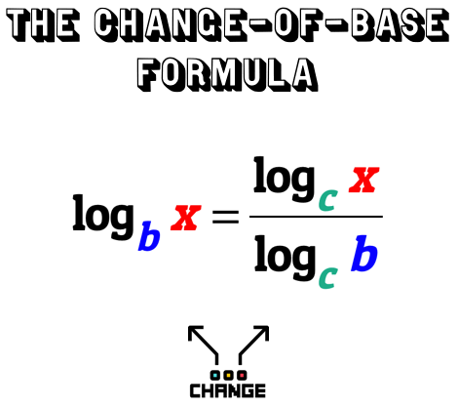
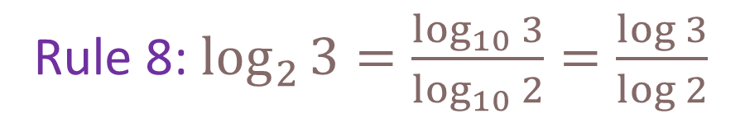
Log Rules
Rule 8: $\log_{2}{3}=\frac{\log_{10}{3}}{\log_{10}{2}}=\frac{\log{3}}{\log{2}}$

Slide 6
Common Logarithm
The logarithm with base 10 is called
the common logarithm.
  It is denoted by omitting the base:
  log x = log₁₀x

Slide 7
Common Logarithms
From the definition of logarithms,
we can easily find that:
log 10 = 1
log 100 = 2

Slide 8
Defs: domain and range
Domain: The set of x components of an equation.
Range: The set of y components of an equation.

Slide 9
Graph of Exponential Function (a > 1)
The graph of y = b^{x}, b > 1
y
4
Range: (0, ∞)
(0, 1)
x
4
Horizontal Asymptote y = 0
Domain: (–∞, ∞)

Slide 10
Graphs of Exponential Functions
The figure shows the graphs of the family
of exponential functions f(x) = a^{x} for various values of the base a.
  All these graphs
  pass through
  the point (0, 1)
  because
  a⁰ = 1 for a ≠ 0.

Slide 11
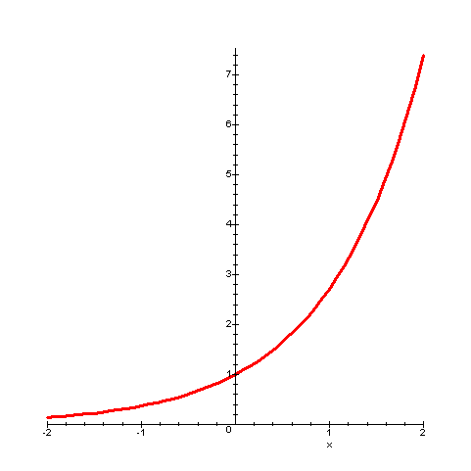
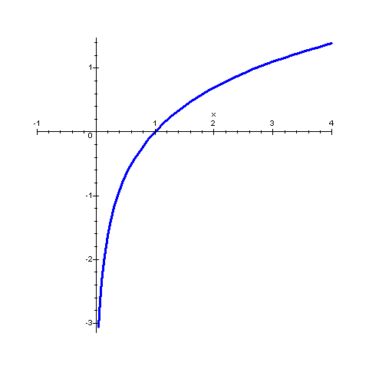
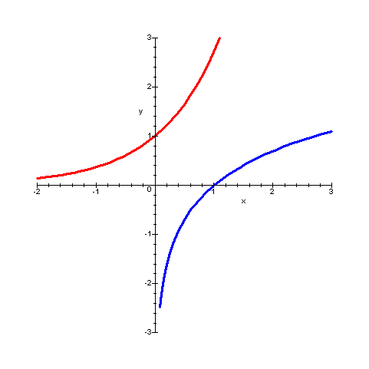
Exponential Graph
Logarithmic Graph
Graphs of inverse functions are reflected about the line y = x

Slide 12
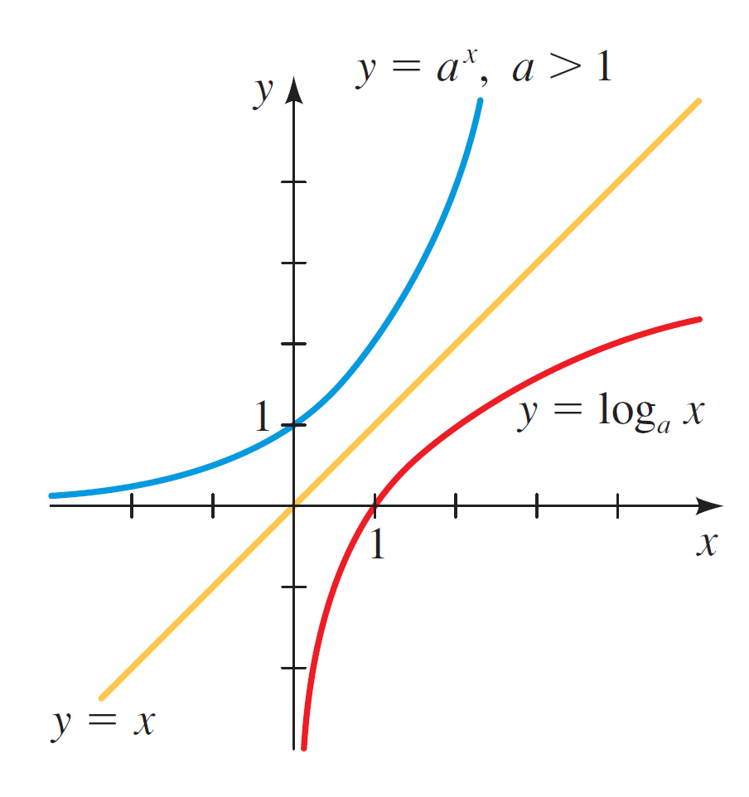

Graphs of Logarithmic Functions
The graph of f ^{–1}(x) = log_{a}x is obtained
by reflecting the graph of f(x) = a^{x} in
the line y = x.
  The figure shows
  the case a > 1.

Slide 13
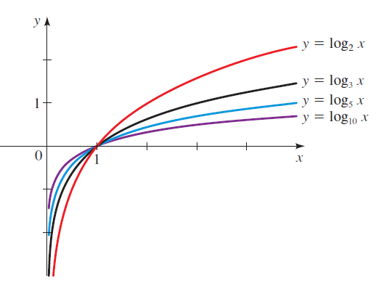
Graphs of Logarithmic Functions
The figure shows the graphs of the family of logarithmic functions with bases 2, 3, 5, and 10.

Slide 14


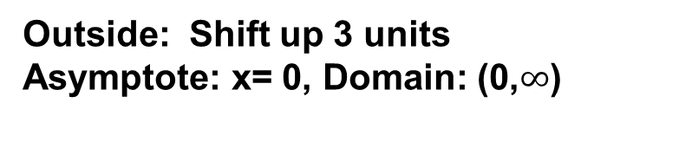


Logarithmic Transformations
Compared to y = log x, describe the graphic relationship between its graph and the following graphs:
y = -log x
y = log (x + 3)
y = log (-x)
y = log x + 3
y = 2 log x
y = 3 – 2 log x
Outside: Reflection across x-axis
Asymptote: x= 0, Domain: (0,$∞$)
Inside: Shift left 3 units
Asymptote: x= –3, Domain: (–3,$∞$)
Inside: Reflection across y-axis
Asymptote: x= 0, Domain: (0,$∞$)
Outside: Shift up 3 units
Asymptote: x= 0, Domain: (0,$∞$)
Outside: Vertical stretch by 2
Asymptote: x= 0, Domain: (0,$∞$)
Outside: Vertical stretch by 2; reflected across x-axis and shifted up by 3

Slide 15
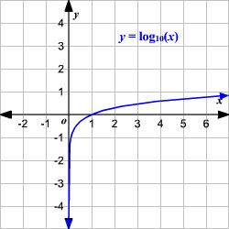
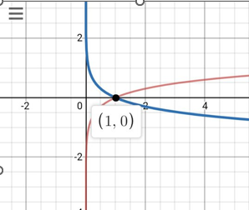
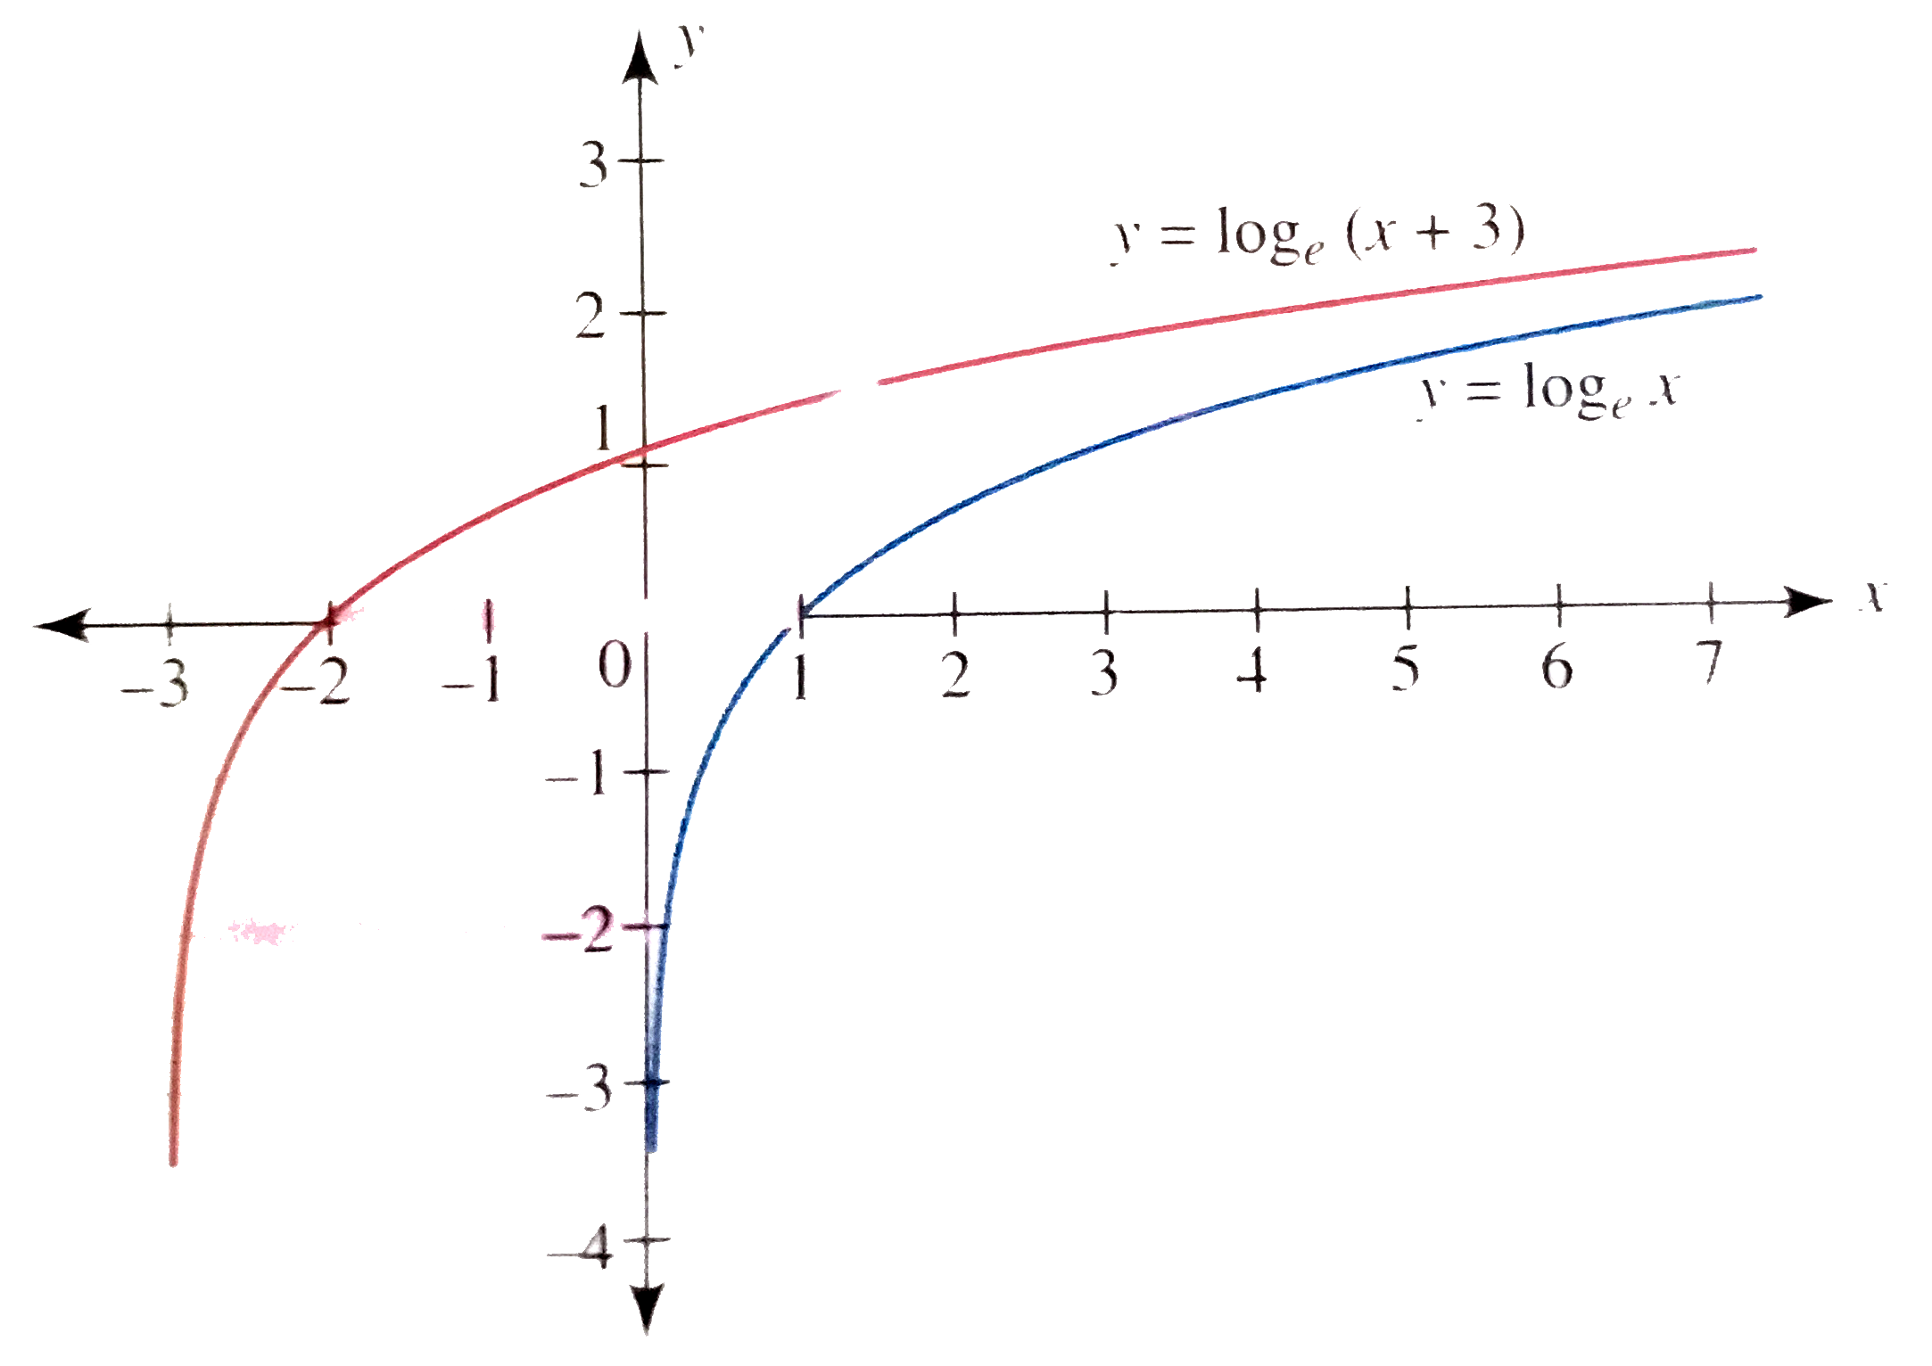
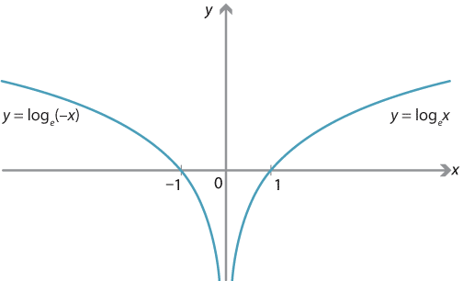
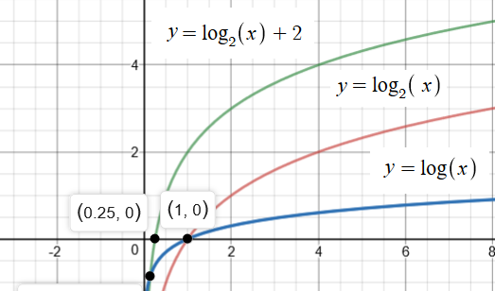
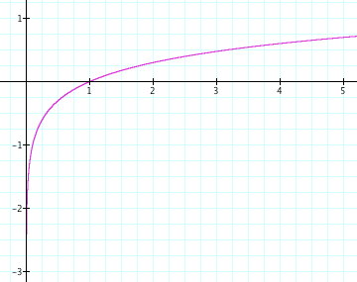
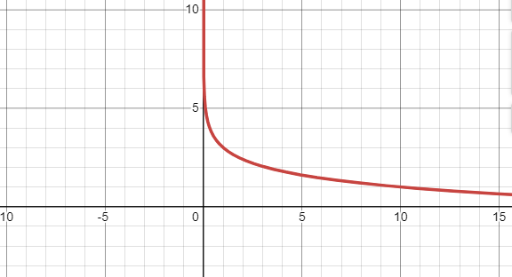
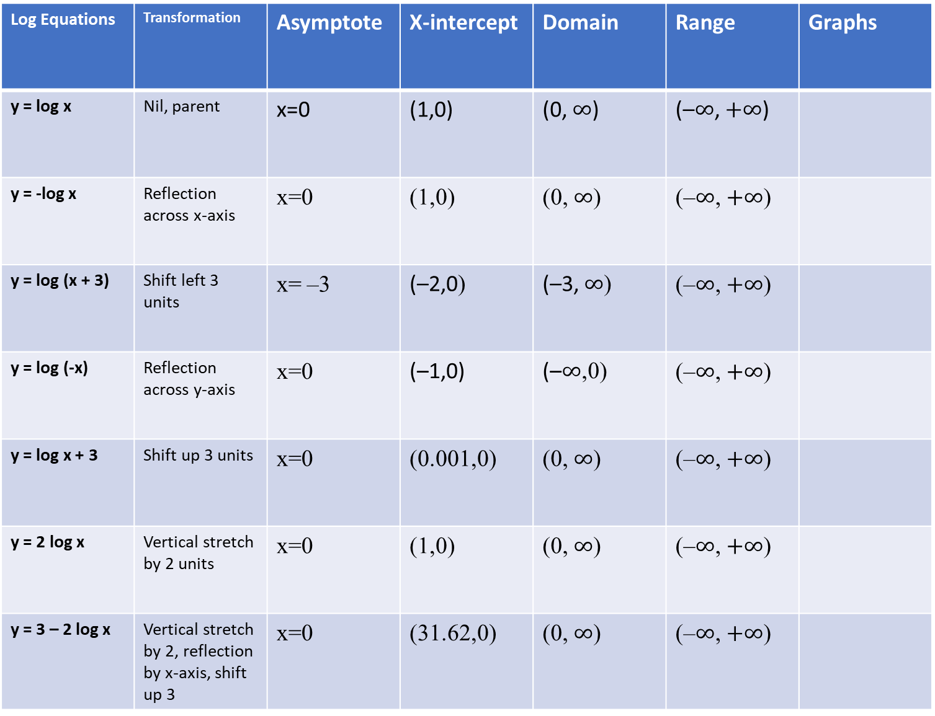
Log Equations | Transformation | Asymptote | X-intercept | Domain | Range | Graphs
y = log x | Nil, parent | x=0 | (1,0) | (0, $∞$) | (–$∞$, $+∞$)
y = -log x | Reflection across x-axis | x=0 | (1,0) | (0, $∞$) | (–$∞$, $+∞$)
y = log (x + 3) | Shift left 3 units | x= –3 | (–2,0) | (–3, $∞$) | (–$∞$, $+∞$)
y = log (-x) | Reflection across y-axis | x=0 | (–1,0) | (–$∞$,0) | (–$∞$, $+∞$)
y = log x + 3 | Shift up 3 units | x=0 | (0.001,0) | (0, $∞$) | (–$∞$, $+∞$)
y = 2 log x | Vertical stretch by 2 units | x=0 | (1,0) | (0, $∞$) | (–$∞$, $+∞$)
y = 3 – 2 log x | Vertical stretch by 2, reflection by x-axis, shift up 3 | x=0 | (31.62,0) | (0, $∞$) | (–$∞$, $+∞$)

