Slide 1
Chapter 5 Revision
https://www.transum.org/Software/SW/Starter_of_the_day/starter_April20.ASP
https://create.kahoot.it/details/90c1dfaa-a467-4032-9b68-31a537aa05cd
https://create.kahoot.it/details/729869f7-ce64-45fe-a93f-1b7251a6f789
https://create.kahoot.it/details/00af65e5-2629-49b2-a08e-228a95bd8e91
https://create.kahoot.it/details/082f61cb-bdff-4d42-a316-f982f506f9a3
https://teacher.desmos.com/activitybuilder/custom/6062d6020bd0ae4e278d1efa
https://teacher.desmos.com/activitybuilder/custom/5e7551522cfdb40bc427ffab?collections=5e7583112425277414fdc1b1

Slide 2
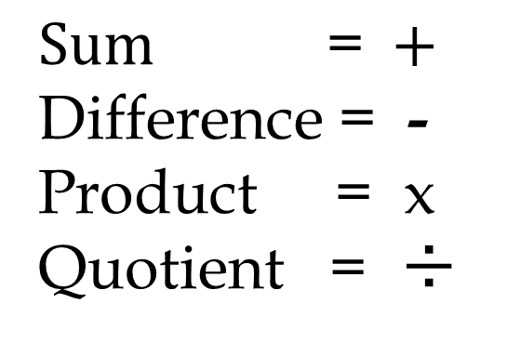
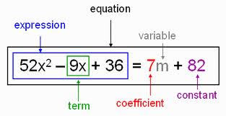
A quick reminder that …

Slide 3
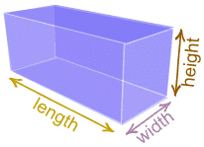
Substitution values in a formula
Volume is the amount of space a shape takes up. The volume formula of the rectangular
prism is below.
or
5ft
V=
V=
Find the volume
9ft
4ft
9
4
5
Steps:
1. Copy the formula.
V=
2. Substitute the value in for the variable.
V=
3. Evaluate using the order of operations.
V=
Notes:
(Time on this slide - 3 min) Time passed 30 min
In-Class Notes
In class practice.
Can be done individually or with a partner.
Encourage students to follow the steps to evaluate the expression.
Give students about 5 minutes to complete.
Depending on the level of your students, an explanation of more than one variable next to each other means to multiply.
Advance the slide to show the process in obtaining the answer.
Students may need reassurance that formulas can be evaluated as well following the steps/process.
Preparation Notes
The practice is designed for students to work individually or with a partner. There are two problems provided. These are optional problems depending on the level of your students. A group work assignment is provided for students after these problems.
If these slides are chosen to be used, reassure the students that formulas are expressions that are evaluated. If they have not been exposed to these formulas yet, explain that in their upcoming units, a complete understanding of the formulas will take place. Otherwise, make the connection that they have seen these formulas before. An explanation of more than one variable next to each other means to multiply. Point out the dimensions of the prism leading the students to decided which number takes the place of which variable.
These types of problems were chosen because the standards reference formulas. Give students about 5 minutes to work on the problems. Depending on the level of your students, an explanation of more than one variable next to each other means to multiply. Advancing the slide will show the process to obtaining the answer.

Slide 4
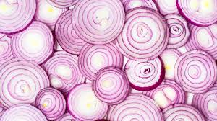
Onion skin peeling method to solve Two Steps Equations

Slide 5

Solving a 2 Step Equation Using Onion Skins
Solve the Equation : 2h + 3 = 11
Draw the first skin around "h", and then draw more skins radiating outwards, until the whole algebra equation is circled by the final outer skin.
2 h + 3 =11
To solve the Equation work from the biggest outer skin, inwards through the smaller skins, applying opposites, until we reach the letter variable.
h = 4

Slide 6


The Problem
Pete and Bryan are cousins. Bryan is three times older than Pete. If the sum of the age of the cousins is 36, how old are Pete and Bryan?
3x + x = 36
Bryan = 3 x
Pete = x

Slide 7
Writing Algebraic Expressions
You can translate word phrases into variable expressions.
  Examples:
  Three more than a number = x + 3
  The quotient of a number and 8 = y/8
  Six times a number = 6 x n or 6n
  15 less than a number = z – 15
  The quotient of 30 and a number plus 10 = 30/x + 10.

Slide 8
Key words to look for:
Addition:
  Add
  Plus
  Sum
  Total
  Increased by
  More than
Subtraction:
  Minus
  Difference
  Subtract
  Less than
  Decreased by
  less

Slide 9
Cont…
Multiplication
  Product
  Times
  multiply
Division
  Quotient
  divide

Slide 10
Write an algebraic phrase for these situations
A car was traveling 35 miles per hour for a number of hours.
Bob ran 7 times a week for a number of weeks.
The plumber added an extra $35 to her bill.
Thirty-five fewer people came than the number expected.

Slide 11
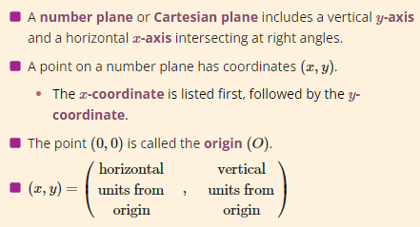
23 May 2023
Plotting Linear Graphs:
Table of Values

Slide 12
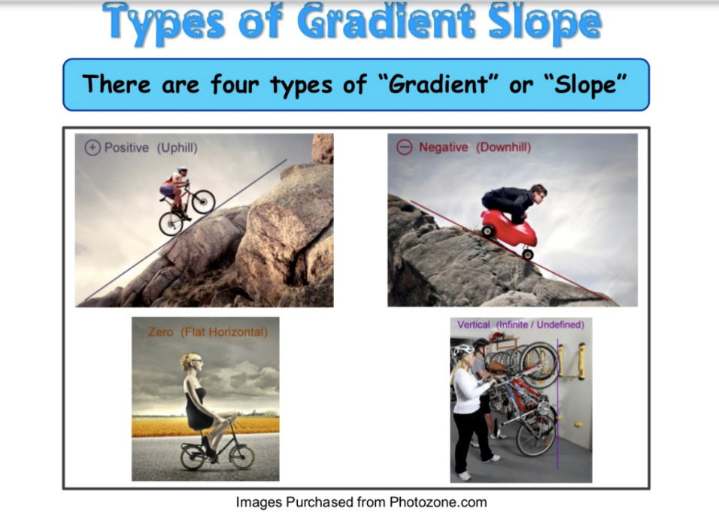


Slide 13
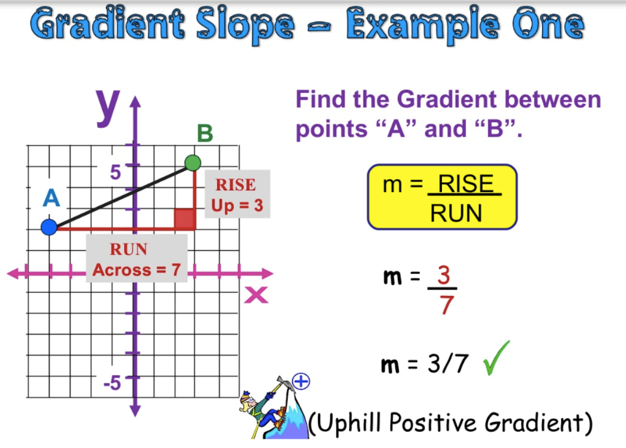

Slide 14
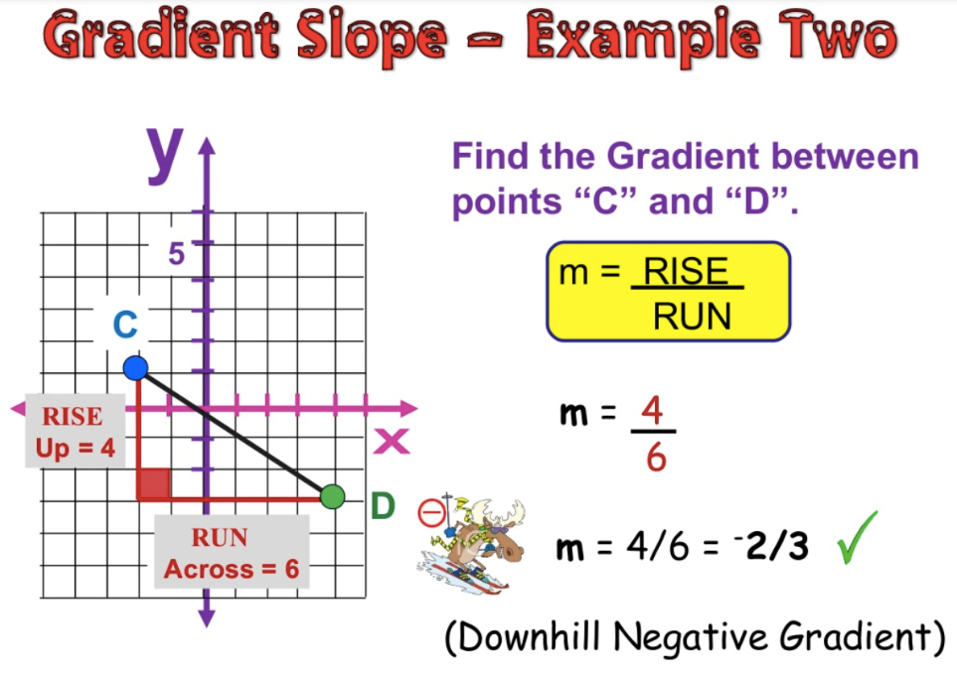

Slide 15
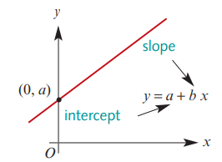
General Equation of a Straight Line…
c +
y = c + mx
y = c + mx
m
The ‘c’ represents the y-intercept of the line:
(where the line crosses the y-axis).
The ‘m’ represents the gradient/slope of the line:
m = $\frac{y_{2}−y_{1}}{x_{2}−x_{1}}$
Keywords: The intercept slope form Equation → y = c+mx

Slide 16
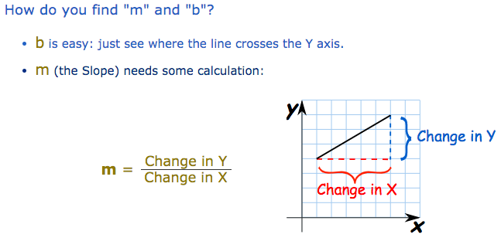
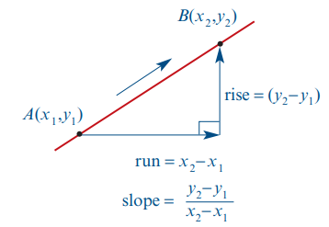
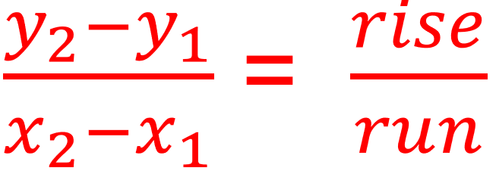

Slide 17
Find the gradient & $y$-intercept for each equation of a line.
Gradient b
$y$-intercept a
$$y=2x+3$$
$$+2$$
$$+3$$
$$y=3x−6$$
$$+3$$
$$−6$$
$$y=5−2x$$
$$−2$$
$$+5$$
$$2y−4=−x$$
$$−0.5$$
$$+2$$

Slide 18
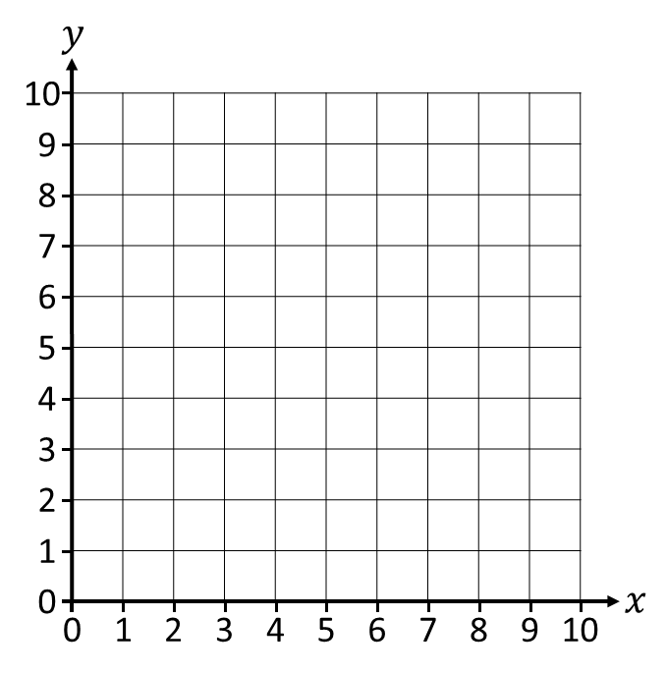
Plotting graphs using the gradient & $y$-intercept.
Plot the graph of
$y=2x+1$
1) Mark the $y$-intercept.
2) Use the gradient to find the
‘next’ coordinate.
“For every 1 across, 2 up.”
3) Plot the line & check!

Slide 19
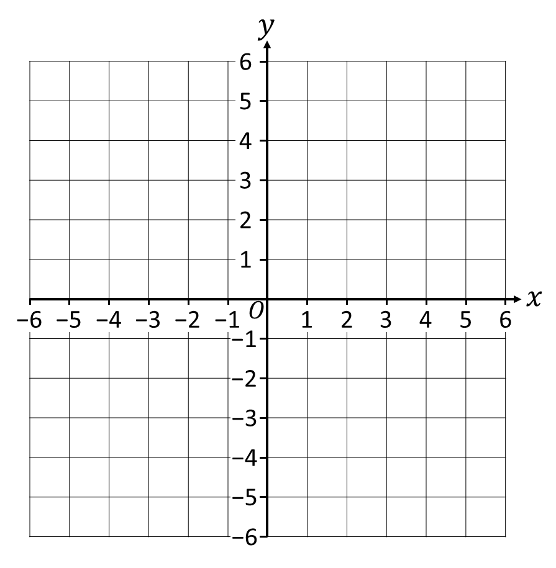
Plotting graphs using the gradient & $y$-intercept.
Plot the graph of
$y=5−2x$
1) Mark the $y$-intercept.
2) Use the gradient to find the
‘next’ integer coordinate.
“For every 1 across, 2 down.”
3) Plot the line & check!

Slide 20
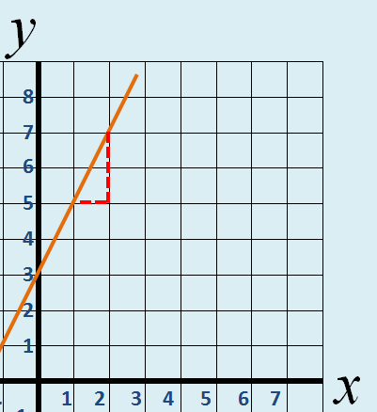


y = c + mx
ALL Using the intercept and slope to find the equation.
MOST Using two points on a graph to find the equation
SOME Finding the equation from two
points using Mathematica
Slope of 2
crosses y-axis
Slope
Increase of 2 up the y-axis
For 1 along the x-axis
Crosses y-axis at 3
y = 3 + 2x

Slide 21
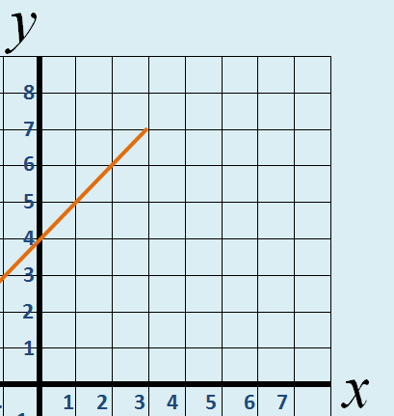

y = c + mx
ALL Using the intercept and slope to find the equation.
MOST Using two points on a graph to find the equation
SOME Finding the equation from two
points using Mathematica
Slope of 1
crosses y-axis
Slope
Increase of 1 up the y-axis
Crosses y-axis at 4
For 1 along the x-axis
y = 4 + x

Slide 22
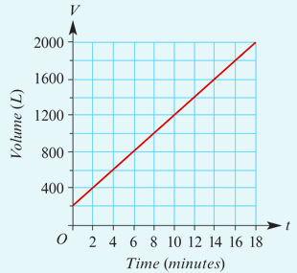
Modelling Real – life
Water is pumped into a partially full tank. The graph gives the volume of water V (in litres) after t minutes.
How much water is in the tank at the start t=0?
Read from the graph (when 𝑡=0 , 𝑉=200 ). 200 L
2. How much water is in the tank after 10 minutes t=10?
Read from the graph (when 𝑡=10 , 𝑉=1200 ). 1200 L
3. The tank holds 2000 L. How long does it take to fill?
Read from the graph (when 𝑉=2000 , 𝑡=18 ). 18 minutes

Slide 23
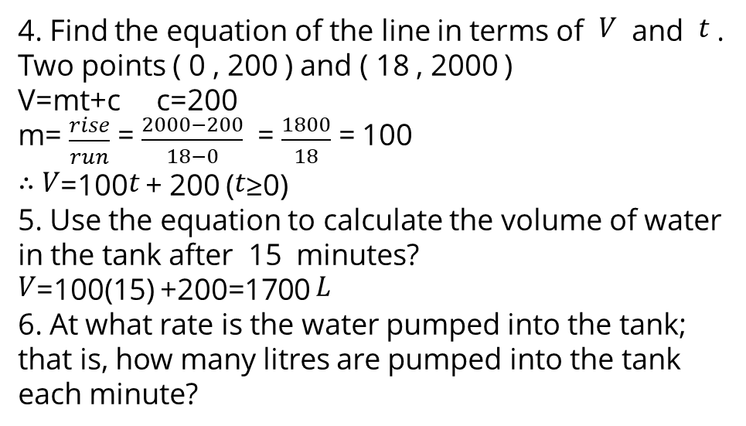
Modelling Real – life
Water is pumped into a partially full tank. The graph gives the volume of water V (in litres) after t minutes.
4. Find the equation of the line in terms of 𝑉 and 𝑡 .
Two points ( 0 , 200 ) and ( 18 , 2000 )
V=mt+c c=200
m= $\frac{rise}{run}$ = $\frac{2000−200}{18−0}$ = $\frac{1800}{18}$ = 100
∴ 𝑉=100𝑡 + 200 (𝑡≥0)
5. Use the equation to calculate the volume of water in the tank after 15 minutes?
𝑉=100(15) +200=1700 𝐿
6. At what rate is the water pumped into the tank; that is, how many litres are pumped into the tank each minute?
The rate = the slope of the graph, 100 L/min

Slide 24
Solve simultaneous Equations
Example 1
Solve the equations
y = x + 1
x + y = 4
by substitution
(1.5, 2.5)
x = 1.5
y = 2 .5

Slide 25
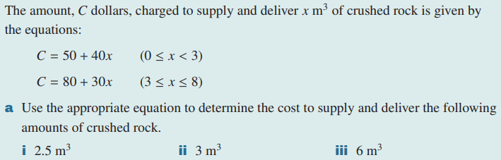
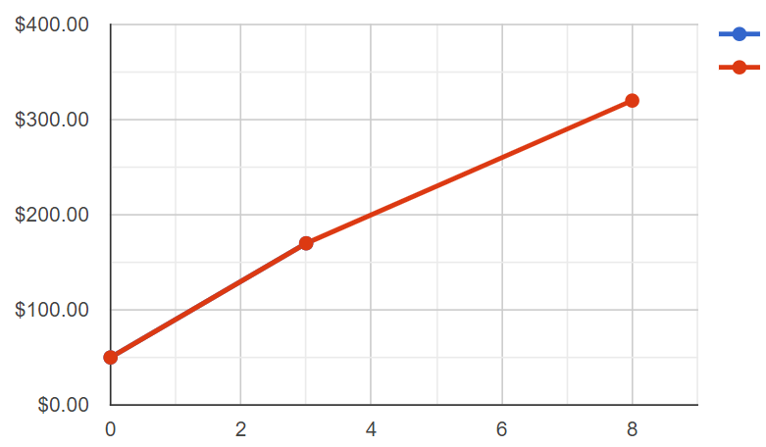
Constructing a piecewise linear graph model
①
②
50+40×2.5=$150 80+30×3=$170 80+30×6=$260
50+40×0=$50 (0,50)
C
C=50+40x
(8,320)
C=80+30x
50+40×2.5=$150 (2.5,150)
80+30×3=$170 (3,170)
(3,170)
80+30×8=$320 (8,320)
(2.5,150)
(0,50)
x

Slide 26
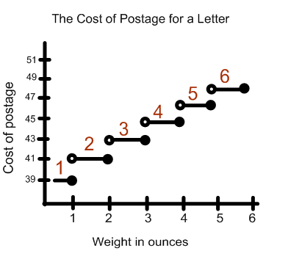
Step graphs
A step graph is a type of piecewise graph that uses line segments where each line segment is horizontal.

