Slide 1
Binary, permutation and communication matrices
10F
Notes:
https://dashboard.blooket.com/set/618966a617762f1c1c272b7d
https://create.kahoot.it/details/76de5c72-45ef-4579-ba10-82e06a4bf912
https://create.kahoot.it/details/86712fd5-d057-47a6-83dc-58f7a6ab5407

Slide 2
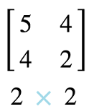
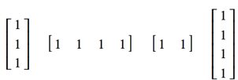
TYPES OF MATRICES
NAME | DESCRIPTION | EXAMPLE
Row matrix | A matrix with only 1 row
Column matrix | A matrix with only I column
Square matrix | the number of rows equals the number of columns
Zero (Null) matrix | A matrix with all zero entries
Summing matrix | A row or column matrix in which all the elements are 1. To sum the rows of an m × n matrix, post-multiply the matrix by an n × 1 summing matrix. To sum the columns of an m × n matrix, pre-multiply the matrix by a 1 × m summing matrix.

Slide 3
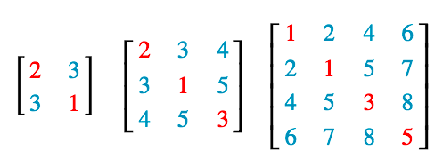
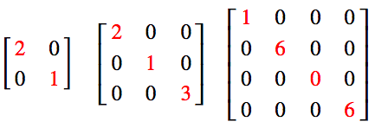
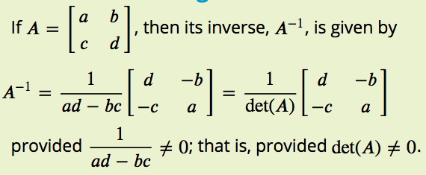
TYPES OF MATRICES
NAME | DESCRIPTION | EXAMPLE
Transpose of a matrix | a new matrix that is formed by interchanging the rows and columns.
Symmetric matrices | A matrix A is called symmetric if A^{T}= A
Diagonal matrices | if all of the elements off the leading diagonal are zero.
Identity matrices | This is denoted by the letter I and has zero entries except for 1’s on the diagonal.
Inverse matrices | A square matrix A has an inverse if there is a matrix $A^{−1}$ such that: A$A^{−1}$ = I

Slide 4
TYPES OF MATRICES
NAME | DESCRIPTION | EXAMPLE
Triangular matrices | 1. An upper triangular matrix: all elements below the leading diagonal are zeros. 2. A lower triangular matrix: all elements above the leading diagonal are zeros.
Binary matrices | A special kind of matrix that has only 1s and zeros as its elements.
Permutation matrices | A square binary matrix in which there is only one ‘1’ in each row and column.

Slide 5
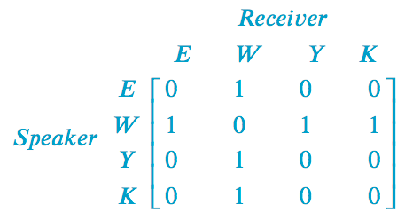
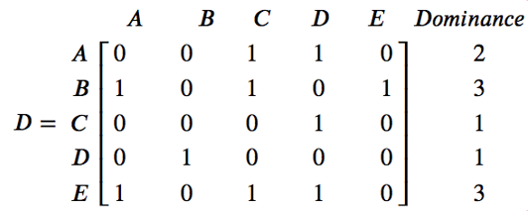
TYPES OF MATRICES
NAME | DESCRIPTION | EXAMPLE
Communication matrices | A square binary matrix in which the 1s represent the links in a communication system. All of the non-zero elements in the leading diagonal of a communication matrix, or its powers, represent redundant links in the matrix.
Dominance matrices | Is a square binary matrix in which 1s represent one-step dominance between members of a group.

Slide 6
Binary matrices
A binary matrix is a special kind of matrix that has only 1s and zeros as its elements. It is used to investigate communication systems and the ranking of players in sporting competition.
The following matrices are examples of binary matrices.

Slide 7
Permutation matrices
A square binary matrix in which there is only one ‘1’ in each row and column.
The following matrices are examples of permutation matrices.
An identity matrix is a special permutation matrix. A permutation matrix can be used to rearrange the elements in another matrix.
The word ‘permutation’ means a rearrangement a group of objects, in this case the elements of a matrix, into a different order.

Slide 8
Applying a permutation matrix
To leave the matrix 𝑋 unchanged, $P^{2}$must be an identity matrix.

Slide 9
Communication matrices
A communication matrix is a square binary matrix in which the 1s represent the links in a communication system.

Slide 10
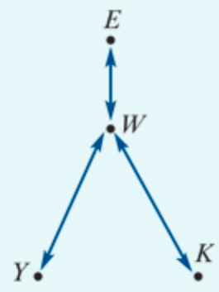
Constructing a communication matrix
Eva, Wong, Yumi and Kim are students who are staying in a backpacker’s hostel. Because they speak different languages, they can have problems communicating. The situation they must deal with is that:
Eva speaks English only
Yumi speaks Japanese only
Kim speaks Korean only
Wong speaks English, Japanese and Korean.
Conveniently, this information can be summarised in a network diagram, as shown above. In this diagram, the arrow linking Eva and Wong indicates that they can communicate directly because they both speak English.
The task is to construct a communication matrix.
Notes:
Designate each element as a ‘1’ or ‘0’ according to the following rules:the element =1 if two people can communicate directly because they speak the same language
the element =0 if two people cannot communicate directly because they do not have a common language.

Slide 11
one-step & two-step communication link
For example, we can see from the network diagram that Eva, who speaks only English, cannot communicate directly with Yumi, who speaks only Japanese. We call this a one-step communication link.
However, Eva can communicate with Yumi by sending a message via Wong, who speaks both English and Japanese. In the language of communication systems we call this a two-step communication link.

Slide 12
one-step & two-step communication link
A one-step communication link is when communication can occur directly between two people in the network.
We can see that W has a one-step communication link with each of the other 3 members of the network, and each of the other three have only a single one-step communication link (with W).
However, Y,K and E can still communicate with each other, by using W as an intermediary. For example:
K can communicate with Y using the links: 𝐾 → 𝑊 → 𝑌. This is called a two-step communication link, because there are two steps (and one intermediary).
Question:
Determine all the two-step communication links in this network?

Slide 13
The power of the matrix → 2-step communication link
The power of the matrix representation is that squaring the communication matrix generates a matrix that identifies all possible two-step communication links in a communication network. For example, if we call the communication matrix 𝐶, we have:

Slide 14
The power of the matrix → 2-step communication link
Multiplying the two 1’s together in the 3rd row and 1st column represents the two step link: Y→ 𝑊 → 𝐸

Slide 15
Redundant communication links
Two-step links that have the same sender and receiver are said to be redundant communication links because they do not contribute to the communication between different people.

Slide 16
Redundant communication links
Consider the element 3 in $C^{2}$ circled:
Each time we multiply 1 by 1 we are representing a 2 step communication link with the communicator and the receiver being the same person:
The first product of 1⋅1 corresponds to: 𝑊 → 𝐸 → 𝑊, which is a redundant communication link.
The product of 0⋅0 corresponds to 𝑊 → 𝑊 → 𝑊, which is not a communication link at all.
The second product of 1⋅1 corresponds to: 𝑊 → 𝑌 → 𝑊, which is a redundant communication link .
The third product of 1⋅1 corresponds to: 𝑊 → K → 𝑊, which is a redundant communication link.

Slide 17
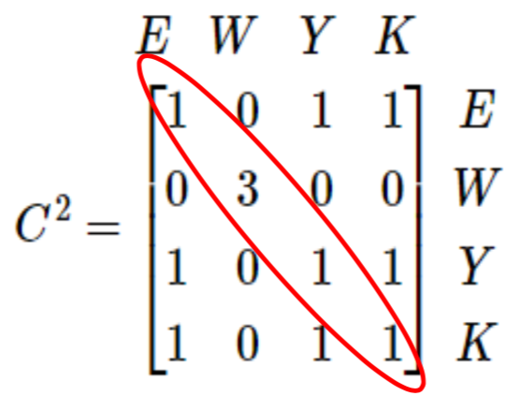
All of the non-zero elements in the leading diagonal of a communication matrix, or its powers, represent redundant links in the matrix.
However, all of the remaining non-zero elements represent meaningful two-step communication links.
For example, the 1 in row Y, column K represents the two-step communication link that enables Yumi to send a message to Kim.

Slide 18
The total number of one step and two-step communication links
If we want to find the total number of one step and two-step communication links we calculate the matrix:
SUMMARY
𝑻 = 𝑪 + $C^{2}$

Slide 19
Analysing communication matrices
A communication matrix (𝐶) is a square binary matrix in which the 1s are used to identify the direct (one-step) links in the communication system.
The number of two-step links in a communication system can be identified by squaring its communication matrix.
The total number of one and two-step links in a communication system can be found by evaluating the matrix sum 𝑇=𝐶+$C^{2}$.
Note: In all cases, the non-zero diagonal elements of a communication matrix (or its power) represent redundant communication links.

