Slide 1
Dominance matrices
10G

Slide 2
Dominance matrix
Is a square binary matrix in which 1s represent one-step dominance between members of a group. The same approach as communication networks can be used to analyse problems.

Slide 3
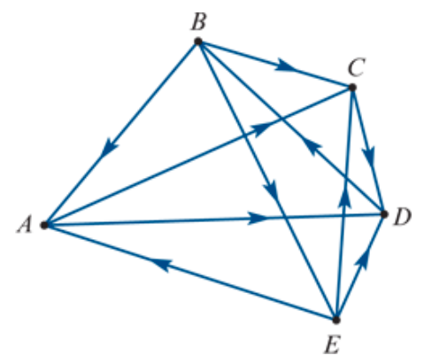
Dominance
For example, five players – Anna, Birgit, Cas, Di and Emma – played in a round-robin tournament of tennis to see who was the dominant (best) player.
The results were as follows:
Anna defeated Cas and Di. (A→C, A→D)
Birgit defeated Anna, Cas and Emma (B→A, B→C, B→E)
Cas defeated Di (C→D)
Di defeated Birgit (D→B)
Emma defeated Anna, Cas and Di (E→A, E→C, E→D).
We can use a network diagram to display the results graphically, as shown above. In this diagram, the arrow from 𝐵 to 𝐴 tells us that, when they played, Birgit defeated Anna.
Both Birgit and Emma had three wins each so there is a tie. How can we resolve this situation and see who is the best player? One way of doing this is to calculate a dominance score for each player. We do this by a constructing a series of dominance matrices.
Notes:
A round-robin tournament is one in which each of the participants play each other once.

Slide 4
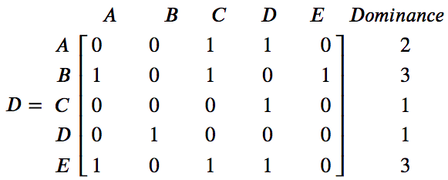
One-step dominances
The first dominance matrix, 𝐷, records the number of one-step dominances between the players.
For example, Anna has a one-step dominance over Cas because, when they played, Anna beat Cas.
This matrix can be used to calculate a one-step dominance score for each player, by summing each of the rows of the matrix. According to this analysis, 𝐵 and 𝐸 are equally dominant with a dominance score of 3.

Slide 5
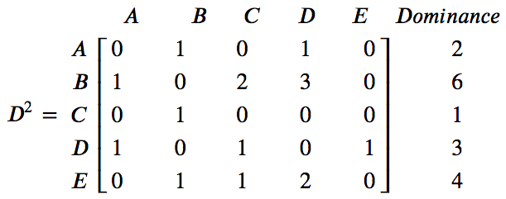
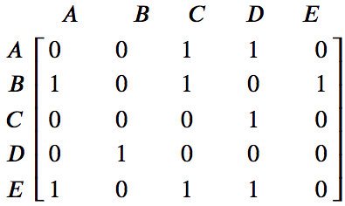
Two-step dominances
$$×$$
$$=$$
$$\begin{matrix}1 \\ 0 \\ \begin{aligned}1 \\ 0 \\ 1\end{aligned}\end{matrix}$$
$$\begin{matrix}[1 & 0 & 1 0 1]\end{matrix}$$
$$×$$
$=$ 1$×1 +0×0 +1×1 +0×0 +1×1 =3$
A two-step dominance occurs when a player beats another player who has beaten someone else. For example, Birgit has a two-step dominance over Di because Birgit defeated Cas who defeated Di.
The first product of 1×1 corresponds to: B → A → D.
The third product of 1×1 corresponds to: B → C → D.
The fifth product of 1×1 corresponds to: B → E → D.

Slide 6
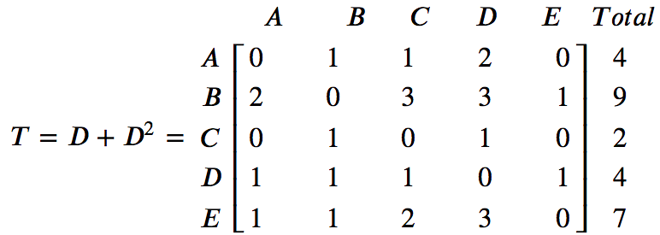
Total dominance scores
We can combine the information contained in both 𝐷 and $D^{2}$ by calculating a new matrix 𝑇=𝐷+ $D^{2}$.
Using these total dominance scores:
Birgit is the top-ranked player with a total dominance score of 9
Eva is second with a total score of 7
Anne and Di are equal third with a total score of 4
Cas is the bottom-ranked player with a total score of 2.

Slide 7
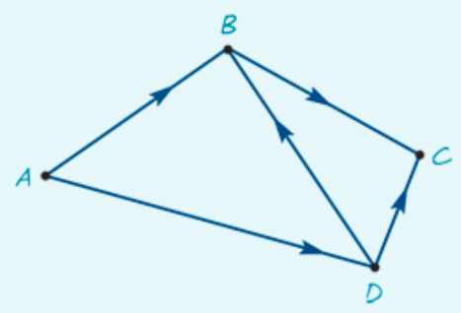
Determining dominance
Four people, 𝐴,𝐵,𝐶 and 𝐷, have been asked to form a committee to decide on the location of a new toxic waste dump.
From previous experience, it is known that:
𝐴 influences the decisions of 𝐵 and 𝐷
𝐵 influences the decisions of 𝐶
𝐶 influences the decisions of no one
𝐷 influences the decisions of 𝐶 and 𝐵.
1. Use the graph to construct a dominance matrix that takes into account both one-step and two-step dominances.
2. From this matrix, determine who is the most influential person on the committee.

Slide 8
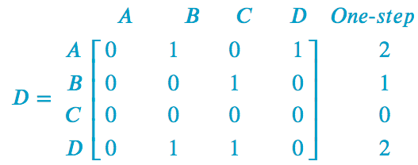
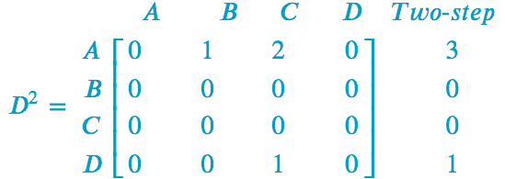
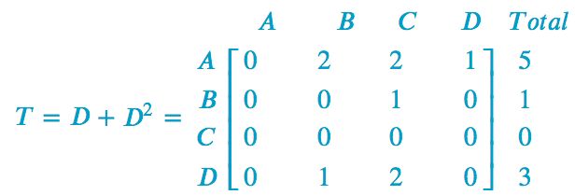
Determining dominance
1. Use the graph to construct a dominance matrix that takes into account both one-step and two-step dominances.
2. From this matrix, determine who is the most influential person on the committee.
Person 𝐴 is the most influential person with a total dominance score of 5.

