Slide 1
Exponential
and
Logarithmic Graphs
Notes:
https://create.kahoot.it/details/5ab380f2-38c2-4796-964e-79abe3256d96
https://create.kahoot.it/details/3d57aa83-efed-473e-ae62-a609e3c0747d
https://create.kahoot.it/details/0a78a796-9c67-40d3-89d7-5410693c4d3c
https://create.kahoot.it/details/7147381e-3468-4760-8448-945c41ccb250
https://create.kahoot.it/details/d2faaa57-6b1f-4cc6-b470-d05fdc4b214a
https://create.kahoot.it/details/f5ca2d2d-a7e3-4016-8dd0-9f16222658e0
https://create.kahoot.it/details/f2b9408f-4cc2-4724-b0f8-613b9a7eb416
https://create.kahoot.it/details/b9c7e057-1dc9-4c5e-9ae5-2cd049dbecd6

Slide 2
Defs: domain and range
Domain: The set of x components of an equation.
Range: The set of y components of an equation.

Slide 3
Graph of Exponential Function (a > 1)
The graph of y = b^{x}, b > 1
y
4
Range: (0, ∞)
(0, 1)
x
4
Horizontal Asymptote y = 0
Domain: (–∞, ∞)

Slide 4
Graphs of Exponential Functions
The figure shows the graphs of the family
of exponential functions f(x) = a^{x} for various values of the base a.
  All these graphs
  pass through
  the point (0, 1)
  because
  a⁰ = 1 for a ≠ 0.

Slide 5
Growth and Decay
Growth: if b > 1
Decay: if 0 < b < 1

Slide 6
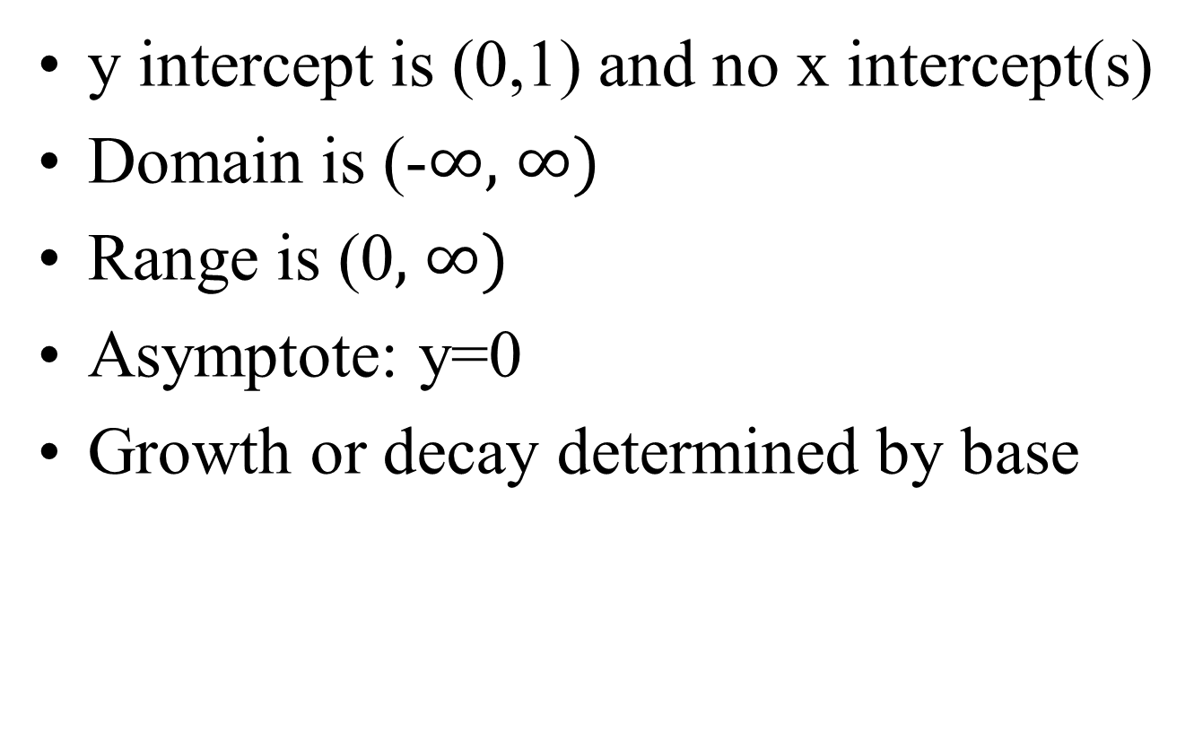
Properties of graphs of exponential functions
y intercept is (0,1) and no x intercept(s)
Domain is (-$∞,$ $∞)$
Range is (0$,$ $∞)$
Asymptote: y=0
Growth or decay determined by base

Slide 7







Asymptote: y=k

Slide 8
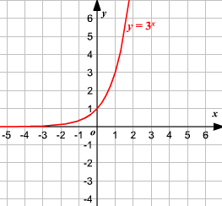
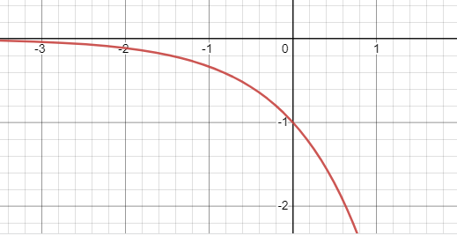
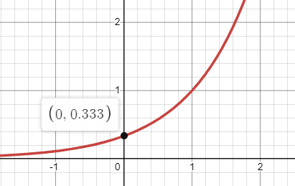
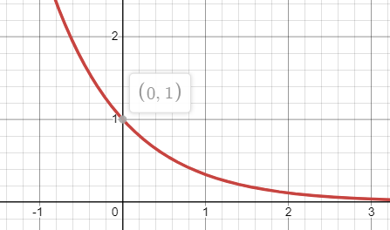
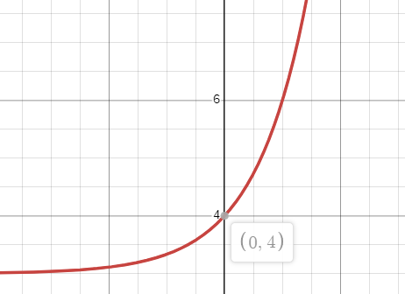
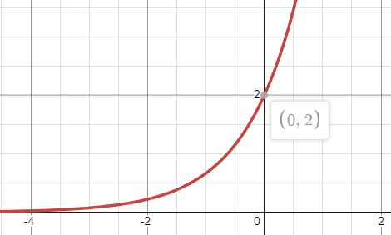
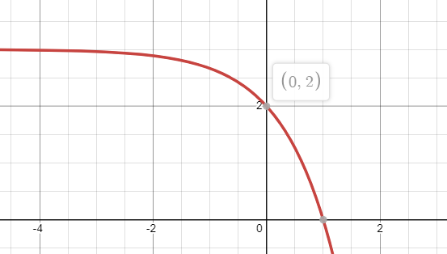
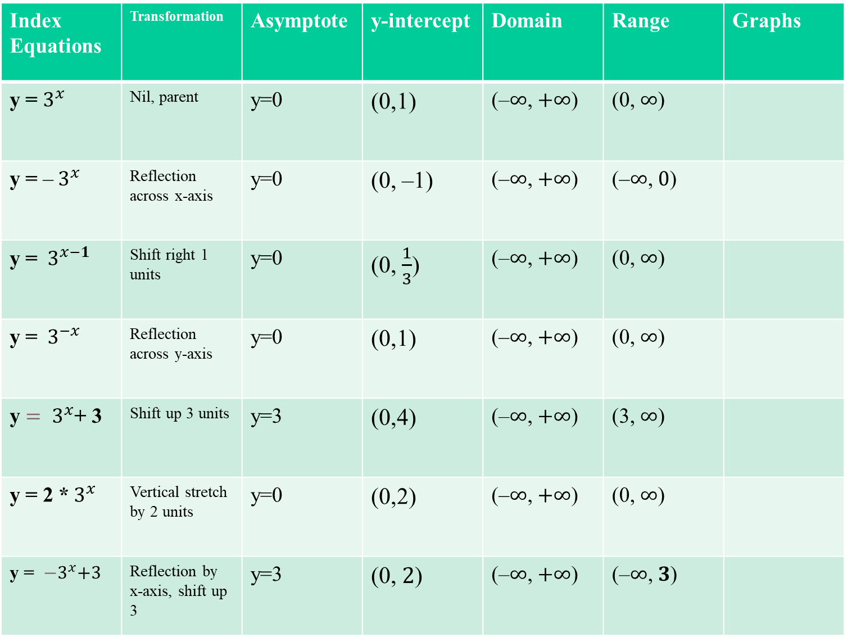
Index Equations | Transformation | Asymptote | y-intercept | Domain | Range | Graphs
y = $3^{x}$ | Nil, parent | y=0 | (0,1) | (–$∞$, $+∞$) | (0, $∞$)
y = –${ 3}^{x}$ | Reflection across x-axis | y=0 | (0, –1) | (–$∞$, $+∞$) | (–$∞$, $0$)
y = ${ 3}^{x−1}$ | Shift right 1 units | y=0 | (0, $\frac{1}{3}$) | (–$∞$, $+∞$) | (0, $∞$)
y = ${ 3}^{−x}$ | Reflection across y-axis | y=0 | (0,1) | (–$∞$, $+∞$) | (0, $∞$)
y ${= 3}^{x}$+ 3 | Shift up 3 units | y=3 | (0,4) | (–$∞$, $+∞$) | (3, $∞$)
y = 2 *${ 3}^{x}$ | Vertical stretch by 2 units | y=0 | (0,2) | (–$∞$, $+∞$) | (0, $∞$)
y = ${ −3}^{x}+3$ | Reflection by x-axis, shift up 3 | y=3 | (0, $2$) | (–$∞$, $+∞$) | (–$∞$, $3$)

Slide 9
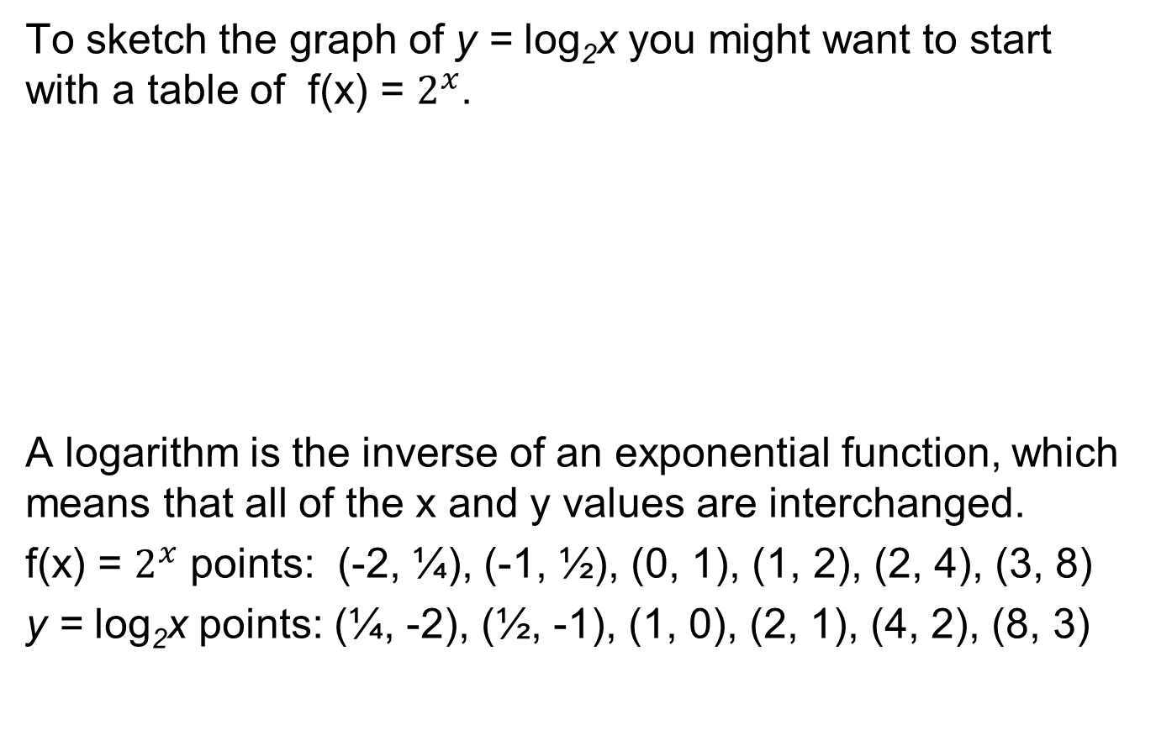
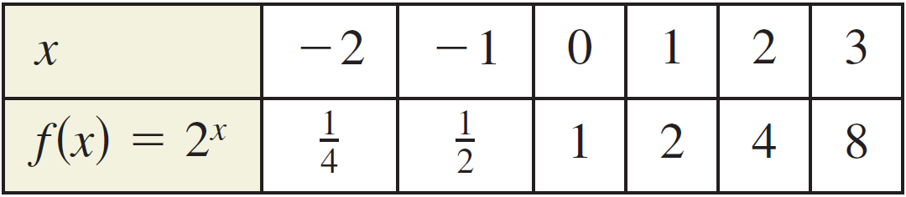
Graphs of Logarithmic Function

Slide 10
Example 4 – Graph of Exponential and Logarithmic Function
In the same coordinate plane, sketch the graph of each function by hand.
a. f (x) = 2^{x}
b. g (x) = log₂x
Solution:
Use the points from the previous
slide to plot points and connect
graph with a smooth curve.

Slide 11
Inverse of a function
The inverse of a function is determined by interchanging the domain and the range of the original function.
Designated by
and read f inverse

Slide 12
Inverse of a function

Slide 13
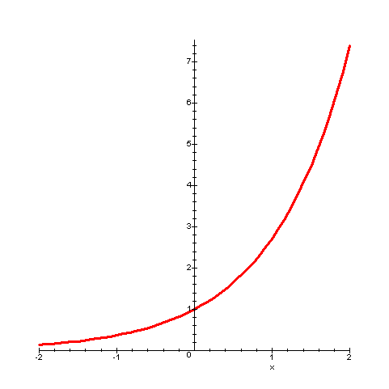
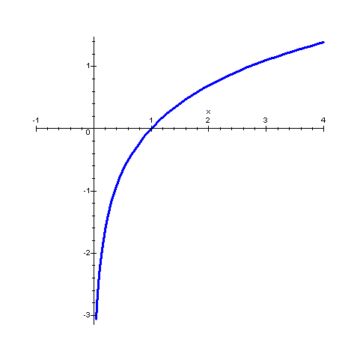
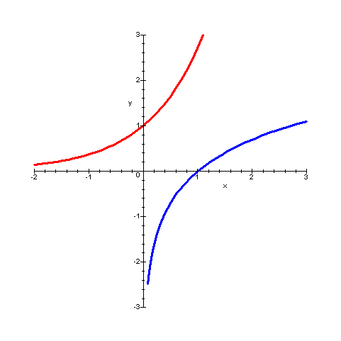
Exponential Graph
Logarithmic Graph
Graphs of inverse functions are reflected about the line y = x

Slide 14
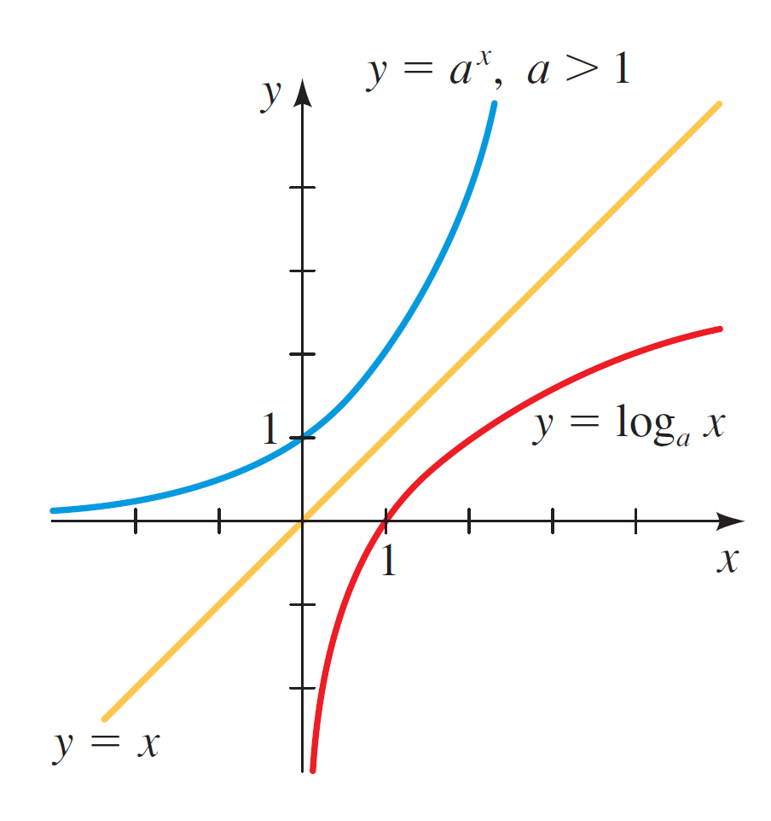

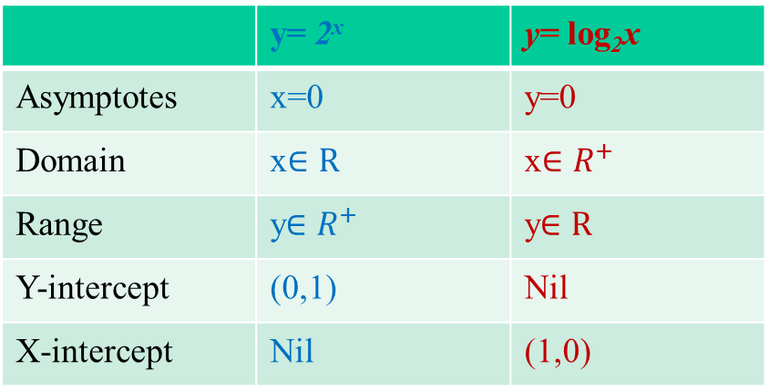
Graphs of Logarithmic Functions
The graph of f ^{–1}(x) = log_{a}x is obtained
by reflecting the graph of f(x) = a^{x} in
the line y = x.
  The figure shows
  the case a > 1.
 | y= 2^{x} | y= log₂x
Asymptotes | x=0 | y=0
Domain | x$∈R$ | x$∈R^{+}$
Range | y$∈R^{+}$ | y$∈R$
Y-intercept | (0,1) | Nil
X-intercept | Nil | (1,0)

Slide 15
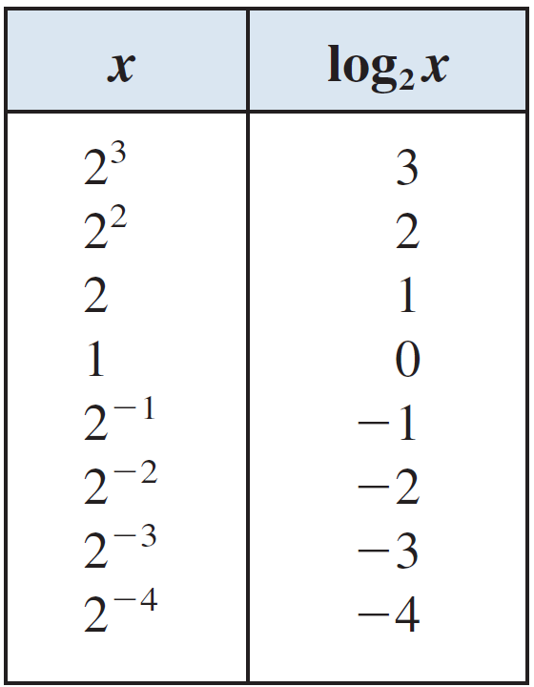
E.g. 4—Graphing a Logarithmic Function by Plotting Points
Sketch the graph of
f(x) = log₂x
  To make a table of values,
  we choose the x-values to be
  powers of 2 so that we can
  easily find their logarithms.

Slide 16
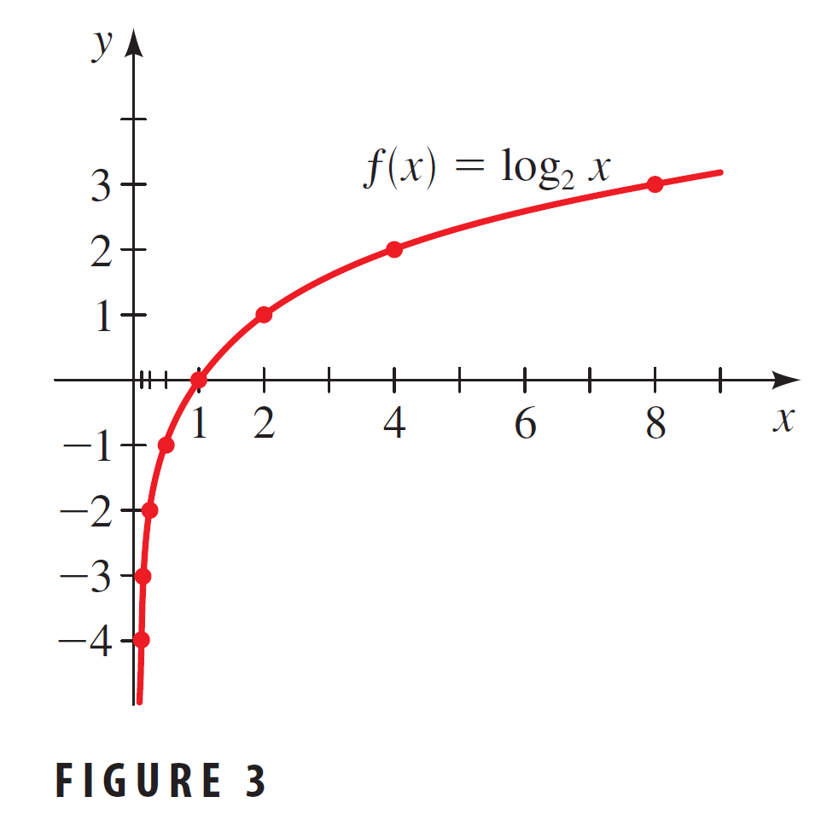
E.g. 4—Graphing a Logarithmic Function by Plotting Points
We plot these points and connect them with a smooth curve.

Slide 17
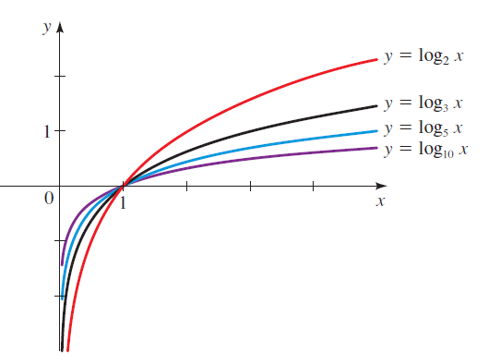
Graphs of Logarithmic Functions
The figure shows the graphs of the family of logarithmic functions with bases 2, 3, 5, and 10.

Slide 18
E.g.—Reflecting Graphs of Logarithmic Functions
Sketch the graph of each function.
(a) g(x) = –log₂x
(b) h(x) = log₂(–x)

Slide 19
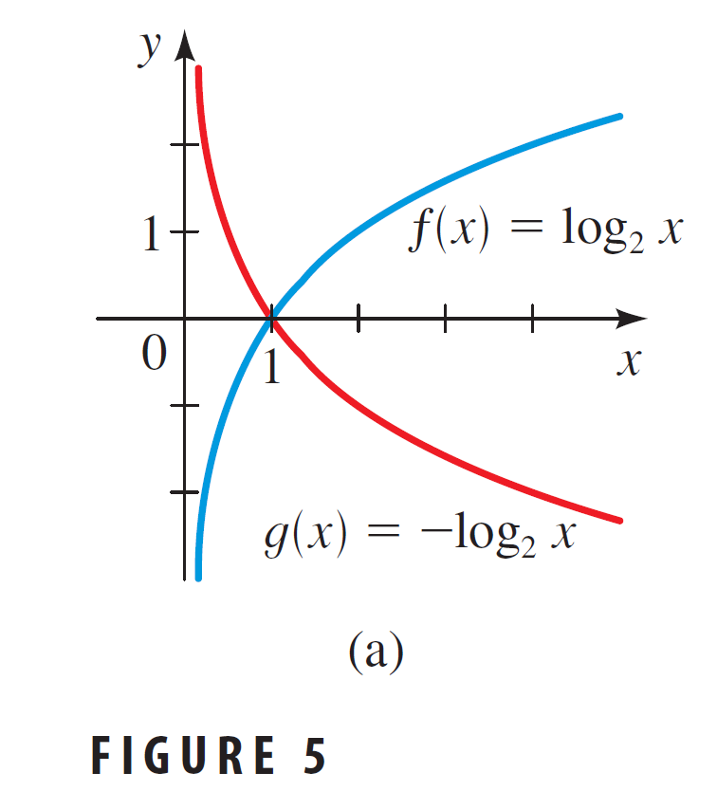
E.g.—Reflecting Graphs
Example
To get the graph of g(x) = –log₂x, we:
  Start with the graph
  of f(x) = log₂x.
  Reflect in the x-axis.

Slide 20
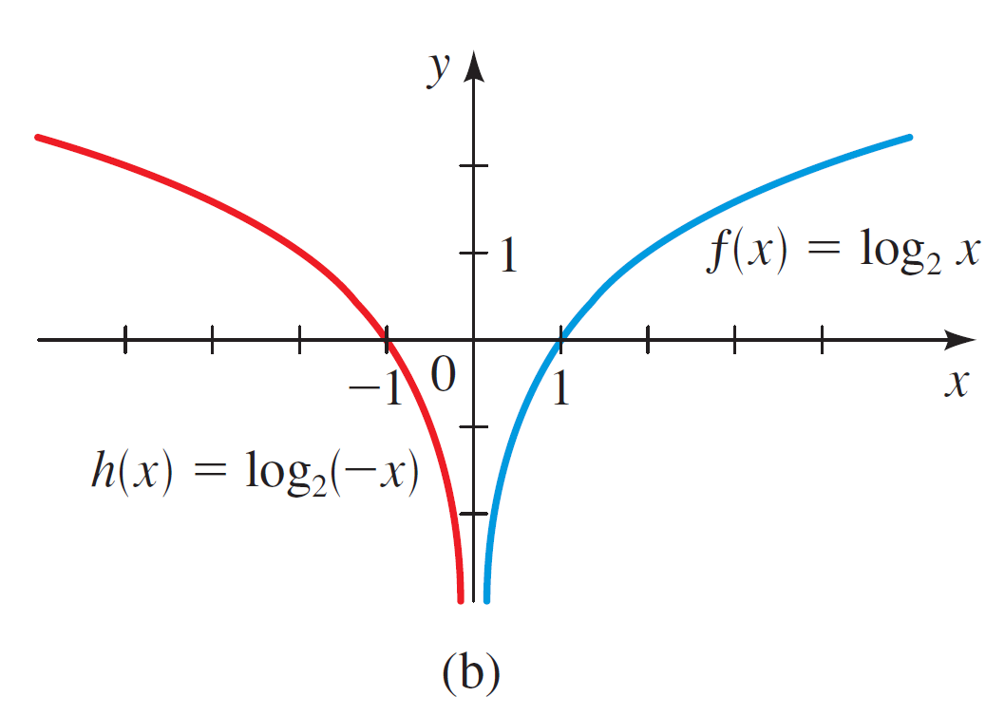

E.g.—Reflecting Graphs
Example
To get the graph of h(x) = log₂(–x), we:
  Start with
  the graph of
  f(x) = log₂x.
  Reflect in
  the y-axis.

Slide 21
E.g.—Shifting Graphs of Logarithmic Functions
Find the domain of each function,
and sketch the graph.
(a) g(x) = 2 + log₅x
(b) h(x) = log₁₀(x – 3)

Slide 22
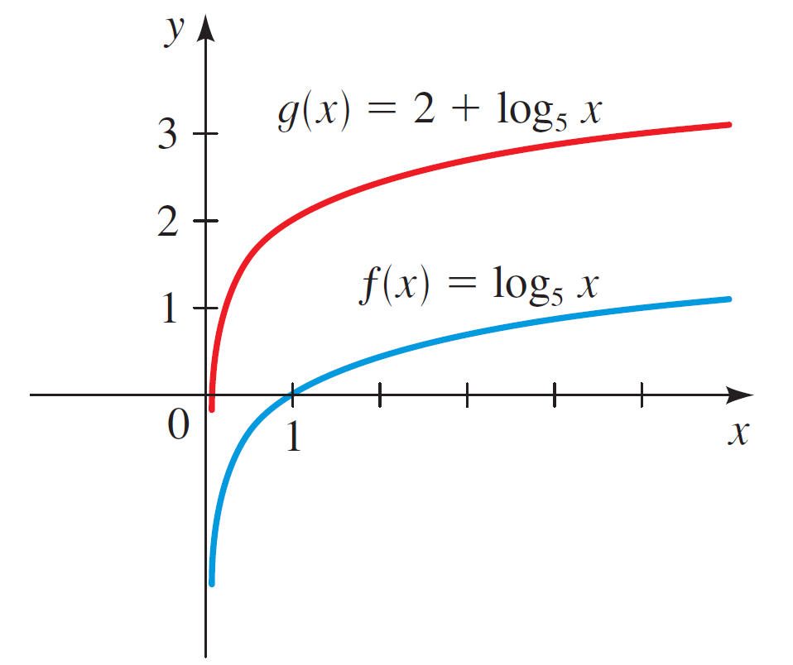

E.g.—Shifting Graphs
Example
The graph of g is obtained from the graph
of f(x) = log₅x (Figure 4) by shifting upward
2 units (Figure 6).
  The domain of f is (0, ∞).

Slide 23
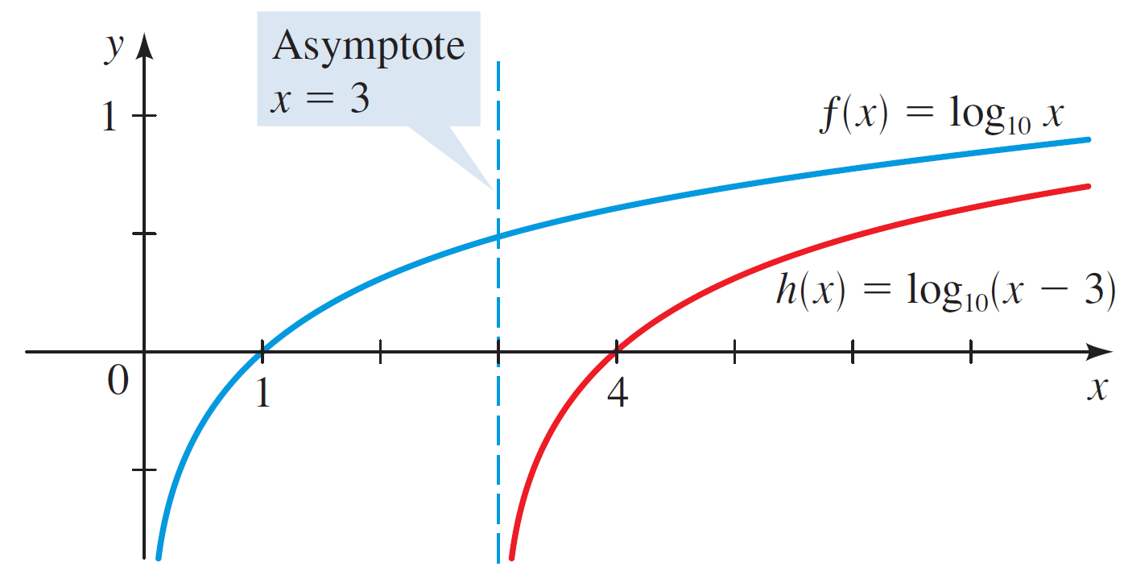

E.g.—Shifting Graphs
Example
The graph of h is obtained from the graph
of f(x) = log₁₀x (Figure 4) by shifting to
the right 3 units (Figure 7).
  The line x = 3 is a vertical asymptote.

Slide 24
E.g.—Shifting Graphs
Example
log₁₀x is defined only when x > 0.
  Thus, the domain of h(x) = log₁₀(x – 3)
  is:
  (3, ∞)

Slide 25
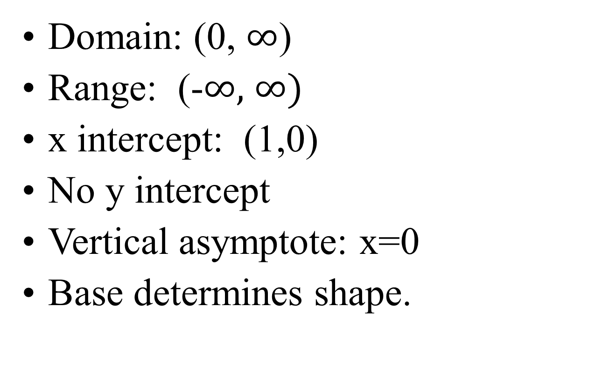
Properties of Logarithmic Function
Domain: (0, $∞$)
Range: (-$∞,$ $∞)$
x intercept: (1,0)
No y intercept
Vertical asymptote: x=0
Base determines shape.

Slide 26
Shape of logarithmic graphs
For b > 1, the graph rises from left to right.
For 0 < b < 1, the graphs falls from left to right.

Slide 27


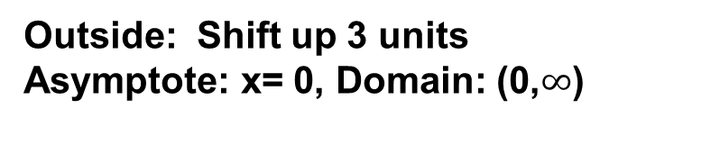


Logarithmic Transformations
Compared to y = log x, describe the graphic relationship between its graph and the following graphs:
y = -log x
y = log (x + 3)
y = log (-x)
y = log x + 3
y = 2 log x
y = 3 – 2 log x
Outside: Reflection across x-axis
Asymptote: x= 0, Domain: (0,$∞$)
Inside: Shift left 3 units
Asymptote: x= –3, Domain: (–3,$∞$)
Inside: Reflection across y-axis
Asymptote: x= 0, Domain: (0,$∞$)
Outside: Shift up 3 units
Asymptote: x= 0, Domain: (0,$∞$)
Outside: Vertical stretch by 2
Asymptote: x= 0, Domain: (0,$∞$)
Outside: Vertical stretch by 2; reflected across x-axis and shifted up by 3

Slide 28
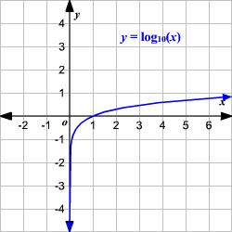
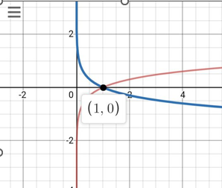
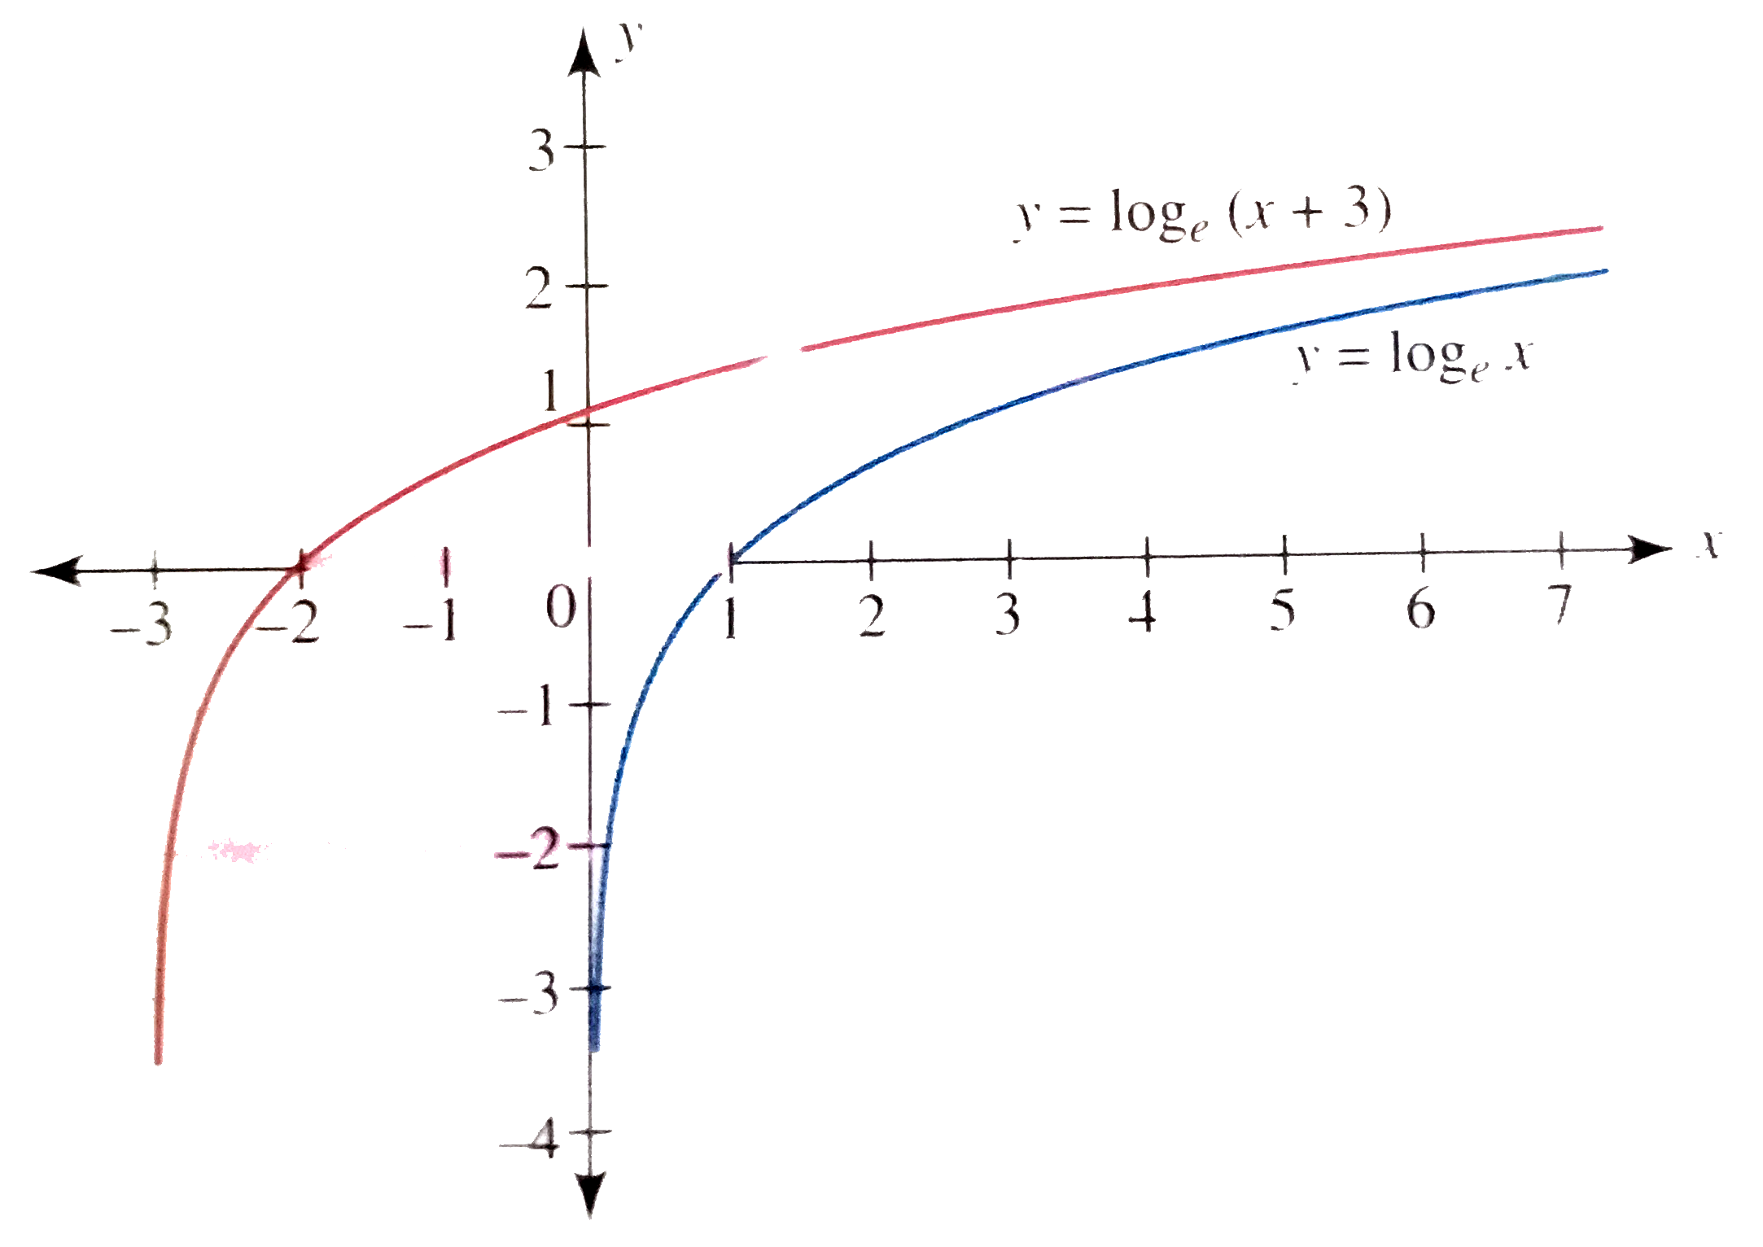
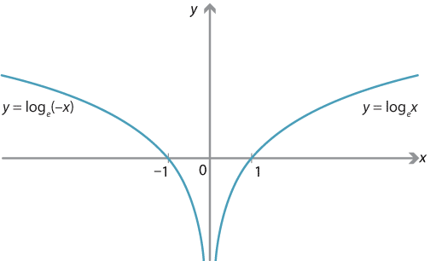
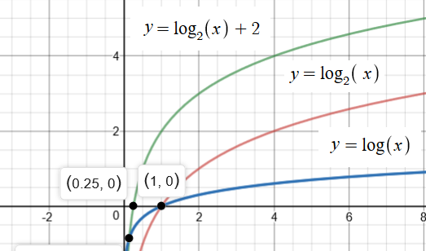
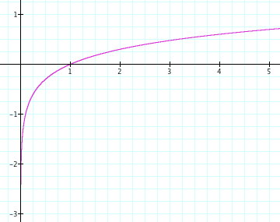
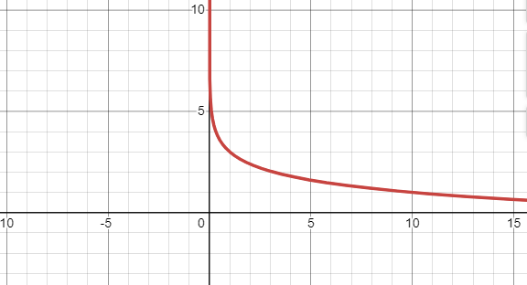
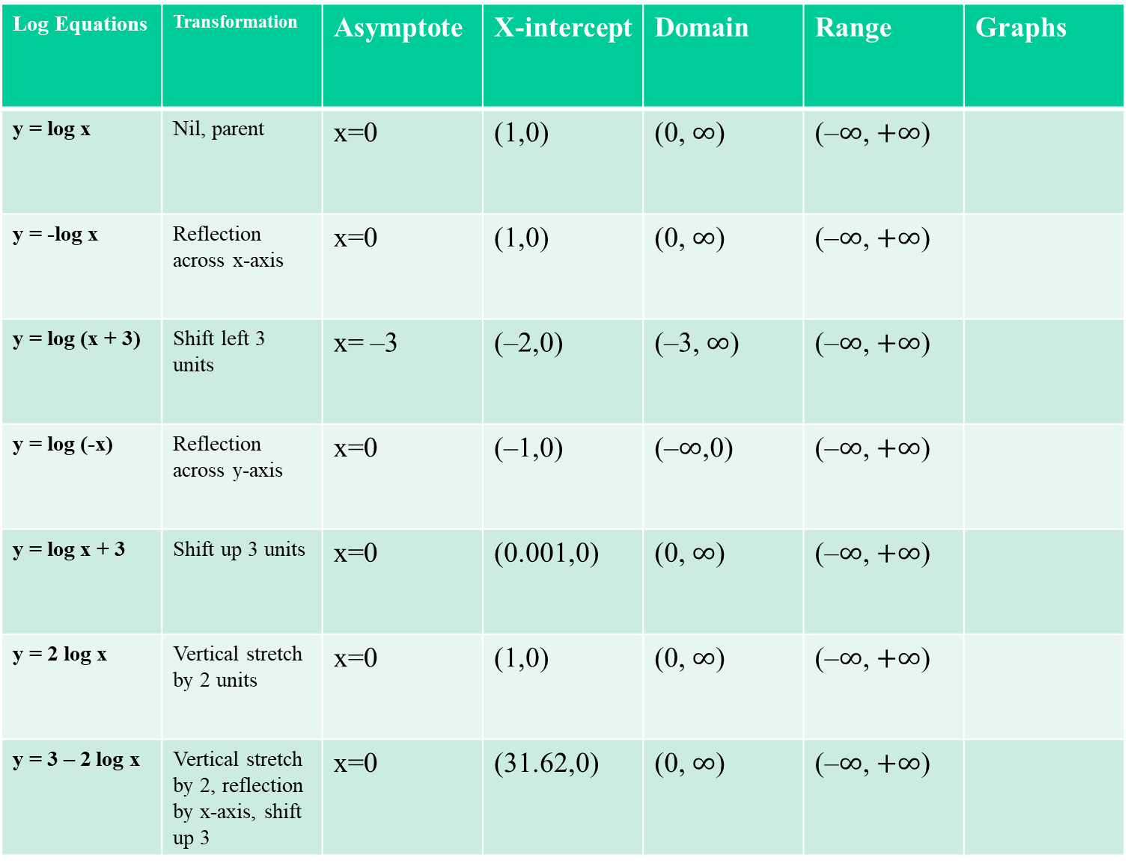
Log Equations | Transformation | Asymptote | X-intercept | Domain | Range | Graphs
y = log x | Nil, parent | x=0 | (1,0) | (0, $∞$) | (–$∞$, $+∞$)
y = -log x | Reflection across x-axis | x=0 | (1,0) | (0, $∞$) | (–$∞$, $+∞$)
y = log (x + 3) | Shift left 3 units | x= –3 | (–2,0) | (–3, $∞$) | (–$∞$, $+∞$)
y = log (-x) | Reflection across y-axis | x=0 | (–1,0) | (–$∞$,0) | (–$∞$, $+∞$)
y = log x + 3 | Shift up 3 units | x=0 | (0.001,0) | (0, $∞$) | (–$∞$, $+∞$)
y = 2 log x | Vertical stretch by 2 units | x=0 | (1,0) | (0, $∞$) | (–$∞$, $+∞$)
y = 3 – 2 log x | Vertical stretch by 2, reflection by x-axis, shift up 3 | x=0 | (31.62,0) | (0, $∞$) | (–$∞$, $+∞$)

Slide 29
Steps for Finding the Inverse of a One-to-One Function
y = f ⁻¹(x)
Solve for y
Trade x and y places
Replace f(x) with y

Slide 30
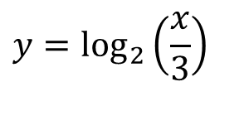



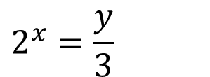
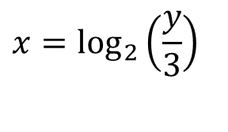
$$f\left(x\right)=\log_{2}\left(\frac{x}{3}\right)$$
Find the inverse of
$$f^{−1}\left(x\right)=3∗2^{x}$$
y = f ⁻¹(x)
Solve for y
$$2^{x}=\frac{y}{3}$$
$$y=3∗2^{x}$$
Trade x and y places
$$x=\log_{2}\left(\frac{y}{3}\right)$$
Replace f(x) with y
Ensure f(x) is one to one first. Domain may need to be restricted.
$$y=\log_{2}\left(\frac{x}{3}\right)$$

