Slide 1
4C
Scalar multiplication
Notes:
https://create.kahoot.it/details/af460f68-7d62-401e-ad75-191da36a6aa4

Slide 2
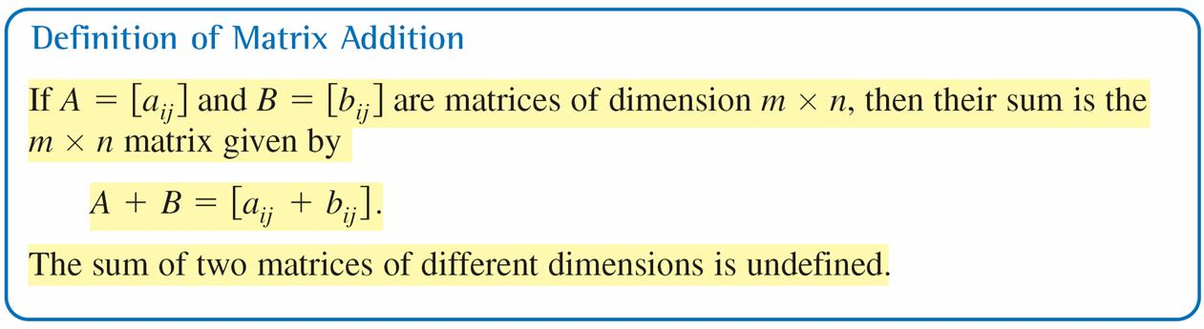
Matrix Addition and Scalar Multiplication
You can add two matrices (of the same dimension) by adding their corresponding entries.

Slide 3
Example 2 – Addition of Matrices
a.
b.
c. The sum of
is undefined because A is of dimension 2 × 3 and B is of
dimension 2 × 2.

Slide 4
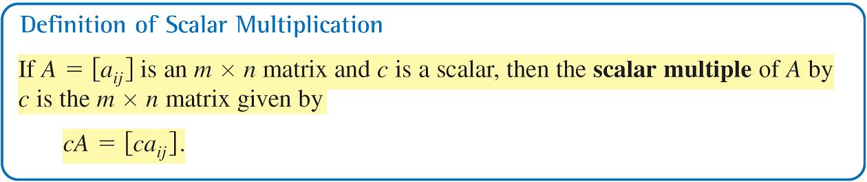
Matrix Addition and Scalar Multiplication
In operations with matrices, numbers are usually referred to as scalars. In this text, scalars will always be real numbers. You can multiply a matrix A by a scalar c by multiplying each entry in A by c.

Slide 5
Example 3 – Scalar Multiplication
For the following matrix, find 3A.
Solution:

Slide 6
Matrix Addition and Scalar Multiplication
The algebra of real numbers and the algebra of matrices have many similarities. For example, compare the following solutions.
Real Numbers m × n Matrices
(Solve for x.) (Solve for X.)
x + a = b X + A = B
x + a + (–a) = b + (–a) X + A + (–A) = B + (–A)
x + 0 = b – a X + O = B – A
x = b – a X = B – A

Slide 7
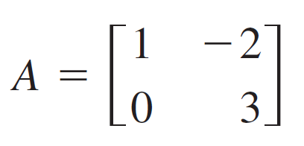
Example 6 – Solving a Matrix Equation
Solve for X in the equation
3X + A = B
where
and

Slide 8

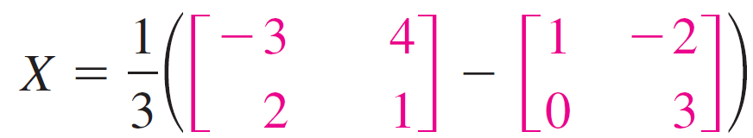
Example 6 – Solution
Begin by solving the equation for X to obtain
3X = B – A
X = (B – A)
Now, using the A matrices and B, you have
Substitute the matrices
Subtract matrix A from matrix B
Multiply the resulting matrix by

