Slide 1

Using recursion to answer questions that require multiple applications of a transition matrix
4H

Slide 2
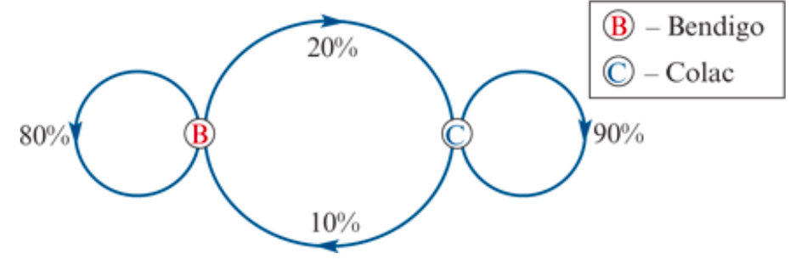
Using recursion to generate state matrices step-by-step
‘If we start with 50 cars in Bendigo, and 40 cars in Colac, how many cars will be available for rent at both towns after 1 week, 2 weeks, etc?’
We solved this type of problem by using a recurrence relation to model the growth in our investment year-by-year. We do the same with the car rental problem, the only difference being that we are now working with matrices.

Slide 3
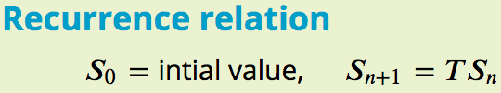
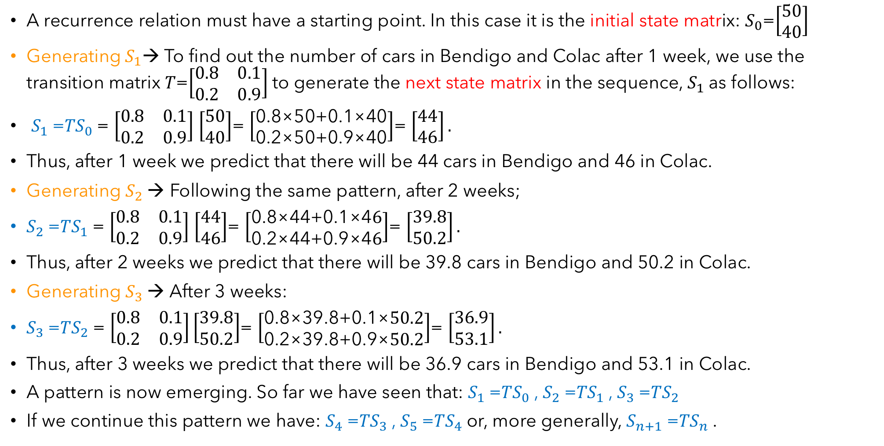
Constructing a matrix recurrence relation
A recurrence relation must have a starting point. In this case it is the initial state matrix: $S_{0}$=$\left[\begin{aligned}50 \\ 40\end{aligned}\right]$
Generating${ S}_{1}$→ To find out the number of cars in Bendigo and Colac after 1 week, we use the transition matrix 𝑇=$\left[\begin{matrix}0.8 & 0.1 \\ 0.2 & 0.9\end{matrix}\right]$to generate the next state matrix in the sequence, $S_{1}$as follows:
$S_{1}$=𝑇$S_{0}$= $\left[\begin{matrix}0.8 & 0.1 \\ 0.2 & 0.9\end{matrix}\right]$ $\left[\begin{aligned}50 \\ 40\end{aligned}\right]$= $\left[\begin{aligned}\text{0.8×50+0.1×40} \\ \text{0.2×50+0.9×40}\end{aligned}\right]$= $\left[\begin{aligned}44 \\ 46\end{aligned}\right].$
Thus, after 1 week we predict that there will be 44 cars in Bendigo and 46 in Colac.
Generating $S_{2}$→ Following the same pattern, after 2 weeks;
$S_{2}$=𝑇$S_{1}$= $\left[\begin{matrix}0.8 & 0.1 \\ 0.2 & 0.9\end{matrix}\right]$ $\left[\begin{aligned}44 \\ 46\end{aligned}\right]$= $\left[\begin{aligned}\text{0.8×}\text{44}\text{+0.1×4}6 \\ \text{0.2×}\text{44}\text{+0.9×4}6\end{aligned}\right]$= $\left[\begin{aligned}39.8 \\ 50.2\end{aligned}\right].$
Thus, after 2 weeks we predict that there will be 39.8 cars in Bendigo and 50.2 in Colac.
Generating $S_{3}$→ After 3 weeks:
$S_{3}$=𝑇$S_{2}$= $\left[\begin{matrix}0.8 & 0.1 \\ 0.2 & 0.9\end{matrix}\right]\left[\begin{aligned}39.8 \\ 50.2\end{aligned}\right]$= $\left[\begin{aligned}\text{0.8×}\text{39.8}\text{+0.1×}50.2 \\ \text{0.2×}\text{39.8}\text{+0.9×}50.2\end{aligned}\right]$= $\left[\begin{aligned}36.9 \\ 53.1\end{aligned}\right].$
Thus, after 3 weeks we predict that there will be 36.9 cars in Bendigo and 53.1 in Colac.
A pattern is now emerging. So far we have seen that: $S_{1}$=𝑇$S_{0}$, $S_{2}$=𝑇$S_{1}$, $S_{3}$=𝑇$S_{2}$
If we continue this pattern we have: $S_{4}$=𝑇$S_{3}$, $S_{5}$=𝑇$S_{4}$or, more generally, $S_{n+1}$=𝑇$S_{n}$.

Slide 4


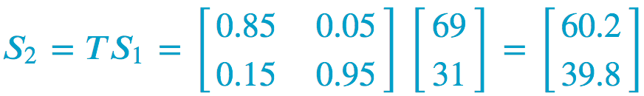
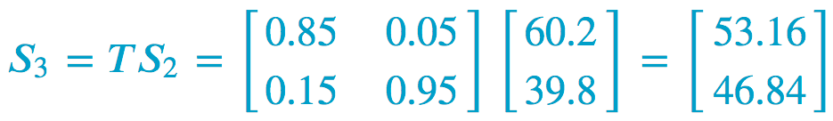
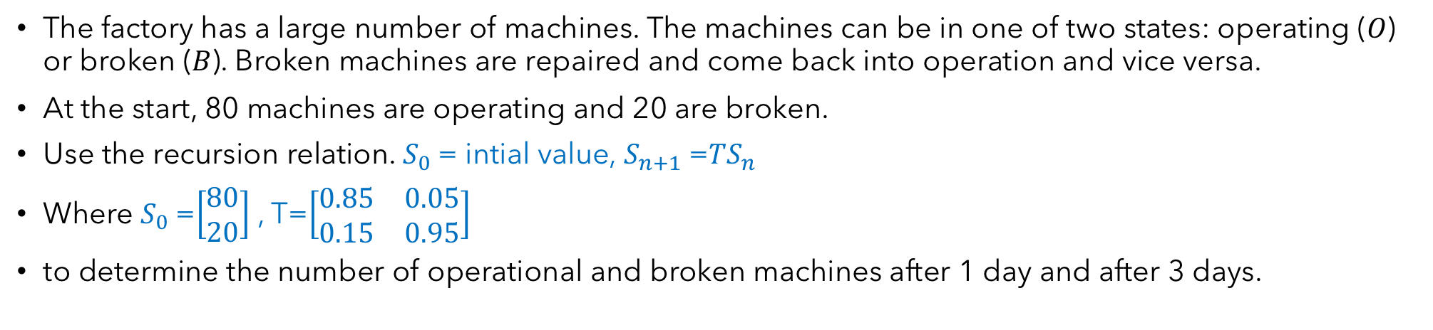
Using a recursion relation to calculate state matrices step-by-step
The factory has a large number of machines. The machines can be in one of two states: operating (𝑂) or broken (𝐵). Broken machines are repaired and come back into operation and vice versa.
At the start, 80 machines are operating and 20 are broken.
Use the recursion relation. $S_{0}$= intial value, $S_{n+1}$=𝑇$S_{n}$
Where $S_{0}$=$\left[\begin{aligned}80 \\ 20\end{aligned}\right]$ , T=$\left[\begin{matrix}0.85 & 0.05 \\ 0.15 & 0.95\end{matrix}\right]$
to determine the number of operational and broken machines after 1 day and after 3 days.
After 1 day, 69 machines are operational and 31 are broken.
After 3 days, 53 machines are operating and 47 are broken.

Slide 5
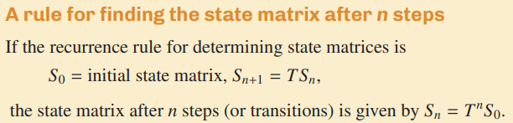
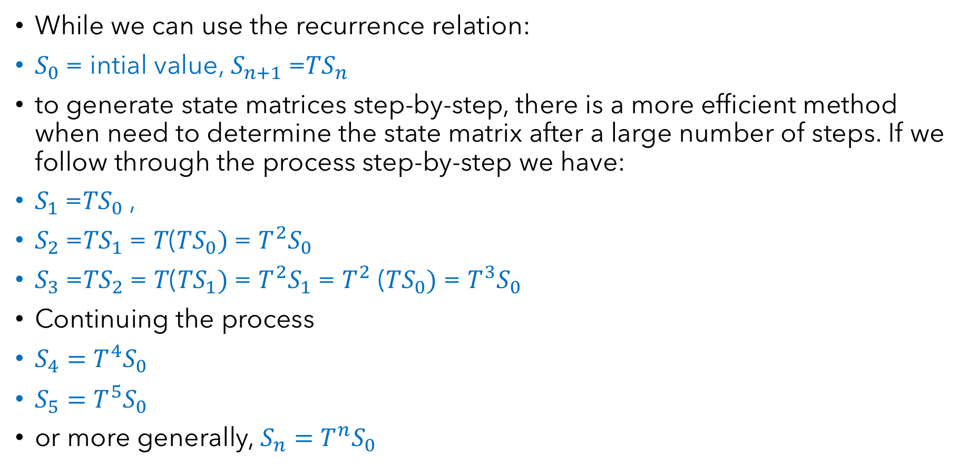
A rule for determining the state matrix of a system after 𝐧 steps
While we can use the recurrence relation:
$S_{0}$= intial value, $S_{n+1}$=𝑇$S_{n}$
to generate state matrices step-by-step, there is a more efficient method when need to determine the state matrix after a large number of steps. If we follow through the process step-by-step we have:
$S_{1}$=𝑇$S_{0}$,
$S_{2}$=𝑇$S_{1}$= 𝑇(𝑇$S_{0})$= $T^{2}S_{0}$
$S_{3}$=𝑇$S_{2}$= 𝑇(𝑇$S_{1})$= $T^{2}S_{1}$= $T^{2}$ (𝑇$S_{0})$= $T^{3}S_{0}$
Continuing the process
$S_{4}=$ $T^{4}S_{0}$
$S_{5}=$ $T^{5}S_{0}$
or more generally, $S_{n}=$ $T^{n}S_{0}$

Slide 6
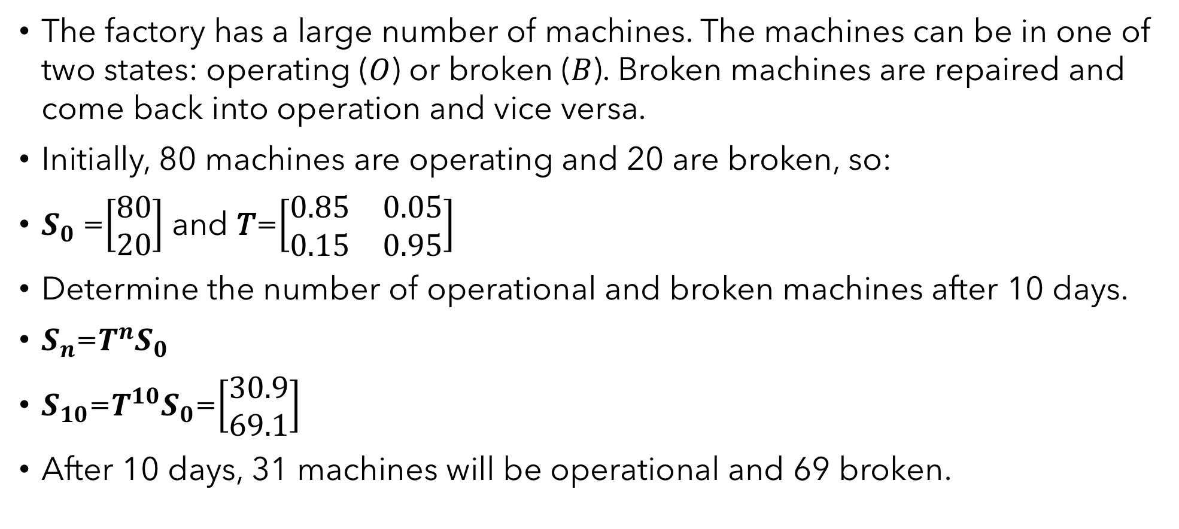
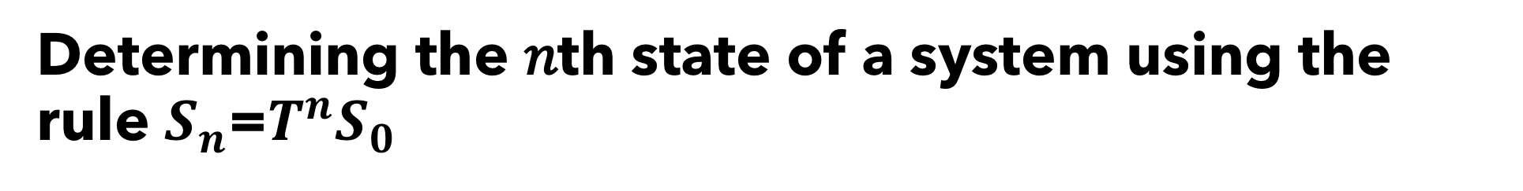
Determining the 𝑛th state of a system using the rule $S_{n}$=$T^{n}S_{0}$
The factory has a large number of machines. The machines can be in one of two states: operating (𝑂) or broken (𝐵). Broken machines are repaired and come back into operation and vice versa.
Initially, 80 machines are operating and 20 are broken, so:
$S_{0}$=$\left[\begin{aligned}80 \\ 20\end{aligned}\right]$ and 𝑇=$\left[\begin{matrix}0.85 & 0.05 \\ 0.15 & 0.95\end{matrix}\right]$
Determine the number of operational and broken machines after 10 days.
$S_{n}$=$T^{n}S_{0}$
$S_{10}$=$T^{10}S_{0}$=$\left[\begin{aligned}30.9 \\ 69.1\end{aligned}\right]$
After 10 days, 31 machines will be operational and 69 broken.
Need Mathematica

Slide 7
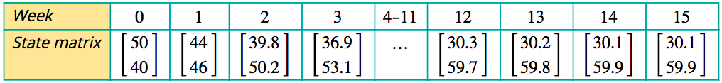
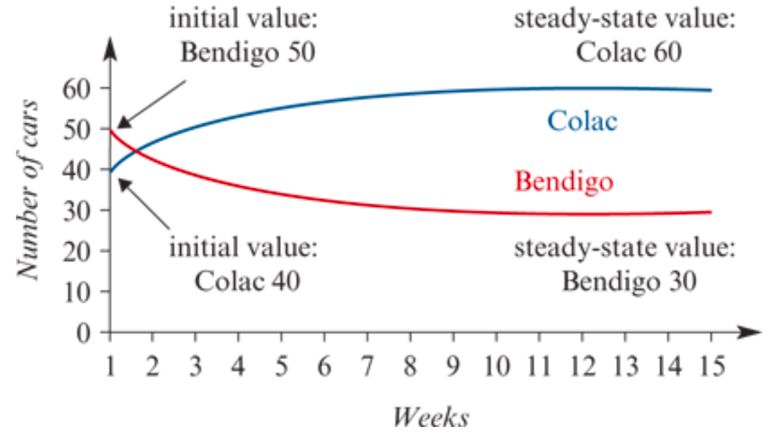
The steady-state solution
A second question a manager might like answered about the car rental is as follows.
‘Will the number of rental cars available from each location vary from week to week or will they settle down to some fixed value?’
To investigate this question, we start by listing the state matrices from week 0 to week 15.
In summary, even though the number of cars returned to each location varied from day to day, the numbers at each location eventually settled down to an equilibrium or steady-state solution. In the steady state, the number of cars at each location remained the same.

Slide 8
The steady-state solution
Important
In the steady state, cars are still moving between Bendigo and Colac, but the number of cars rented in Bendigo and returned to Colac is balanced by the number of cars rented in Colac and returned to Bendigo. Because of this balance, the steady state is also called the equilibrium state.
For a system to have a steady state, the transition matrix must be regular and the columns must add up to 1. A regular matrix is one whose powers never contain any zero elements. In practical terms, this means that every state represented in the transition matrix is accessible, either directly or indirectly from every other state.

Slide 9
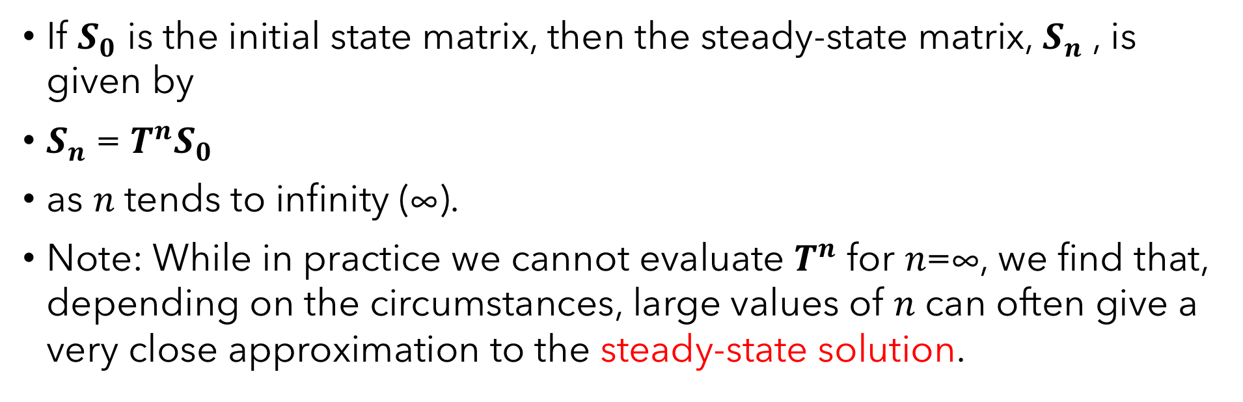
Estimating the steady state solution
If $S_{0}$ is the initial state matrix, then the steady-state matrix, $S_{n}$, is given by
$S_{n}$= $T^{n}S_{0}$
as 𝑛 tends to infinity (∞).
Note: While in practice we cannot evaluate $T^{n}$ for 𝑛=∞, we find that, depending on the circumstances, large values of 𝑛 can often give a very close approximation to the steady-state solution.

Slide 10
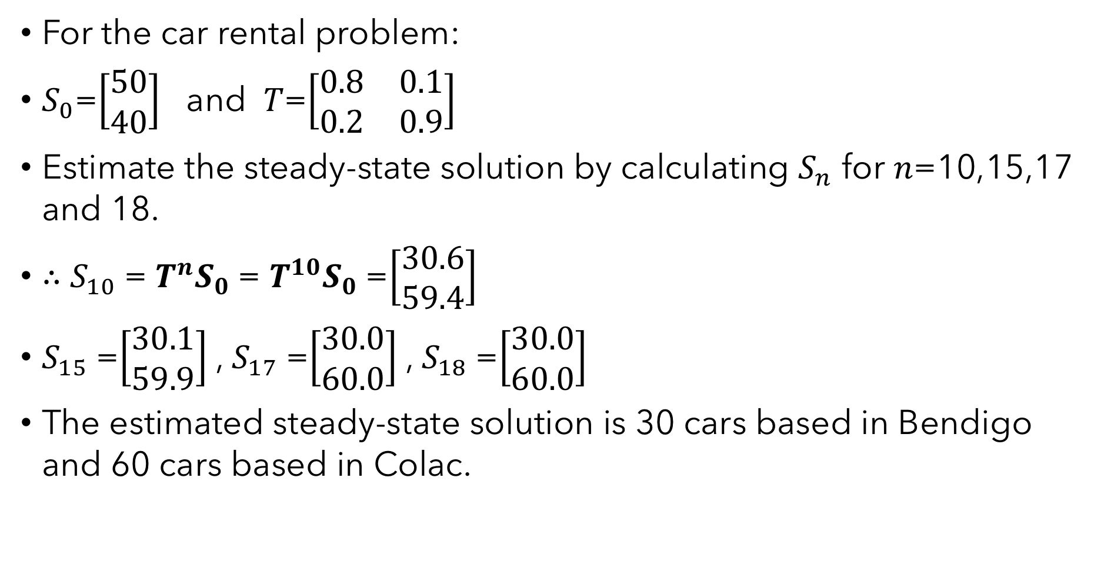
Estimating the steady-state solution
For the car rental problem:
$S_{0}$=$\left[\begin{aligned}50 \\ 40\end{aligned}\right]$ and 𝑇=$\left[\begin{matrix}0.8 & 0.1 \\ 0.2 & 0.9\end{matrix}\right]$
Estimate the steady-state solution by calculating $S_{n}$ for 𝑛=10,15,17 and 18.
∴ $S_{10}$= $T^{n}S_{0}$= $T^{10}S_{0}$=$\left[\begin{aligned}30.6 \\ 59.4\end{aligned}\right]$
$S_{15}$=$\left[\begin{aligned}30.1 \\ 59.9\end{aligned}\right]$, $S_{17}$=$\left[\begin{aligned}30.0 \\ 60.0\end{aligned}\right]$, $S_{18}$=$\left[\begin{aligned}30.0 \\ 60.0\end{aligned}\right]$
The estimated steady-state solution is 30 cars based in Bendigo and 60 cars based in Colac.
Need Mathematica

Slide 11
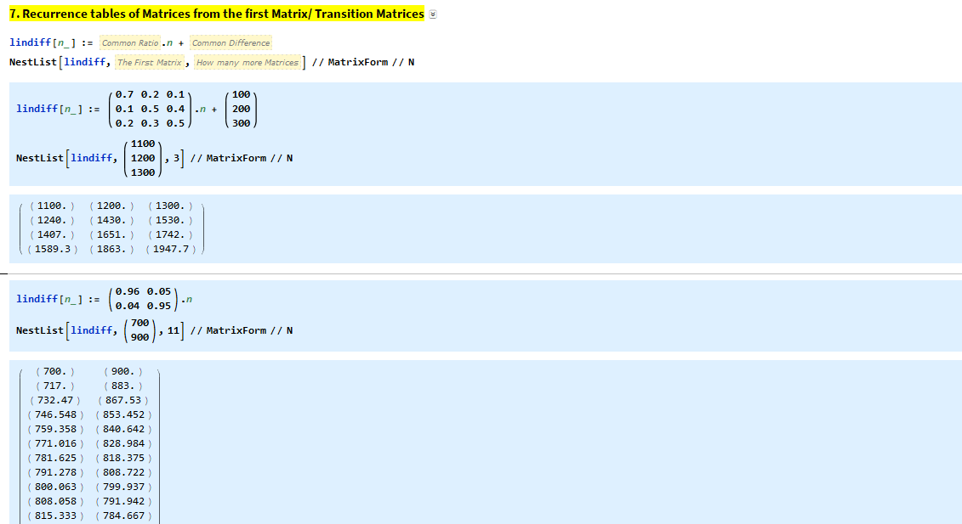
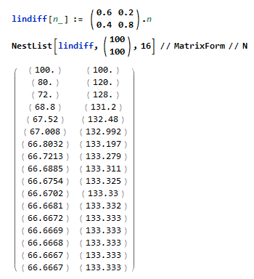
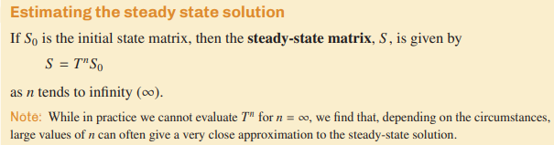

Slide 12
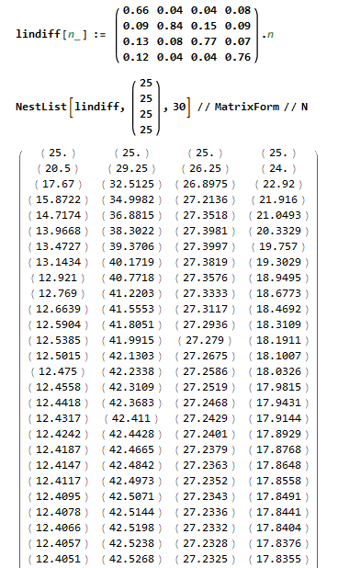
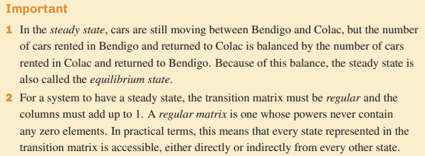

$S_{0}$=$\left[\begin{aligned}25 \\ 25 \\ 25 \\ 25\end{aligned}\right]$
The steady-state

