Slide 1
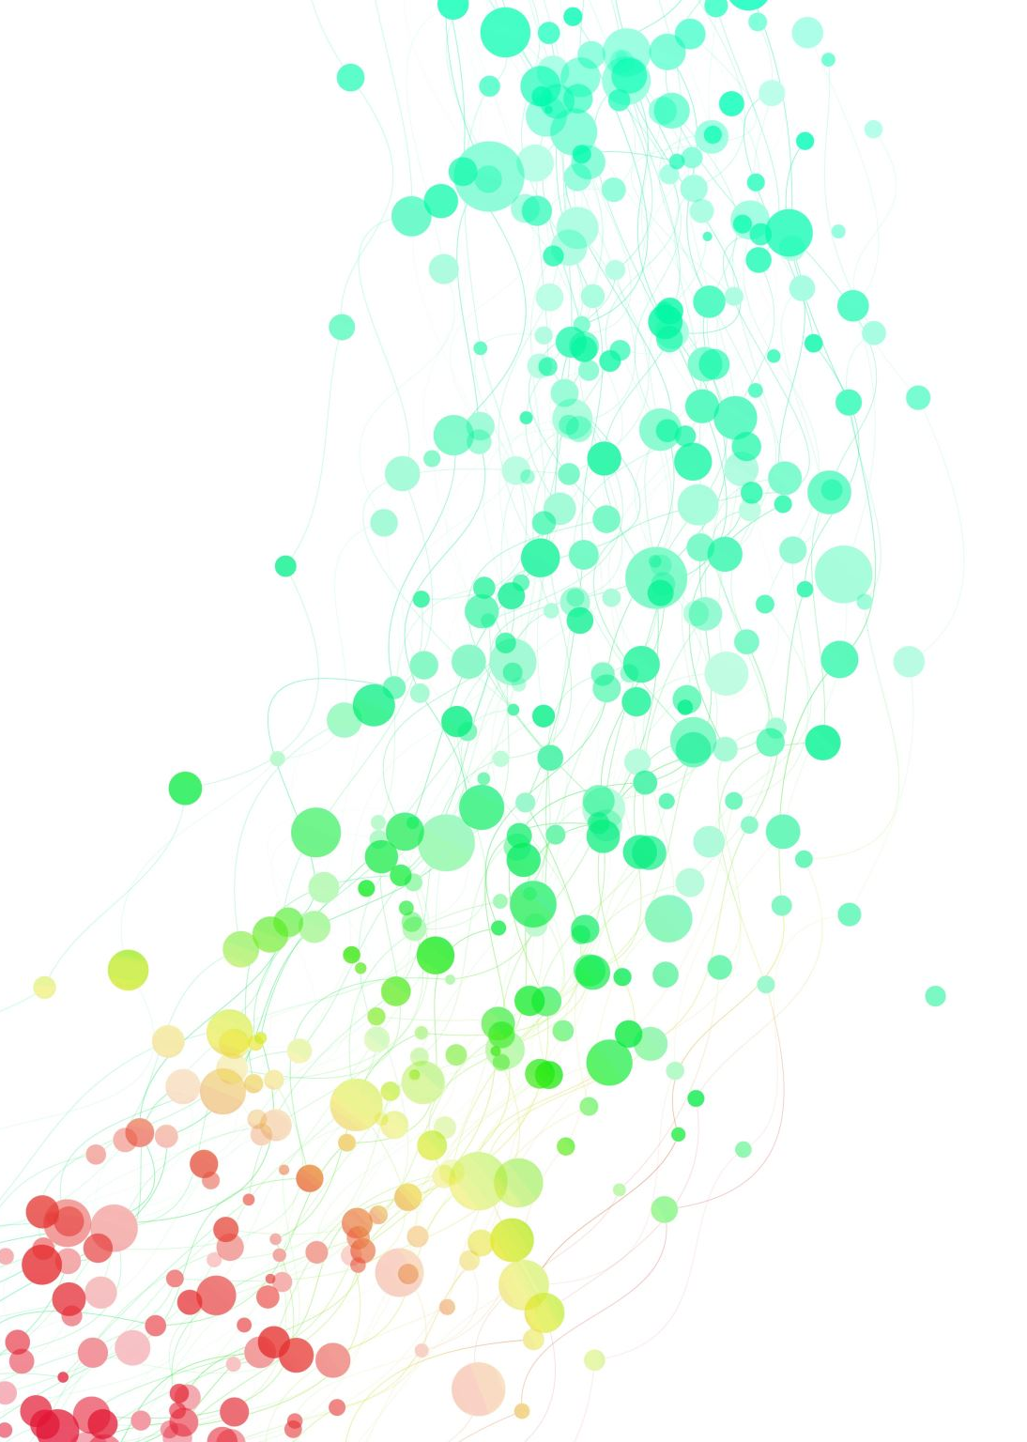
Matrices Revision
10
Notes:
https://dashboard.blooket.com/set/618966a617762f1c1c272b7d
https://create.kahoot.it/details/76de5c72-45ef-4579-ba10-82e06a4bf912
https://create.kahoot.it/details/86712fd5-d057-47a6-83dc-58f7a6ab5407

Slide 2
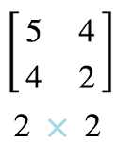
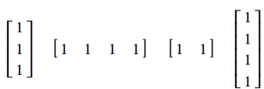
TYPES OF MATRICES
NAME | DESCRIPTION | EXAMPLE | Mathematica
Row matrix | A matrix with only 1 row |  | Nil
Column matrix | A matrix with only I column |  | Nil
Square matrix | the number of rows equals the number of columns |  | Nil
Zero (Null) matrix | A matrix with all zero entries |  | Nil
Summing matrix | A row or column matrix in which all the elements are 1. To sum the rows of an m × n matrix, post-multiply the matrix by an n × 1 summing matrix. To sum the columns of an m × n matrix, pre-multiply the matrix by a 1 × m summing matrix. |  | 4a Or 12 Step by step

Slide 3

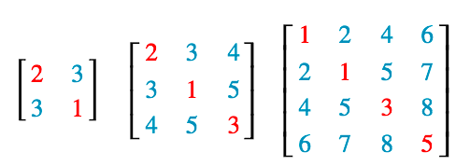
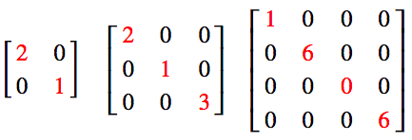
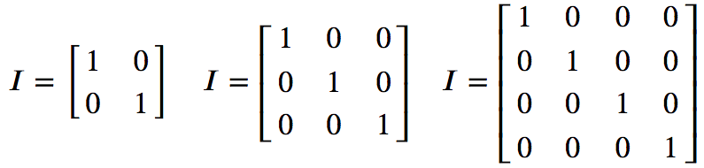
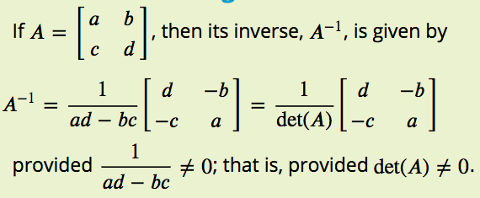
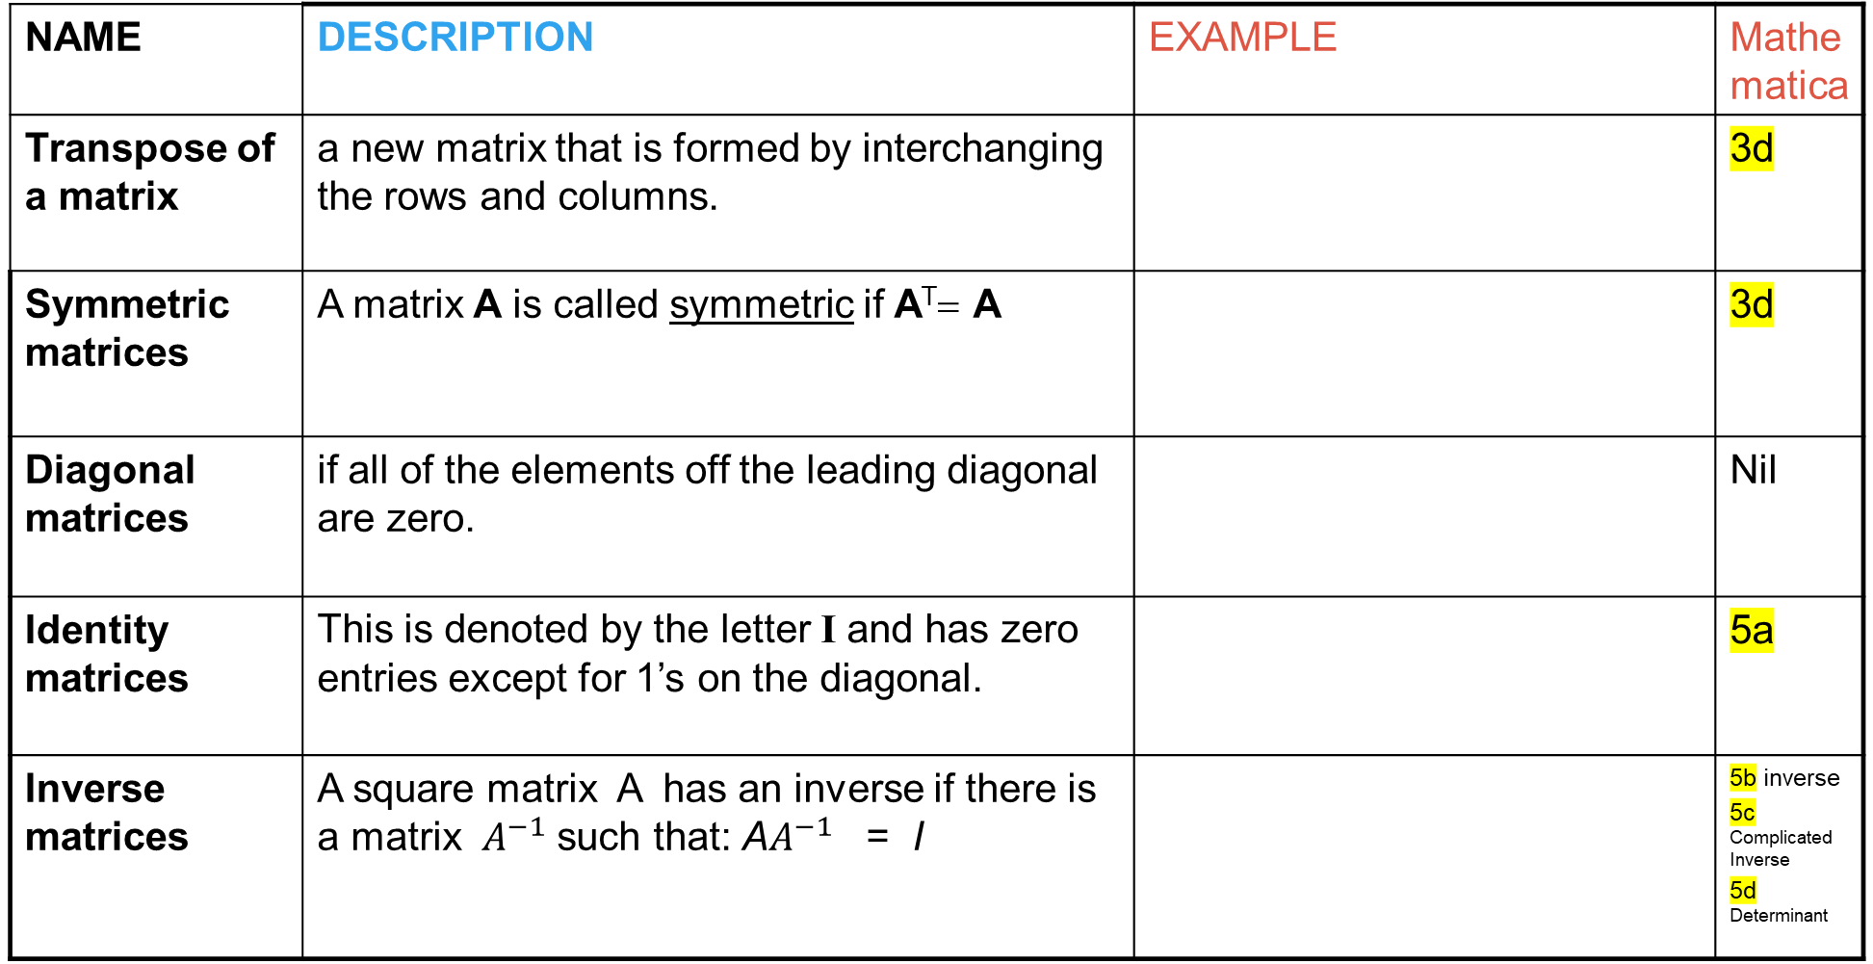
TYPES OF MATRICES
NAME | DESCRIPTION | EXAMPLE | Mathematica
Transpose of a matrix | a new matrix that is formed by interchanging the rows and columns. |  | 3d
Symmetric matrices | A matrix A is called symmetric if A^{T}= A |  | 3d
Diagonal matrices | if all of the elements off the leading diagonal are zero. |  | Nil
Identity matrices | This is denoted by the letter I and has zero entries except for 1’s on the diagonal. |  | 5a
Inverse matrices | A square matrix A has an inverse if there is a matrix $A^{−1}$ such that: A$A^{−1}$ = I |  | 5b inverse 5c Complicated Inverse 5d Determinant

Slide 4
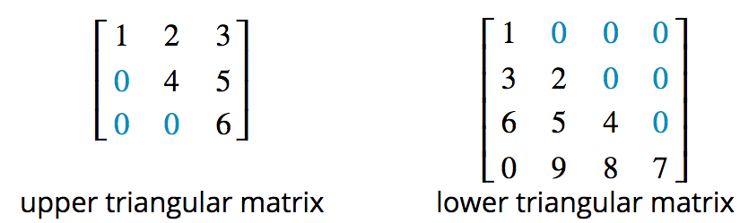


TYPES OF MATRICES
NAME | DESCRIPTION | EXAMPLE | Mathematica
Triangular matrices | 1. An upper triangular matrix: all elements below the leading diagonal are zeros. 2. A lower triangular matrix: all elements above the leading diagonal are zeros. |  | Nil
Binary matrices | A special kind of matrix that has only 1s and zeros as its elements. |  | Nil
Permutation matrices | A square binary matrix in which there is only one ‘1’ in each row and column. |  | 4a Or 12 Step by step

Slide 5
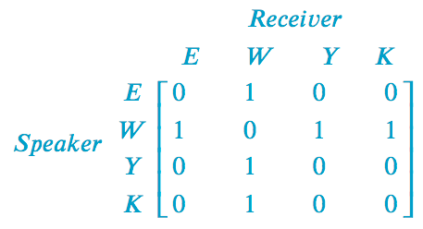
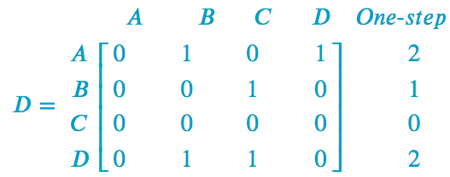
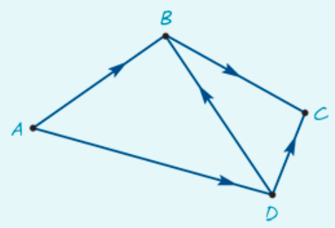
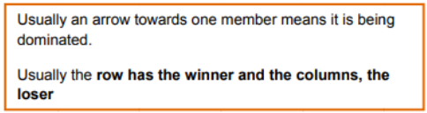
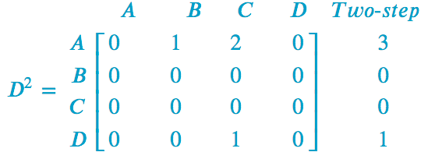
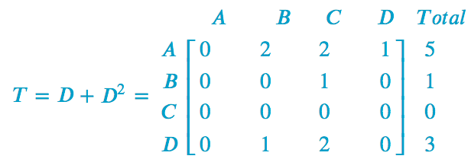
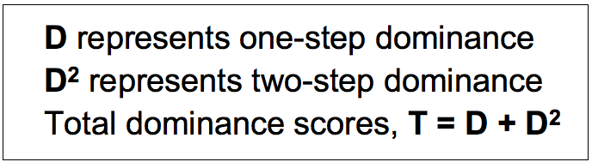
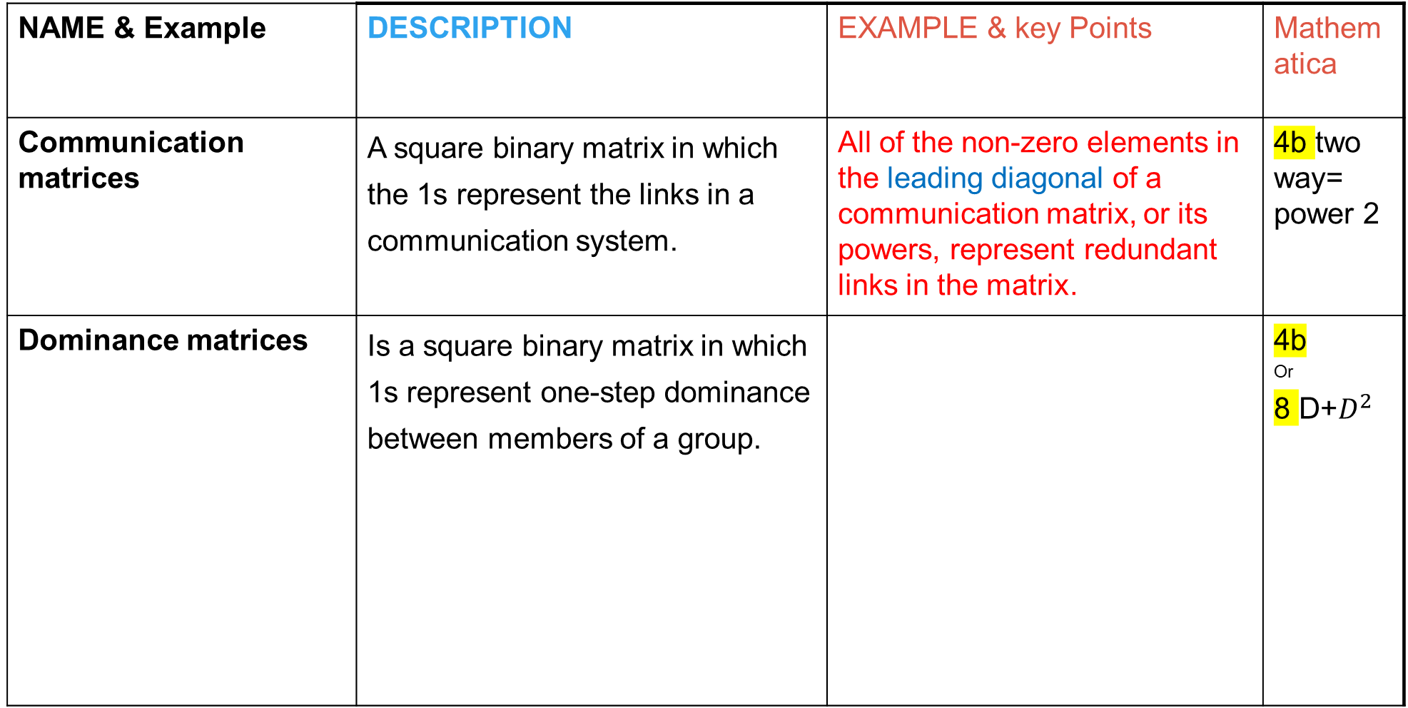
TYPES OF MATRICES
NAME & Example | DESCRIPTION | EXAMPLE & key Points | Mathematica
Communication matrices | A square binary matrix in which the 1s represent the links in a communication system. | All of the non-zero elements in the leading diagonal of a communication matrix, or its powers, represent redundant links in the matrix. | 4b two way= power 2
Dominance matrices | Is a square binary matrix in which 1s represent one-step dominance between members of a group. |  | 4b Or 8 D+$D^{2}$

Slide 6
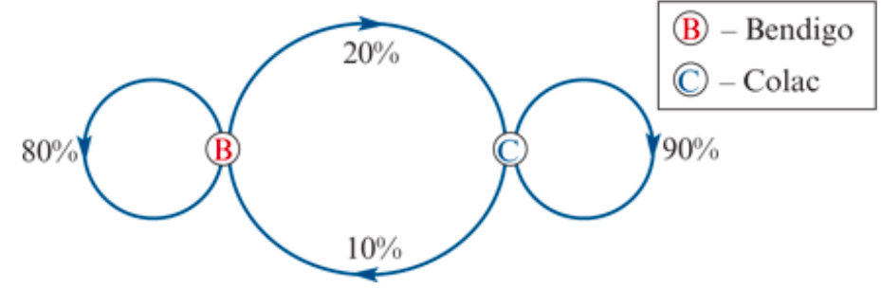
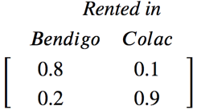

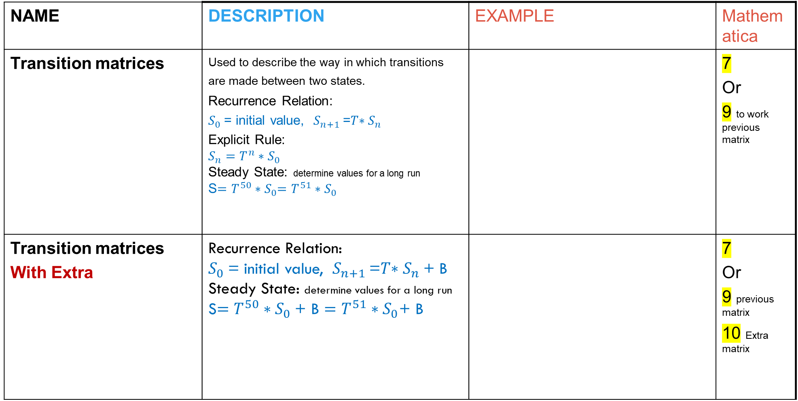
TYPES OF MATRICES
NAME | DESCRIPTION | EXAMPLE | Mathematica
Transition matrices | Used to describe the way in which transitions are made between two states. Recurrence Relation: $S_{0}$= initial value, $S_{n+1}$=𝑇$∗S_{n}$ Explicit Rule: $S_{n}=$ $T^{n}{∗S}_{0}$ Steady State: determine values for a long run S$=$ $T^{50}{∗S}_{0}=T^{51}{∗S}_{0}$ |  | 7 Or 9 to work previous matrix
Transition matrices With Extra | Recurrence Relation: $S_{0}$= initial value, $S_{n+1}$=𝑇$∗S_{n}$+ B Steady State: determine values for a long run S$=$ $T^{50}{∗S}_{0}\text{+ }\text{B}=T^{51}{∗S}_{0}$+ B |  | 7 Or 9 previous matrix 10 Extra matrix

Slide 7
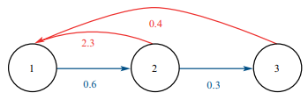
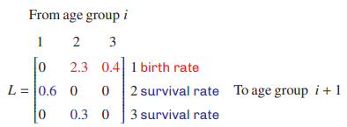
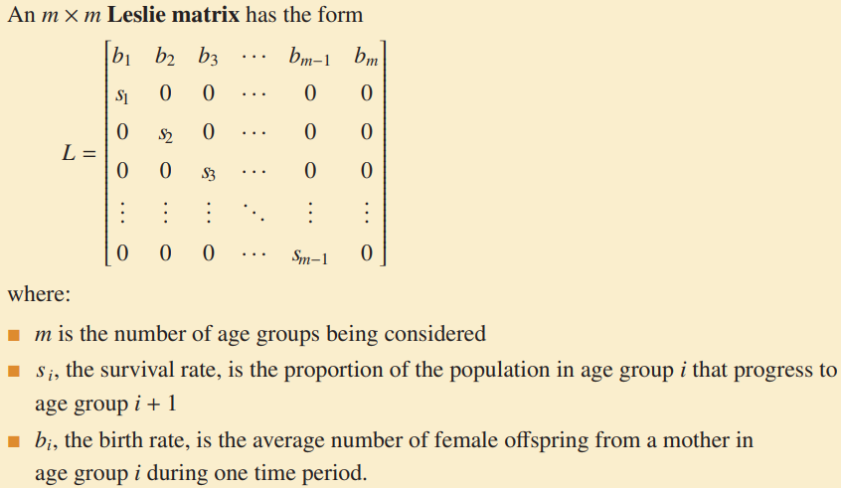
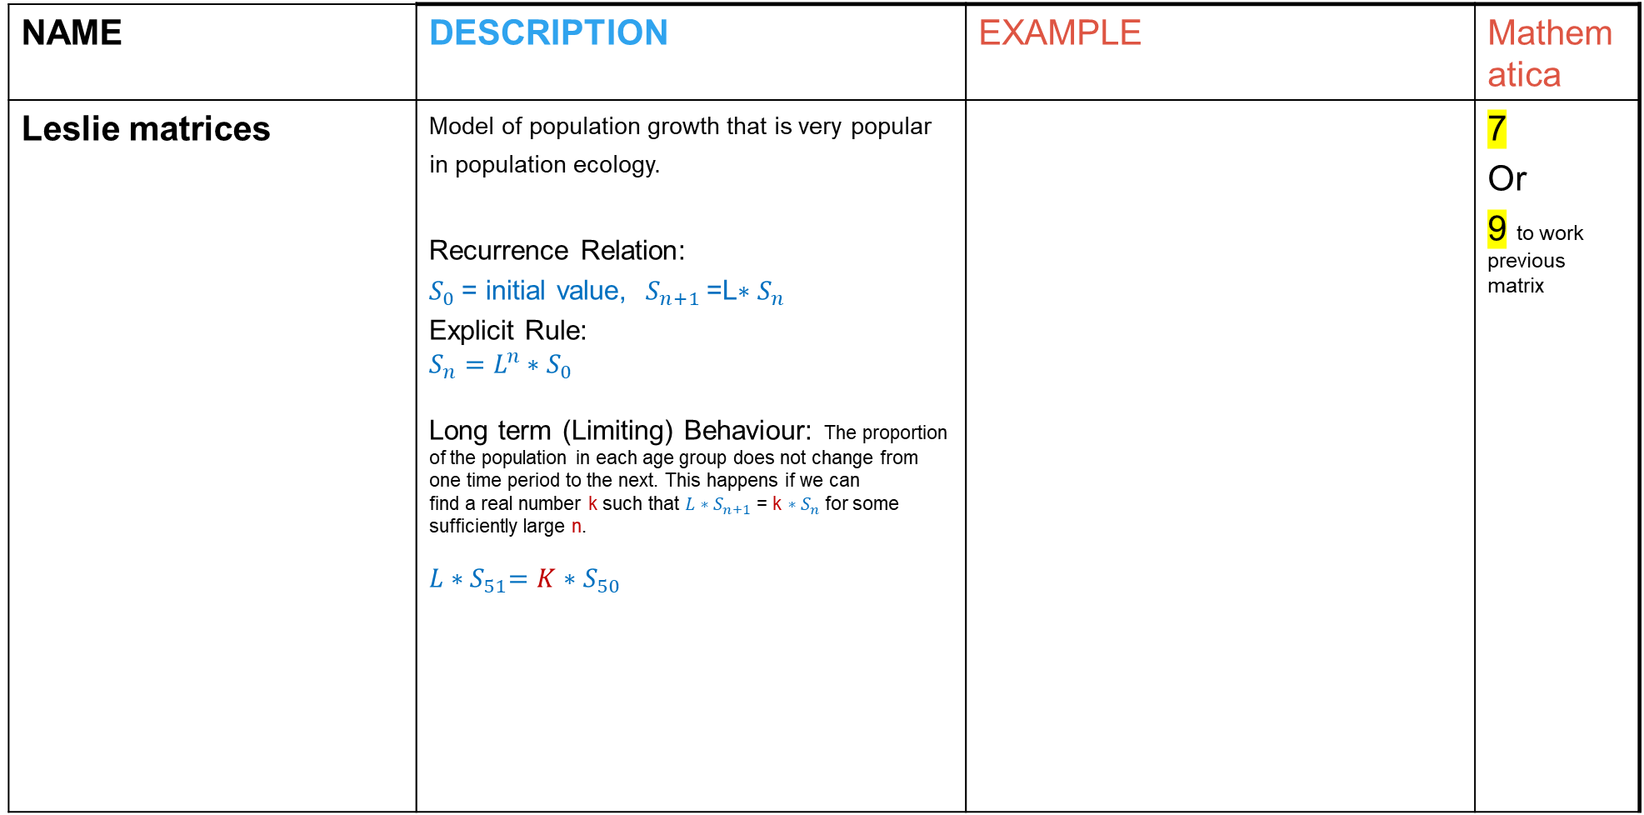
TYPES OF MATRICES
NAME | DESCRIPTION | EXAMPLE | Mathematica
Leslie matrices | Model of population growth that is very popular in population ecology. Recurrence Relation: $S_{0}$= initial value, $S_{n+1}$=L$∗S_{n}$ Explicit Rule: $S_{n}=$ $L^{n}{∗S}_{0}$ Long term (Limiting) Behaviour: The proportion of the population in each age group does not change from one time period to the next. This happens if we can find a real number k such that ${L∗S}_{n+1}$ = k ${∗S}_{n}$ for some sufficiently large n. $$L{∗S}_{51}=K{∗S}_{50}$$ |  | 7 Or 9 to work previous matrix

Slide 8
MATRICES Operations
Matrices Operations | Mathematica Commands | Matrices Operations | Mathematica Commands
Insert matrix | 1 | Power of a Matrix | 4b
Define a matrix (given a letter name) | 2 | Simultaneous Equations/ Matrices | 6a or 6b 6c Matrices → Equations 6d Equations → Matrices
Adding, subtracting, scalar multiplication | 3 | Solving unknow Matrix by given matrix equation | 10
Two matrices multiplication | 4a or 12 | Constructing a Matrix by given i, j rule | 11

Slide 9
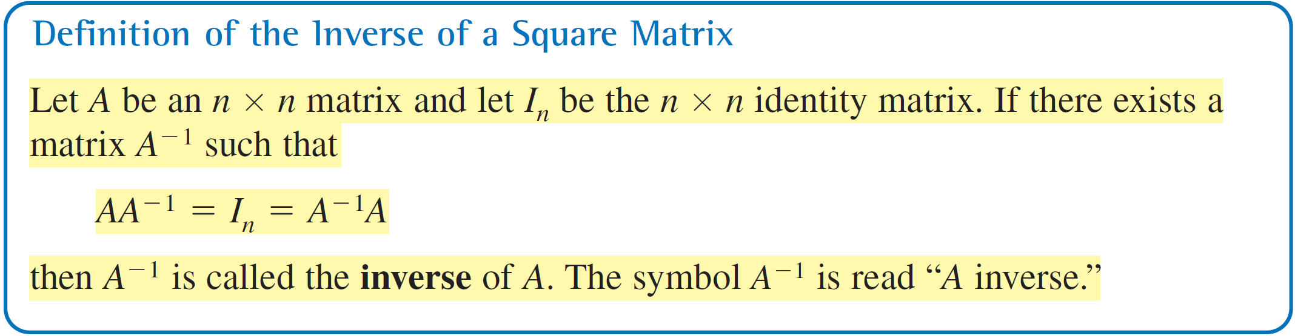
The Inverse of a Matrix
The number A^{–1} is called the multiplicative inverse of a because
A^{–1} A = I.
The definition of the multiplicative inverse of a matrix is similar.

Slide 10
The Inverse of a Matrix
This section further develops the algebra of matrices. To begin, consider the real number equation
AX = B.
To solve this equation for x, multiply each side of the equation by A^{–1} (provided that A ≠ 0).
AX = B
(A^{–1}A)X = A^{–1}B
(I)X = A^{–1}B
x = A^{–1}B

Slide 11
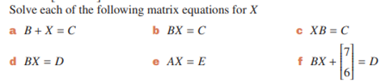
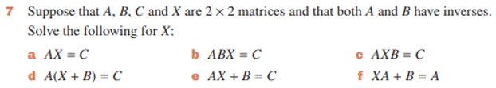
Exercise 10E

