Slide 1
Graph theory basics
Lesson 9A

Slide 2
Learning Intention: The graph theory
The Königsberg bridge problem
The elements of graph: Vertices, Edges, Degree of a Vertex
Euler’s discovery

Slide 3
Friendship network

Slide 6
internet

Slide 7
In New York City, garbage collection, curb sweeping, snow removal, and other municipal services have been scheduled and organized using graph theory since the 1970s and the improved efficiency has yielded savings estimated in the tens of millions of dollars annually.

Slide 8
https://www.youtube.com/watch?v=nZwSo4vfw6c
Notes:
the königsberg bridge problem

Slide 9
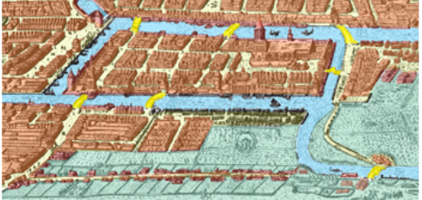
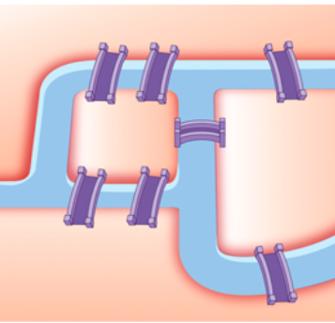
The problem simplified

Slide 10
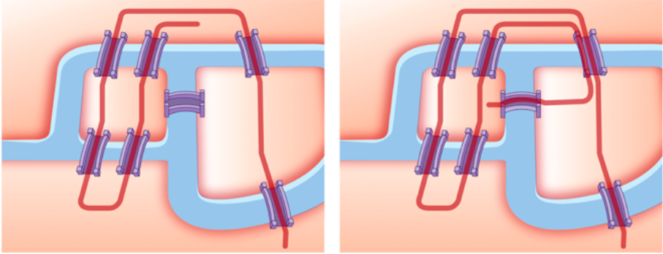
Can a continuous walk be planned so that all bridges are crossed only once?

Slide 11
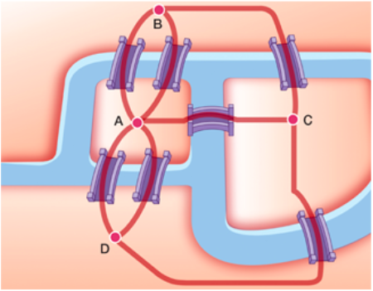
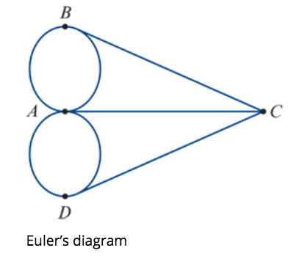
a simplified diagram to represent the situation---a graph.

Slide 12
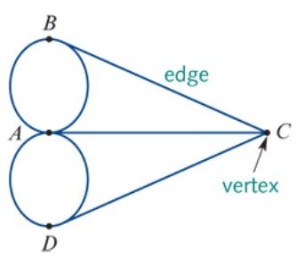
What is a graph?
A graph is made up of dots and lines joining these dots.
The dots in a graph are called vertices (plural of vertex). These vertices represent the riverbanks and the islands.
The lines in a graph are called edges. These edges represent the bridges.

Slide 13
In the Real-World
Vertices may represent things such as people, places or region.
Edges may represent connections such as roads, bridges or relationships.
What are the edges, and what do they represent?
What about the vertices?

Slide 14
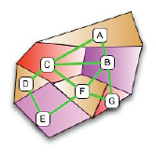
Degree of the Vertex
The number of edges attached to the vertex.
Euler found that the solution of the Königsberg bridge problem was connected to the degree of each vertex.
What is the degree of vertex A?
What is the degree of vertex C?
2
4

Slide 15
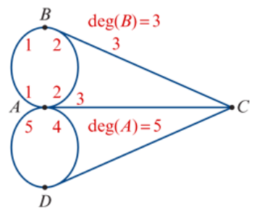
Degree of the Vertex
For the Königsberg bridge graph:
the degree of vertex 𝐴 is 5 (because five edges are attached to vertex 𝐴): write this as deg(𝐴)=5
vertices 𝐵,𝐶 and 𝐷 are all of degree 3 (three edges touch each of these vertices): write this as deg(𝐵)=3, etc.
The degree ----even or odd.
Even: even number of edges (2, 4, 6,…) attached to the vertex.
Odd: odd number of edges (1, 3, 5,…) to the vertex.
All four vertices in the Königsberg bridge graph have an odd degree.

Slide 16
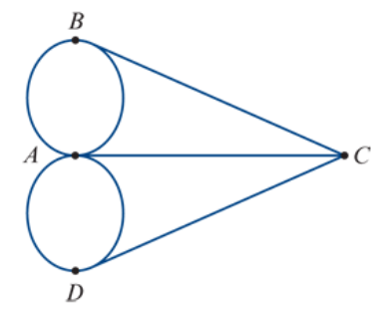
Euler’s discovery
A graph with all odd vertices cannot be traced or drawn without lifting the pencil or going over the same edge more than once.
Can all even vertices or only two odd vertices do that? Yes.

Slide 17
exercises & Summary Book
1. Ex 9A
2. Summary notes for Homework.

