Slide 1
What is a Graph?
Lesson 9B

Slide 2
Learning Intention: What is a Graph?
Vertex
Edge
Loop
Multiple Edges
Degree of Vertices

Slide 3
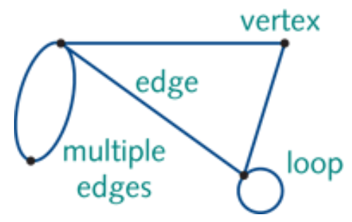
Graph elements: definitions
A graph is a diagram that consists of a set of points called vertices that are joined by a set of lines called edges. Each edge joins two vertices.
A loop is an edge in a graph that joins a vertex in a graph to itself.
Two or more edges that connect the same vertices are called multiple edges.
A
D
B
C

Slide 4
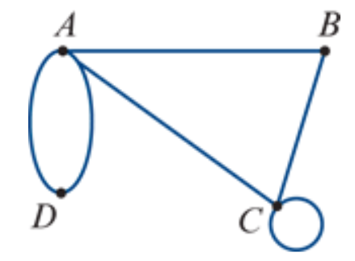
The degree of a vertex
deg(𝐴)=4
The degree of a vertex is the number of edges attached to the vertex. The degree of a vertex is denoted deg(𝑉).
A loop contributes two degrees to a vertex because a loop is attached to its vertex at both ends.
In any graph, the sum of degrees of the vertices is equal to twice the number of edges.
A loop contributes one edge to the graph.
$$e_{4}$$
deg(𝐵)=2
$$e_{1}$$
$$e_{3}$$
$$e_{2}$$
$$e_{5}$$
deg(𝐶)=4
deg(𝐷)=2
$$e_{6}$$
deg(𝐴) + deg(𝐵) + deg(𝐶) + deg(𝐷) = 4+2+4+2=12 =6 $× 2$

Slide 5
exercises & Summary Book
1. Ex 9B
2. Summary notes for Homework.

