Slide 1
Isomorphic, connected graphs and adjacency matrices
Lesson 9C
Notes:
https://create.kahoot.it/details/3617a50d-75c9-4d88-9554-ec64dc7c6af1
https://create.kahoot.it/details/f6ab49f7-455a-4c3d-8538-dd693ee49ad3

Slide 2
Learning Intentions
Isomorphic graphs
Connected graphs and bridges
Adjacency matrices

Slide 3
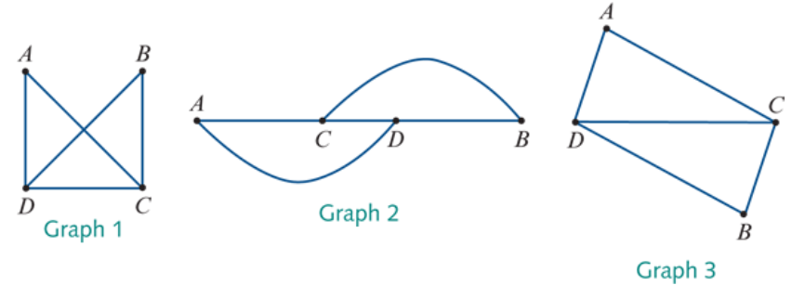
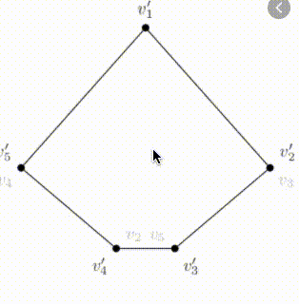
Isomorphic graphs
Different looking graphs can contain the same information. When this happens, we say that these graphs are equivalent or isomorphic.
deg(𝐴)=2
deg(𝐴)=2
deg(B)=2
$$e_{3}$$
$$e_{4}$$
$$e_{1}$$
deg(𝐴)=2
deg(C)=3
$$e_{1}$$
deg(B)=2
$$e_{5}$$
$$e_{1}$$
$$e_{4}$$
$$e_{3}$$
$$e_{5}$$
$$e_{2}$$
$$e_{2}$$
deg(C)=3
deg(D)=3
$$e_{3}$$
deg(D)=3
$$e_{2}$$
$$e_{5}$$
$$e_{4}$$
deg(C)=3
deg(D)=3
deg(B)=2
Two graphs are said to be isomorphic (equivalent) if:
they have the same numbers of edges and vertices
corresponding vertices have the same degree and the edges connect the same vertices.
Rules

Slide 4
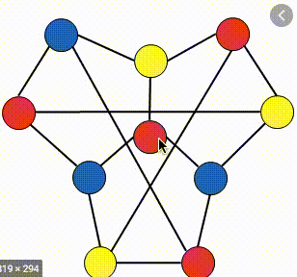
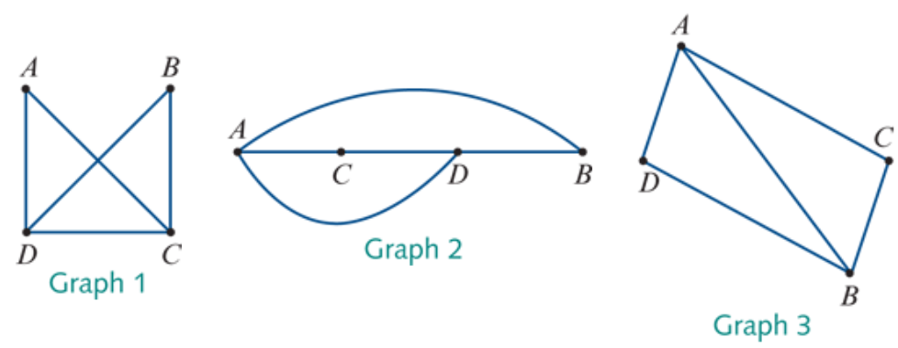
Isomorphic graphs
Example: The same numbers of edges and vertices.
Not the same degree and the edges do not connect the same vertices.
Not Isomorphic
deg(𝐴)=3
deg(𝐴)=2
deg(𝐴)=3
deg(B)=2
deg(B)=3

Slide 5
Connected graphs
A graph is connected if every vertex in the graph is accessible from every other vertex in the graph along a path formed by the edges of the graph.

Slide 6
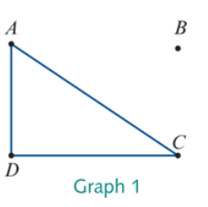
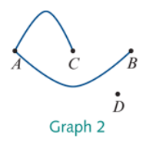
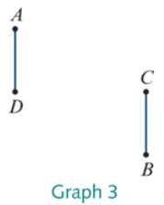
Connected graphs
Not Connected
The three graphs below are not connected, because there is not a path along the edges that connects vertex 𝐴 (for example) to every other vertex in the graph.

Slide 7
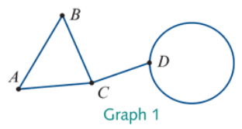
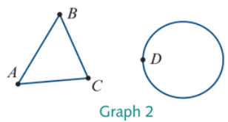
Bridges
A bridge is an edge in a connected graph that, if removed, leaves the graph disconnected.
bridge
A bridge is a single edge in a connected graph that if removed leaves the graph disconnected. A graph can have more than one bridge.

Slide 8
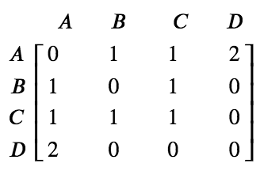
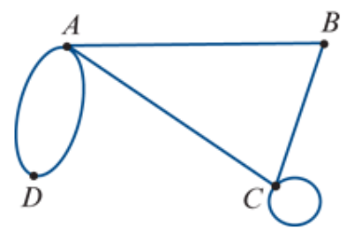
Adjacency matrices
An adjacency matrix is a square matrix that uses a zero or an integer to record the number of edges connecting each pair of vertices in the graph.
0
1
2
$$e_{1}$$
$$e_{2}$$
1

Slide 9
exercises & Summary Book
1. Ex 9C
2. Summary notes for Homework.

