Slide 1
Planar graphs and Euler's formula
Lesson 9D
Notes:
https://create.kahoot.it/details/ea758a22-8d2e-4964-b816-eba600b6b60d
https://create.kahoot.it/details/f5030623-796a-4a7c-a01d-f27f2ea4048f

Slide 2
Learning Intentions
Planar graphs
Faces of a graph
Euler’s formula

Slide 3
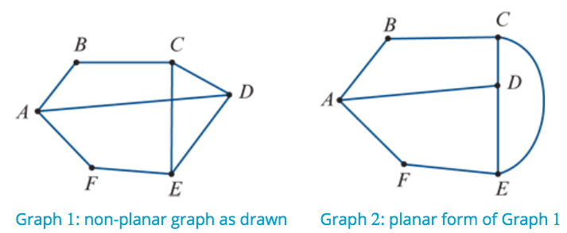
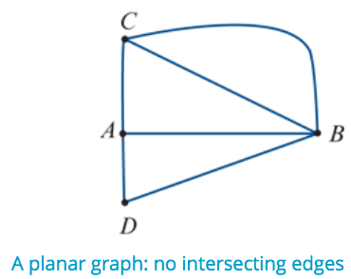
Planar graphs
A planar graph can be drawn on a plane (page surface) so that no edges intersect (cross), except at the vertices.

Slide 4
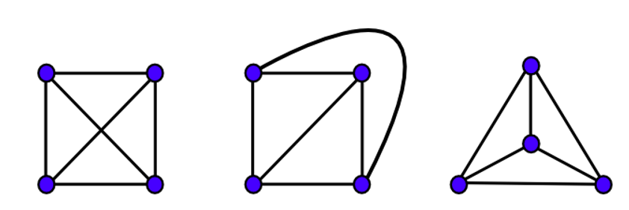
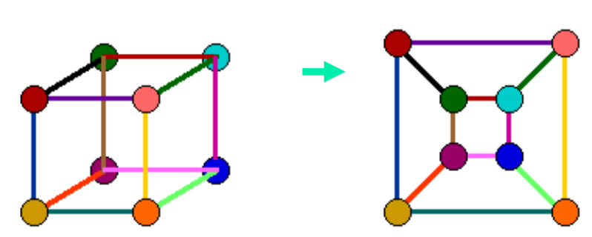
Planar graphs

Slide 5
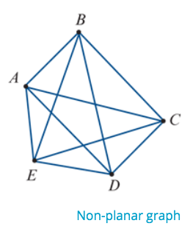
Planar Graphs
Not all graphs are planar.
For example, the graph opposite cannot be redrawn in an equivalent planar form, no matter how hard you try.

Slide 6
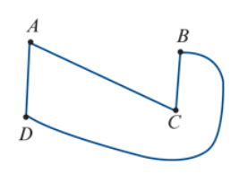
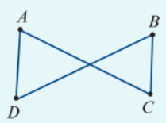
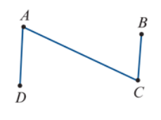
Redrawing a graph in planar form

Slide 7
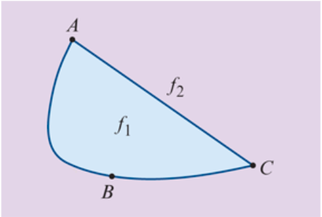
Faces of a graph
The graph opposite can be regarded as dividing the paper it is drawn on into two regions.
In the language of graphs, these regions are called the faces of the graph.
One face, $f_{1}$, is bounded by the graph.
The other face, $f_{2}$, is the region surrounding the graph. This ‘outside’ face is infinite.

Slide 8
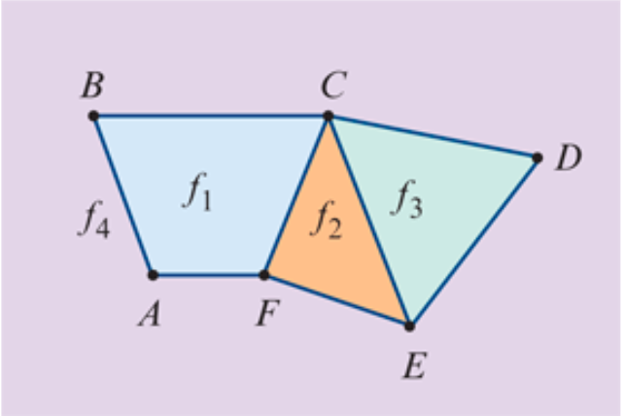
Faces of a graph
The graph opposite divides the paper into four regions, so we say that it has four faces: $f_{1}$, $f_{2}$, $f_{3}$ and $f_{4}$. Here $f_{4}$ is an infinite face.

Slide 9
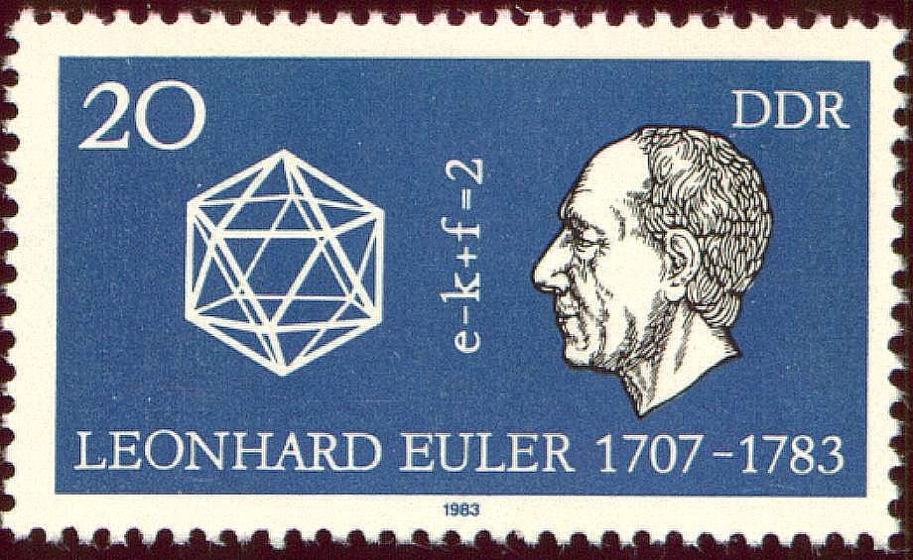
Euler’s Formula
If G is a connected planar graph with v vertices, e edges and f faces, then v – e + f = 2
For a connected planar graph:
number of vertices − number of edges + number of faces=2

Slide 10
7 $−$ 9 + 4 =2

Slide 11
Using Euler’s formula to find the number of faces of a graph
A connected planar graph has four vertices and five edges. Find the number of faces.
Solution
Write down 𝑣 and 𝑒. 𝑣=4, 𝑒=5
Euler's formula: v−e+f=2
Substitute the values of 𝑣 and 𝑒.
4−5+f=2
− 1+f=2
f − 1=2
f=3 The graph has three faces.

Slide 14
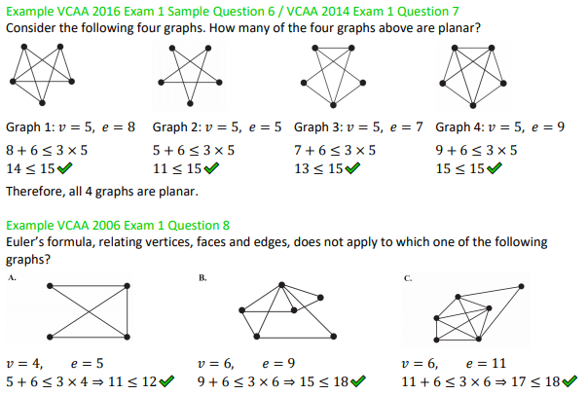

Slide 15
exercises & Summary Book
1. Ex 9D
2. Summary notes for Homework.

