Slide 1
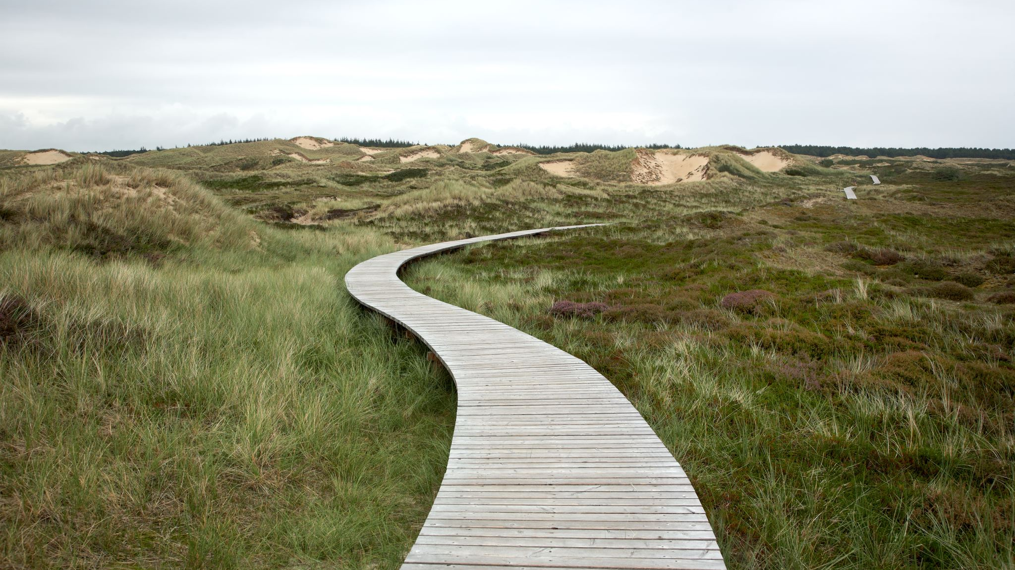
Walks, trails, paths, circuits and cycles
9E
Notes:
https://create.kahoot.it/details/d01af1f0-120f-4f0b-b377-47699822de4f
https://create.kahoot.it/details/c1b4a5da-e73f-4a87-a14e-9c381f4241bb
https://create.kahoot.it/details/ff293372-170d-44ec-8682-28085701eeac
https://create.kahoot.it/details/ed11ceb5-1aae-4c4d-846a-c9ddd9bdf6ba

Slide 2
Learning Intentions
Walk
Trail
Path
Circuit
Cycle

Slide 3
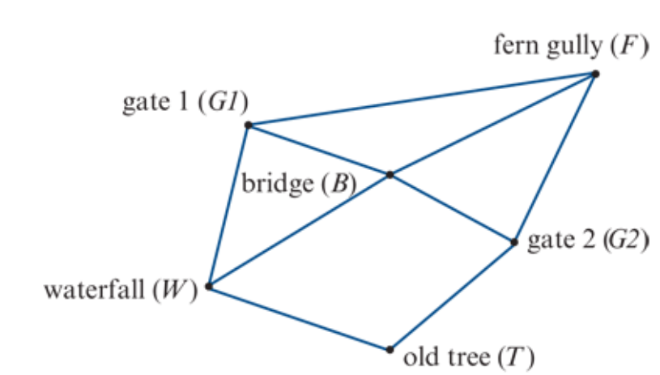
Practical problems
Practical problems: designing a postal delivery route or solving the Königsberg bridge problem.
To solve such problems you will need to know about a number of concepts

Slide 4
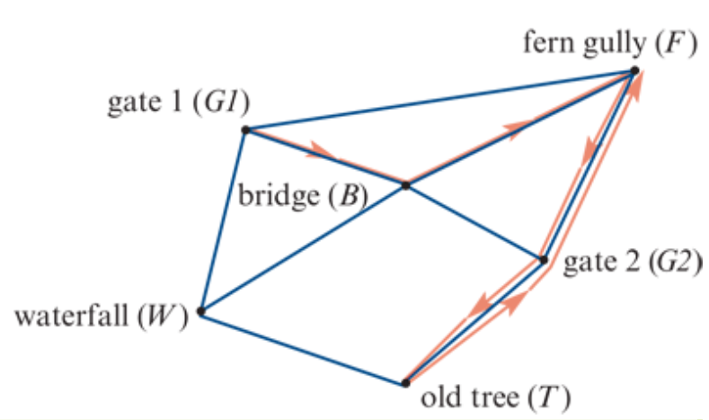
Walk
Finish
Start
A walk is a sequence of edges, linking successive vertices, that connects two different vertices in a graph.
𝐺1 -𝐵-𝐹-𝐺2-𝑇-𝐺2-𝐹
Note 1: The double red arrows on the graph indicate that this track is walked along in both directions.
Note 2: A walk does not require all of its edges or vertices to be different.

Slide 5
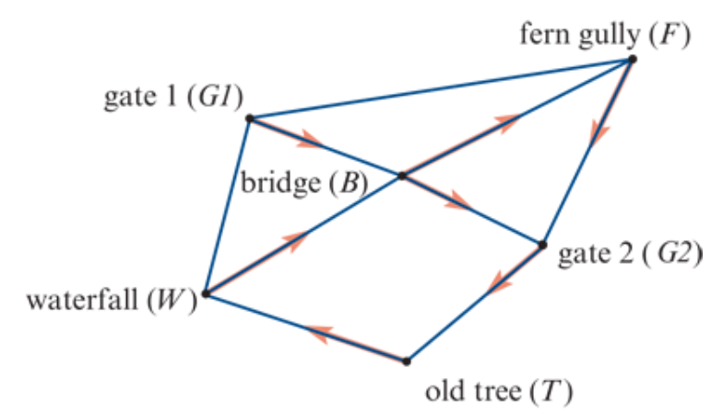
Trail
Start
A trail is a walk with no repeated edges.
𝐺1-𝐵-𝐹-𝐺2-𝑇-𝑊-𝐵-𝐺2
The red arrows on the graph trace out this trail. It has no repeated edges. However, there is one repeated vertex G2. This is permitted on a trail.
Finish

Slide 6
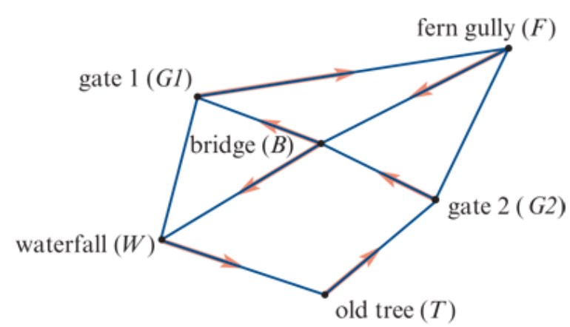
Circuit
Finish
Start
A circuit is a walk that has no repeated edges and starts and ends at the same vertex.
𝐺1-𝐹-𝐵-𝑊-𝑇-𝐺2-𝐵-𝐺1
This circuit begins and ends at the same vertex (𝐺1). The red arrows on the graph trace out this circuit.
There are no repeated edges. However, the circuit passes through vertex 𝐵 twice.

Slide 7
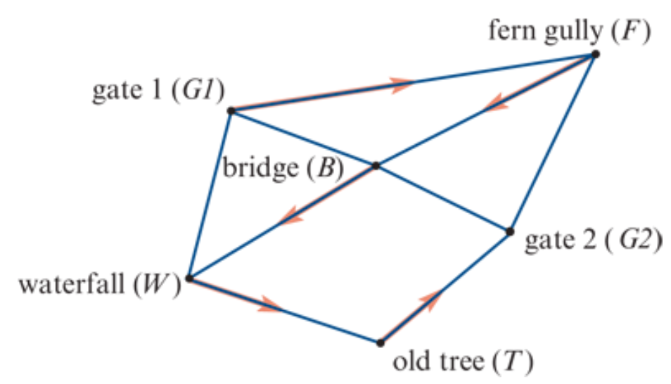
Path
Start
A path is a walk with no repeated vertices.
Note: Because a path has no repeated vertices, there can be no repeated edges.
𝐺1-𝐹-𝐵-𝑊-𝑇-𝐺2
The red arrows on the graph trace out this path. There are no repeated edges or vertices.
Finish

Slide 8
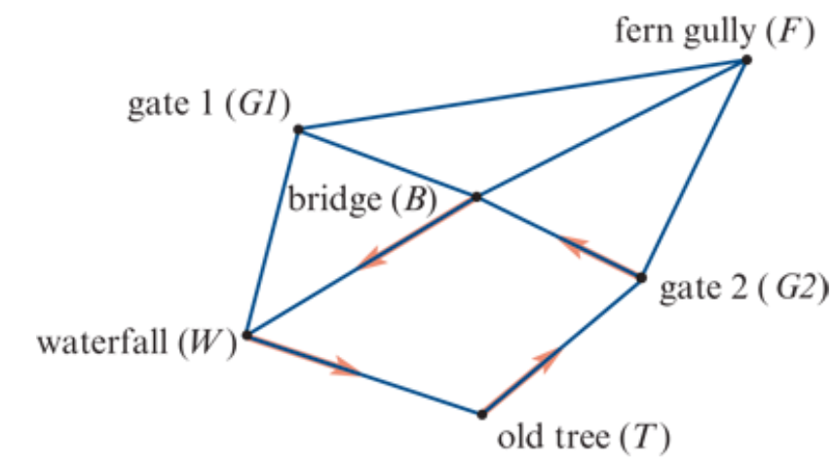
Cycle
A cycle is a walk that has no repeated vertices and starts and ends at the same vertex.
𝐺2-𝐵-𝑊-𝑇-𝐺2
The red arrows on the graph trace out this cycle. Except for the first and last there are no repeated edges or vertices in a cycle.
Start
Finish

Slide 9
Hamilton
Euler

Slide 10
exercises & Summary Book
1. Ex 9E
2. Summary notes for Homework.

