Slide 1
Eulerian trails and circuits
9G

Slide 2
Learning Intentions
Eulerian Trails
Eulerian Circuits

Slide 4
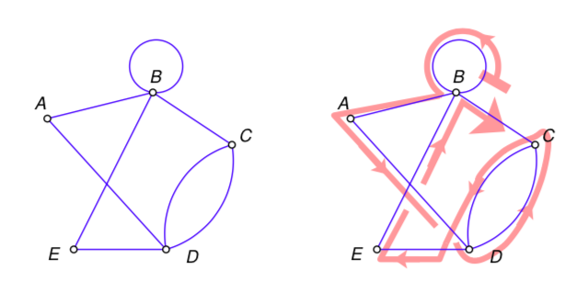
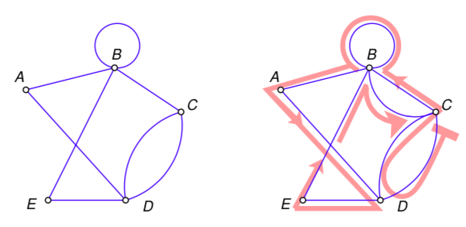
Eulerian trails and circuits
An Eulerian trail is a trail that includes every edge in a graph.
An Eulerian circuit is a circuit that includes every edge in a graph.
An Eulerian trail starts and ends at different vertices.
An Eulerian circuit starts and ends at the same vertex.
An Eulerian trail: BBADCDEBC
An Eulerian circuit: CDCBBADEBC

Slide 5
The Criterion for Eulerian trails
Only traversable graphs
If a graph has an Eulerian trail, then it must have exactly two odd vertices.
Or, to put it another way,
If the number of odd vertices in a graph is anything other than 2, then the graph cannot have an Eulerian trail.

Slide 6
The Criterion for Eulerian Circuits
Only traversable graphs
If a graph has an Eulerian circuit, then all of its vertices must be even vertices.
Or, to put it another way,
If the number of odd vertices in a graph is anything other than 0, then the graph cannot have an Eulerian circuit.

Slide 7
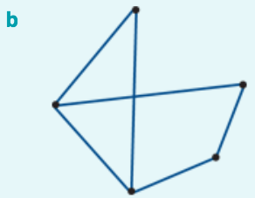
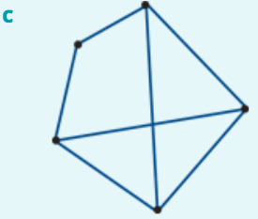
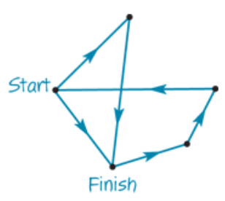
Identifying Eulerian trails and circuits
deg(𝐴)=2
deg(B)=2
deg(𝐴)=2
deg(𝐴)=3
deg(E)=2
deg(B)=2
deg(E)=3
deg(B)=3
deg(D)=3
deg(C)=2
deg(D)=2
deg(C)=2
deg(D)=3
deg(C)=3
Neither: more than two odd vertices
Eulerian circuit: all even vertices
Eulerian trail: two odd vertices, the rest even.

Slide 8
Applications of Eulerian trails and circuits
A postman wants to deliver mail without travelling along any street more than once.
A visitor to a tourist park wants to minimise the distance they walk to see all of the attractions by not having to retrace their steps at any stage.
A road inspector wants to inspect the roads linking several country towns without having to travel along each road more than once.

Slide 9
exercises & Summary Book
1. Ex 9G
2. Summary notes for Homework.

