Slide 1
Hamiltonian paths and cycles
9H
Notes:
https://create.kahoot.it/details/6eb31834-771c-4292-9ce4-94c0d34b790d
https://create.kahoot.it/details/fd463afc-9e30-46cb-b3fe-bf5391903354

Slide 2
Learning Intentions
Hamiltonian Path
Hamiltonian Cycle

Slide 4
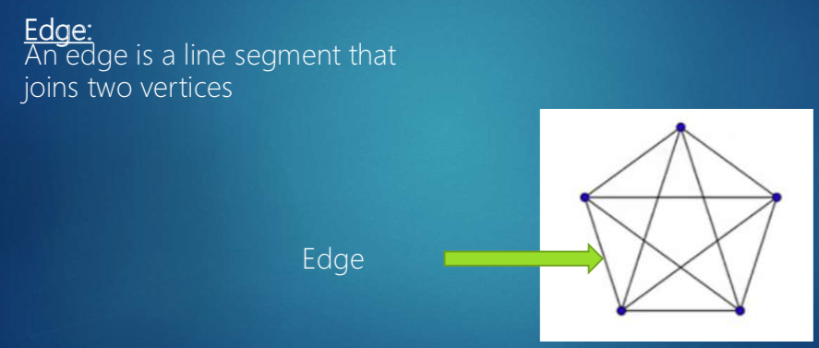
Difference between Euler & Hamilton
Eulerian trails and circuits focus on edges.
Hamiltonian paths and cycles focus on vertices.

Slide 8
Hamiltonian paths and cycles
A Hamiltonian path passes through every vertex in a connected graph. It may or may or may not involve all of the edges in the graph.
A Hamiltonian cycle is a Hamiltonian path that starts and finishes at the same vertex.

Slide 9
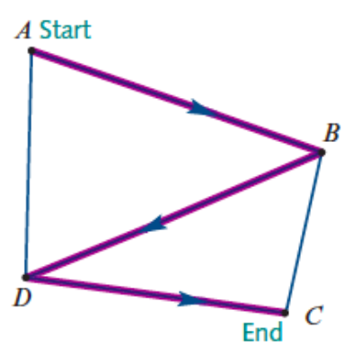
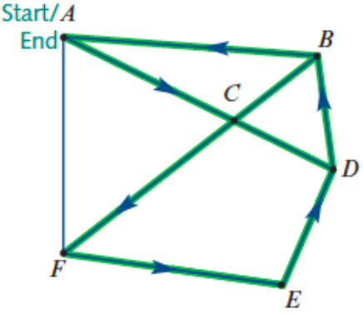
Hamiltonian path: 𝐴-𝐵-𝐷-𝐶
Hamiltonian cycle: 𝐴-𝐶-𝐹-𝐸-𝐷-𝐵-𝐴

Slide 10
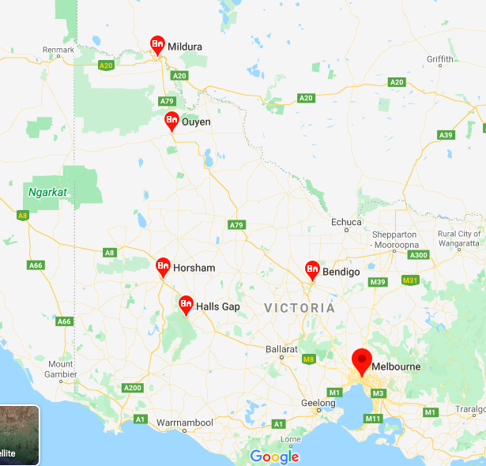
Applications of Hamiltonian paths
Hamiltonian paths You plan a trip from Melbourne to Mildura, with visits to Bendigo, Halls Gap, Horsham, Stawell and Ouyen on the way, but do not want to visit any town more than once.

Slide 11
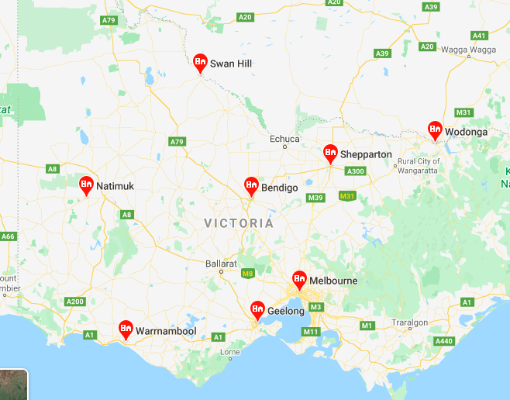
Applications of Hamiltonian cycles
A courier leaves her depot to make a succession of deliveries to a variety of locations before returning to her depot. She does not like to go past each location more than once.
A tourist plans to visit all of the historic sites in a city without visiting each more than once.
You are planning a trip from Melbourne to visit Shepparton, Wodonga, Bendigo, Swan Hill, Natimuk, Warrnambool and Geelong before returning to Melbourne. You don’t want to visit any town more than once.

Slide 12
exercises & Summary Book
1. Ex 9H
2. Summary notes for Homework.

