Slide 1
9A Direct Variation

Slide 2
Some linear equations
are also examples of
direct variation.

Slide 3
Direct Variation
y = k x
Y varies directly with x.
k is the constant
of variation.

Slide 4
Using symbols, we write ‘y is directly proportional to x’ as: y ∝ x.
The symbol ∝ means ‘is proportional to’ or ‘varies as’.

Slide 5
Y = k x
same as
y
x
= k

Slide 6
How to find a
y
x
x y
8
12
16
20
= k
y/x is same
every time
8
2
= 4
12
3
= 4

Slide 7
Direct variation
Goes
through
the
origin.

Slide 8
Not
direct

Slide 9
Determining the constant of variation
y ∝ x
y = kx
When x = 3, y = 21
21 = 3k
∴ k = 7
y = 7x
When x = 5
y = 7(5)
∴ y = 35
When y = 63
63 = 7(x)
∴ x = 9
9
35

Slide 10
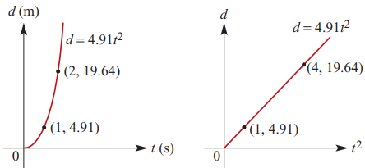
Variation involving powers
If y ∝ $x^{n}$, then y = k$x^{n}$, where k is a constant of variation.
If y ∝ $x^{n}$, then the graph of y against $x^{n}$ is a straight line passing through the origin.

Slide 11
Variation involving powers
y ∝ $x^{2}$
y = k$x^{2}$
When x = 2, y = 12
12 = ($2^{2}$)k
∴ k = 3
y = 3$x^{2}$
When x = 6, y = 3($6^{2}$) = 108
When x = 4, y = 3($4^{2}$)
∴ y = 48
When y = 192
192 = 3($x^{2}$)
∴ x = 8
8
48

Slide 14
What is c ?
1
Y intercept = 1
What is m?
2/3 Up 2, right3

Slide 15
Find an equation
with m = 3 through
point ( 2, 5 ).
y = mx + c
y = 3 X + c

Slide 16
y = mx + c y = 3 X + c
m = 3 ( 2 , 5)
substitute
for x and y
5 = 3(2) + c
5 = 6 + c
-1 = c
y = 3X -1

