Slide 1
9B Inverse variation
A step-by-step guide to direct and inverse proportion

Slide 2
Starter
Strength or Target?
Solve for k:
18=9k
3=2k
72=9k
8=$\frac{k}{3}$
3=$\frac{k}{7}$
5=$\frac{k}{9}$
If a=2b, Find a when b=3 Find b when a = 7
If c=1.5d Find c when d=12 Find d when c=15
If T=8V Find T when V=7 Find V when T=24
If a=$\frac{24}{b}$ Find a when b=6 Find b when a=2
If D=$\frac{21}{E}$ Find D when E=21 Find E when D=42
If f=$\frac{45}{g}$ Find f when g=15 Find g when f=9
k=2
a=6
a=4
k=1.5
b=3.5
b=12
k=8
c=18
d=10
D=1
k=24
E=0.5
k=21
T=56
V=3
f=3
k=45
g=5

Slide 3
Direct variation
y ∝ $\frac{1}{x}$
Inverse variation
y ∝ x
vs
Y is directly proportional to X
Y “is proportional to” X
Y $α$ X
Y = k * X
y = k x
What the question would say
Y is inversely proportional to X
Y “is proportional to” $\frac{1}{X}$
Y $α$ $\frac{1}{X}$
Y = k * $\frac{1}{X}$
y = $\frac{k}{x}$
Read as…
In maths…
Write it as a general formula we can work with…
“k” is the constant that links our two numbers.

Slide 4
Direct variation
Inverse variation
vs
Y is directly proportional to X.
When Y=10, X=5.
Find the equation linking Y and X.
Y is inversely proportional to X.
When Y=10, X=5.
Find the equation linking Y and X.
Y = $\frac{k}{X}$
10 = $\frac{k}{5}$
10 x 5 = k
k = 50
Y = $\frac{50}{X}$
Y = kX
10 = k x 5
k = $\frac{10}{5}$
k = 2
Y = 2X
Start with the general formula
Substitute in values in the question
Solve for k…
Write the specific formula
We can use the general formula to find the specific formula for this relationship.
We can use the specific formula to find other values in the relationship, when one variable is a specific value.

Slide 5
Direct variation
Inverse variation
vs
Y is directly proportional to X.
When Y=10, X=5.
Find the equation linking Y and X.
Y = 2X
2. Find Y when X=2.
Y = 2X
Y = 2 x 2
Y= 4
3. Find X when Y=5
Y = 2X
5 = 2X
X = $\frac{5}{2}$ = 2.5
Y is inversely proportional to X.
When Y=10, X=5.
Find the equation linking Y and X.
Y = $\frac{50}{X}$
2. Find Y when X = 2.
Y = $\frac{50}{X}$
Y = $\frac{50}{2}$
Y = 25
Find X when Y=5
Y = $\frac{50}{X}$
5 = $\frac{50}{X}$
X = $\frac{50}{5}$ = 10
Start with the specific formula
Substitute in values in the question
Start with the specific formula
Substitute in values in the question
Solve for B

Slide 6
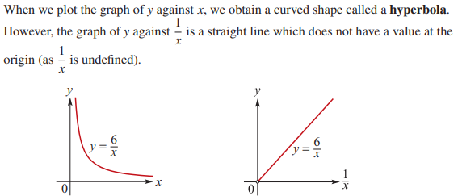

Slide 7
5
1.5
y ∝ $\frac{1}{x}$
y = $\frac{k}{x}$
When x = 1, y = 3
3 = $\frac{k}{1}$
∴ k = 3
y = $\frac{3}{x}$
When x = 3, y = $\frac{3}{3}$ = 1
When x = 2 y = $\frac{3}{2}$ = 1.5
When y = 0.6
0.6 = $\frac{3}{x}$
x = $\frac{3}{0.6}$
∴ x = 5

Slide 8
