Slide 1
9C Data Transformations

Slide 2
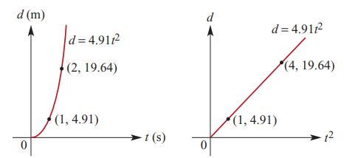
The squared transformation: $x^{2}$
In this transformation, we change the scale on the horizontal axis from $x$ to $x^{2}$.
When we plotted d against $t^{2}$we obtained a straight-line graph, passing through the origin.

Slide 3
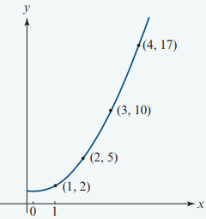
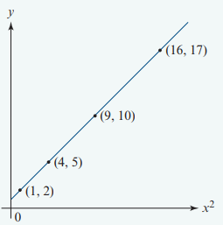
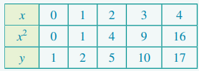

Slide 4
The reciprocal transformation: $\frac{1}{x}$
In this transformation we change the scale on the horizontal axis from $x$ to $\frac{1}{x}$.
By changing the horizontal axis from x to $\frac{1}{x}$ we obtain a linear graph.

Slide 5
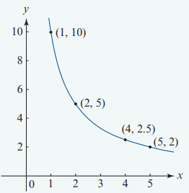
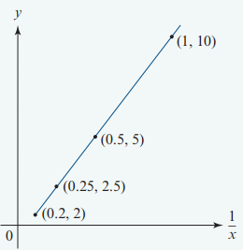
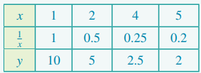

Slide 6
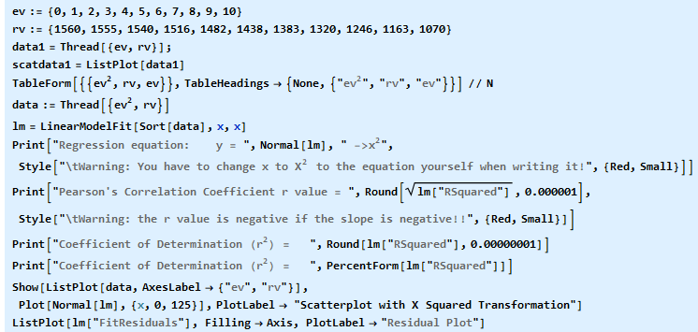
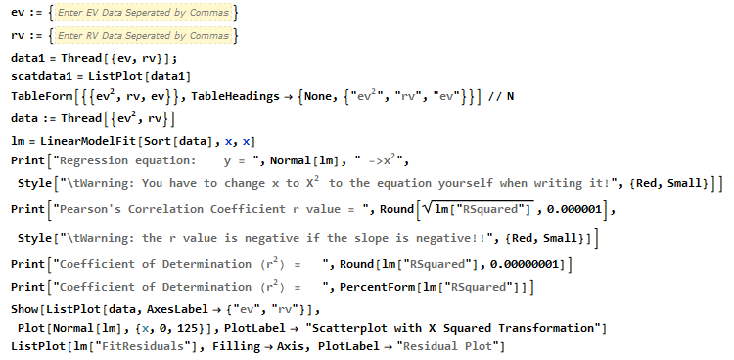
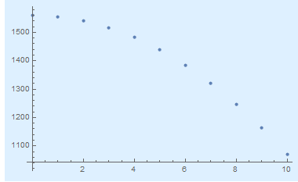
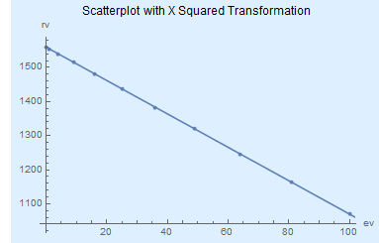

Slide 7
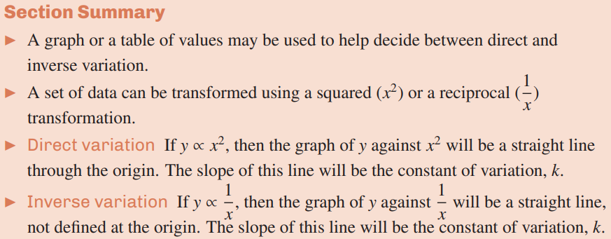

Slide 8
Transformations
8

