Slide 1
Further modelling of non-linear data
9E
Notes:
https://quizizz.com/admin/quiz/5eb3ecd0272827001be13023?source=quiz_share
https://quizizz.com/admin/quiz/5f439516596f6b001b7eb347?source=quiz_share

Slide 2
Modelling non-linear data
$y$ = $kx^{2}$ + $c$
$y$ = $\frac{k}{x}$ + $c$ where $k$ > 0
$y$ = $k\log\left(x\right)$+ $c$ where $k$ > 0.
Instead of plotting y against $x$, we will plot $y$against
$x^{2}$,
$\frac{k}{x}$
$\log_{10}\left(x\right)$
For each of these, $k$ is the slope and $c$ is the y-intercept.
To change the scale on x-axis in order to linearise a non-linear graph.

Slide 3
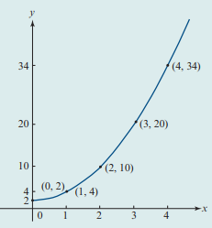
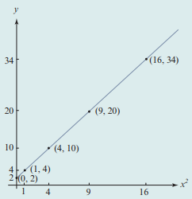
k = slope = $\frac{rise}{run}$ = $\frac{y_{2}−y_{1}}{x_{2}−x_{1}}$
Use (4, 10) and (9, 20)
Label($x_{1}$, $y_{1}$) &($x_{2}$, $y_{2}$)
k = = $\frac{\text{20 − 10}}{\text{9 − 4}}$= $\frac{10}{5}$ = 2
The graph crosses the y-axis at 2.
So c = 2.
$y$ = $2x^{2}$ + $2$

Slide 4
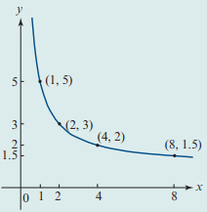
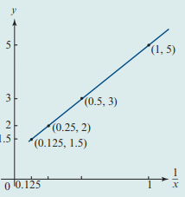
k = slope = $\frac{rise}{run}$ = $\frac{y_{2}−y_{1}}{x_{2}−x_{1}}$
Use (0.5, 3) and (1, 5)
Label($x_{1}$, $y_{1}$) &($x_{2}$, $y_{2}$)
k = = $\frac{\text{5}\text{ − }\text{3}}{\text{1}\text{ − }0.5}$= $\frac{2}{0.5}$ = 4
$y$ = $\frac{4}{x}$ + $c$ Use (2, 3)
3 = $\frac{4}{2}$ + $c$ Label($x$,$y$)
∴ $c$ = 1
$y$ = $\frac{4}{x}$ + $1$

Slide 5
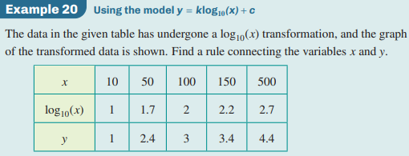
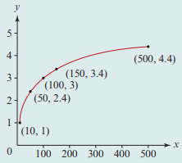
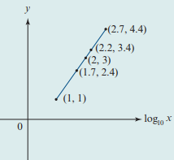
k = slope = $\frac{rise}{run}$ = $\frac{y_{2}−y_{1}}{x_{2}−x_{1}}$
Use (1.7, 2.4) and (2, 3)
Label ($x_{1}$, $y_{1}$) &($x_{2}$, $y_{2}$)
k = = $\frac{\text{3}\text{ − }\text{2.4}}{\text{2}\text{ − }1.7}$= $\frac{0.6}{0.3}$ = 2
$y$ = $k\log\left(x\right)$+ $c$ Use (10, 1)
$1$ = $2\log\left(10\right)$+ $c$ Label($x$,$y$)
∴ $c$ = —1
$y$ = $2\log\left(x\right)$ —1

