Slide 1

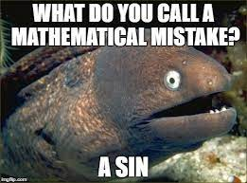
Trigonometry Ratios
Finding a side

Slide 2
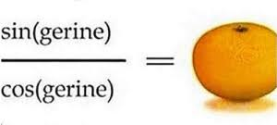
Learning intentions
Use the previous knowledge of Pythagoras
Theorem to find sides of a right-angle triangle.
Determine trigonometric ratios of a right-angle triangle.

Slide 3
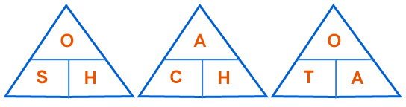

SOH-CAH-TOA
When we are faced with a trigonometry problem in a right-angled triangle, you need to remember…
SOH-CAH-TOA
This is the SINE triangle
This is the TANGENT triangle
These triangles allow us to easily remember each formula.
This is the COSINE triangle

Slide 4





Which rule do we use?
Every time you are faced with a trigonometry question,
you will need to decide which rule you are using.
Do we use Sine, Cosine or Tan?
H
$$x$$
O
$$35°$$
A
$$12cm$$
We would be using the Tan rule.
$$Opposite=tan35×adjacent$$

Slide 5




Which rule do we use?
Do we use Sine, Cosine or Tan?
H
$$12cm$$
O
$$35°$$
A
$$x$$
We would be using the Cosine rule.
$$adjacent= \frac{Hypotenuse}{cos(x)}$$

Slide 6
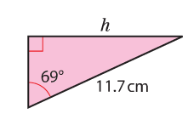

SOH-CAH-TOA
Grade 9
Finding lengths in
right-angled triangles

Slide 7




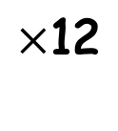


On your calculator:
Find the length of x in the following triangle
12
12
12
12
tan
(35)
$$×\text{12}$$
=
Label the triangle
H
$$x$$
Decide which rule to use.
O
Use the cover-up method
$$35°$$
$$Opposite=tan\left(x\right)×adjacent$$
A
$$12cm$$
Substitute in your values
$$Opposite=tan\left(35\right)×12$$
$$Opposite=8.4cm$$

Slide 8
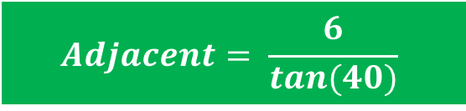







On your calculator:
Find the length of x in the following triangle
12
12
12
12
6
$$÷$$
$$tan40$$
=
Label the triangle
H
$$6cm$$
Decide which rule to use.
O
Use the cover-up method
$$40°$$
$$Adjacent= \frac{opposite}{tan(x)}$$
A
$$x$$
Substitute in your values
$$Adjacent= \frac{6}{tan(40)}$$
$$Adjacent=7.15cm$$

Slide 9
Now it’s time to test your knowledge!
Ex paper

