Slide 1
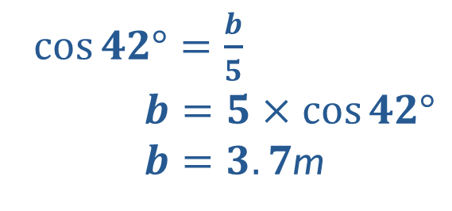

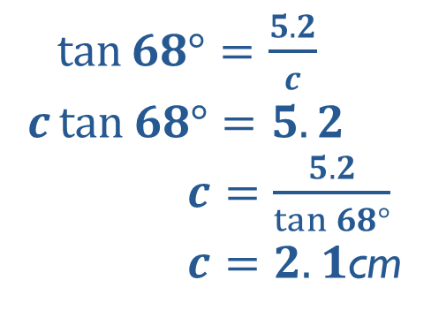
Starter
Work out the length to 1 d.p.
20m
$\sin{30°}=\frac{a}{20}$
$a=20×\sin{30°}$
$a=10$m
a m
5.2cm
30º
68º
$\tan{68°}=\frac{5.2}{c}$
$c\tan{68°}=5.2$
$c=\frac{5.2}{\tan{68°}}$
$c=2.1$cm
c cm
$\cos{42°}=\frac{b}{5}$
$b=5×\cos{42°}$
$b=3.7$m
b cm
42º
5cm

Slide 2
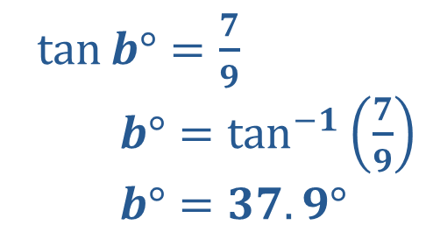
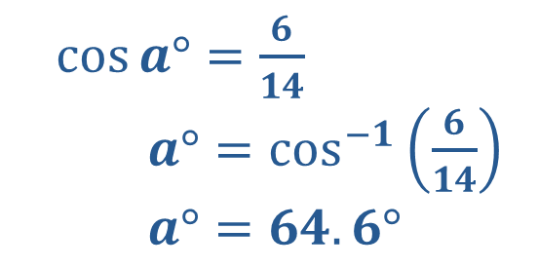
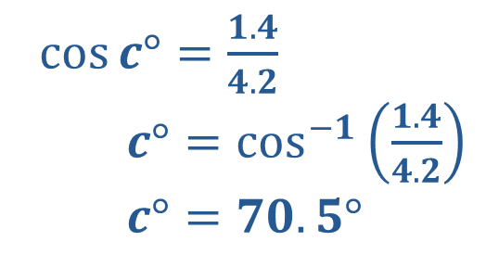
Work out the angle to 1 d.p.
1.4mm
aº
14cm
6cm
$\cos{a°}=\frac{6}{14}$
$a°=\cos^{−1}\left(\frac{6}{14}\right)$
$a°=64.6°$
cº
4.2mm
$\cos{c°}=\frac{1.4}{4.2}$
$c°=\cos^{−1}\left(\frac{1.4}{4.2}\right)$
$c°=70.5°$
bº
$\tan{b°}=\frac{7}{9}$
$b°=\tan^{−1}\left(\frac{7}{9}\right)$
$b°=37.9°$
9m
7m

Slide 3

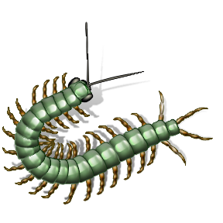
Angle of elevation (looking up from the horizontal)
Angle of depression (looking down from the horizontal)

Slide 4
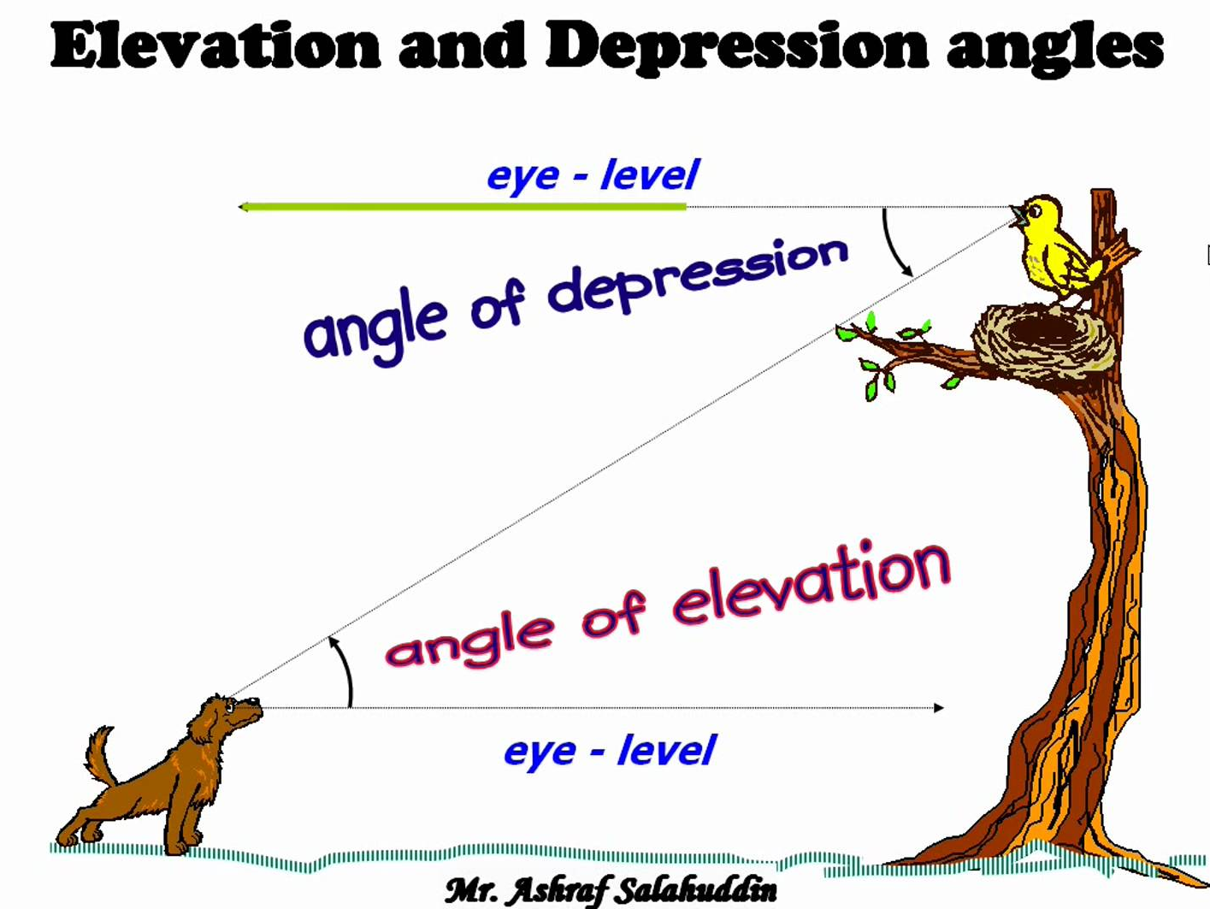

Slide 5
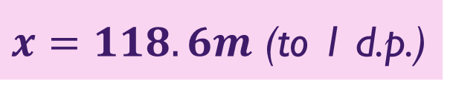

Bob is at the top of a vertical cliff, 80m high. He sees a boat out at sea. The angle of depression from Bob to the boat is 34º. How far from the cliff base is the boat?
x
$$\tan{34°}=\frac{80}{x}$$
$$x\tan{34°}=80$$
$$x=\frac{80}{\tan{34°}}$$
34º
80m
$x=118.6m$ (to 1 d.p.)

Slide 6
Now try Exercise 3H on page 57-58.
You will need to draw a diagram for each question to help you.
O A O
S H C H T A

Slide 7
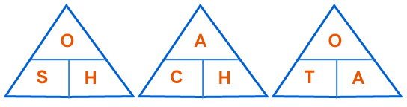

SOH-CAH-TOA
When we are faced with a trigonometry problem in a right-angled triangle, you need to remember…
SOH-CAH-TOA
This is the SINE triangle
This is the TANGENT triangle
These triangles allow us to easily remember each formula.
This is the COSINE triangle

Slide 8
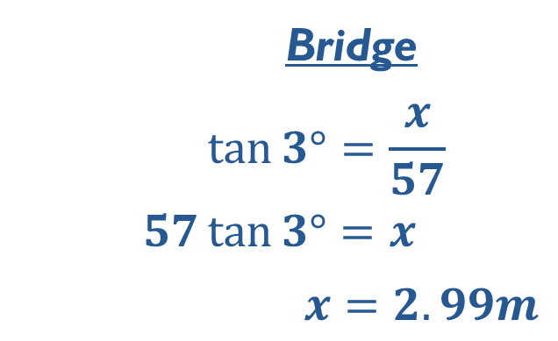
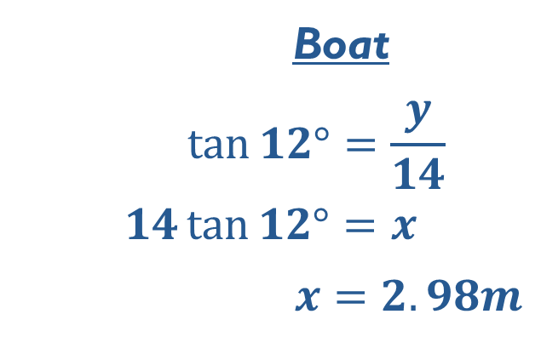
From a point on a riverside, a bridge arch is 57m away and has an angle of elevation of 3º, and the top of a yacht mast 14m away has an angle of elevation of 12º.
Will the yacht fit under the bridge?
Yes! But only just.
y
x
3º
12º
57m
14m
Bridge
$$\tan{3°}=\frac{x}{57}$$
$$57\tan{3°}=x$$
$x=2.99m$
Boat
$$\tan{12°}=\frac{y}{14}$$
$$14\tan{12°}=x$$
$x=2.98m$

