Slide 1
24th April 2013
Trigonometry
Objective: to be able to apply the sine rule to triangles (Grade A)
By the end of the lesson:
All: will be able to remember the sine rule
Most: will be able to find missing angles using Sine Rule
Some: will be able to find missing sides using Sine Rule

Slide 2
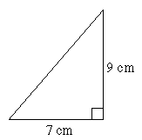
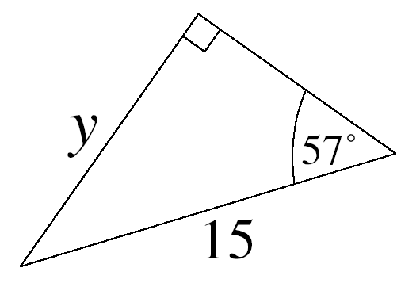
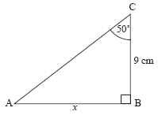
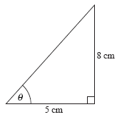
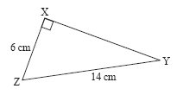
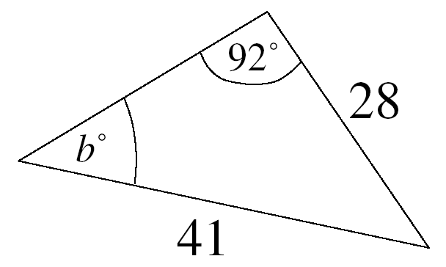
Pythagoras, Sin, Cos or Tan?
1)
2)
3)
x
Pythagoras
Sin – Missing Side
Tan – Missing Side
4)
5)
6)
a
Tan – Missing angle
Pythagoras
Neither...?

Slide 3
Question
What do we do when I have a missing angle or side in a non right angled triangle?

Slide 4
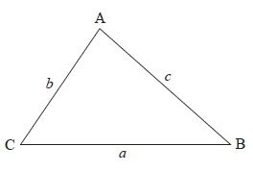
Not a right angle?
It is important you see this is a proportional relationship

Slide 5
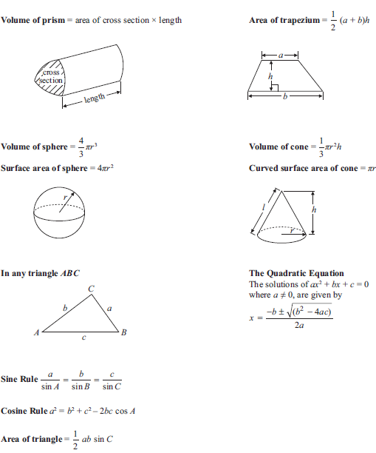
Formula Page
You don’t need to remember it1

Slide 6
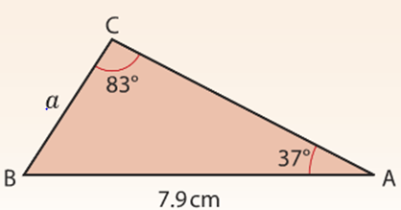
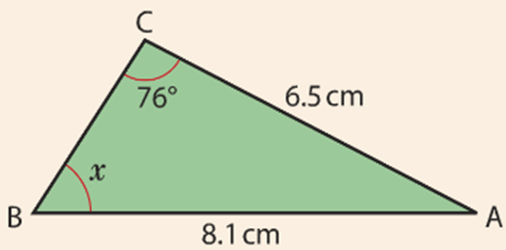
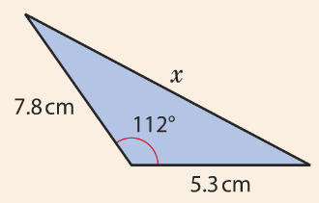
How can I be sure?

Slide 7
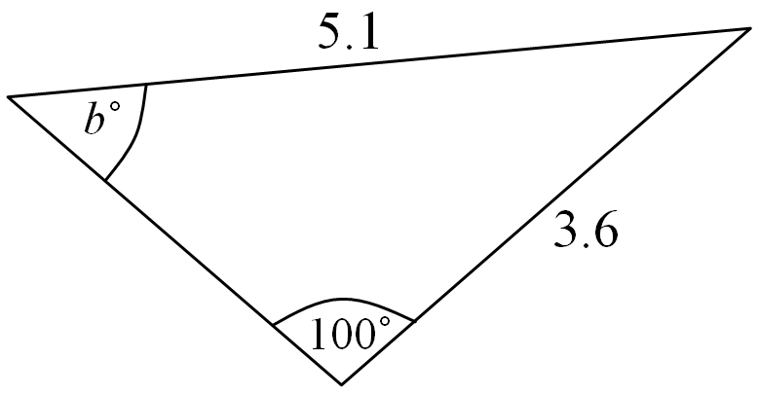
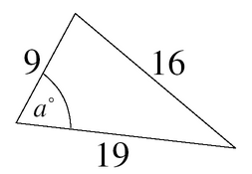
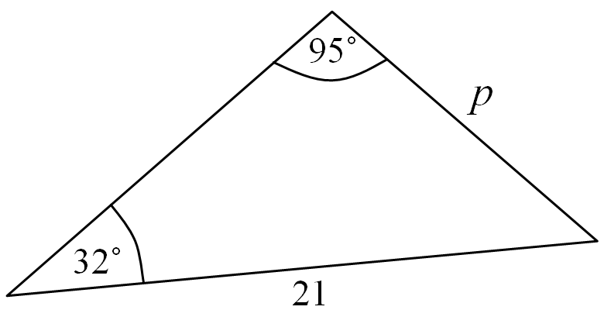
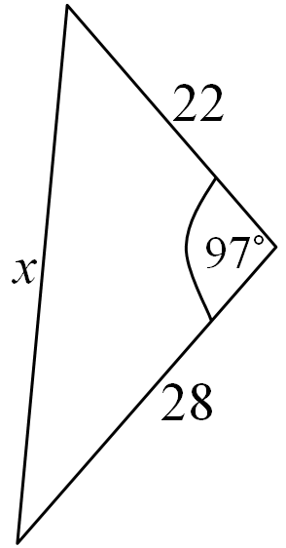
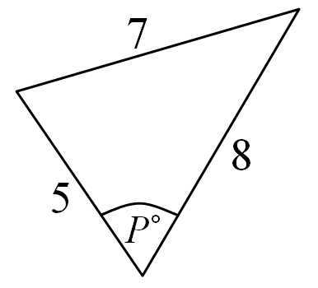
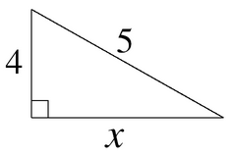
Circle if we can apply the Sine Rule

Slide 8
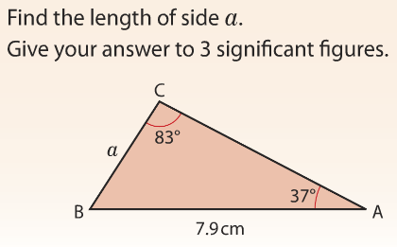
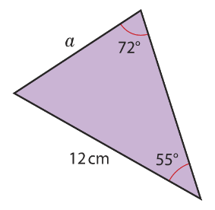
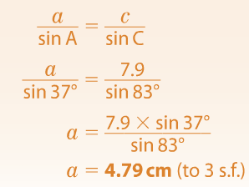

Slide 9
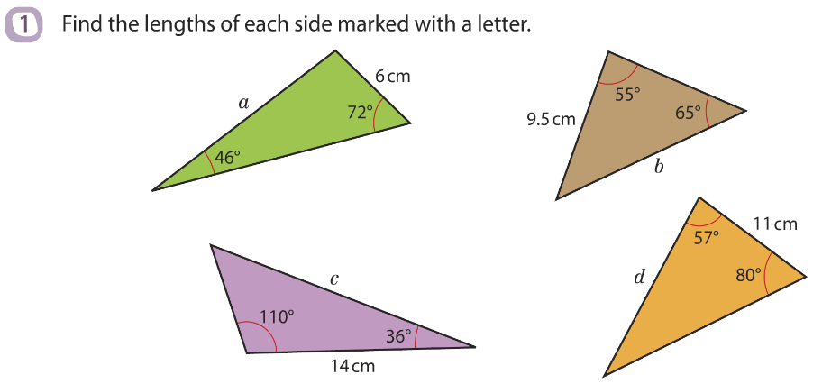
Your Turn – Give your answer to 3 significant figures
Extension
Create and draw your own non right triangle problem that requires the Sine Rule to calculate a missing side. Give this to the person next to you to answer. You must mark their work

Slide 10
Missing Side Solutions
a = 7.93 cm
b = 8.59 cm
c = 23.5 cm
d = 15.9 cm

Slide 11
In your words
To find a missing side on a non right angle triangle using the Sine rule I...

Slide 12
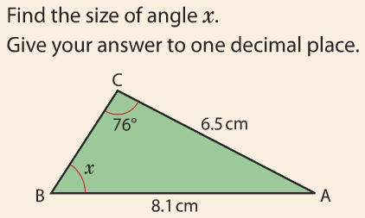
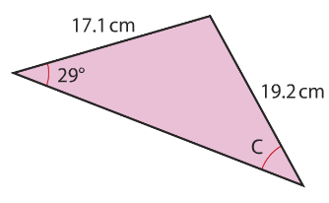
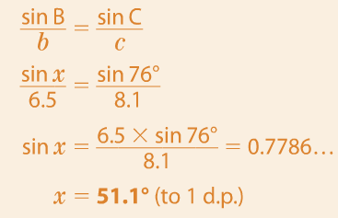

Slide 13
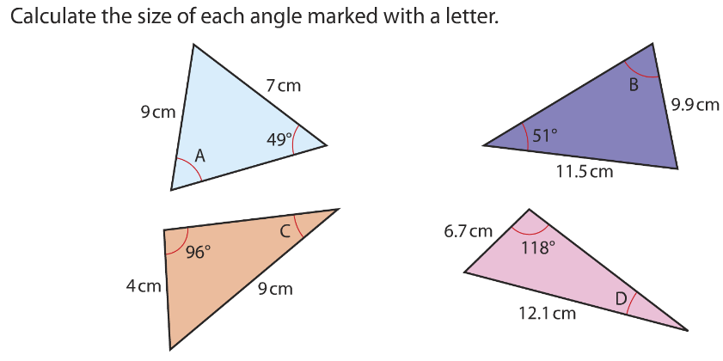
Your Turn – Give your answer to 1 decimal place
Extension
Create and draw your own non right triangle problem that requires the Sine Rule to calculate a missing angle. Give this to the person next to you to answer. You must mark their work

Slide 14
Missing Angle Solutions
a = 35.9º
b = 64.5º
c = 26.2º
d = 29.3º

