Slide 1
Sine Rule and Cosine Rule
Clicker Practice

Slide 2
SOH/CAH/TOA can only be used for right-angled triangles.
The Sine Rule can be used for any triangle:
C
The sides are labelled to match their opposite angles
b
a
A
B
c
a
sinA
b
sinB
c
sinC
The Sine Rule:
= =

Slide 3
We use the Sine Rule when:
We have two angles and a side
OR
We have two sides and the non-included angle (this is the ambiguous case)

Slide 4
Practice Together: find the length of h in mm.
G
41º
Degree mode!!
76º
I
H
26 mm

Slide 5


Find the length of a in cm.
B
53º
3 sig figs!!
A
62º
5.53
0
5 cm
C

Slide 6
Find the length of f in cm.
3 sig figs!!
F
13 cm
6.36
0
28º
130º
D
E

Slide 7
Practice Together: Find the measure of angle ABC.
C
47º
5 cm
θ
A
B
6 cm

Slide 8
Find the measure of angle PRQ:
Q
6 km
P
27º
3.5 km
θ
51.1
0.1
3 sig figs!!
R

Slide 9
Find the measure of angle EDF:
D
8 m
θ
3 sig figs!!
F
70º
9.5 m
57.7
0
E

Slide 10
We use the Cosine Rule when:
Two sides and the INCLUDED angle (SAS)
OR
All three sides (SSS)

Slide 11
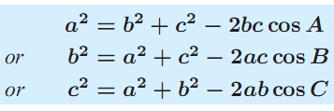
The Cosine Rule
A°
c
b
B°
C°
B
a
C
(One side)²
=
(other side)²+(last side)²
-
2(other side)(last side)cos(angle of 1st side)

Slide 12
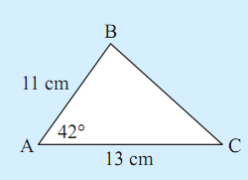
Practice Together: Find the length of side a

Slide 13
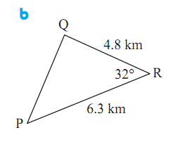
Find the length of side r in km:
3 sig figs!!
3.38
0

Slide 14
Find the length of AC in cm:
B
8.3 cm
72º
3 sig figs!!
A
5.4 cm
8.39
0
C

Slide 15
Practice Together: Find the measure of the unknown angles

Slide 16
Find the measure of angle GHI
G
3 sig figs!!
13 cm
11 cm
68.7
0
θ
I
H
12 cm

Slide 17
Find the measure of angle DEF:
3 sig figs!!
F
10 cm
5 cm
112
0
D
7 cm
E

Slide 18
Find the measure of the largest angle of a triangle with sides 11cm, 13cm, and 19cm.
3 sig figs!!
104
0

Slide 19
