Slide 1
The language of polynomials
6A
Notes:
https://www.transum.org/software/GraphMatch/Default.asp?Level=2

Slide 2
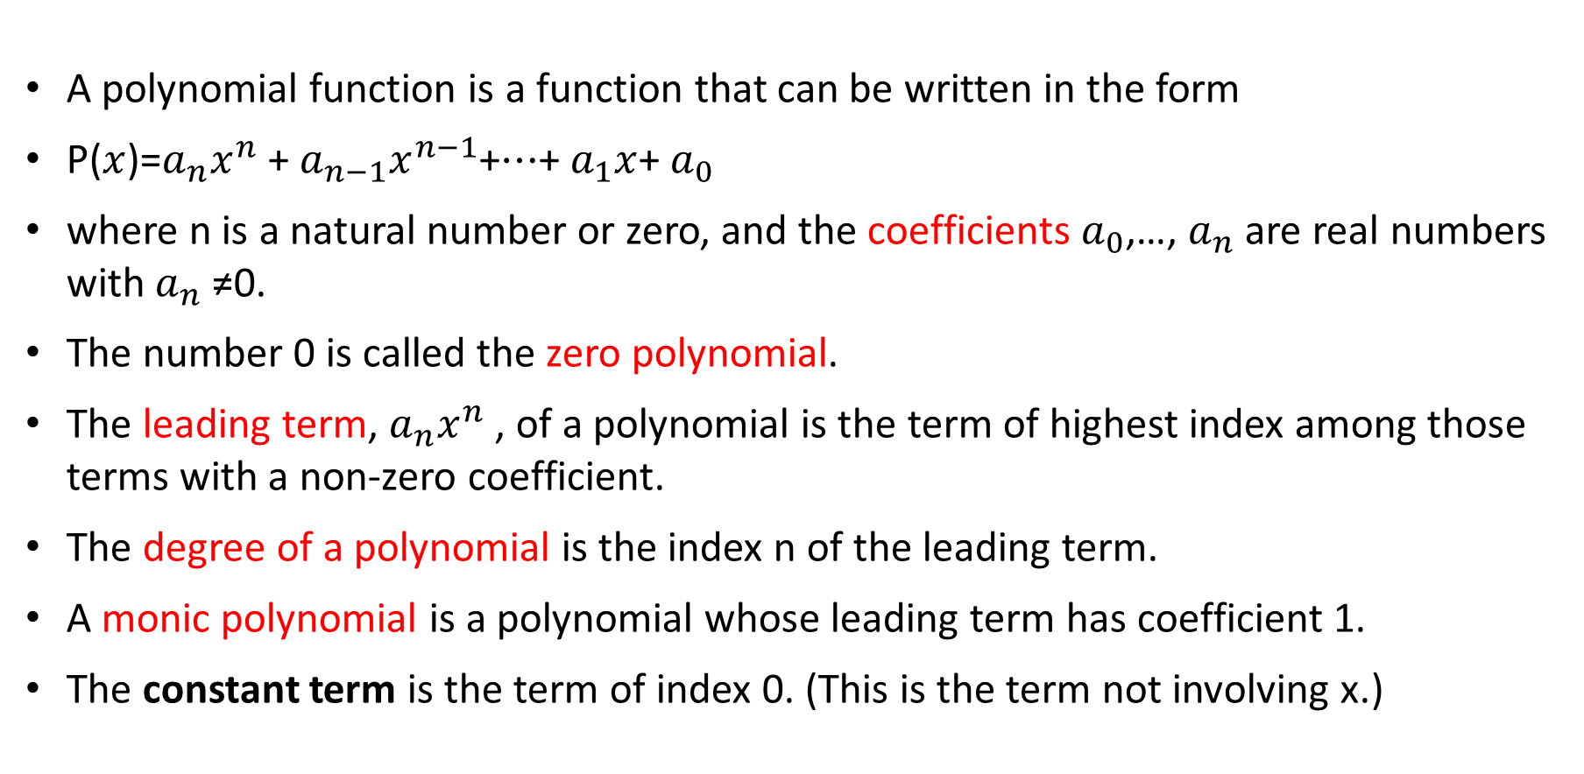
A polynomial function
A polynomial function is a function that can be written in the form
P($x$)=$a_{n}x^{n}$+ $a_{n−1}x^{n−1}$+⋯+ $a_{1}x$+ $a_{0}$
where n is a natural number or zero, and the coefficients $a_{0}$,…, $a_{n}$ are real numbers with $a_{n}$≠0.
The number 0 is called the zero polynomial.
The leading term, $a_{n}x^{n}$, of a polynomial is the term of highest index among those terms with a non-zero coefficient.
The degree of a polynomial is the index n of the leading term.
A monic polynomial is a polynomial whose leading term has coefficient 1.
The constant term is the term of index 0. (This is the term not involving x.)

Slide 3

Example
Let P($x$)= $x^{4}$−3$x^{3}$−2. Find:
1. P(1)
2. P(−1)
3. P(2)
4. P(−2)
Solution
1. P(1)= $1^{4}$−3×$1^{3}$−2 =1−3−2=−4
2. P(−1)= ${\text{(−1)}}^{4}$−3× ${\text{(−1)}}^{3}$−2=1+3−2=2
3. P(2)= $2^{4}$−3× $2^{3}$−2=16−24−2=−10
4. P(−2)= ${\text{(−}\text{2}\text{)}}^{4}$−3× ${\text{(−}\text{2}\text{)}}^{3}$−2=16+24−2=38

Slide 4
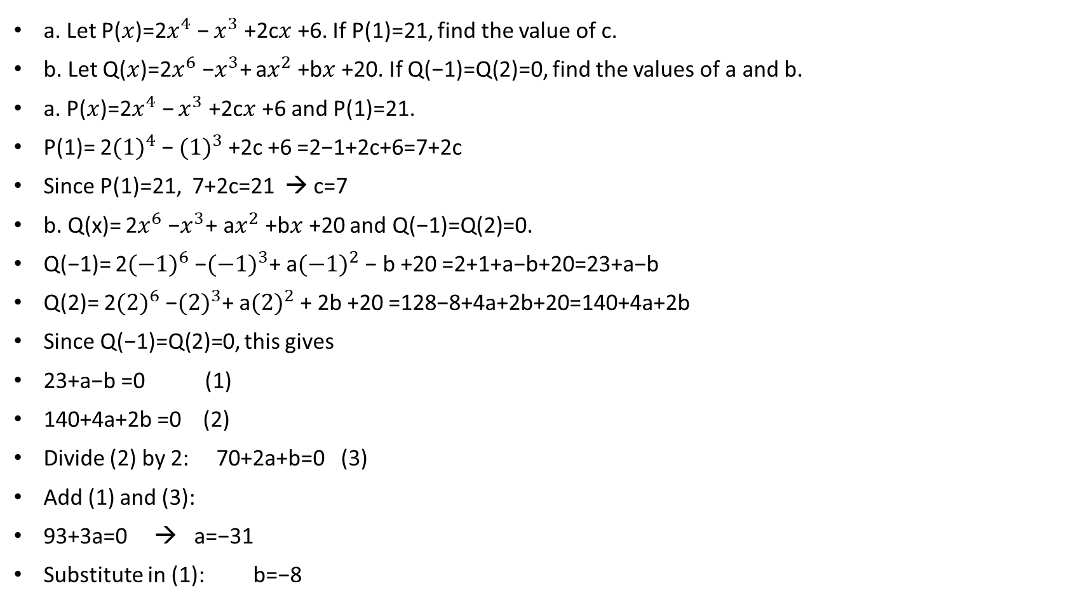
Example
a. Let P($x$)=2$x^{4}$− $x^{3}$+2c$x$+6. If P(1)=21, find the value of c.
b. Let Q($x$)=2$x^{6}$−$x^{3}$+ a$x^{2}$+b$x$+20. If Q(−1)=Q(2)=0, find the values of a and b.
a. P($x$)=2$x^{4}$− $x^{3}$+2c$x$+6 and P(1)=21.
P(1)= 2${(1)}^{4}$− ${(1)}^{3}$+2c +6 =2−1+2c+6=7+2c
Since P(1)=21, 7+2c=21 → c=7
b. Q(x)= 2$x^{6}$−$x^{3}$+ a$x^{2}$+b$x$+20 and Q(−1)=Q(2)=0.
Q(−1)= 2${(−1)}^{6}$−${(−1)}^{3}$+ a${(−1)}^{2}$− b +20 =2+1+a−b+20=23+a−b
Q(2)= 2${(2)}^{6}$−${(2)}^{3}$+ a${(2)}^{2}$+ 2b +20 =128−8+4a+2b+20=140+4a+2b
Since Q(−1)=Q(2)=0, this gives
23+a−b =0 (1)
140+4a+2b =0 (2)
Divide (2) by 2: 70+2a+b=0 (3)
Add (1) and (3):
93+3a=0 → a=−31
Substitute in (1): b=−8

Slide 5
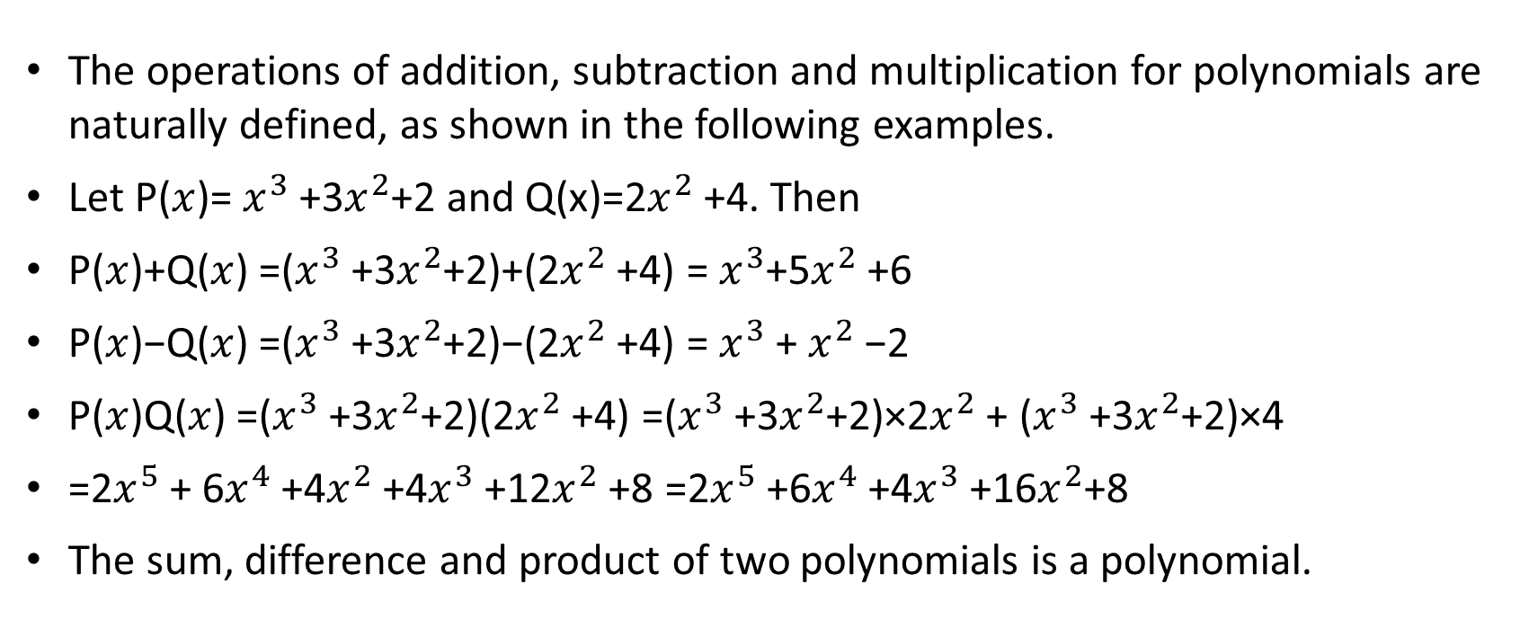
The arithmetic of polynomials
The operations of addition, subtraction and multiplication for polynomials are naturally defined, as shown in the following examples.
Let P($x$)= $x^{3}$+3$x^{2}$+2 and Q(x)=2$x^{2}$+4. Then
P($x$)+Q($x$) =($x^{3}$+3$x^{2}$+2)+(2$x^{2}$+4) = $x^{3}$+5$x^{2}$+6
P($x$)−Q($x$) =($x^{3}$+3$x^{2}$+2)−(2$x^{2}$+4) = $x^{3}$+ $x^{2}$−2
P($x$)Q($x$) =($x^{3}$+3$x^{2}$+2)(2$x^{2}$+4) =($x^{3}$+3$x^{2}$+2)×2$x^{2}$+ ($x^{3}$+3$x^{2}$+2)×4
=2$x^{5}$+ 6$x^{4}$+4$x^{2}$+4$x^{3}$+12$x^{2}$+8 =2$x^{5}$+6$x^{4}$+4$x^{3}$+16$x^{2}$+8
The sum, difference and product of two polynomials is a polynomial.

Slide 6
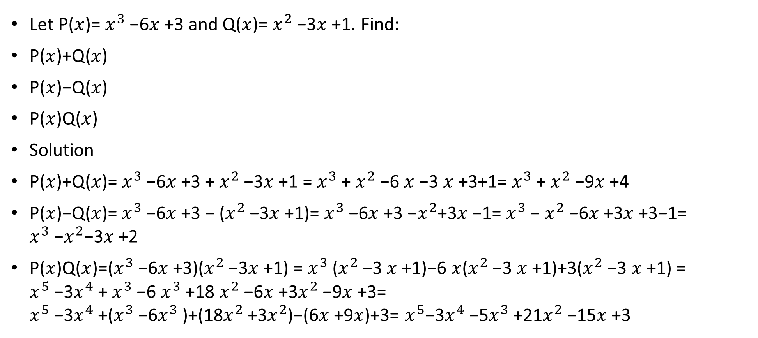
example
Let P($x$)= $x^{3}$−6$x$+3 and Q($x$)= $x^{2}$−3$x$+1. Find:
P($x$)+Q($x$)
P($x$)−Q($x$)
P($x$)Q($x$)
Solution
P($x$)+Q($x$)= $x^{3}$−6$x$+3 + $x^{2}$−3$x$+1 = $x^{3}$+ $x^{2}$−6 $x$−3 $x$+3+1= $x^{3}$+ $x^{2}$−9$x$+4
P($x$)−Q($x$)= $x^{3}$−6$x$+3 − ($x^{2}$−3$x$+1)= $x^{3}$−6$x$+3 −$x^{2}$+3$x$−1= $x^{3}$− $x^{2}$−6$x$+3$x$+3−1= $x^{3}$−$x^{2}$−3$x$+2
P($x$)Q($x$)=($x^{3}$−6$x$+3)($x^{2}$−3$x$+1) = $x^{3}$($x^{2}$−3 $x$+1)−6 $x$($x^{2}$−3 $x$+1)+3($x^{2}$−3 $x$+1) = $x^{5}$−3$x^{4}$+ $x^{3}$−6 $x^{3}$+18 $x^{2}$−6$x$+3$x^{2}$−9$x$+3= $x^{5}$−3$x^{4}$+($x^{3}$−6$x^{3}$)+(18$x^{2}$+3$x^{2}$)−(6$x$+9$x$)+3= $x^{5}$−3$x^{4}$−5$x^{3}$+21$x^{2}$−15$x$+3

Slide 7
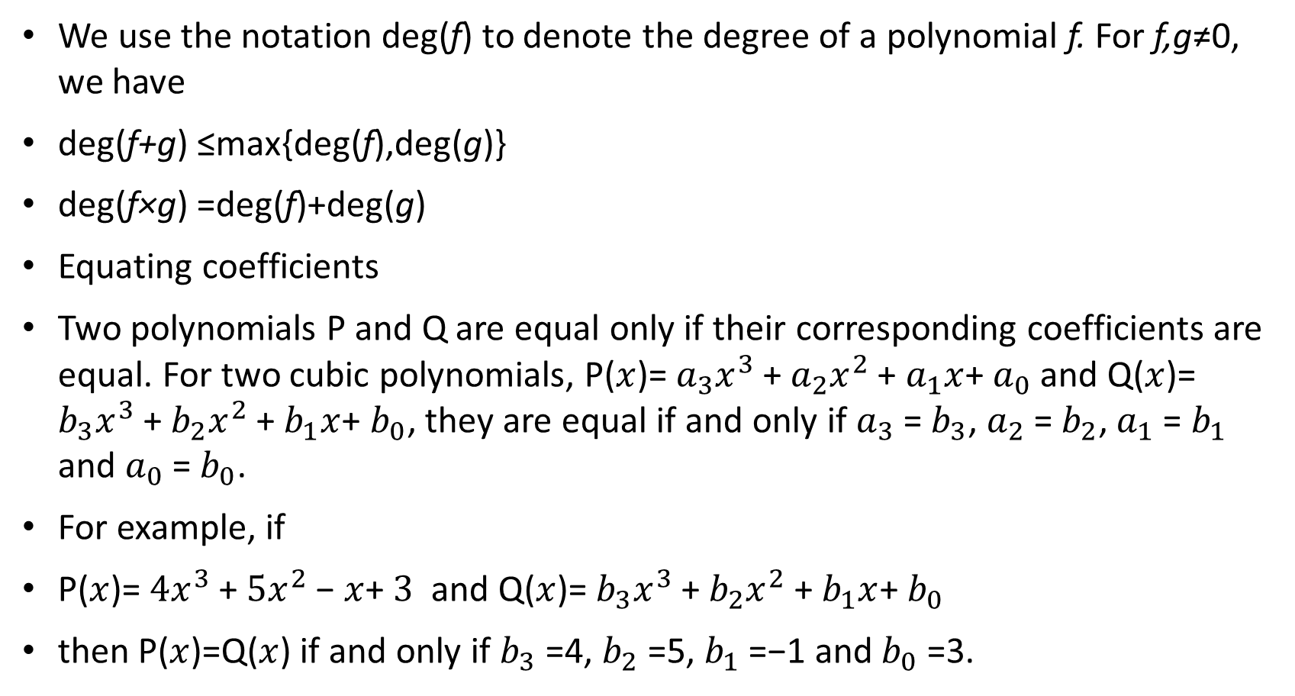
Equating coefficients
We use the notation deg(f) to denote the degree of a polynomial f. For f,g≠0, we have
deg(f+g) ≤max{deg(f),deg(g)}
deg(f×g) =deg(f)+deg(g)
Equating coefficients
Two polynomials P and Q are equal only if their corresponding coefficients are equal. For two cubic polynomials, P($x$)= $a_{3}x^{3}$+ $a_{2}x^{2}$+ $a_{1}x$+ $a_{0}$ and Q($x$)= $b_{3}x^{3}$+ $b_{2}x^{2}$+ $b_{1}x$+ $b_{0}$, they are equal if and only if $a_{3}$= $b_{3}$, $a_{2}$= $b_{2}$, $a_{1}$= $b_{1}$ and $a_{0}$ = $b_{0}$.
For example, if
P($x$)= $4x^{3}$+ $5x^{2}$− $x$+ $3$ and Q($x$)= $b_{3}x^{3}$+ $b_{2}x^{2}$+ $b_{1}x$+ $b_{0}$
then P($x$)=Q($x$) if and only if $b_{3}$=4, $b_{2}$=5, $b_{1}$=−1 and $b_{0}$=3.

Slide 8
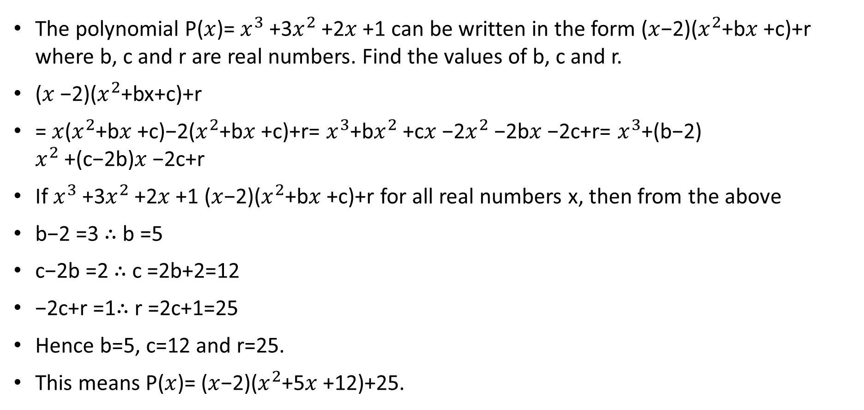
Example
The polynomial P($x$)= $x^{3}$+3$x^{2}$+2$x$+1 can be written in the form ($x$−2)($x^{2}$+b$x$+c)+r where b, c and r are real numbers. Find the values of b, c and r.
($x$−2)($x^{2}$+bx+c)+r
= $x$($x^{2}$+b$x$+c)−2($x^{2}$+b$x$+c)+r= $x^{3}$+b$x^{2}$+c$x$−2$x^{2}$−2b$x$−2c+r= $x^{3}$+(b−2) $x^{2}$+(c−2b)$x$−2c+r
If $x^{3}$+3$x^{2}$+2$x$+1 ($x$−2)($x^{2}$+b$x$+c)+r for all real numbers x, then from the above
b−2 =3 ∴ b =5
c−2b =2 ∴ c =2b+2=12
−2c+r =1∴ r =2c+1=25
Hence b=5, c=12 and r=25.
This means P($x$)= ($x$−2)($x^{2}$+5$x$+12)+25.

Slide 9
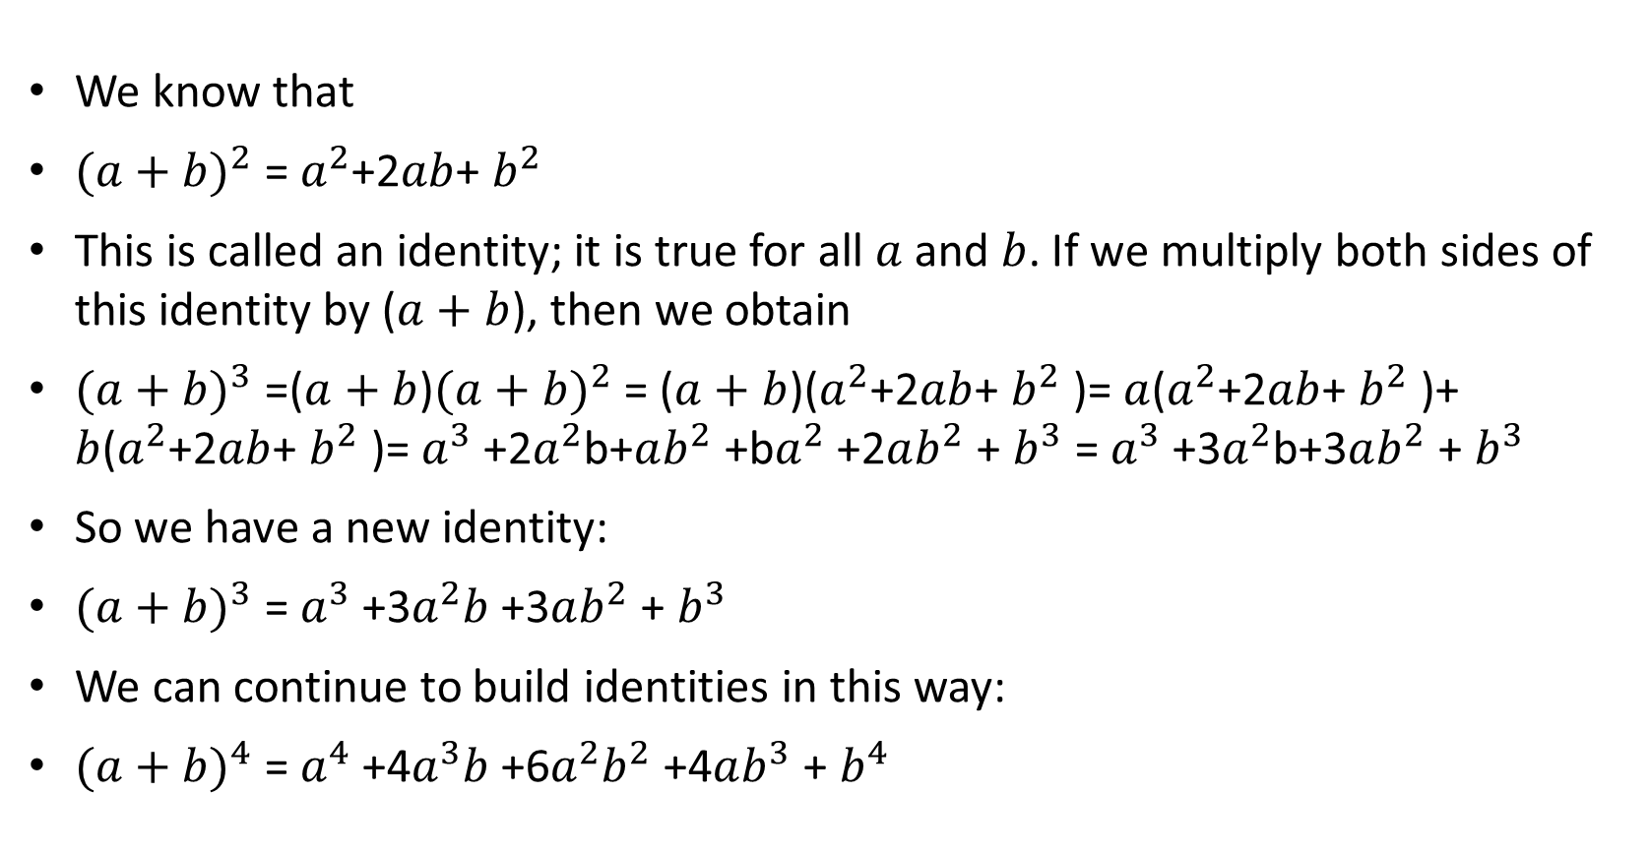

The expansion of ${(a+b)}^{n}$
We know that
${(a+b)}^{2}$= $a^{2}$+2$ab$+ $b^{2}$
This is called an identity; it is true for all $a$ and $b$. If we multiply both sides of this identity by ($a+b$), then we obtain
${(a+b)}^{3}$=($a+b$)${(a+b)}^{2}$= ($a+b$)($a^{2}$+2$ab$+ $b^{2}$)= $a$($a^{2}$+2$ab$+ $b^{2}$)+ $b$($a^{2}$+2$ab$+ $b^{2}$)= $a^{3}$+2$a^{2}$b+$ab^{2}$+b$a^{2}$+2$ab^{2}$+ $b^{3}$= $a^{3}$+3$a^{2}$b+3$ab^{2}$+ $b^{3}$
So we have a new identity:
${(a+b)}^{3}$= $a^{3}$+3$a^{2}b$+3$ab^{2}$+ $b^{3}$
We can continue to build identities in this way:
${(a+b)}^{4}$= $a^{4}$+4$a^{3}b$+6$a^{2}b^{2}$+4$ab^{3}$+ $b^{4}$

Slide 10
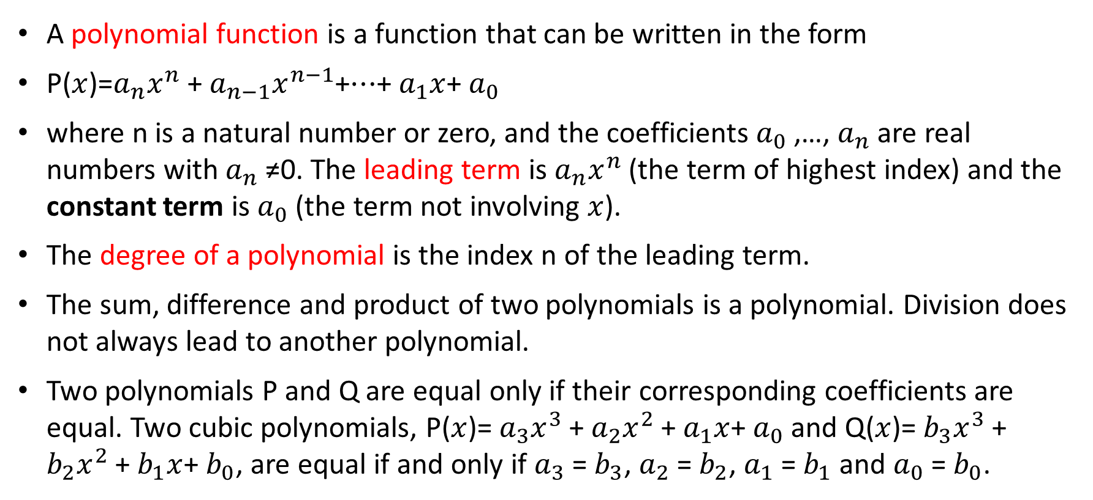
Section Summary
A polynomial function is a function that can be written in the form
P($x$)=$a_{n}x^{n}$+ $a_{n−1}x^{n−1}$+⋯+ $a_{1}x$+ $a_{0}$
where n is a natural number or zero, and the coefficients $a_{0}$,…, $a_{n}$ are real numbers with $a_{n}$≠0. The leading term is $a_{n}x^{n}$ (the term of highest index) and the constant term is $a_{0}$ (the term not involving $x$).
The degree of a polynomial is the index n of the leading term.
The sum, difference and product of two polynomials is a polynomial. Division does not always lead to another polynomial.
Two polynomials P and Q are equal only if their corresponding coefficients are equal. Two cubic polynomials, P($x$)= $a_{3}x^{3}$+ $a_{2}x^{2}$+ $a_{1}x$+ $a_{0}$ and Q($x$)= $b_{3}x^{3}$+ $b_{2}x^{2}$+ $b_{1}x$+ $b_{0}$, are equal if and only if $a_{3}$= $b_{3}$, $a_{2}$= $b_{2}$, $a_{1}$= $b_{1}$ and $a_{0}$ = $b_{0}$.

