Slide 1
Solving cubic inequalities
6G

Slide 2
Notes:
https://www.transum.org/Software/SW/Starter_of_the_day/starter_April29.ASP

Slide 3
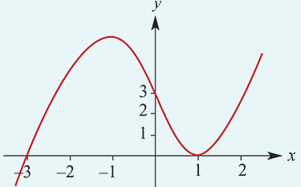
Example
Find {$x$: $x^{3}$+ $x^{2}$−5$x$+3≤0}.
P($x$)= $x^{3}$+ $x^{2}$−5$x$+3
P(1)=1+1−5+3=0
∴ $x$−1 is a factor. By division, y= ${(x−1)}^{2}$($x$+3).
There are only two $x$-axis intercepts, 1 and −3. The $y$-axis intercept is 3.
From the graph we can see that $y$≤0 when x≤−3 or when x=1.
∴{$x$: $x^{3}$+ $x^{2}$−5$x$+3 ≤0}=(−∞,−3]∪{1}
Notes:
https://www.purplemath.com/modules/ineqpoly.htm

Slide 4
Section Summary
Cubic inequalities can be solved by sketching the graph of the corresponding cubic function and analysing the graph.

