Slide 1
Quartic and other polynomial functions
6I

Slide 2
Notes:
https://www.transum.org/Software/sw/Starter_of_the_day/Starter_August5.asp
https://www.mathopenref.com/heronsformula.html

Slide 3
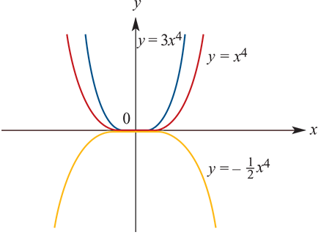
Quartic functions of the form $f\left(x\right)=a{\left(x−h\right)}^{4}+k$
The graph of $f\left(x\right)={\left(x−1\right)}^{4}+3$ is obtained from the graph of $y=x^{4}$ by a translation of 1 unit in the positive direction of the $x$-axis and 3 units in the positive direction of the $y$-axis.
As with other graphs it has been seen that changing the value of $a$ simply narrows or broadens the graph without changing its fundamental shape. Again, if $a$<0, the graph is inverted.
The significant feature of the graph of a quartic of this form is the turning point (a point of zero gradient). The turning point of $y=x^{4}$ is at the origin (0,0).
For the graph of a quartic function of the form
$y=a{\left(x−h\right)}^{4}+k$ the turning point is at ($h$, $k$).
When sketching quartic graphs of the form $y=a{\left(x−h\right)}^{4}+k$, first identify the turning point. To add further detail to the graph, find the $x$-axis and $y$-axis intercepts.

Slide 4
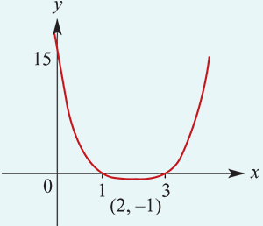
example
Sketch the graph of the function $y={\left(x−2\right)}^{4}−1$.
Turning point is (2,−1).
$x$-axis intercepts:
Let $y=$0
$$0={\left(x−2\right)}^{4}−1$$
$$1={\left(x−2\right)}^{4}$$
$$±\sqrt[4]{1}=x−2$$
$x=2+1$ or $x=2−1$
$x=3$ or $x=1$
$y$-axis intercept:
Let $x=0$
$$y={\left(0−2\right)}^{4}−1$$
$$y=16−1=15$$
The implied domain of all quartics is R, but unlike cubics the range is not R.

Slide 5
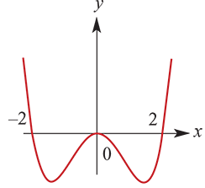
Other quartic functions
The techniques for graphing quartic functions in general are very similar to those employed for cubic functions.
The graph of $y=2x^{4}−8x^{2}$ is shown.

Slide 6
example
Solve each of the following equations for x:
1. $x^{4}−8x=0$
2. 2$x^{4}−8x^{2}=0$
$${3. x}^{4}−2x^{3}−24x^{2}=0$$
$$x^{4}−8x=0$$
Factorise to obtain $x\left(x^{3}−8\right)=0$ → $x=0 or x^{3}$ $−$ 8 =0 ∴ $x=0$ or $x=2$.
2$x^{4}−8x^{2}=0$
Factorise to obtain ${2x}^{2}\left(x^{2}−4\right)=0$ → ${2x}^{2}$=0 or $x^{2}−4=0$ ∴ $x=0$ or $x=2$or $x=−2$
$$x^{4}−2x^{3}−24x^{2}=0$$
Factorise to obtain $x^{2}\left(x^{2}−2x−24\right)=0$ → $x^{2}$=0 or $x^{2}−2x−24=0$→$x=0$ or $(x−6)(x+4)=0$
∴ $x=0$ or $x=6$or $x=−4$

Slide 7
Odd and even polynomials
In this subsection we look briefly at odd and even polynomial functions. Knowing that a function is even or that it is odd is very helpful when sketching its graph.
A function $f$ is even if $f\left(−x\right)$= $f\left(x\right)$. This means that the graph is symmetric about the $y$-axis. That is, the graph appears the same after reflection in the $y$-axis.
A function $f$ is odd if $f\left(−x\right)$=$−f\left(x\right)$. The graph of an odd function has rotational symmetry with respect to the origin: the graph remains unchanged after rotation of 180° about the origin.
A power function is a function f with rule $f\left(x\right)$=$x^{r}$ where $r$ is a non-zero real number. In this book we focus on the cases where $r$ is a positive integer or $r$∈{−2,−1, $\frac{1}{2}$, $\frac{1}{3}$}.

Slide 8
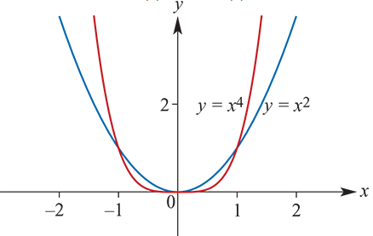
Even-degree power functions
The functions with rules $f\left(x\right)=x^{2}$ and $f\left(x\right)=x^{4}$are examples of even-degree power functions.
The following are properties of all even-degree power functions:
$f\left(−x\right)$=($x$) for all $x$
$f$(0)=0
As $x$→±∞, $y$→∞.
Note that, if $m$ and $n$ are positive even integers with $m$>$n$, then:
$x^{m}$> $x^{n}$ for $x$>1 or $x$<−1
$x^{m}$< $x^{n}$ for −1< $x$<1 with $x$≠0
$x^{m}$= $x^{n}$ for $x$=1 or $x$=−1 or $x$=0.

Slide 9
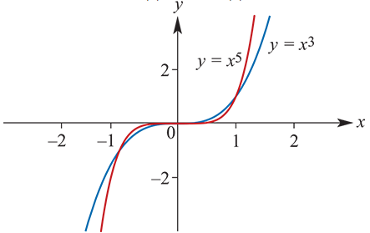
Odd-degree power functions
The functions with rules $f\left(x\right)=x^{3}$ and $f\left(x\right)=x^{5}$are examples of odd-degree power functions.
The following are properties of all odd-degree power functions:
$f\left(−x\right)$=− $f\left(x\right)$ for all $x$
$f$(0)=0
As $x$→∞, y→∞ and
as $x$→−∞, y→−∞.
Note that, if $m$ and $n$ are positive odd integers with $m$>$n$, then:
$x^{m}$> $x^{n}$ for $x$>1 or −1< $x$<0
$x^{m}$< $x^{n}$ for $x$<−1 or 0< $x$<1
$x^{m}$= $x^{n}$ for $x$=1 or $x$=−1 or $x$=0.

Slide 10
example
State whether each of the following polynomials is even or odd:
$$f\left(x\right)={6x}^{4}−{3x}^{2}$$
$$g\left(x\right)={3x}^{5}−x^{3}+ x$$
$$h\left(x\right)=x^{6}−{3x}^{2}+2$$
$$m\left(x\right)=x^{7}−4x$$
$$f\left(−x\right)={6(−x)}^{4}−{3(−x)}^{2} ={6x}^{4}−{3x}^{2}=f\left(x\right)$$
The function is even.
$$g\left(−x\right)={3(−x)}^{5}−{\left(−x\right)}^{3}+\left(−x\right)={−3x}^{5}+x^{3}−x=−g\left(x\right)$$
The function is odd.
$$h\left(−x\right)={(−x)}^{6}−{3\left(−x\right)}^{2}+2=x^{6}−{3x}^{2}+2=h\left(x\right)$$
The function is even.
$$m\left(−x\right)={(−x)}^{7}−4\left(−x\right)=−x^{7}+4x=−m\left(x\right)$$
The function is odd.

Slide 11
Even or Odd-degree power functions?
The results of the example are not surprising since:
The sum of two even functions is even, and any constant multiple of an even function is even.
The sum of two odd functions is odd, and any constant multiple of an odd function is odd.
Not every polynomial is even or odd. For example, the polynomial $f\left(x\right)=x^{2}+x$ is neither.

Slide 12
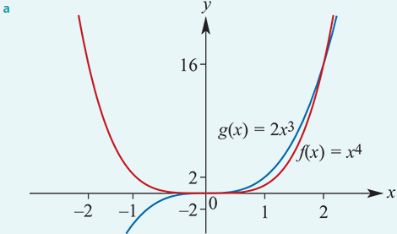
example
a. On the one set of axes sketch the graphs of $f\left(x\right)=x^{4}$ and $g\left(x\right)=2x^{3}$.
b. Solve the equation $f\left(x\right)$= $g\left(x\right)$.
c. Solve the inequality $f\left(x\right)$≤ $g\left(x\right)$.
b. $f\left(x\right)$= $g\left(x\right)$
$x^{4}$ = $2x^{3}$→ $x^{4}$ − $2x^{3}$=0 → $x^{3}\left(x−2\right)=0$
$x$=0 or $x$=2
c. $f\left(x\right)$≤ $g\left(x\right)$
$x^{4}$ ≤ $2x^{3}$
From the graphs and part b, $f\left(x\right)$≤ $g\left(x\right)$for $x$∈[0,2].

Slide 13
Section Summary
The graph of $y$=𝑎${(x−h)}^{4}$+𝑘 has the same shape as $y$= $x^{4}$ but is translated $h$ units in the positive $x$-axis direction and 𝑘 units in the positive y-axis direction (for $h$ and 𝑘 positive constants).
The implied domain of all quartic functions is R.
A function f is even if $f\left(−x\right)=f\left(x\right)$. This means that the graph is symmetric about the $y$-axis.
A function f is odd if $f\left(−x\right)=−f\left(x\right)$. The graph of an odd function has rotational symmetry with respect to the origin.
A power function is a function f with rule $f\left(x\right)=x^{r}$ where $r$ is a non-zero real number.

