Slide 1
Applications of polynomial functions
6J

Slide 2
Notes:
https://www.transum.org/Software/SW/Starter_of_the_day/starter_June26.ASP

Slide 3
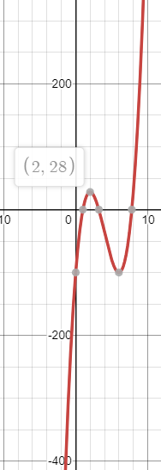
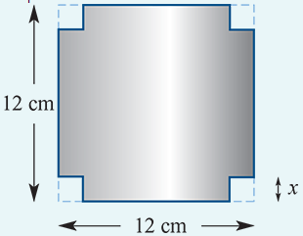
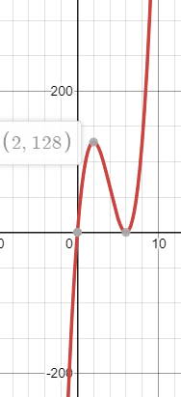
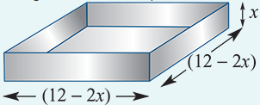
example
A square sheet of tin measures 12 cm×12 cm.
Four equal squares of edge x cm are cut out of the corners and the sides are turned up to form an open rectangular box. Find:
a. the values of $x$ for which the volume is 100 $cm^{3}$
b. the maximum volume.
The figure shows how it is possible to form many open rectangular boxes with dimensions 12−2$x$, 12−2$x$ and $x$.
The volume of the box is V=$x{\left(12−2x\right)}^{2}=100$
Cubic Equation Calculator (calculatorsoup.com)
0=${4x}^{3}$-48$x^{2}+144x−100$, $x_{1}=7.79, x_{2}$=1, $x_{3}$=3.21, 0≤ $x$≤6
Min Max Problem (desmos.com)
Vmax=128 when x=2

Slide 4
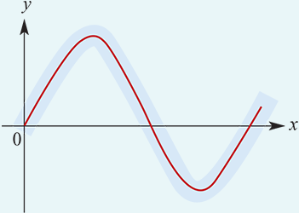
example
It is found that 250 metres of the path of a stream can be modelled by a cubic function. The cubic passes through the points (0,0), (100,22), (150,−10), (200,−20).
Find the equation of the cubic function.
Find the maximum deviation of the graph from the $x$-axis for $x$∈[0,250].

Slide 5
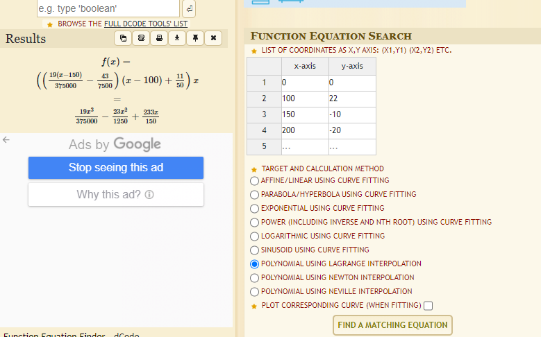
https://www.dcode.fr/function-equation-finder

Slide 6
Min Max Problem (desmos.com)

