Slide 1
The bisection method
6K

Slide 2
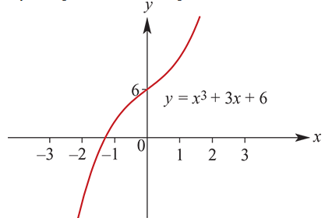
The bisection method
The bisection method is a method for finding approximate solutions of equations. Here we restrict our attention to equations involving polynomial functions.
With higher degree polynomials, the problem of finding exact solutions is more demanding, and it can be shown that beyond degree 4 there is no nice general formula to find all the solutions of a polynomial equation.
For the cubic function $f\left(x\right)=x^{3}+3x+6$, the equation $f\left(x\right)$=0 has only one real solution. The exact solution is
$x=\frac{−1}{{\left(−3+\sqrt{10}\right)}^{−\frac{1}{3}}}+{\left(−3+\sqrt{10}\right)}^{−\frac{1}{3}}$
Finding this by hand is beyond the requirements of this course, but we can find a numerical approximation to this solution using the bisection method.
We note that $f$(−2)<0 and $f$(−1)>0. This observation is central to using the bisection method.

Slide 3
The bisection method
In general, consider an equation $f\left(x\right)$=0 that has one solution α in the interval [$a_{1}$, $b_{1}$].
The sign of $f\left(a_{1}\right)$ is the opposite of the sign of $f\left(b_{1}\right)$, because $f\left(a\right)$=0 and so the function must change from being positive to being negative or vice versa.
Calculate $c_{1}$=$\frac{a_{1}+b_{1}}{2}$ and $f\left(c_{1}\right)$.
Choose the interval [$a_{1}$, $c_{1}$] if $f\left(a_{1}\right)$× $f\left(c_{1}\right)$<0, and the interval [$c_{1}$, $b_{1}$] otherwise.
The process is then repeated with the new interval, and then repeatedly until the required accuracy is reached.

Slide 4
Using a spreadsheet with the bisection method
We now return to the function $f\left(x\right)=x^{3}+3x+6$ and finding the solution of the equation $x^{3}+3x+6$ =0.
Step 1 We start with the interval [−2,−1], since we know the solution lies in this interval.
$f\left(−2\right)$=−8<0 and $f\left(−1\right)$=2>0.
Let $c_{1}$= $\frac{\text{−}\text{2}\text{+(−1)}}{2}$=−1.5.
Since $f$(−1.5)=−1.875<0, we now know the solution is between −1.5 and −1.
Step 2 Choose −1.5 as the new left endpoint. Therefore the second interval is [−1.5,−1].
Now $c_{2}$= $\frac{\text{−}\text{1.5}\text{+(−1)}}{2}$=−1.25 and $f$(−1.25)=0.296875>0.
Step 3 Choose −1.25 as the new right endpoint. Thus the third interval is [−1.5,−1.25].
Now $c_{3}$= $\frac{\text{−}\text{1.5}\text{+(−1}\text{.25}\text{)}}{2}$=−1.375 and $f$(−1.375)=−0.724609<0.

Slide 5
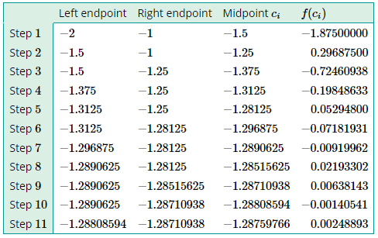
Using a spreadsheet with the bisection method
Step 4 Choose −1.375 as the new left endpoint. Thus the fourth interval is [−1.375,−1.25].
At this point we know that the solution is in the interval [−1.375,−1.25].
We continue with the spreadsheet as shown. This spreadsheet can be modified for other functions.
We conclude that the solution is −1.29 correct to two decimal places.
Whatever equation we are working with, if the starting interval is 1 unit, then the ‘error’ is at most $\frac{1}{2}$ after the next step and at most ${\left(\frac{1}{2}\right)}^{n−1}$ after $n$ steps.

Slide 6
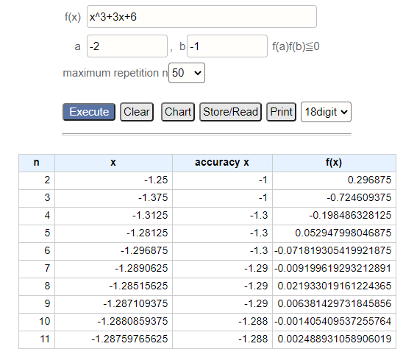
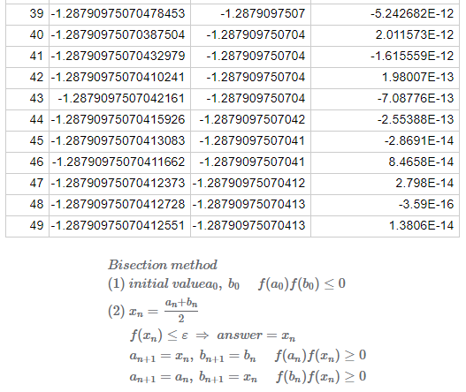
https://keisan.casio.com/exec/system/1222999061

