Slide 1
Chapter 6 Polynomials
Revision

Slide 2
Remainder theorem
The sum, difference and product of two polynomials is a polynomial.
Division of one polynomial by another does not always result in a polynomial.
Remainder theorem When $P\left(x\right)$ is divided by $x$−α, the remainder is equal to $P$(α).
e.g. When $P\left(x\right)=x^{3}$+ ${3x}^{2}$+$2x$+ $1$ is divided by $x$−2, the remainder is
$P\left(2\right)={(2)}^{3}$+ ${3(2)}^{2}$+$2(2)$+ $1$=25

Slide 3
Factor theorem
Factor theorem For a polynomial $P\left(x\right)$, if $P$(α)=0, then $x$−α is a factor. Conversely, if $x$−α is a factor of $P\left(x\right)$, then $P$(α)=0.
e.g. For $P\left(x\right)$ = $x^{3}$ − ${4x}^{2}$+$x$+ $6$,
$P\left(−1\right)$ = ${(−1)}^{3}$ − ${4(−1)}^{2}$+$(−1)$+ $6$=0
and so $x$+1 is a factor of $P\left(x\right)$.
Sums and differences of cubes:
$x^{3}−a^{3}$= $\left(x−a\right)\left(x^{2}+ax+a^{2}\right)$
e.g. $x^{3}−27$= $\left(x−3\right)\left(x^{2}+3x+9\right)$
$x^{3}+a^{3}$= $\left(x+a\right)\left(x^{2}−ax+a^{2}\right)$
e.g. ${8x}^{3}+64$= $\left(2x+4\right)\left({4x}^{2}−8x+16\right)$

Slide 4
Rational-root theorem
Rational-root theorem Let P($x$)=$a_{n}x^{n}$+ $a_{n−1}x^{n−1}$+⋯+ $a_{1}x$+ $a_{0}$ be a polynomial of degree $n$ with all the coefficients $a_{i}$ integers. Let α and β be integers such that the highest common factor of α and β is 1 (i.e. α and β are relatively prime). If β$x$+α is a factor of P($x$), then β divides $a_{n}$ and α divides $a_{0}$ .

Slide 5
The null factor theorem
The following are the steps in the process of solving cubic equations:
1. Determine factors by using the factor theorem and dividing.
2. Use the null factor theorem to determine solutions.
e.g. Solve $x^{3}$ − ${4x}^{2}$− $11x$+ $30=0$.
Since P(2)=8−16−22+30=0, we know that $x$−2 is a factor.
Dividing $x$−2 into $x^{3}$ − ${4x}^{2}$− $11x$+ $30$ gives
$x^{3}$ − ${4x}^{2}$− $11x$+ $30$= ($x$−2)($x^{2}$ −2 $x$−15)=($x$−2)($x$−5)($x$+3)
∴($x$−2)($x$−5)($x$+3)= 0
∴ $x$=2, 5 or −3

Slide 6
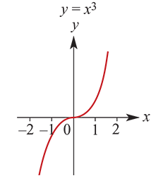
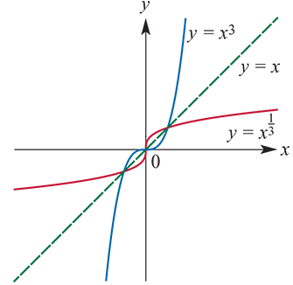
Cubic equations
The basic shape of the curve defined by $y=x^{3}$ is shown in the graph.
The implied domain of all polynomial functions is R.
The functions $f(x)=x^{3}$and $f^{−1}\left(x\right)=x^{\frac{1}{3}}$ are inverse functions of each other.
The graph of $y={a(x−h)}^{3}+k$ has the same shape as $y={ax}^{3}$ but is translated $h$ units in the positive $x$-axis direction and $k$ units in the positive $y$-axis direction (where $h$ and $k$ are positive constants).

Slide 7
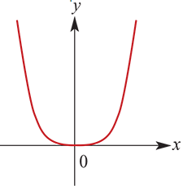
Quartic equations
The basic shape of the curve defined by $y=x^{4}$ is shown in the graph.
The graph of $y={a(x−h)}^{4}+k$ has the same shape as $y={ax}^{4}$ but is translated $h$ units in the positive $x$-axis direction and $k$ units in the positive $y$-axis direction (where $h$ and $k$ are positive constants). The turning point is at ($h$, $k$).

Slide 8
Sign diagrams
Sign diagrams assist in sketching graphs of cubic functions.
e.g. $y$=$x^{3}$ + ${2x}^{2}$− $5x$ − $6$ =($x$+1)($x$−2)($x$+3)
When $x$<−3, $y$ is negative.
When −3< $x$<−1, $y$ is positive.
When −1< $x$<2, $y$ is negative.
When $x$>2, $y$ is positive.
To sketch the graph of a cubic function $y$=${ax}^{3}$ + ${bx}^{2}$+ $cx$ + $d$, the steps are:
1. Use the factor theorem and division to determine the $x$-axis intercepts.
2. The $y$-axis intercept is $d$.
3. Draw a sign diagram.

Slide 9
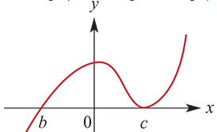
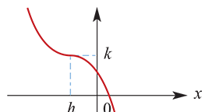
Finding equations
Finding equations for given cubic graphs. The following may assist:
Form: $y=a\left(x−b\right){\left(x−c\right)}^{2}$
Assume $b$ and $c$ are known, substitute another known point to calculate $a$.
Form: $y={a(x−h)}^{4}+k$
Substitute known values to determine $a$.
Alternatively, use the general form $y$=${ax}^{3}$ + ${bx}^{2}$+ $cx$ + $d$ and the known points to determine $a$, $b$, $c$ and $d$.
A function f is even if $f\left(−x\right)=f\left(x\right)$. This means that the graph is symmetric about the $y$-axis.
A function f is odd if $f\left(−x\right)=−f\left(x\right)$. The graph of an odd function has rotational symmetry with respect to the origin.
A power function is a function $f$ with rule $f\left(x\right)=x^{r}$ where $r$ is a non-zero real number.

