Slide 1
Constant rate of change
16B

Slide 2
Constant rate of change
Any function that is linear will have a constant rate of change. That rate of change is simply the gradient of the graph and, given appropriate information, the rate can be calculated from the graph of the function or simply read from the rule of the function if it is stated.

Slide 3
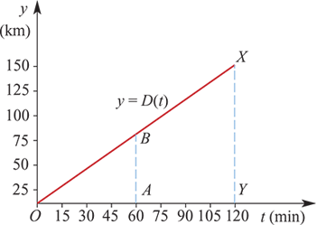
Example
A car travels from Copahunga to Charlegum, which is a distance of 150 km, in 2 hours (120 minutes). Assuming the car travels at a constant speed, draw a distance–time graph and calculate the speed.
We denote the distance function by D. The graph of y=D(t) is shown.
The rule of the function may be written: D(t) = $\frac{150}{120}$t= $\frac{5}{4}$t
Note that $\frac{XY}{YO}$= $\frac{BA}{AO}$= $\frac{5}{4}$
The gradient of the graph gives the speed in kilometres per minute. Therefore, the speed of the car is $\frac{5}{4}$ kilometres per minute.
This speed may be expressed in kilometres per hour (km/h):
Speed=$\frac{5}{4}$×60=75 km/h

Slide 4
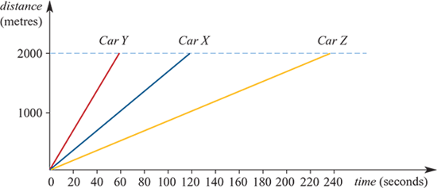
Example
Three cars aroe driven over a 2-kilometre straight track. They are all to go from point A to pint B. Each car travels with constant speed. It is not a race as:
the speed of car Y is twice that of car X
the speed of car Z is half that of car X.
Illustrate this situation with a distance–time graph. Assume that car X travels at 1 km/min.
The gradient of the graph for car X is
$\frac{2000}{120}$=16 $\frac{2}{3}$
The gradient of the graph for car Y is
$\frac{2000}{60}$=33 $\frac{1}{3}$
The gradient of the graph for car Z is
$\frac{2000}{240}$ =8 $\frac{1}{3}$

Slide 5
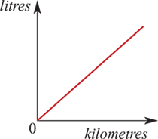
The gradient of the straight-line graph represents a rate.
Petrol consumption of a car A straight-line graph has been used as a model, and its gradient represents the rate of consumption of petrol, which is measured in litres per kilometre. Such a model makes fairly large assumptions. What are they?

Slide 6
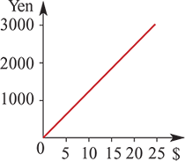
The gradient of the straight-line graph represents a rate.
Exchange rates for currencies The gradient of the graph gives the exchange rate of dollars to yen.

Slide 7
Section summary
A linear function f(x)=mx+c has a constant rate of change, m.
Examples include an object travelling with constant speed and currency exchange rates.

