Slide 1
Average rate of change
16C

Slide 2
Notes:
https://www.transum.org/software/SW/Starter_of_the_day/starter_October31.asp

Slide 3
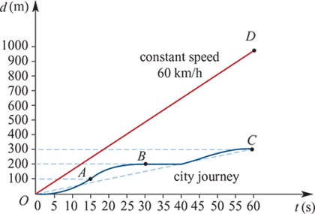
Average speed
The graph below shows the motion of two cars both travelling in a straight line away from a fixed point O, where d is the distance travelled (in metres) at time t (in seconds).

Slide 4
Average speed
Although we do not know the actual speed of the car travelling in the city at any particular time (other than when it is stationary), we can work out the average speed of the car over the full 60 seconds.
The average speed is given by $\frac{distance travelled}{time taken}$=$\frac{300}{60}$
The average speed is the gradient of the line OC=5.
The average speed may also be calculated for any given time interval. For example, for the time interval from t=15 to t=30, the average speed is given by the gradient of the line joining points A and B. This is $\frac{100}{15}$=6 $\frac{2}{3}$ metres per second.

Slide 5
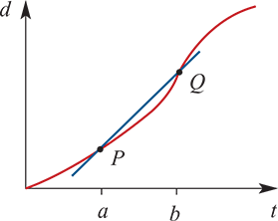
Average speed
In general: average speed= $\frac{total distance travelled}{total time taken}$
So the average speed of an object for a≤t≤b is given by the gradient of the line passing through points P and Q.

Slide 6
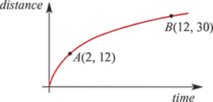
Example
The graph of distance travelled (metres) against time (seconds) for the motion of an object is shown.
Find the average speed of the object in m/s over the interval from t=2 to t=12.
Solution
Average speed= $\frac{total distance travelled}{total time taken}$
= $\frac{30−12}{12−2}$= $\frac{18}{10}$=1.8 m/s

Slide 7
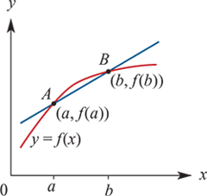
Average rate of change for a function
The line which passes through two points on a curve is called a secant.
The line segment joining two points on a curve is called a chord.
Average rate of change
For any function y=f(x), the average rate of change of y with respect to x over the interval [a,b] is the gradient of the line through A(a,f(a)) and B(b,f(b)) (secant AB).
That is,
average rate of change= $\frac{f(b)−f(a)}{b−a}$

Slide 8
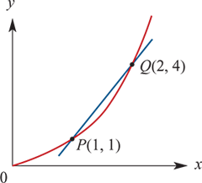
Average rate of change for a function
For example, for the function with the graph shown, the average rate of change of y with respect to x over the interval [1,2] is given by the gradient of the secant PQ:
gradient= $\frac{4−1}{2−1}$=3

Slide 9
Example
Find the average rate of change of the function with rule f($x$)=$x^{2}$−2$x$+5 as $x$ changes from 1 to 5.
Solution
Average rate of change = $\frac{change in y}{change in x}$
f(1)= ${(1)}^{2}$−2$(1)$+5 =4
f(5)= ${(5)}^{2}$−2$(5)$+5 =20
Average rate of change = $\frac{20−4}{5−1}$=4

Slide 10
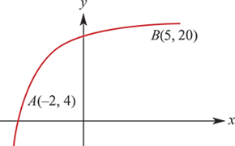
Example
Find the average rate of change of the function depicted in the graph for the interval [−2,5].
Solution
Average rate of change for the interval [−2,5]
= $\frac{20−4}{5−(−2)}$= $\frac{16}{7}$

Slide 11
Example
The air temperature, T°C, at a weather station on a particular evening is modelled by the equation T= $\frac{600}{t^{2}\text{+}2t \text{+}30}$, where t is the time in hours after 6 p.m.
a. Find the temperature at 6 p.m.
b.Find the temperature at midnight.
c. Find the average rate of change of the air temperature from 6 p.m. until midnight.
Solution
a. At 6 p.m., t=0. Hence T= $\frac{600}{{\left(0\right)}^{2}\text{+}2(0) \text{+}30}$=20°C
b. At midnight, t=6. Hence T= $\frac{600}{{\left(6\right)}^{2}\text{+}2(6) \text{+}30}$= $\frac{100}{13}$=7.69°C (correct to two decimal places)
c. Average rate of change of temperature = $\frac{\frac{100}{13}−20}{6−0}$= − $\frac{80}{39}$= −2.05°C per hour

Slide 12
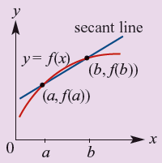
Section summary
The line which passes through two points on a curve is called a secant.
The line segment joining two points on a curve is called a chord.
For a function y=f(x), the average rate of change of y with respect to x over the interval [a,b] is the gradient of the secant line through (a,f(a)) and (b,f(b)).
That is,
average rate of change= $\frac{f(b)−f(a)}{b−a}$

