Slide 1
Instantaneous rate of change
16D

Slide 2
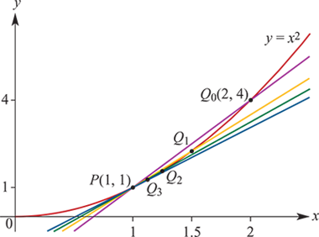
Tangent line at a point
It is a line which has ‘the same slope’ as the graph at this point.
We can illustrate this idea with a specific example. Part of the graph of y=$x^{2}$ is shown below. We will find the tangent line at the point P(1,1).

Slide 3
Tangent line at a point
We start with the secant PQ0 passing through P(1,1) and $Q_{0}$(2,4).
The gradient of P$Q_{0}$ is $\frac{4−1}{2−1}$=3, and so the equation of the secant P$Q_{0}$ is y=3x−2.
The points $Q_{1}$ , $Q_{2}$ , $Q_{3}$ ,…, $Q_{n}$ ,… on the curve y= $x^{2}$ are chosen so that they get closer and closer to P in the following way:
The x-coordinate of $Q_{1}$ is $\frac{1}{2}$(1+2)= $\frac{3}{2}$.
The x-coordinate of $Q_{2}$ is $\frac{1}{2}$(1+ $\frac{3}{2}$)= $\frac{5}{4}$.
The x-coordinate of $Q_{3}$ is $\frac{1}{2}$(1+ $\frac{5}{4}$)= $\frac{9}{8}$.

Slide 4
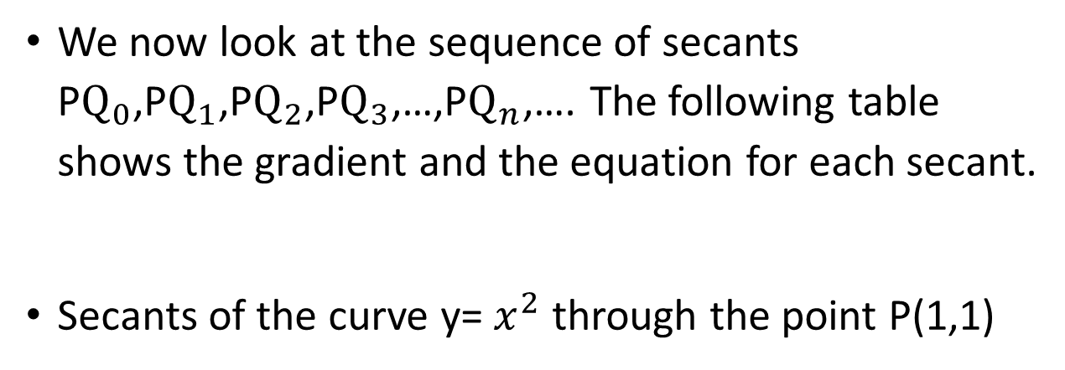
Tangent line at a point
We now look at the sequence of secants P$Q_{0}$,P$Q_{1}$,P$Q_{2}$,P$Q_{3}$,…,P$Q_{n}$,…. The following table shows the gradient and the equation for each secant.
Secants of the curve y= $x^{2}$ through the point P(1,1)

Slide 5
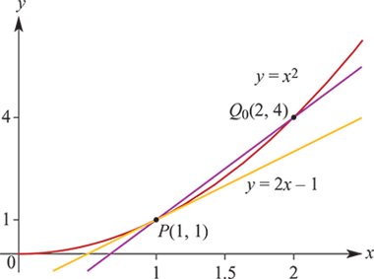
Tangent line at a point
The sequence of gradients is 3, $\frac{5}{2}$, $\frac{9}{4}$, $\frac{17}{8}$, …, 2+ $\frac{1}{2^{n}}$, …
We can see that the gradients get closer and closer to 2. This is particularly evident from the general gradient, 2+ $\frac{1}{2^{n}}$, since as n→∞, $\frac{1}{2^{n}}$→0.
We can also see that the secants get closer and closer to the line with equation y=2x−1. This line is the tangent line at the point P, and the gradient of the tangent line is the instantaneous rate of change of y with respect to x at the point P.

Slide 6
Example
Estimate the instantaneous rate of change of y with respect to x at the point P(2,9) on the curve y= $x^{3}$ +1 by considering the secant PQ, where Q=(2.01, ${(2.01)}^{3}$+1).
Solution
Gradient of PQ= $\frac{{(2.01)}^{3}+1−9}{2.01−2}$ =12.0601

Slide 7
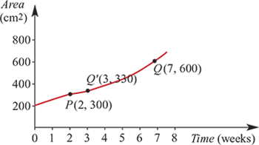
Example
The graph represents the area covered by a spreading plant. Area is measured in square centimetres and time in weeks.
Find the gradient of the secant PQ.
The point Q′ has coordinates (3,330). Find the average rate of change of area with respect to time for the interval [2,3], and hence estimate the instantaneous rate of change of the area of the plant at t=2.
Solution
Gradient of PQ= $\frac{600−300}{7−2}$= $\frac{300}{5}$=60
The average rate of change of area from t=2 to t=7 is 60 ${cm}^{2}$ per week.
Gradient of PQ′= $\frac{300−300}{1}$=30
∴ Gradient at P is approximately 30.
The instantaneous rate of change of the area of the plant with respect to time when t=2 is approximately 30 ${cm}^{2}$ per week.

Slide 8
Example
Consider the curve y= $2^{x}$.
Using the secant through the points where x=3 and x=3.1, estimate the instantaneous rate of change of y with respect to x at the point where x=3.
Repeat for the points where x=3 and x=3.001.
Solution
When x=3, y=8 and when x=3.1, y=8.5742 (correct to four decimal places).
The gradient of the line through (3,8) and (3.1,8.5742) is 5.7419.
Thus an estimate for the instantaneous rate of change of y= $2^{x}$ at x=3 is 5.742.
When x=3.001, y=8.005547.
The gradient of the line through (3,8) and (3.001,8.005547) is 5.547.
Note: The true instantaneous rate of change of y with respect to x at x=3 is 5.5452 (correct to four decimal places).

Slide 9
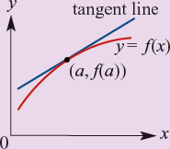
Section summary
For a function y=f(x), the instantaneous rate of change of y with respect to x at the point (a,f(a)) is the gradient of the tangent line to the graph of y=f(x) at the point (a,f(a)).

