Slide 1
Chapter 16 Rates of change
Revision

Slide 2
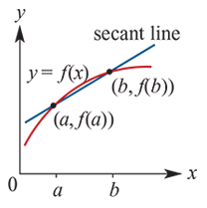
The gradient of the secant line
Where a real-life situation is modelled by a straight-line graph, the gradient represents the rate of change of one quantity with respect to another.
Average speed = $\frac{total distance travelled}{total time taken }$
For a function y=f(x), the average rate of change of y with respect to x over the interval [a,b] is the gradient of the secant line through (a,f(a)) and (b,f(b)).

Slide 3
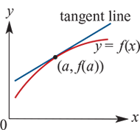
Velocity
For a function y=f(x), the instantaneous rate of change of y with respect to x at the point (a,f(a)) is the gradient of the tangent line to the graph of y=f(x) at the point (a,f(a)).
The position of a particle moving along a straight line specifies its location relative to a reference point O.
The average velocity of the particle is the average rate of change in position with respect to time over a given time interval.
The Instantaneous velocity is the instantaneous rate of change in position with respect to time at a given moment.

