Slide 1
Mathematical Methods
Unit 1 Lesson 0

Slide 2
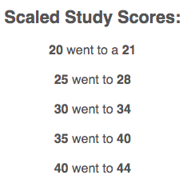
Methods Structure
Year 11: Unit 1 & Unit 2
Year 12: Unit 3 & Unit 4
Year 12: 4 SACs(School Assessment Coursework)=34%
Year 12: External Exam 1 & 2 =66%
34%+66%=ATAR Methods study score

Slide 3
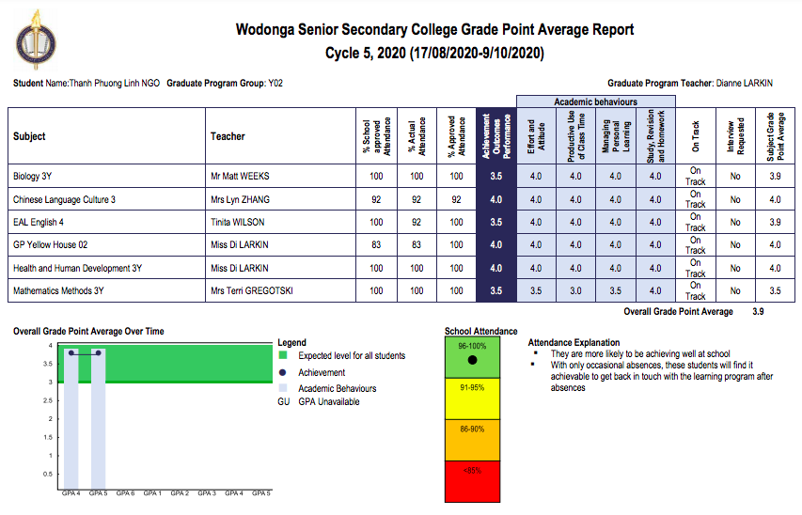

Slide 4
How to get a higher GPAs 4.0?
Assignment each chapter =Study, Revision and homework
Chapter workbook= Use of Class Time + Managing Learning
Chapter Tests= Achievement + Effort and Attitudes

Slide 5
Where to hand in your work?

Slide 6
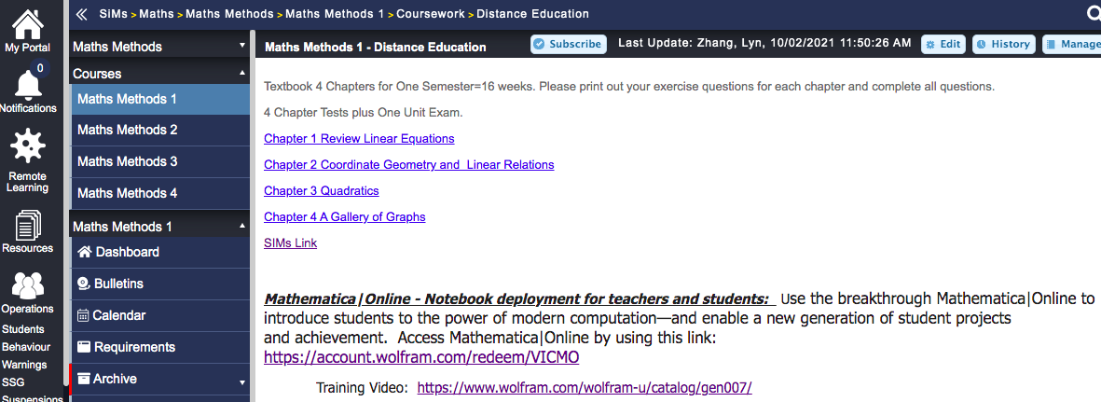
Where to find your Textbook?
https://sims.wssc.vic.edu.au/SiMs/Site/Modules/HTML/624/64750

Slide 7
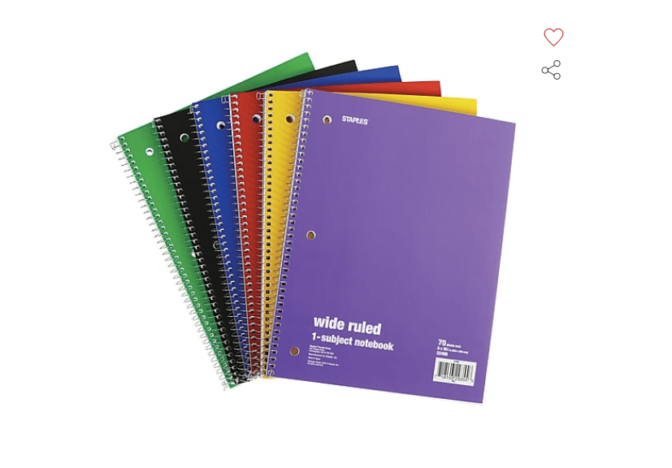
What to bring for final Year 12 Exams?
Bound Reference(a sturdy notebook).
In your Bound Reference, you should have:
Summary notes for each key concept/Chapter).
Glossary List for all vocabularies.

Slide 8
Who and Where to ask questions?
MS Teams → Methods Channel/Class

Slide 9
Required Questions to complete for Chapter 1 &2

Slide 10
Glossary/ Vocabulary List

Slide 11
How far you can go?
https://www.transum.org/Maths/Exercise/Algebra/Fraquations/Default.asp?Level=4
10 minutes for above link.
https://www.transum.org/Maths/Exam/Exam.asp?Title=Equations+with+Fractions&QuestionOrder=307%2C118
Email to your teacher this transom exam.

