Slide 1
Families of straight lines
Lesson 2F

Slide 2
Notes:
https://www.transum.org/software/SW/Starter_of_the_day/Students/M-words.asp

Slide 3
Families of straight lines
𝑦=𝑚𝑥 , where the gradient 𝑚 of the lines varies – the graphs are the straight lines through the origin.
𝑦=3𝑥+𝑐, where the 𝑦-axis intercept 𝑐 of the lines varies – the graphs are the straight lines with gradient 3.
𝑦=𝑚𝑥+2, where the gradient 𝑚 of the lines varies – the graphs are the straight lines with 𝑦-axis intercept 2. Some graphs in this family are illustrated below.

Slide 4
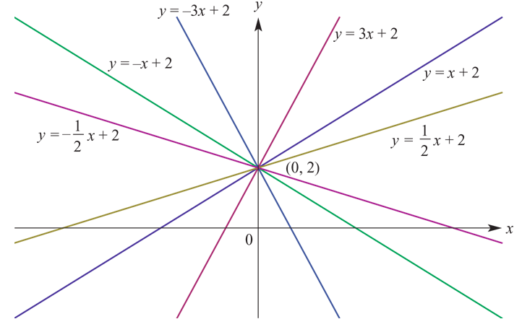
The variable 𝑚 is called a parameter.

Slide 5
example

Slide 6
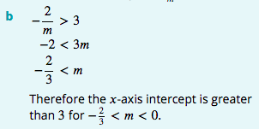
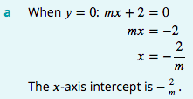
example

Slide 7
example

Slide 8
Section summary
Families of straight lines can be described through the use of a parameter. For example:
All the non-vertical lines passing through (0,2) have equation of the form 𝑦=𝑚𝑥+2, where 𝑚 is a real number. (If 𝑚=0, the line is horizontal.)
All the lines with gradient 3 have equation of the form 𝑦=3𝑥+𝑐, where 𝑐 is a real number.
All the lines with 𝑥-axis intercept 4 have equation of the form $\frac{\text{x}}{4}$+ $\frac{\text{y}}{\text{b}}$=1, where 𝑏 is a non-zero real number.

