Slide 1
Linear models
Lesson 2G practical situations

Slide 2
Percentages and applications
Objective:-Discounts and markups; Calculating the original price; Goods and services tax (GST); Shares and dividends
Notes:
https://www.transum.org/Software/MathsMenu/Starter.asp?ID_Starter=109

Slide 3
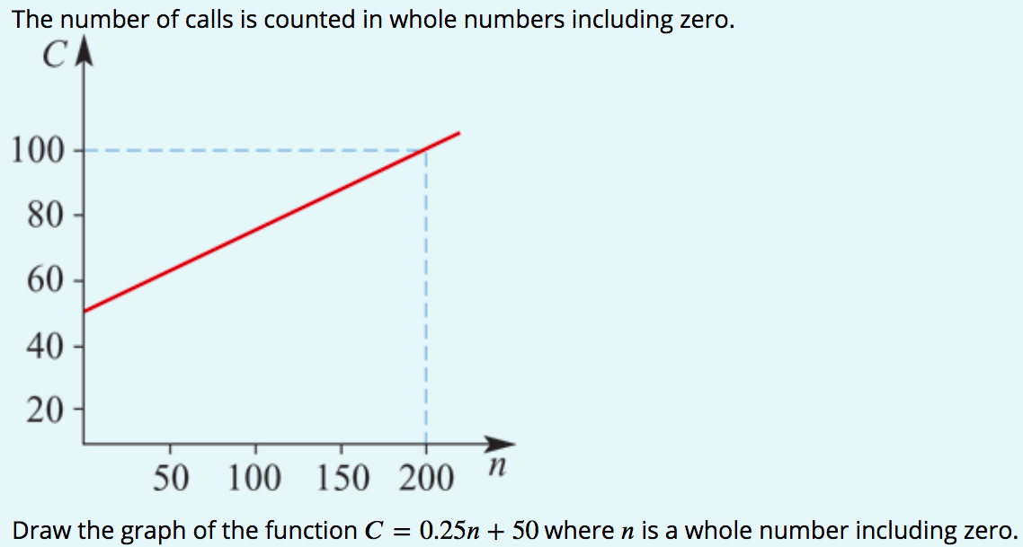
Example

Slide 4
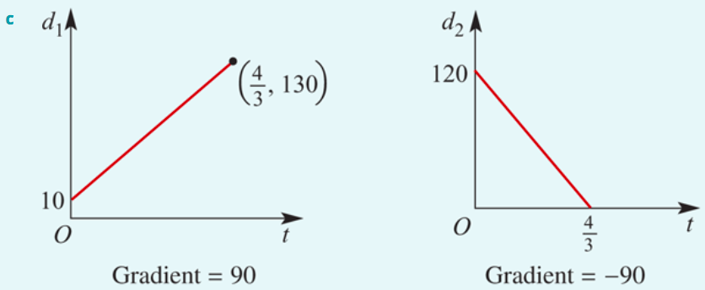
Example

