Slide 1
Simultaneous linear equations
Lesson 2H

Slide 2
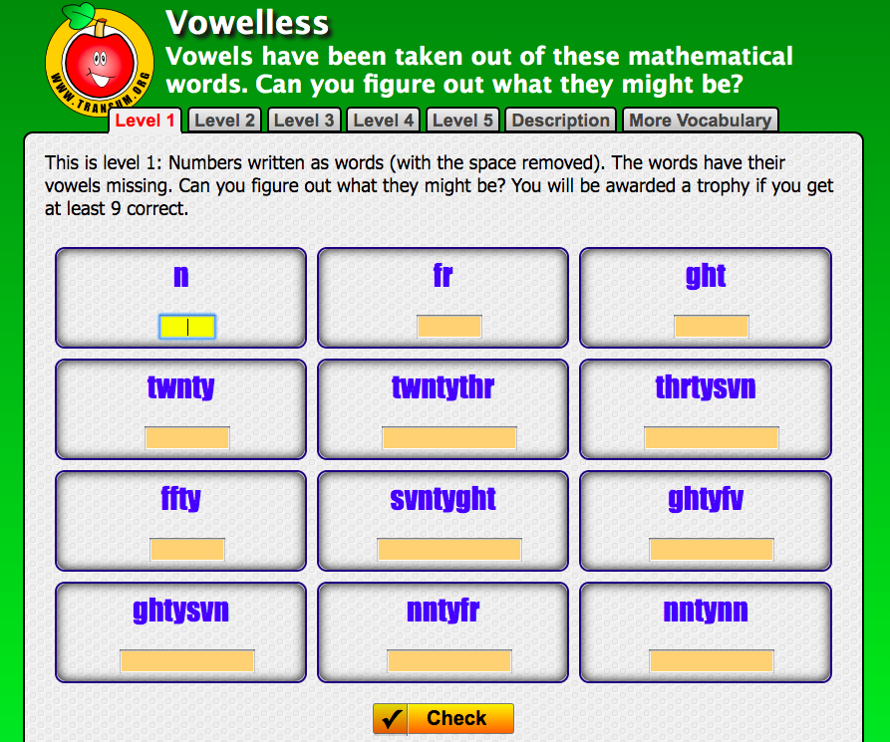
Notes:
https://www.transum.org/software/SW/Starter_of_the_day/students/Vowelless.asp?Level=1

Slide 3
The geometry of simultaneous equations
There are three possible outcomes when considering a system of two simultaneous linear equations in two unknowns:
There is a unique solution. (Lines intersect at a point.)
There are infinitely many solutions. (Lines coincide.)
There is no solution. (Lines are parallel.)

Slide 4
Example

Slide 5
Example

Slide 6
Example

Slide 7
Example

Slide 8
Example

Slide 9
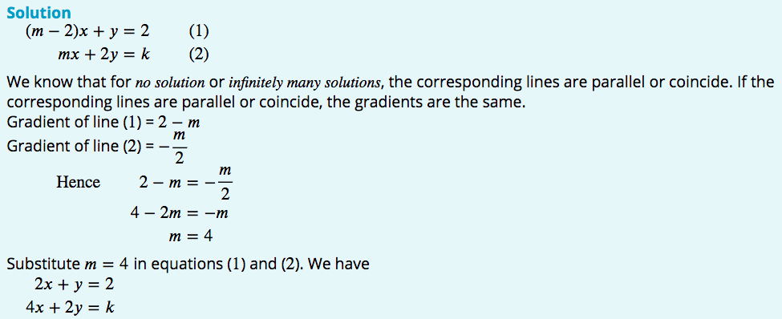
Example

Slide 10
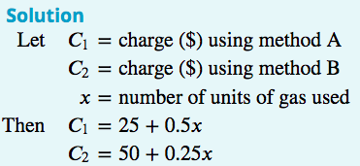
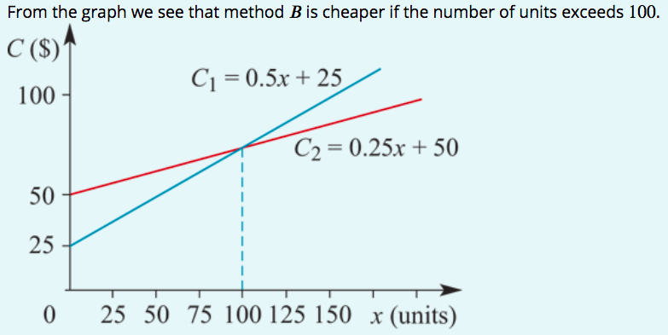
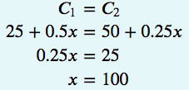
Example

Slide 11
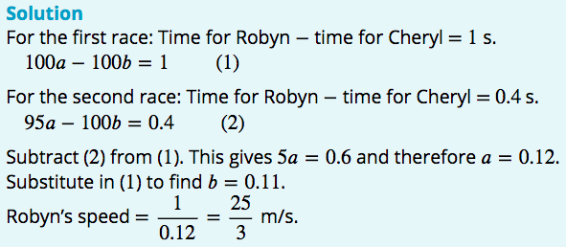
Example

Slide 12
Summary
There are three cases for a system of two linear equations with two variables:
unique solution (lines intersect at a point), e.g. 𝑦=2𝑥+3 and 𝑦=3𝑥+3
infinitely many solutions (lines coincide), e.g. 𝑦=2𝑥+3 and 2𝑦=4𝑥+6
no solution (lines are parallel), e.g. 𝑦=2𝑥+3 and 𝑦=2𝑥+4.

