Slide 1
Rectangular hyperbolas
4A
Notes:
https://create.kahoot.it/details/0e8bc211-2cf0-4998-aa8c-26c1ade2c622
https://create.kahoot.it/details/d485d951-c94b-4eb1-8d5a-c063fe63e4f8
https://create.kahoot.it/details/697ef97b-b694-4657-9e74-5bdeb9bba8b9

Slide 2
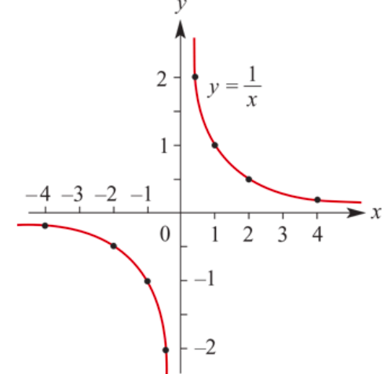
Rectangular hyperbola
Consider the rule:
𝑦=$\frac{1}{x}$ =$x^{−1}$ for 𝑥≠0
We can construct a table of values for 𝑦= $\frac{1}{x}$ when −4≤𝑥≤4

Slide 3
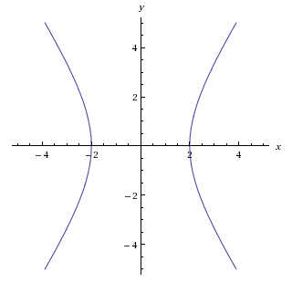
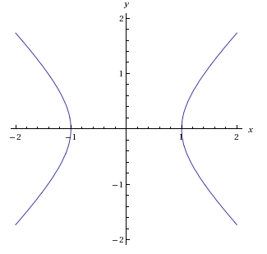
Rectangular Hyperbolas
$$\frac{x^{2}}{4}−\frac{y^{2}}{9}=1$$
! A rectangular hyperbola is a hyperbola whose asymptotes are perpendicular.
Example: $x^{2}−y^{2}=1$
$$y=\frac{3}{2}x$$
$$y=−\frac{3}{2}x$$
The asymptotes of a hyperbola are not necessarily perpendicular
In this chapter, you only need to know about rectangular hyperbola whose asymptotes are vertical and horizontal.

Slide 4
Asymptotes
There are two lines associated with this graph that help to describe its shape.
Horizontal asymptote
Vertical asymptote

Slide 5
Horizontal asymptote
From the graph we see that, as 𝑥 approaches infinity in either direction, the value of 𝑦 approaches zero. The following notation will be used to state this:
As 𝑥→∞, 𝑦→$0^{+}$. This is read: ‘As 𝑥 approaches infinity, 𝑦 approaches 0 from the positive side.’
As 𝑥→−∞, 𝑦→ $0^{−}$. This is read: ‘As 𝑥 approaches negative infinity, 𝑦 approaches 0 from the negative side.’
The graph approaches the 𝑥-axis (the line 𝑦=0) but does not cross this line. The line 𝑦=0 is a horizontal asymptote.

Slide 6
Vertical asymptote
As 𝑥 approaches zero from either direction, the magnitude of 𝑦 becomes very large. The following notation will be used to state this:
As 𝑥→ $0^{+}$, 𝑦→∞. This is read: ‘As 𝑥 approaches zero from the positive side, 𝑦 approaches infinity.’
As 𝑥→ $0^{−}$, 𝑦→−∞. This is read: ‘As 𝑥 approaches zero from the negative side, 𝑦 approaches negative infinity.’
The graph approaches the 𝑦-axis (the line 𝑥=0) but does not cross this line. The line 𝑥=0 is a vertical asymptote.

Slide 7
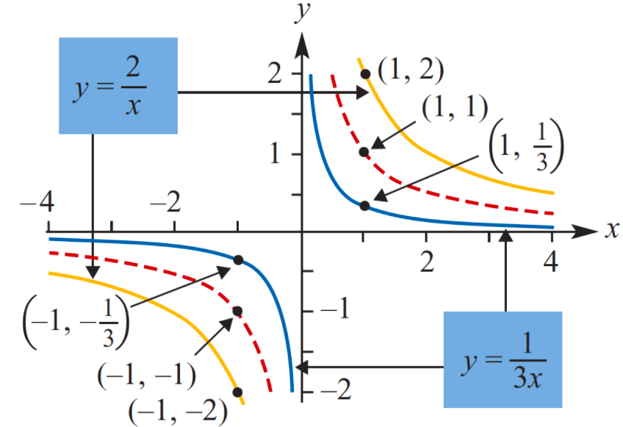
Dilations from an axis
The graphs of
𝑦=$\frac{1}{x}$, 𝑦=$\frac{2}{x}$and 𝑦= $\frac{1}{3x}$= $\frac{ \frac{1}{3} }{x}$
The asymptotes: 𝑦=0 & 𝑥=0.
The same ‘shape’ & asymptotes, but ‘stretched’ from 𝑦=$\frac{1}{x}$.
The transformation that takes the graph of 𝑦=$\frac{1}{x}$ to the graph of 𝑦=$\frac{2}{x}$is called the dilation of factor 2 from the 𝑥-axis.
Dilation: 𝑦=$\frac{1}{x}$→ 𝑦=$\frac{2}{x}$

Slide 8
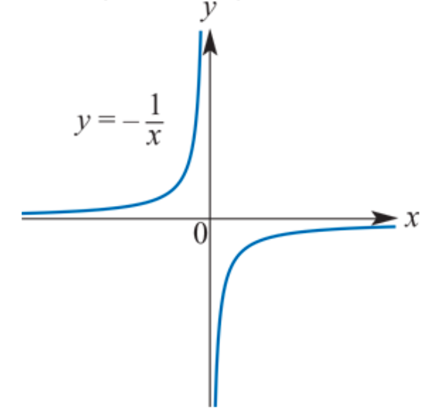
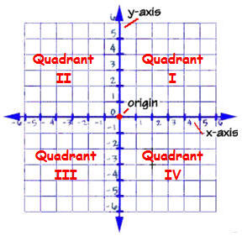
Reflection in the 𝑥-axis
𝑦=$\frac{1}{x}$is reflected in the 𝑥-axis, the result is 𝑦=− $\frac{1}{x}$.
The asymptotes: 𝑥=0 and 𝑦=0.
Similarly, 𝑦=− $\frac{2}{x}$is the reflection of 𝑦= $\frac{2}{x}$in the 𝑥-axis.
Reflecting in the 𝑦-axis gives the same result for these two graphs.

Slide 9
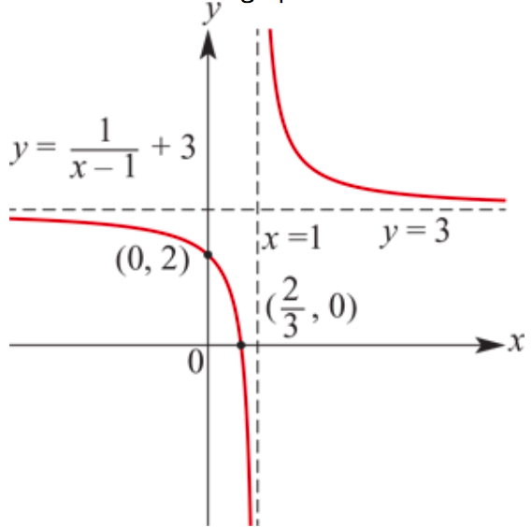
Translations
The graph of 𝑦=$\frac{1}{x−1}$+3.
The basic graph of 𝑦= $\frac{1}{x}$has been translated 1 unit to the right and 3 units up.
Asymptotes: 𝑥=1& 𝑦=3.
Intercepts with the axes The graph now has 𝑥-axis and 𝑦-axis intercepts.
3 units
1 unit

Slide 10
Sketching rectangular hyperbolas
Using dilations, reflections and translations, we are now able to sketch the graphs of all rectangular hyperbolas of the form 𝑦=$\frac{a}{x−h}$+k.

Slide 11
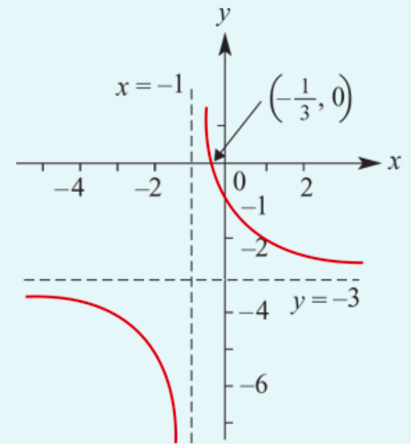
Sketch the graph of 𝑦=$\frac{2}{x+1}$−3.
The graph of 𝑦= $\frac{2}{x}$has been translated 1unit ← and 3 units
The asymptotes: 𝑥=−1 & 𝑦=−3.
When 𝑥=0, 𝑦= $\frac{2}{0+1}$−3 =−1.
∴ the 𝑦-axis intercept is −1.
When 𝑦=0, 0=$\frac{2}{x+1}$−3
→ $\frac{2}{x+1}$=3 → 3(𝑥+1) =2
→ 𝑥+1= $\frac{2}{3}$→ 𝑥 =−$\frac{1}{3}$
∴ the 𝑥-axis intercept is −$\frac{1}{3}$.

Slide 12
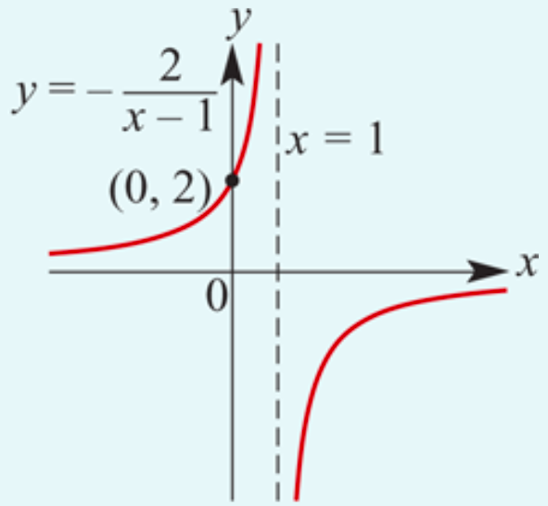
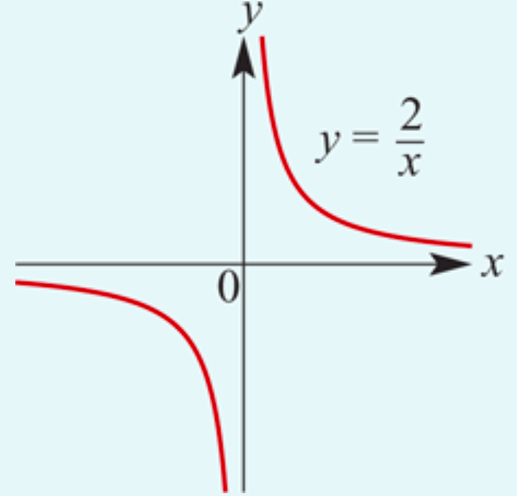
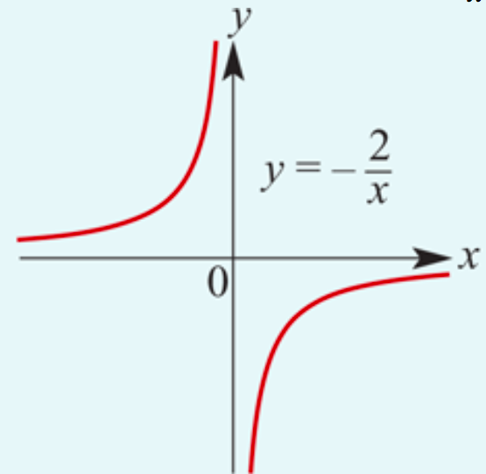
Sketch the graph of 𝑦=$\frac{−2}{x−1}$.
The graph of 𝑦=− $\frac{2}{x}$is obtained from the graph of 𝑦= $\frac{2}{x}$by reflection in the 𝑥-axis.
This graph is then translated 1 unit → to obtain the graph of 𝑦=$\frac{−2}{x−1}$.

Slide 13
Section summary
For 𝑎>0, a dilation of factor 𝑎 from the 𝑥-axis transforms the graph of 𝑦=$\frac{1}{x}$ to the graph of 𝑦=$\frac{a}{x}$.
A reflection in the 𝑥-axis transforms the graph of 𝑦=$\frac{a}{x}$ to the graph of 𝑦=−$\frac{a}{x}$.
For ℎ, 𝑘≥0, a translation of ℎ to the right and 𝑘 upwards transforms the graph of 𝑦= $\frac{a}{x}$ to the graph of 𝑦= $\frac{a}{x−h}$+𝑘.
A rectangular hyperbola with rule of the form 𝑦= $\frac{a}{x−h}$+𝑘 has:
vertical asymptote 𝑥=ℎ
horizontal asymptote 𝑦=𝑘.

Slide 14
How to find a, h, k
𝑦=$\frac{a}{x−h}$+k.
$y=\frac{1}{3x+6}$
3*$x$+3*2=3($x$+2)
$y=\frac{1}{3x+6}$ = $\frac{1}{3(x+2)}$ = $\frac{\frac{1}{3}}{x+2}$ +0
a= $\frac{1}{3}$, h=—2, k=0

Slide 15
How to find a, h, k
𝑦=$\frac{a}{x−h}$+k.
$y=\frac{3−2x}{x−2}$ $=$ $\frac{−(−3+2x)}{x−2}=$ $\frac{−(2x−3)}{x−2}=$ $\frac{−(2x−4+1)}{x−2}$ $=$ $\frac{−\left(2x−4\right)−1}{x−2}$
$=$ $\frac{−2(x−2)−1}{x−2}$ $=$ $−$2 $− \frac{1}{x−2}$
a= $−1$, h=2, k= $−$2

