Slide 1
The truncus
4B
Notes:
https://create.kahoot.it/details/6fdee536-64c1-4b95-b733-067a0d7ff9f6
https://create.kahoot.it/details/e5033bd8-cd1c-4d6b-bb34-ac9b8fddc3cc
https://create.kahoot.it/details/2520f82f-5388-40ee-b1cd-5d5fa1159a25
https://create.kahoot.it/details/26a32e76-838e-4235-8954-9866adc6eaa6

Slide 3
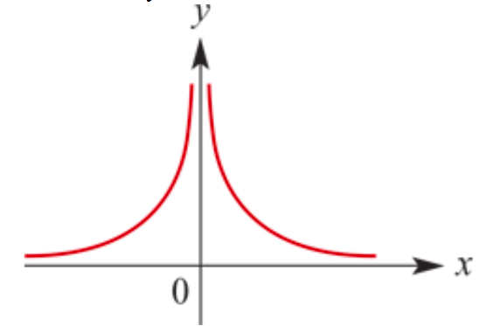
Truncus
𝑦=$\frac{1}{x^{2}}$=$x^{−2}$ for 𝑥≠0, Construct a table to sketch the graph.
As 𝑥→∞, 𝑦→$0^{+}$.
As 𝑥→−∞, 𝑦→ $0^{+}$.
As 𝑥→ $0^{+}$, 𝑦→∞.
As 𝑥→ $0^{−}$, 𝑦→∞.
The graph of 𝑦= $\frac{1}{x^{2}}$has asymptotes 𝑦=0 and 𝑥=0.
All graphs of the form 𝑦= $\frac{a}{{(x−h)}^{2}}$+𝑘 will have the same basic ‘truncus’ shape. The asymptotes: 𝑦=𝑘 & 𝑥=ℎ.

Slide 4
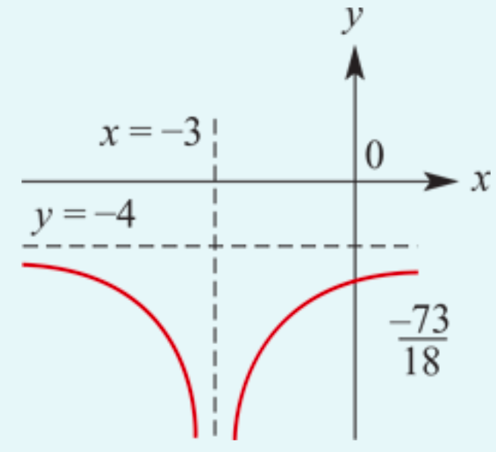
Sketch the graph of 𝑦= $\frac{−1}{{2(x+3)}^{2}}$−4.
The graph of 𝑦= $\frac{−1}{{2x}^{2}}$ is translated 3 units to the left and 4 units down.
a= $−1$, h= $−$3, k= $−$4→ Asymptotes: x= $−$3,y= $−$4
The 𝑦-axis intercept is found by putting 𝑥=0; it is $\frac{−73}{18}$.
𝑦= $\frac{a}{{(x−h)}^{2}}$+𝑘

Slide 5
Sketching truncus graphs
Using dilations, reflections and translations, we are now able to sketch the graphs of all truncus of the form 𝑦= $\frac{a}{{(x−h)}^{2}}$+𝑘 .

Slide 6
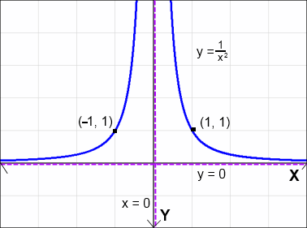
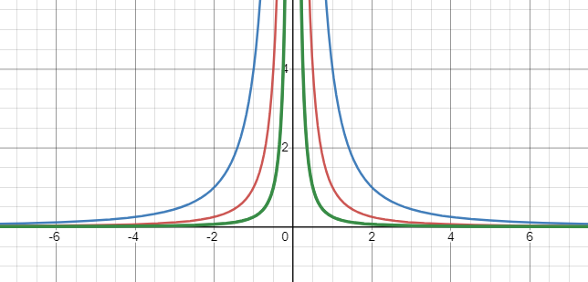
Dilation
𝑦= $\frac{1}{x^{2}}$
𝑦= $\frac{4}{x^{2}}$
𝑦= $\frac{1}{4x^{2}}=\frac{\frac{1}{4}}{x^{2}}$
a=1
a=4
a= $\frac{1}{4}$

Slide 7
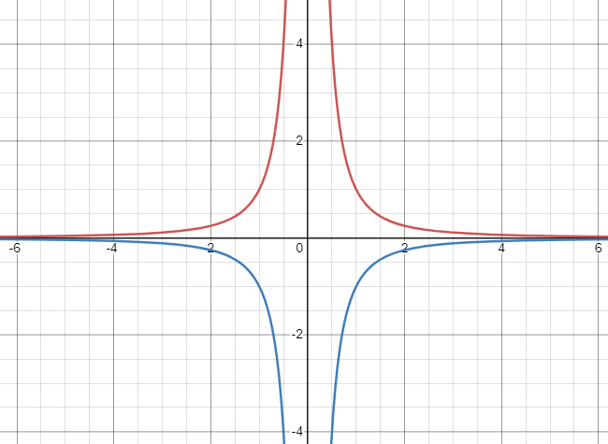
Reflection
𝑦= $\frac{1}{x^{2}}$
𝑦= $\frac{−1}{x^{2}}$
a=1
a= $−$1

Slide 8
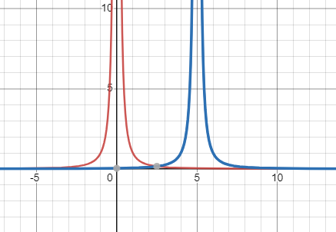
Translation: Translated 5 units to the right
𝑦= $\frac{1}{x^{2}}$
𝑦= $\frac{1}{{(x−5)}^{2}}$
h=0 → x=0
h=5 → x=5

Slide 9
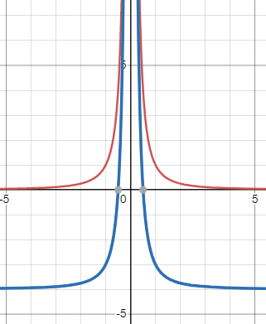
Translation: Translated down 4 units
𝑦= $\frac{1}{x^{2}}$
𝑦= $\frac{1}{x^{2}}$ — 4
k=0 → y=0
k= — 4 → y= — 4

