Slide 1
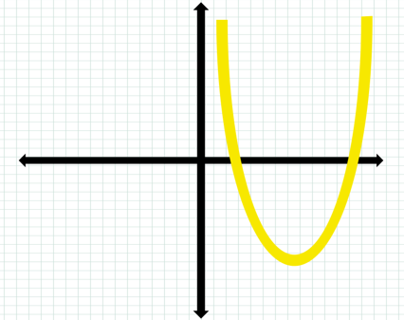
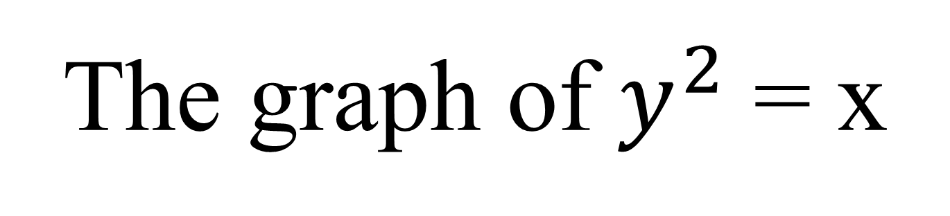
The graph of $y^{2}$ = x
4C
Notes:
https://create.kahoot.it/details/d878278a-3664-43c6-8e2b-0b3fe8057ccd
https://create.kahoot.it/details/2520f82f-5388-40ee-b1cd-5d5fa1159a25

Slide 2
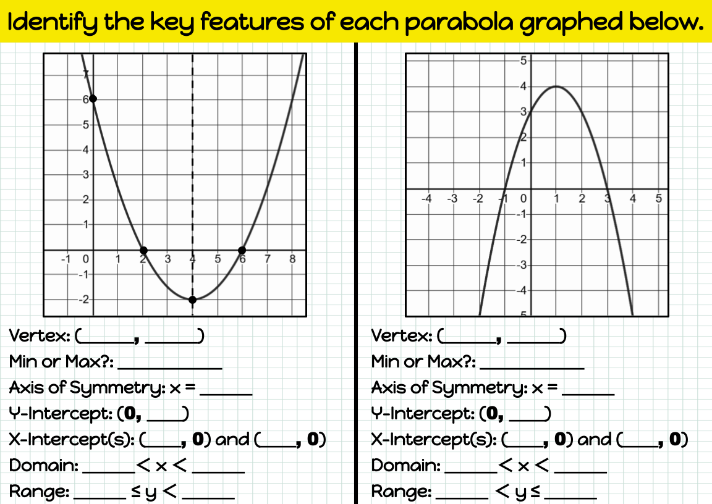

Slide 3
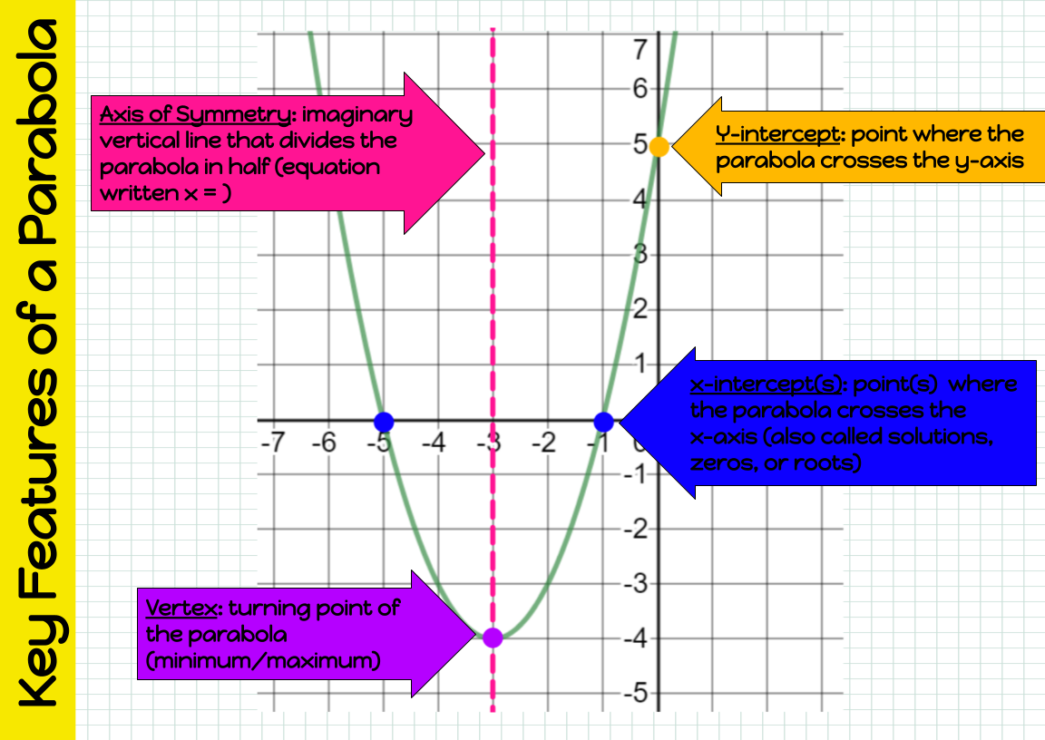

Slide 4
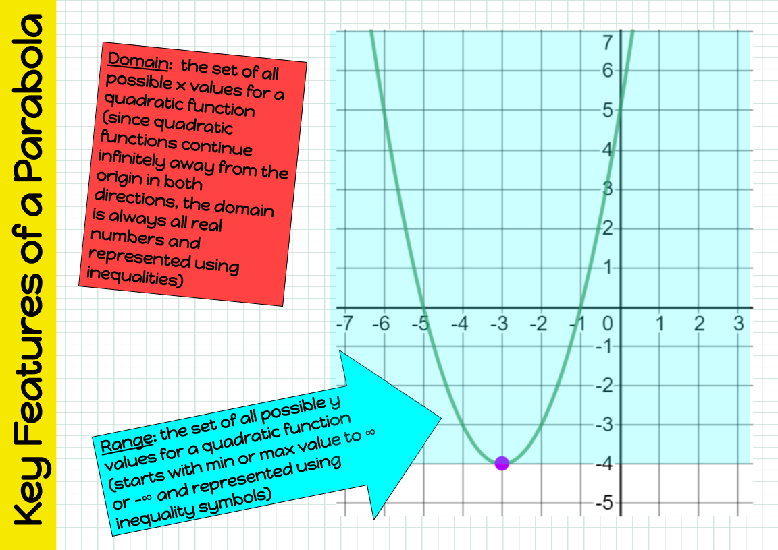

Slide 5
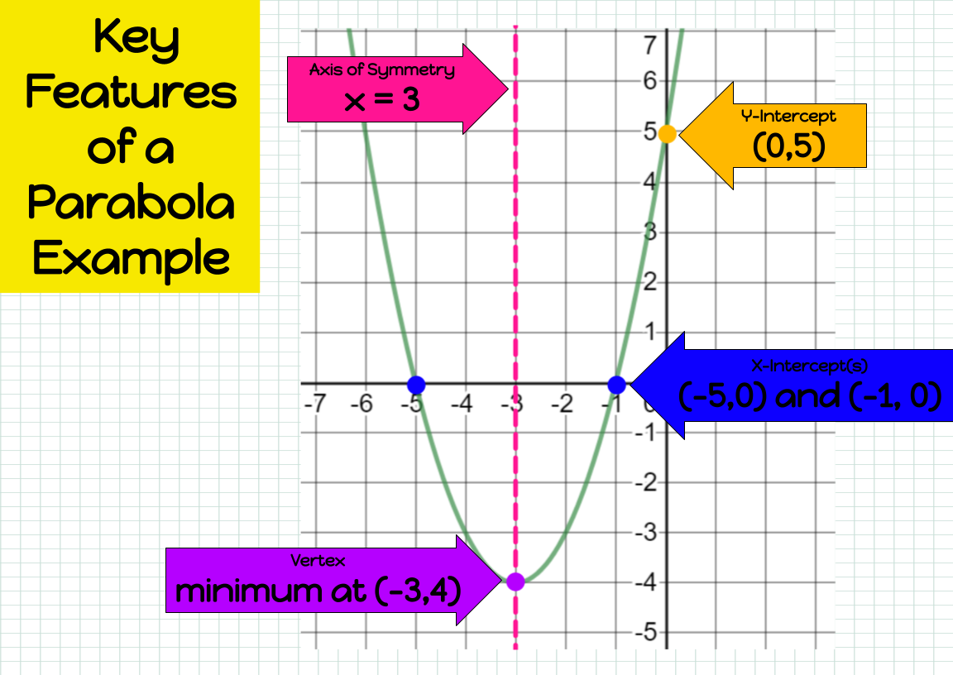

Slide 6
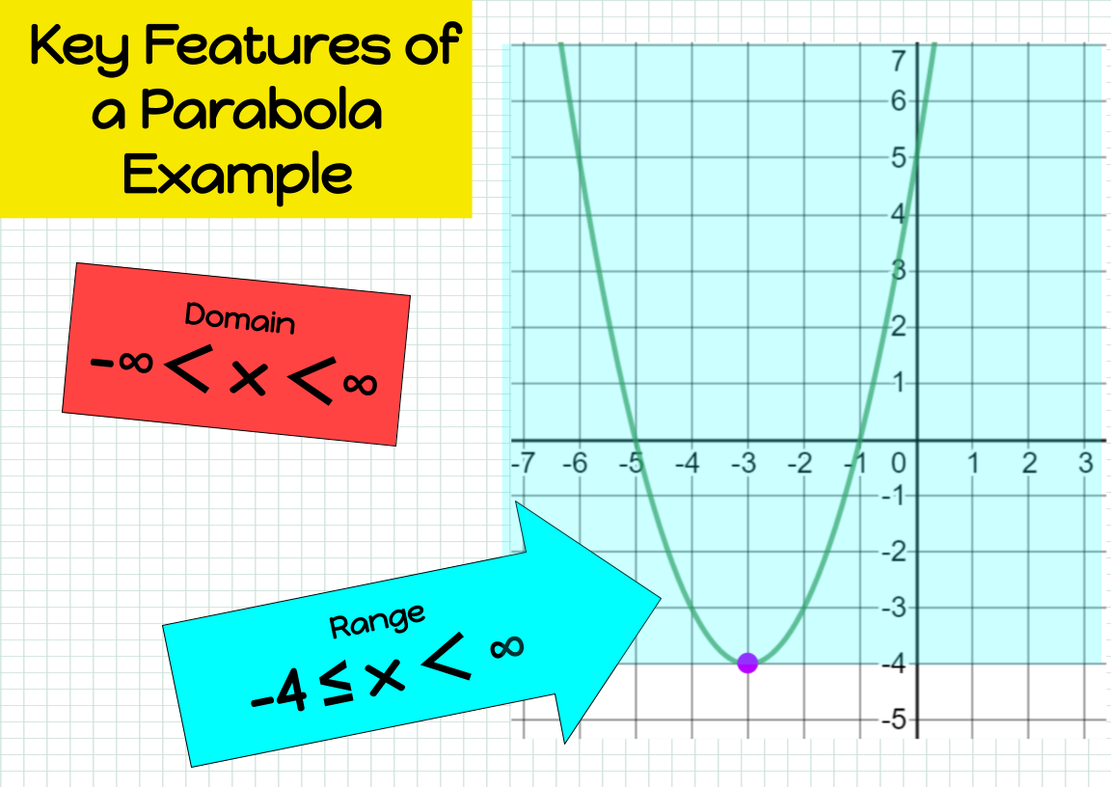

Slide 7
The Vertex Form of the Quadratic Function
Horizontal
Shift
Vertical
Shift
Dilation
Factor
y= a(x - h)² + k
Indicates direction
of opening
Coordinates of
the vertex are (h, k)
If a > 0, the graph opens
up and there is a
minimum value of y.
If a < 0, the graph opens
down and there is a
maximum value of y.
Axis of Symmetry
is x =h
3.1.12

Slide 8
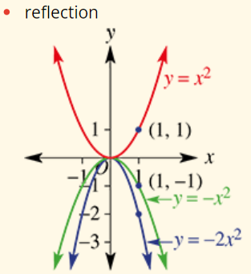
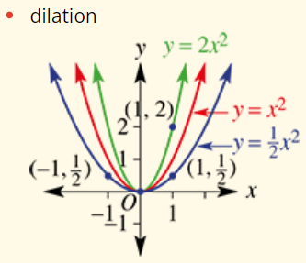
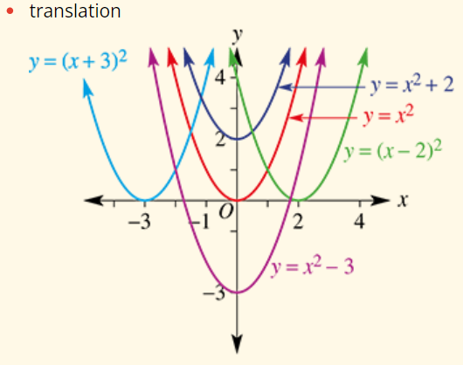

Slide 9
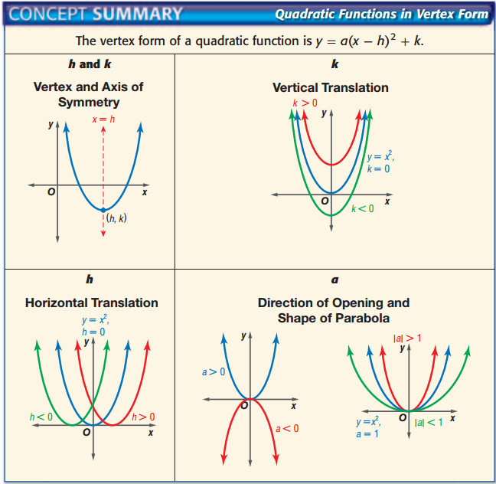

Slide 10
Characterises of y= a(x - h)² + k
Comparing y = a(x - h)² + k with y = x ²:
(3, 2)
(-2, 1)
y= (x +2)² + 1
y= x²
y= -(x - 3)² + 2
Vertex is (-2, 1)
Axis of symmetry is x + 2 = 0
Minimum value of y = 1
x- intercepts
y-intercept
Vertex is (3, 2)
Axis of symmetry is x = 3
Maximum value of y = 2
x- intercepts
y-intercepts
3.1.13

Slide 11
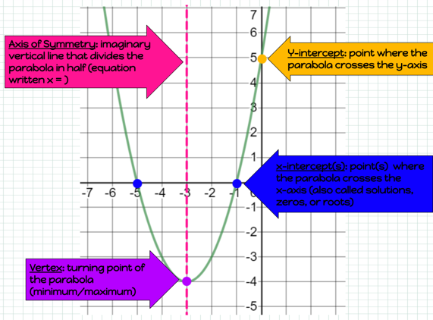
Symmetry Line y=3
Vertex(-4,3)
y-intercepts
X-intercept

Slide 12
The Vertex Form of the Quadratic Function
Vertical
Shift
Dilation
Factor
Horizontal
Shift
(y - k)² = a² (x - h)
Symmetry line
y=k
Indicates direction
of opening
Coordinates of
the vertex are (h, k)
3.1.12

Slide 13

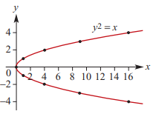

Graph of $y^{2}=x$

Slide 14
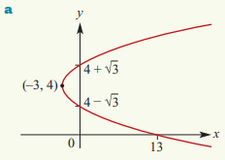
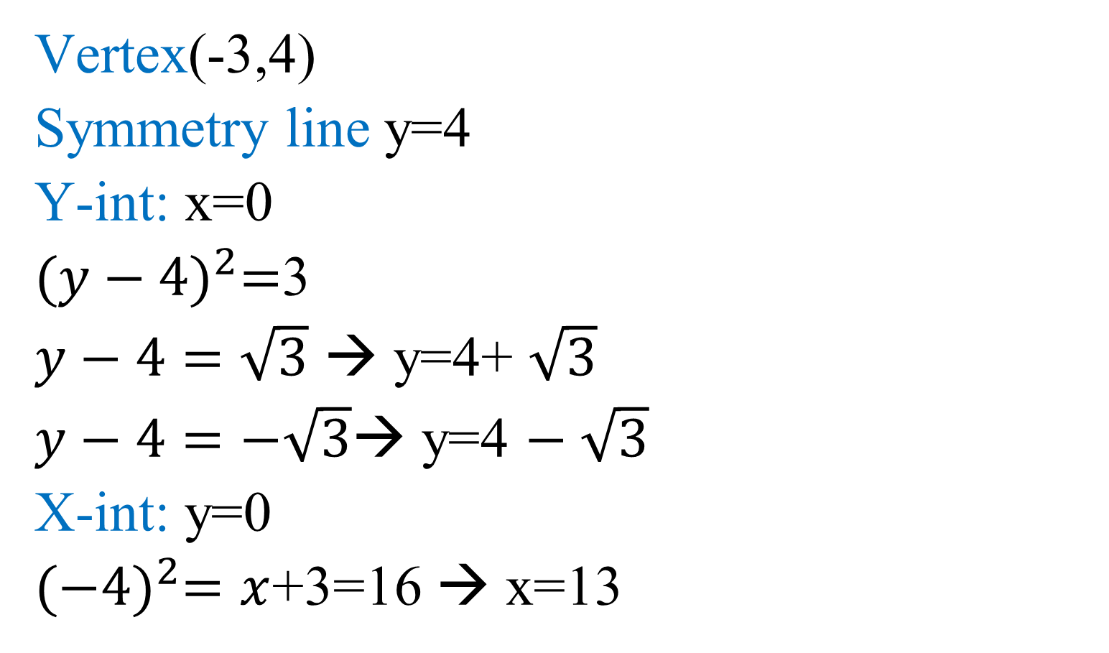

Sketch ${(y−4)}^{2}=x$+3
(y - k)² = a² (x - h)
Vertex(-3,4)
Symmetry line y=4
Y-int: x=0
${(y−4)}^{2}=$3
$y−4=\sqrt{3}$ → y=4+ $\sqrt{3}$
$y−4=−\sqrt{3}$→ y=4 $− \sqrt{3}$
X-int: y=0
${(−4)}^{2}=x$+3=16 → x=13

Slide 15
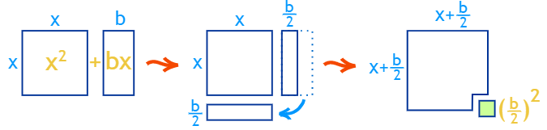
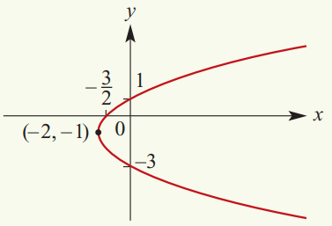


Sketch $y^{2}$+ 2$y$ = 2$x$ + 3
(y - k)² = a² (x - h)
${(y+1)}^{2}\text{―}$1= 2$x$ + 3
+1 +1
${(y+1)}^{2}$= 2$x$ + 4
${(y+1)}^{2}$= 2$(x$ + 2)
Vertex(― 2, ― 1)
Symmetry line y = ―1
Y-int: x=0
$${(y+1)}^{2}=4$$
$y+1=2$ → y=1
$y+1=−2$→ y=$−3$
X-int: y=0
${(1)}^{2}=2x$+4=1
$−4 −$4
$2x$= $−$3 →$x=− \frac{3}{2}$

Slide 16


